Slide 1
Lung ca

Slide 2
It is the most common cause of cancer death in men
and the second most common cause in women, after breast cancer.

Slide 3
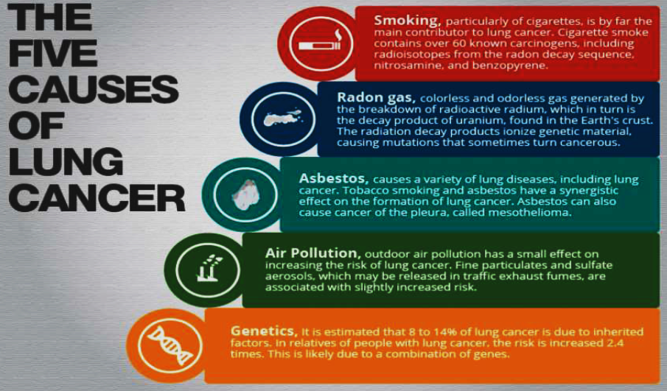
etiology

Slide 4
CLASSIFICATION

Slide 5
Based on the characteristics of the disease and its response to treatment Lung cancer maybe divided into small-cell carcinoma and non-small-cell carcinoma

Slide 6
Non-small-cell carcinoma
1-Squamous carcinoma
Most present as obstructive lesions of the bronchus leading to infection

Slide 7
2-Adenocarcinoma
arises from mucous cells in the bronchial epithelium.
more common in non-smokers and in women,.

Slide 8
3-Large cell carcinomas
These account for about 25% of all lung cancers

Slide 9
4-Bronchoalveolar cell carcinoma
accounts for only 1-2% of lung tumours and occurs either as a peripheral solitary nodule or as diffuse nodular lesions

Slide 10
Small-cell carcinoma
20 % of all lung cancers.
It arises from endocrine cells . These cells are members of the APUD system, which explains why many polypeptide hormones are secreted by these tumours. which cause cell growth.
Small-cell carcinoma spreads early and is almost always inoperable at presentation.
It responds to chemotherapy but the prognosis remains poor.

Slide 11
SPREAD
Direct
Lymphatics
Hematogenous

Slide 12
1. Direct
Invades pleura
Invades Chest wall
Invades Intercostal nerves
Invades Brachial plexus

Slide 13
Lymphatics
Mediastinal lymph nodes
Compressing:
•Esophagus
• Superior vena cava
•Trachea
• Phrenic/ left recurrent laryngeal nerve
Pericardium

Slide 14
Hematogenous
Liver
Bone
Brain
Adrenal

Slide 15
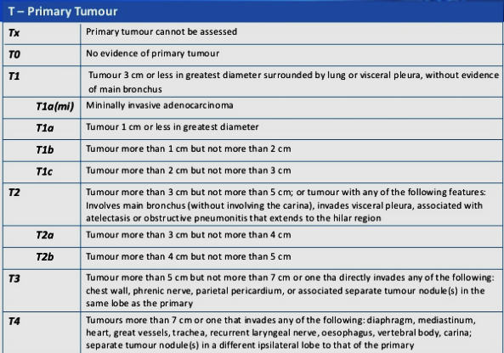
staging

Slide 16
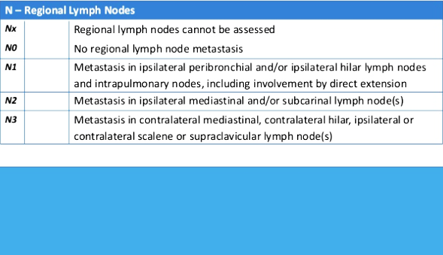

Slide 17
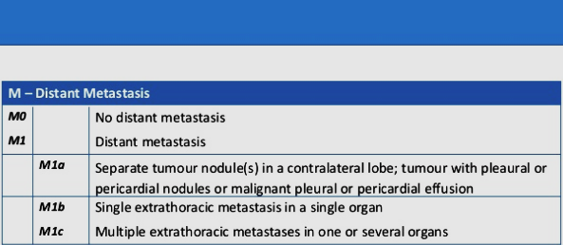

Slide 18
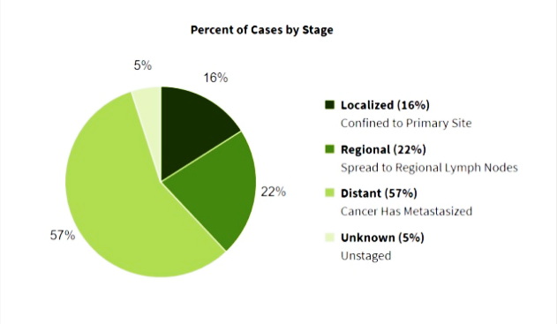

Slide 19
CLINICAL FEATURES
• These may be due to:
1. Local tumour effects
2. Metastatic tumour effects
3. Paraneoplastic manifestations.
Fatigue and loss of weight.
• Many patients have no specific signs.

Slide 20
Local Tumour effects
Persistent cough or change in usual cough.
Haemoptysis.
Chest pain:suggests pleural involvement.
Unresolving pneumonia or lobar collapse.
dyspnoea (due to bronchial narrowing or obstruction).
Wheeze.
Dyspnea and chest pain due to Pleural effusion.

Slide 21
Local Tumour effects
Hoarse voice (tumour invasion of the left recurrent laryngeal nerve).
Dysphagia.
Raised hemidiaphragm (phrenic nerve paralysis).
SVCO.
Horner’s syndrome (miosis, ptosis, enophthalmos, anhydrosis) due
to apical or pancoast’s tumour damaging sympathetic chain.
Pancoast’s tumours can also directly invade the rib and brachial
plexus, causing C8–T1 dermatome numbness, shoulder pain, and
weakness of small muscles of the hand.

Slide 22
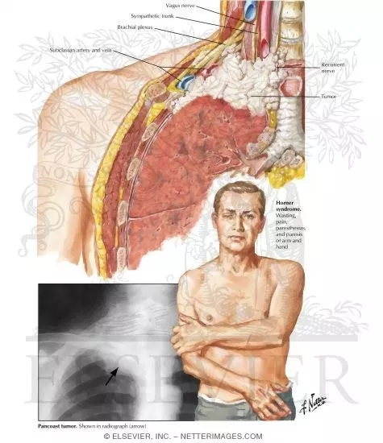
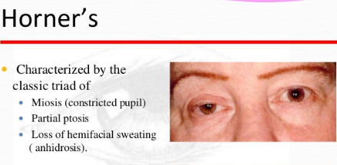

Slide 23
mets
Cervical/supraclavicular lymphadenopathy (easy site for diagnostic biopsy)
palpable liver .
Bone pain/pathological fracture due to bone metastases
Neurological sequelae 2° to cerebral metastases
Hypercalcaemic effects (due to bony metastases or direct tumour
production of parathyroid hormone (PTH)-related peptide or PTH).

Slide 24
Paraneoplastic syndromes
Endocrine syndromes are due to the ectopic production of hormones or hormonally active peptides.
Neurological syndromes are due to antibody-mediated CNS damage.
Cachexia and wasting
Clubbing +_Hypertrophic pulmonary osteoarthropathy

Slide 25
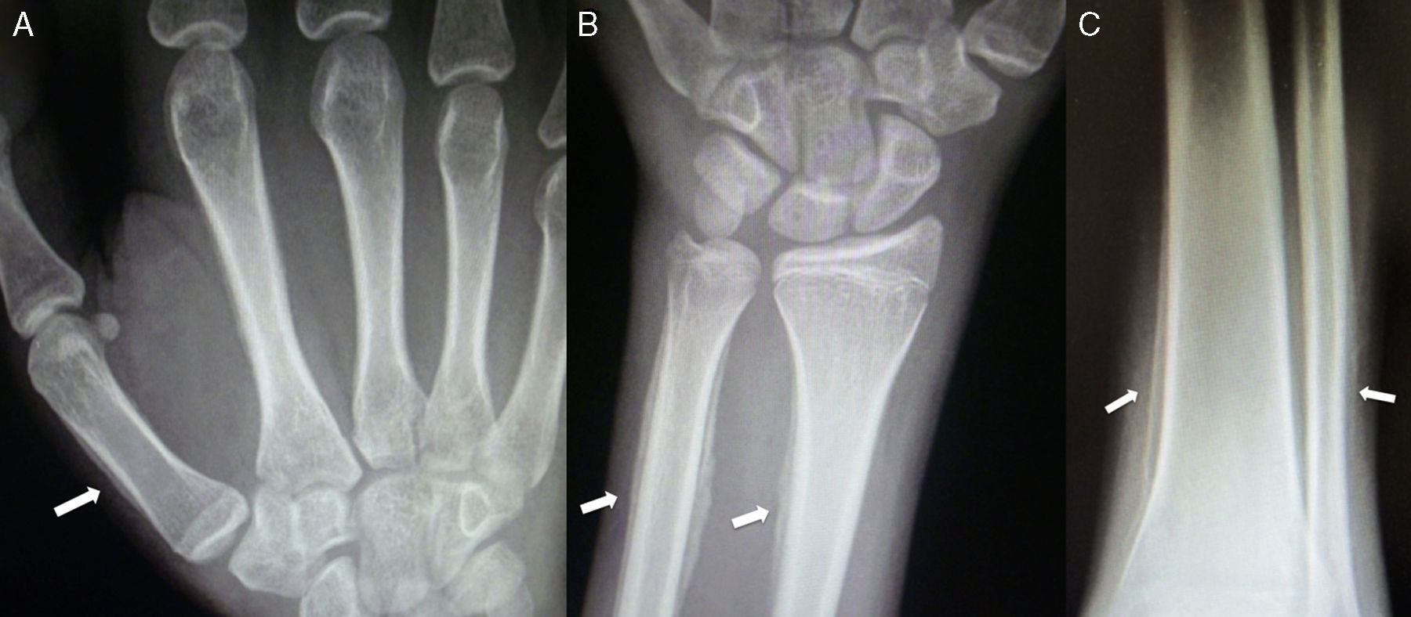
Clubbing and pulmonary osteoarthropathy

Slide 26
Clf eatures
Gynaecomastia
Ectopic ACTH (Cushing’s syndrome).
Cerebellar syndrome (usually SCLC).
Dermatomyositis/polymyositis.
Glomerulonephritis.

Slide 28
History and examination
Blood tests, including sodium, calcium, and LFTs. Check clotting if biopsy
CXR
Diagnostic pleural tap, if effusion present
FNA /biopsy of enlarged supraclavicular or cervical lymph nodes.

Slide 30
Radiology
1. CT neck, chest, liver, adrenals (contrast-enhanced) to assess tumour site and size
2. USG of neck or liver may provide information about enlarged lymph nodes or metastases suitable for biopsy.
3. MRI Used to answer specific questions relating to tumour invasion/ borders.
4. Bone scan Indicated if ? Bone involvment .
5. CT head Indicated if any neurological evidence of metastatic
6. Positron Emission Tomography (PET) scanning.

Slide 32
Percutaneous biopsy
biopsy of Peripheral lung obtained by biopsy through the chest wall under CT screening

Slide 35
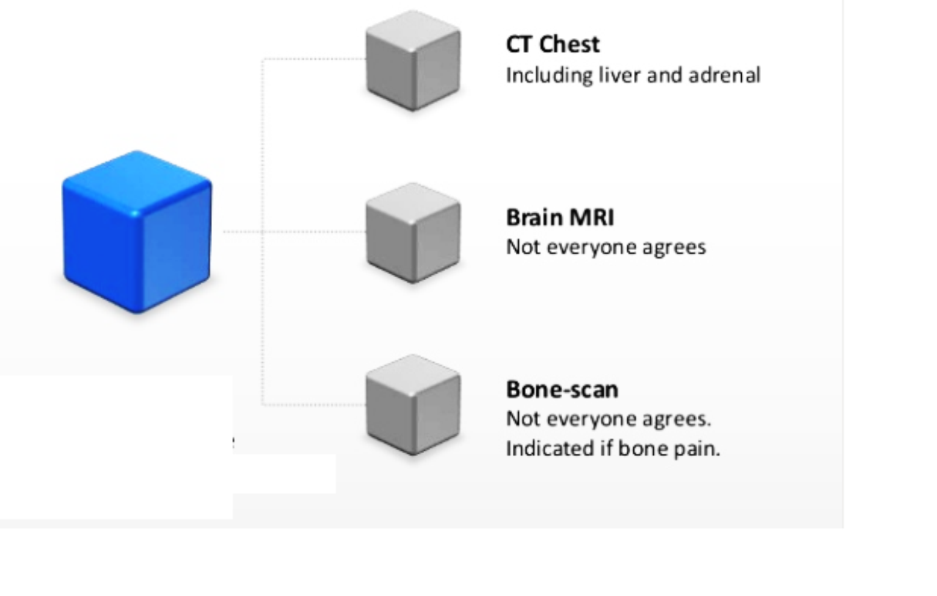
Suspected advanced dis

Slide 36
Suspected early disease

Slide 38
surgery
Patients with NSCLC who have disease limited to one lung and not involving the mediastinum or more distant sites have localized, stage I or stage II disease
Stage I plus stage II disease accounts for approximately 30 percent of patients with NSCLC.
In this setting, surgical resection is the primary approach to treatment if there are no contraindications.

Slide 39
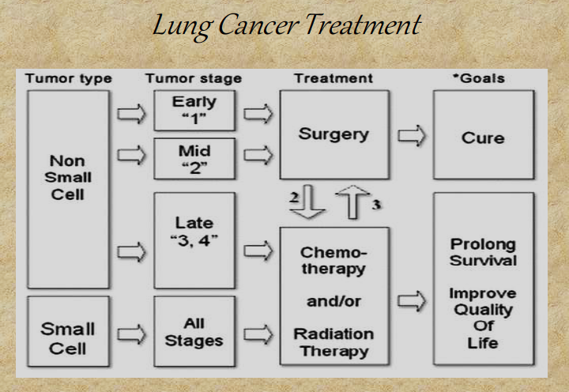

Slide 40
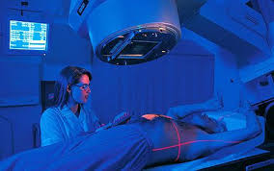
Radiotherapy
SVCO sup vena cava obstruction.
Recurrent hemoptysis.
Skeletal metastasis.
To relieve obstruction of airways.
With chemotherapy,it can prevent brain metastasis in small cell carcinoma

Slide 41
Chemotherapy
For Small cell carcinoma +radio

Slide 42
Laser Therapy
Via fiber optic bronchoscopy
Palliative treatment
To destroy tumour tissue occluding major
airways & to allow re aeration of collapsed
lung.

Slide 43
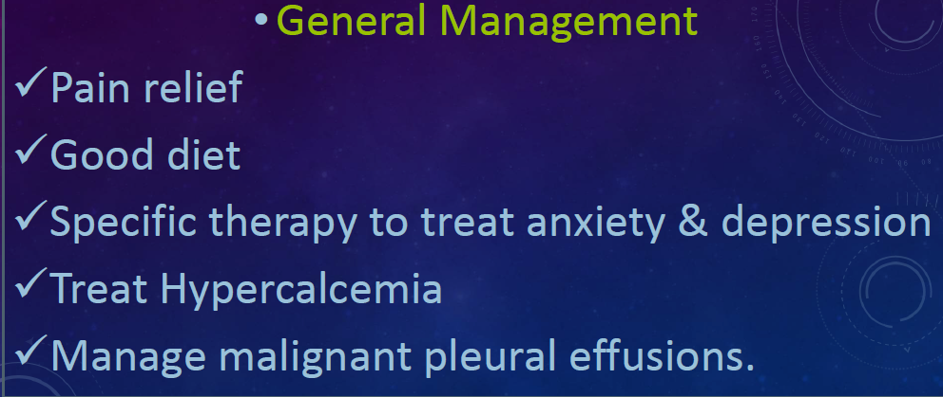

Slide 44
thanx

