Slide 1






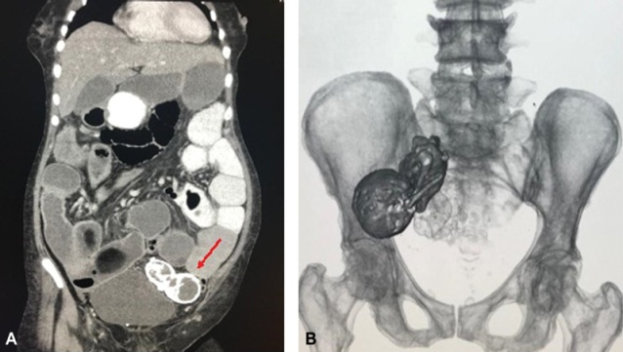
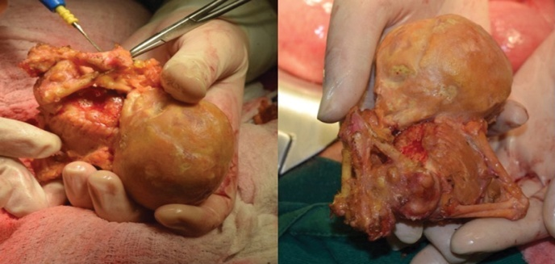
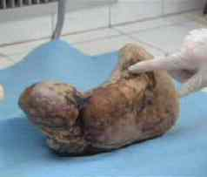
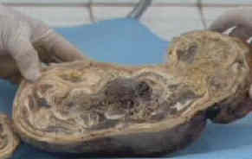

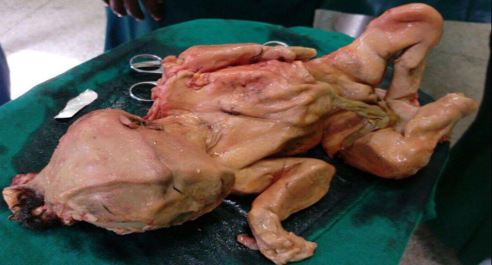
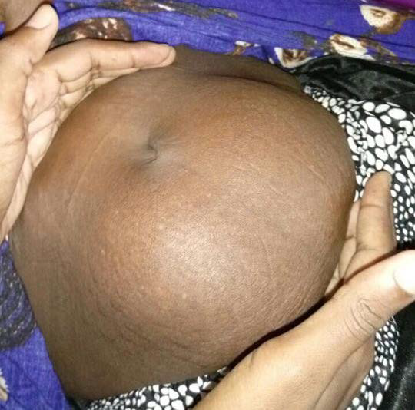
Lithopedion (stone baby)
Hanan Mohammed abdullah 1288- 3rd Year Basic Medical Science
Libyan International Medical University
Lithopedion (litho = stone; pedion = child) is the name given to an extra-uterine pregnancy that evolves to fetal death and calcification . It is a rare phenomenon that mostly comes from an abdominal pregnancy. The incidence of abdominal pregnancy is 1:11,000 pregnancies and lithopedion occurs in 1.5 to 1.8% of these cases.^{1,3} There have been less than 300 cases in 400 years of world medical literature .^{2,3} On the other hand, the occurrence of abdominal pregnancy and lithopedion has tended to become even rarer due to medical and pre-natal care becoming more accessible to the population, with the possibility of early diagnosis and treatment of the pathology.( fig1)
A 77-year-old female patient from Tumaco, in the Paciﬁc coast
of Colombia, presented with 8 days of generalized abdominal
pain associated with symptoms of absent peristalsis. She
referred 4 pregnancies, of which she had had 3 normal vaginal
deliveries and 1 miscarriage (40 years prior, a contrasted abdominal CT was performed, revealing thickening of the ascending colon walls, signs of ileocolic intussusception and heterogeneous calciﬁcations in the lower left pelvis compatible with a mummiﬁed fetus(2) see in figur 2(A,B).
Cases studies
Discussion
Introduction
.
Discussion
.
Case 1
If the deceased fetus is too large to be re-absorbed by the mother’s body it becomes a foreign body to the mother’s immune system. To protect itself from possible infection, the mother’s body will encase the fetus in a calciferous substance. The fetus is gradually mummified becoming a stone baby. Lithopedion may occur from 14 weeks’ gestation to full term. It is not unusual for a stone baby to remain undiagnosed for decades
in which problem of the diagnosis of the disease was missing during antenatal care. Good history taking and
physical examination and also the imaging studies such as X-ray,CT-scan and MRI to diagnosis of this disease.
clinicians should be attentive in diagnosis of this disease.
he suspects, we recommend asking for help from the experienced clinicians.
Conclusion
A
B
Figure 1
.Figuer.2(A) Abdominal CT evidencing the mummifIed fetus
Figur.2( B) fetus extracted during laparotomy.
Case 2
1-Mitra KR, Ratnaparkhi CR, Gedam BS, Tayade KA. An unusual case of retained abdominal pregnancy for 36 years in a postmenopausal woman. Int J Appl Basic Med Res.
2015;5(3):208-10.
2-Irick MB e. Therapeutic aspects in the management of a lithopedion. - PubMed - NCBI. Ncbi.nlm.nih.gov.
https://www.ncbi.nlm.nih.gov/pubmed/5436104. Published .
3-Gouri S. LITHOPAEDION. Ijmhr.org. https://www.ijmhr.org/ijar_articles_vol2_1/IJAR-2014-421.pdf. Published 2019. Accessed February 18, 2019.
4. Spiritos NM, Eisenkop SM, Mishell DR. Lithokelyphos: a case report and literature review. J Reprod Med 1987;32:43-6.February 18, 2019.
A 26-year-old woman was referred to our department of obstetrics and gynecology at Benadir Hospital, Mogadishu-Somalia with complained of a lower abdominal pain with associated palpitation, dizziness, poor appetite was married at age of 17 years old (3). Her obstetrical and gynecological history was normal such as menstrual cycle On examination figure 2(D)
References
Aim of studies
The aim of these studies to define lithopedion and a natural reaction by the mother’s body to the death of an undelivered fetus. There are a lot of odd ways the body protects itself, but this is certainly one to add to the list.
C
D
Figure2: (C) lithopedion after dessection.
Figure2: (D) infra umbilical mass.

