Slide 1




Growth and development of children
Name:Retaj BenKhdoura
Student number:3096
Date: 2022-4-3
Block: pts
1

Slide 2

-Objectives:
-Discuses the developmental milestones
-Outline factors affect in growth and development
-Discuses the celiac disease and how it affect in the growth

Slide 3
Introduction

Slide 4

-Developmental milestones are things most children can do by a certain age.
-Such as a first step ,smiling for the first time, Crawling ,walking and waving bye
-but it is different for each age
-Children reach milestones in how they play , learn ,speak ,behave and move
Developmental milestones
-Developmental milestones gives a general Idea and offer an important clues about child growth , development and health

Slide 5

-If child does not meeting or reaching the milestones for his or her age , it can be the earliest indication that a child may have developmental delay

Slide 6
Factors affect in growth and development
1-Heredity and genetic
2-Nutrition
3-Enviromental factor

Slide 7

1-Heredity and genetic
1-Heredity and genetic
It is transmission of physical characteristic from parents to child through their genes it influences all aspects such as high, weight , intelligence and skin color

Slide 8

2-Nutrition
-Nutrition is a critical part of health and
development.
- Better nutrition is related to
improved infant, child and maternal health,
stronger immune systems, safer pregnancy and childbirth, lower risk of non communicable diseases , longevity and protect from malnutrition.

Slide 9
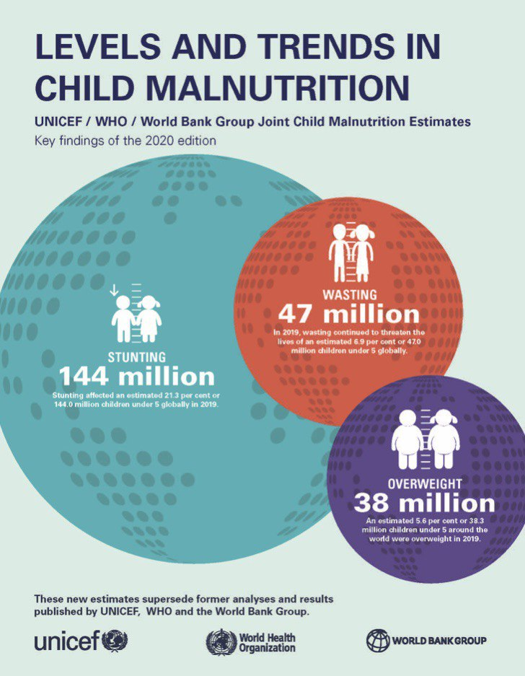
-WHO estimate child malnutrition for the indicators stunting , wasting and over weight

Slide 10

-It is necessary to support human life and good health through all life stages
So develop a healthy diet begins early in life ,because these benefits are reflected in higher educational outcomes , productivity and lifelong healthy

Slide 11
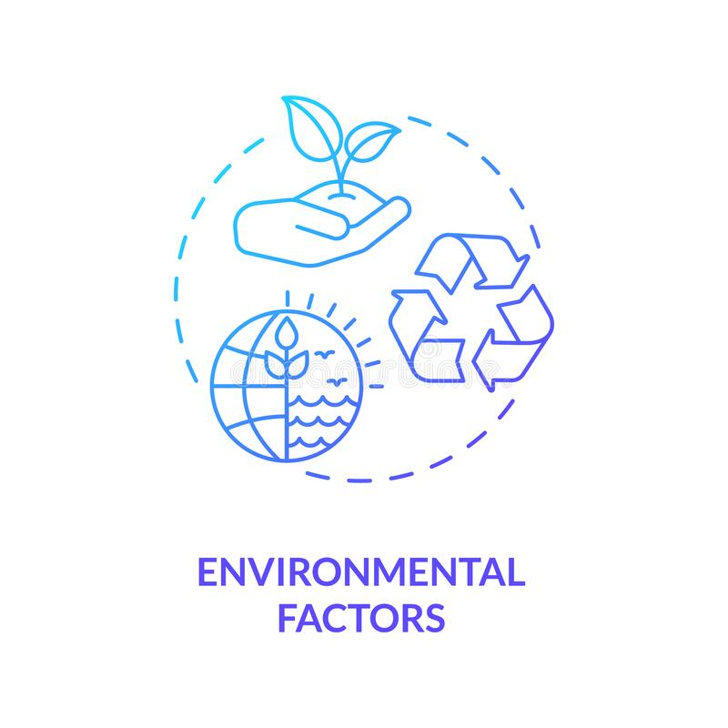
3-Enviromantal factors
- physical environmental development
(Environmental pollution)

Slide 12

Celiac disease
-Celiac disease and how It affect in the growth
-Celiac disease is an autoimmune in which can not eat gluten because it will damage the small intestine (gastrointestinal disease)
Gluten
Gliadin
Proline glutamine

Slide 13
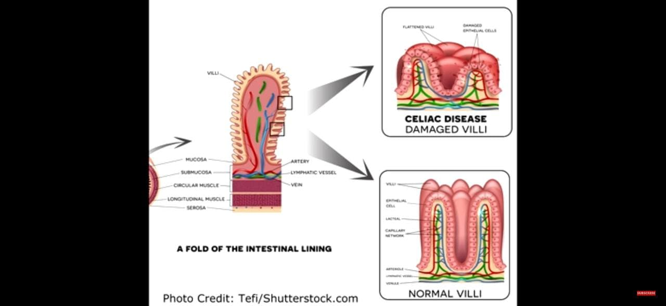
$2B

Slide 14
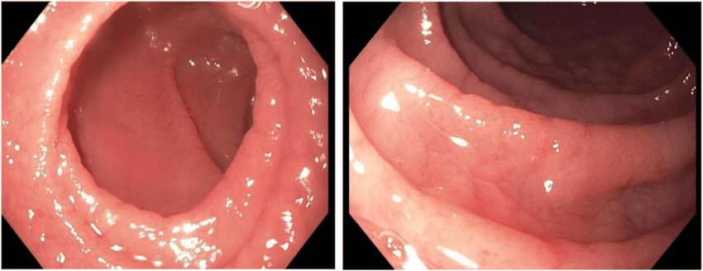
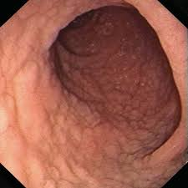
Diagnosis and treatment:
Serology test to detect antibody tTg and IgA
Endoscopy
Avoid food contain gluten

Slide 15


Slide 16
References:
-Robbins basic pathology, 10th edition, 2018
-Medical microbiology and immunology, 14th edition
- MD.CDC.Developmental Milestone.January 3 -Paul H. Lipkin, MD, Michelle M. Macias, MD, Julie F. Pajek, PhD, Judith S. Shaw, EdD, MPH, RN, Karnesha Slaughter, MPH, Jane K. Squires, PhD, Toni M. Whitaker, MD, Lisa D. Wiggins, PhD, and Jennifer M. Zubler1, 2022,
.- County Health Rankings and Roadmaps.2022. Retrieved 2022 hristine, m., ganhua, l., molly, b., eunce, p., matt, r., hoffelder, j., & olson, h.

Slide 17

Thank you

