Slide 1

ketogenic diet
MOHAMED NAJI
3007
PTS
24/5/2022
1

Slide 2
Objective
Describe the history of ketogenic diet
Explain the physiology of ketogenic diet
Illustrate types of ketogenic diet
Outline the side effect of ketogenic diet
2

Slide 3
Introduction
obesity
Efforts to decrease Obesity
Diets
3

Slide 4
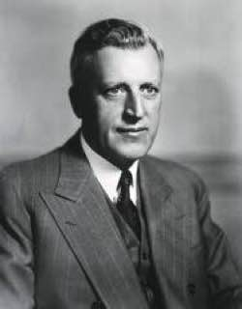
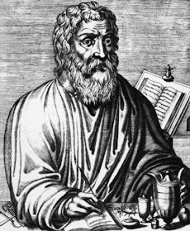
History of ketogenic diet
as treatment for epilepsy
Dr.Russell wilder
re-emergence as alternative for weight loss
4

Slide 5
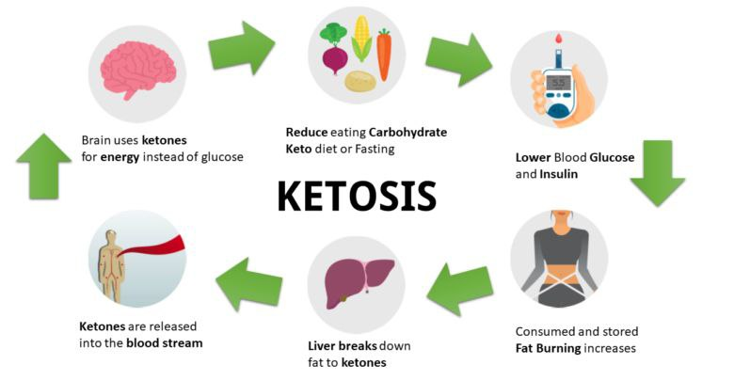
Physiology of ketogenic diet
5

Slide 6
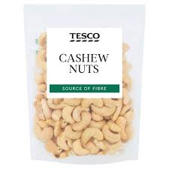
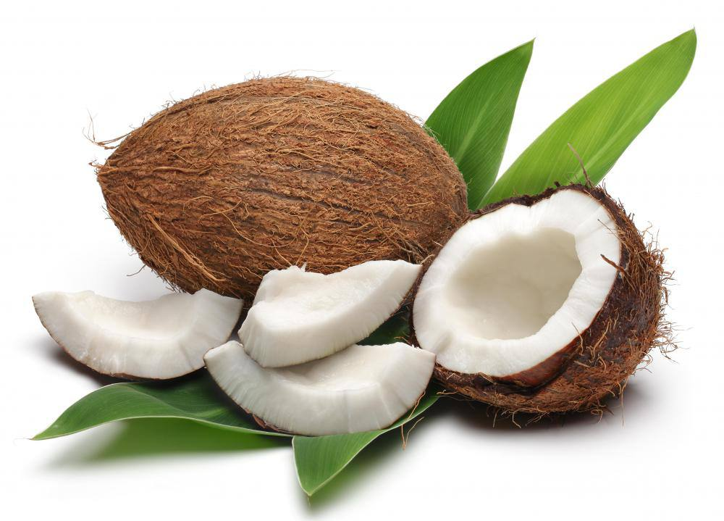
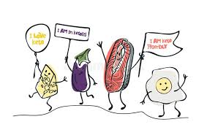

Types of ketogenic diet
Traditional ‘classic’ ketogenic diet
The medium-chain triglyceride ketogenic diet
The modified Atkins diet
The low glycaemic index treatment
6

Slide 7


DIET | Pros | Cons
Classical KD | Very consistent, therefore little variation in ketones | Difficult to adjust amount consumed based on appetite Protein limited
Medium chain TAG | Provide more protein increased variety of food | Gastrointestinal side effects
Modified atkins | Greater flexibility to adjust meal to variations in appetite; Provides more protein | No firm guidelines regarding fat amounts; Requires Often more variability in ketone production
Low glycemic index diet | Same as Mad | Requires knowledge of the foods
7

Slide 8


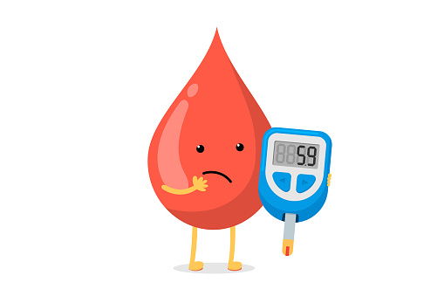
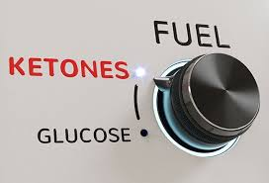


Acute side effect
nausea
vomiting
hypoglycaemia
ketosis
acidosis
lethargy
8

Slide 9
Chronic side effect
constipation, renal stones , cardiomyopathy , retarded growth, anorexia, progressive bone mineral content loss , high cholesterol levels, low albumin and carnitine levels , specific vitamin and/or mineral deficiencies
9

Slide 10
Conclusion
10

Slide 11
References
Paoli A. Ketogenic diet for obesity: friend or foe?. International journal of environmental research and public health. 2014 Feb;11(2):2092-107.AUTHOR (YEAR). Title of the publication. Publisher
Dhamija R, Eckert S, Wirrell E. Ketogenic diet. Canadian journal of neurological sciences. 2013 Mar;40(2):158-67.AUTHOR (YEAR). Title of the publication. Publisher
Wheless JW. History of the ketogenic diet. Epilepsia. 2008 Nov;49:3-5.AUTHOR (YEAR).
11

Slide 12
Thanks
12

