Slide 1
COMPUTER NETWORK
Muna Eldrnawi
3749

Slide 2
OBJECTIVES
Define computer network &why they are important?
Explain the purpose pf network?
List & describe the different types of network components?
List & describe types of network defined by geography?
​5. Summary​.

Slide 3
Define computer network &why they are important?
Computer networks interconnect a variety of devices through a medium for exchanging information or data communication..

Slide 4
Explain the purpose pf network?

Slide 5
Purpose is to make connections. These connections might be between a PC and a printer , the true value of a network comes from the traffic flowing over those connections.
“

Slide 6
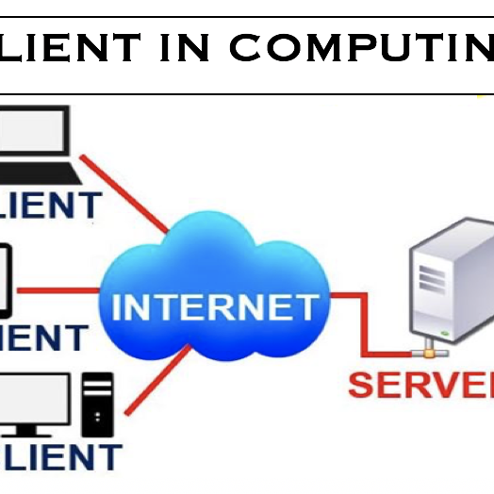

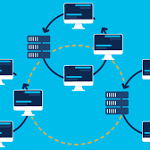
List & Describe The Different Types Of Network Components?
CLIENT
MEDIA
WIDE-AREA NETWORK LINK

Slide 7
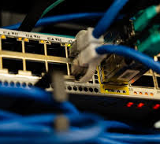
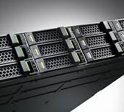
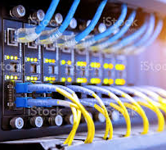
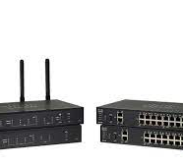
MEET OUR Extended TEAM
SERVER
HUB
SWITCH
ROUTER

Slide 8
Describe The Different Types Of Network Components
Hub
switch
router
is a networking device which connects various Ethernet devices together enabling them to act as a single network element.
A switch is also like a hub, but it takes in packets being sent by devices that are connected to its physical ports and sends them out again
router is a networking device which forwards data packets between computer networks.

Slide 9
Describe The Different Types Of Network Components
Server
Client
In a network when a computer shares resources with other client machines, then it is considered as a server.
On a network, a client is a computer that is connected to and uses the resources of a remote-computer or server.

Slide 10
List & describe types of network defined by geography?
- Personal Area Network (PAN)
- Local Area Network (LAN)
is a computer network that enables communication between computer devices near a person.
is a group of computers or other devices interconnected within a single, limited area, typically via Ethernet or Wi-Fi.
- Metropolitan Area Network (MAN)
- Wide Area Network (WAN)
is a computer network that is larger than a single building local area network (LAN) but is located in a single geographic area that is smaller than a wide area network (WAN).
is a large network of information that is not tied to a single location. WANs can facilitate communication, the sharing of information and much more between devices from around the world through a WAN provider.
- Campus Area Network (CAN)
is a computer network that spans a limited geographic area. CANs interconnect multiple local area networks (LAN) within an educational or corporate campus.

Slide 11
THANK YOU
Muna Eldrnawi
Muna_3749@limu.edu.ly

