Slide 1


Periodic cheek up in lung cancer
Presented by: Marwa Salem Boanaz
Student ID: 2861
Block: PTC
Date: 2022/4/2
1

Slide 2
Introduction
Certain tests help finding specific types of cancers before signs or symptoms appear.
Screening for lung cancer is done with attest called “ a low dose helical or spiral computed tomography (CT or CTA) scan, A CT scan takes picture of the inside of the body with an x-ray machine.
2

Slide 3

Objectives:
Outline the warning signs of lung cancers.
Discuss the early detection of lung cancer.
Describe the methods and the treatment requirement for lung cancer according to type and stage.
Discuss the follow up care after the treatment of lung cancers.
3

Slide 4


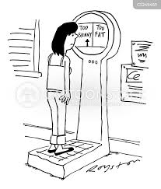
Warning signs of lung cancer:
Hemoptysis
Dyspnea
Anorexia
4

Slide 5
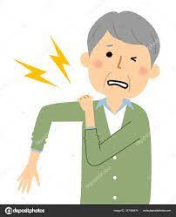
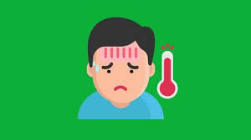

Chest and shoulder pain
Fever
Loss of apatite
5

Slide 6
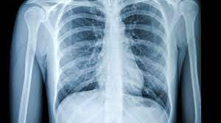
Early detection of lung cancers:
Lung cancer screening:
The most important specific methods are chest X-ray and CT
Bronchoscopy:
Narrow flexible tubes that goes inside of the Tracheae and airways.
6

Slide 7
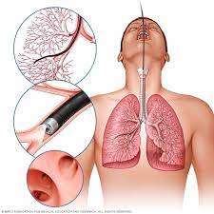
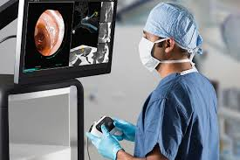
Bronchoscopy:
7

Slide 8
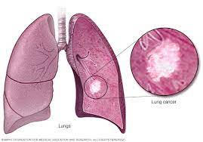
Antibodies:
Autoantibodies produced by B lymphocytes bind to self-antigens released by apoptotic or necrotic cells, forming antigen–antibody (immune) complexes.
ctDNA
ctDNA was detectable in all late stage NSCLC cases.
8

Slide 9
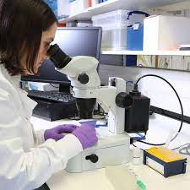
Sputum analysis:
Examination under a microscope of cells found in sputum (mucus and other matter brought up from the lungs by coughing). The test checks for abnormal cells, such as lung cancer cells.
9

Slide 10
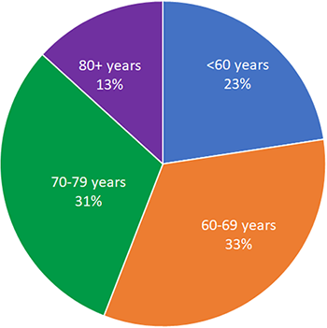
American Cancer society:
Age | Percentage
Less than 60 years | 22.6%
60 to 69 years | 33.3%
70 to 79 years | 30.8%
80 years and over | 13.3%
10

Slide 11
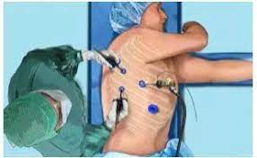
Treatment of lung cancer according to type and stage :
Surgery:
Surgery is part of the treatment for early-stage lung cancers, Some early stage tumors may be treated with video-assisted thoracic surgery (VATS)
Radiation Therapy
Radiation therapy is the use of high-energy radiation to kill cancer cells and to shrink tumors
11

Slide 12
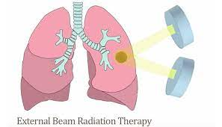
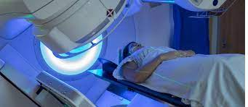
External beam radiation therapy (EBRT):
12

Slide 13
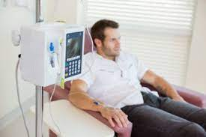
Chemotherapy:
chemotherapy works by interfering with the cancer cells ability to grow or reproduce.
Targeted Therapy
These are drugs that target specific parts of cancer cells or nearby cells that help them grow.
13

Slide 14
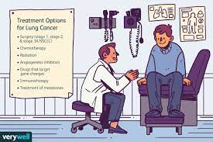
Follow-up care after Treatment:
many doctors recommend follow-up visits
At some point after your cancer treatment, you might find yourself seeing a new doctor who doesn’t know about your medical history. It’s important to keep copies of your medical records to give your new doctor the details of your diagnosis and treatment.
Quitting smoking
14

Slide 15

Dietary supplements
Diet and physical activity
15

Slide 16
Conclusion:
The importance of periodic cheek-ups and regular follow up care can reduce the risks of getting lung cancers.
16

Slide 17
References:
1. Planchard D, Besse B, Groen H, Souquet P, Quoix E, Baik C et al. Dabrafenib plus trametinib in patients with previously treated BRAFV600E-mutant metastatic non-small cell lung cancer: an open-label, multicentre phase 2 trial. 2022.03:46 PM
2. Lamy A, Blanchard F, Le Pessot F, Sesboüé R, Di Fiore F, Bossut J et al. Metastatic colorectal cancer KRAS genotyping in routine practice: results and pitfalls. 2022.
3. [Internet]. Ascopubs.org. 2011 [cited 3 April 2022]. Available from: https://ascopubs.org/doi/pdfdirect/10.1200/JCO.2010.33.1280
4. Nagano T, Tachihara M, Nishimura Y. Molecular Mechanisms and Targeted Therapies Including Immunotherapy for Non-Small Cell Lung Cancer [Internet]. http://www.eurekaselect.com. [cited 3 April 2022].
5. Zhang Y, Wang Y, Su X, Wang P, Lin W. The Value of Circulating Circular RNA in Cancer Diagnosis, Monitoring, Prognosis, and Guiding Treatment. 2021.
17

Slide 18


