Slide 1
Transport & Network Layers
The Middle Layers

Slide 2
Basic Function Of The Transport Layer
is to accept data from the layer above, split it up into smaller units, pass these data units to the Network layer, and ensure that all the pieces arrive correctly at the other end.

Slide 3
Advantage & disAdvantage of. TCP / UDP
Transmission Control Protocol (TCP): A connection-oriented transport protocol. Connection-oriented transport protocols provide reliable transport, in that if a segment is dropped, the sender can detect that drop and retransmit that dropped segment.
User Datagram Protocol (UDP): A connectionless transport protocol. Connectionless transport protocols provide unreliable transport, in that if a segment is dropped, the sender is unaware of the drop, and no retransmission occurs.

Slide 4


Flow Control Process
(also known as congestion control): Helps prevent a sender from sending data more rapidly than the receiver is capable of receiving
the data

Slide 5
Function of the Network layer
is primarily concerned with forwarding data based on logical addresses.

Slide 6
How network layer protocol and service support communication
The network layer, which resides at OSI Layer 3, provides services that allow end devices to exchange data across a network.
• The network layer uses four processes in order to provide end-to-end transport:
• Addressing of end devices – IP addresses must be unique for identification purposes.
• Encapsulation – The protocol data units from the transport layer are encapsulated by adding IP header information including source and destination IP addresses.
• Routing – The network layer provides services to direct packets to other networks. Routers select the best path for a packet to take to its destination network.
• De-encapsulation – The destination host deencapsulates the packet to see if it matches its own.

Slide 7
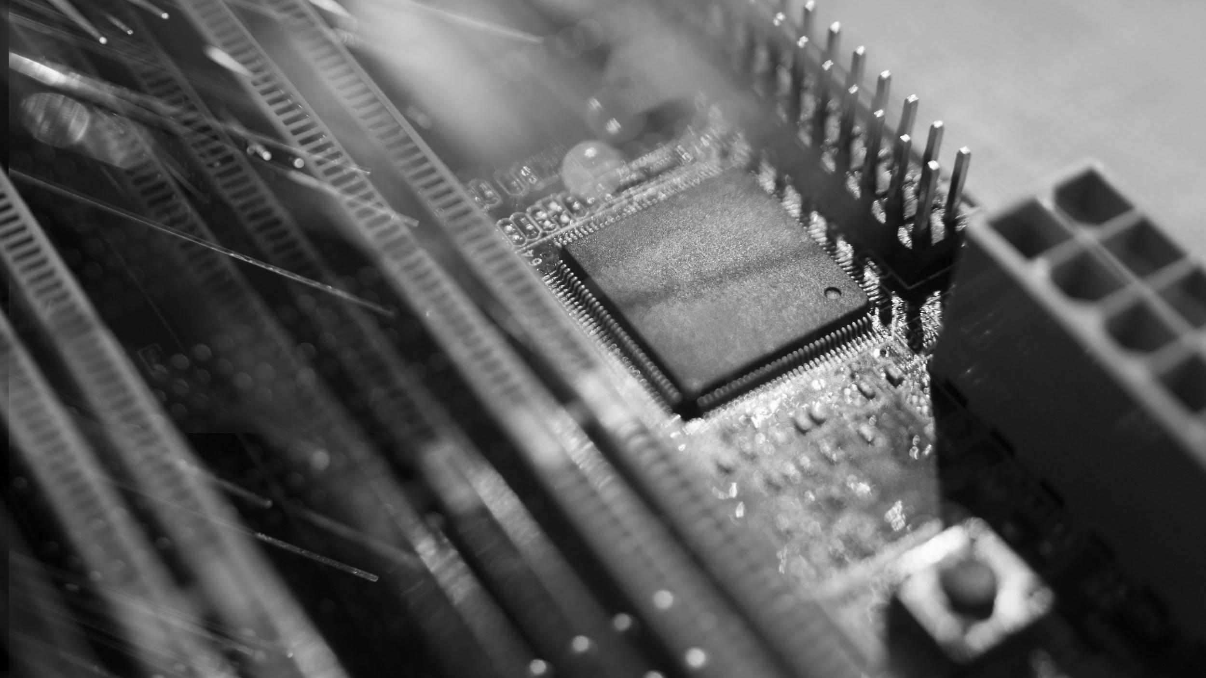

#~Done

Slide 8
THANKS
Does anyone have any questions?
By: Ali Alghazali
Reference:
Network+ N10 – 006 | CompTIA

