Slide 1




The Main Function of Law in Society
Libyan International Medical University
Faculty of Business Administration
By: Abdelgader Idris Elallam
ID: 4081
Abdualkader-4081@limu.edu.ly
1

Slide 2
Table of contents
01
02
03
04
Introduction
The Main Function of Law in Society
Conclusion
Reference
2

Slide 3

Introduction
The functions of law in a society are multifaceted and crucial for maintaining order, promoting justice, and upholding the rights and responsibilities of individuals and institutions within that society.
3

Slide 4
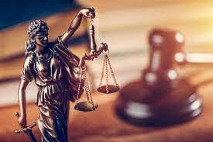
Maintaining Order and Stability
One of the primary functions of law is to establish and maintain order within a society. Laws provide a framework of rules and regulations that govern behavior, preventing chaos and promoting stability
4

Slide 5

Promoting Justice and Fairness
Law plays a vital role in promoting justice and fairness by establishing a system of rules and procedures that guide the resolution of disputes..
5

Slide 6

Protecting Individual Rights and Liberties
Laws are instrumental in protecting the rights and liberties of individuals within a society.( Parfitt, R.) (2019).
6

Slide 7
Conclusion
Of course! The functions of law in a society are multifaceted and crucial for maintaining order, promoting justice, and upholding the rights and responsibilities of individuals and institutions within that society. Let's explore some of the main functions
7

Slide 8
References
Parfitt, R. (2019). The process of international legal reproduction : inequality,
historiography, resistance. Cambridge, United Kingdom New York, Ny, Usa Port
Melbourne, Australia New Delhi, India Singapore Cambridge University Press.
8

Slide 9

Thank you

