Slide 1


Understanding The Term New Public Management
Libyan International Medical University Faculty Of Business Administration
By Ghadi Dreza
ID Nom-2830
Email- ghudai_2830@limu.edu.ly
29TH November 2020

Slide 2
Contents
Definition of New Public Management.
Christopher Hood 1991
What is the New Right (political and intellectual) movement?
factors behind the emergence of then NPM
Pros and cons of NPM
Conclusion
References

Slide 3
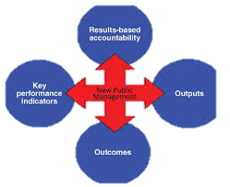
What is New Public Management? And who is Christopher Hood?
Christopher Hood was the first person to coin the term New Public Management, in 1991, after the reforms in the 1980s.
New Public Management (NPM) is the label given to a series of reforms from the 1980s onwards, to improve the efficiency as well as the performances of western governments.
However, it was also created to pin point the failures and incompetence of the public sectors that where evident over time.

Slide 4
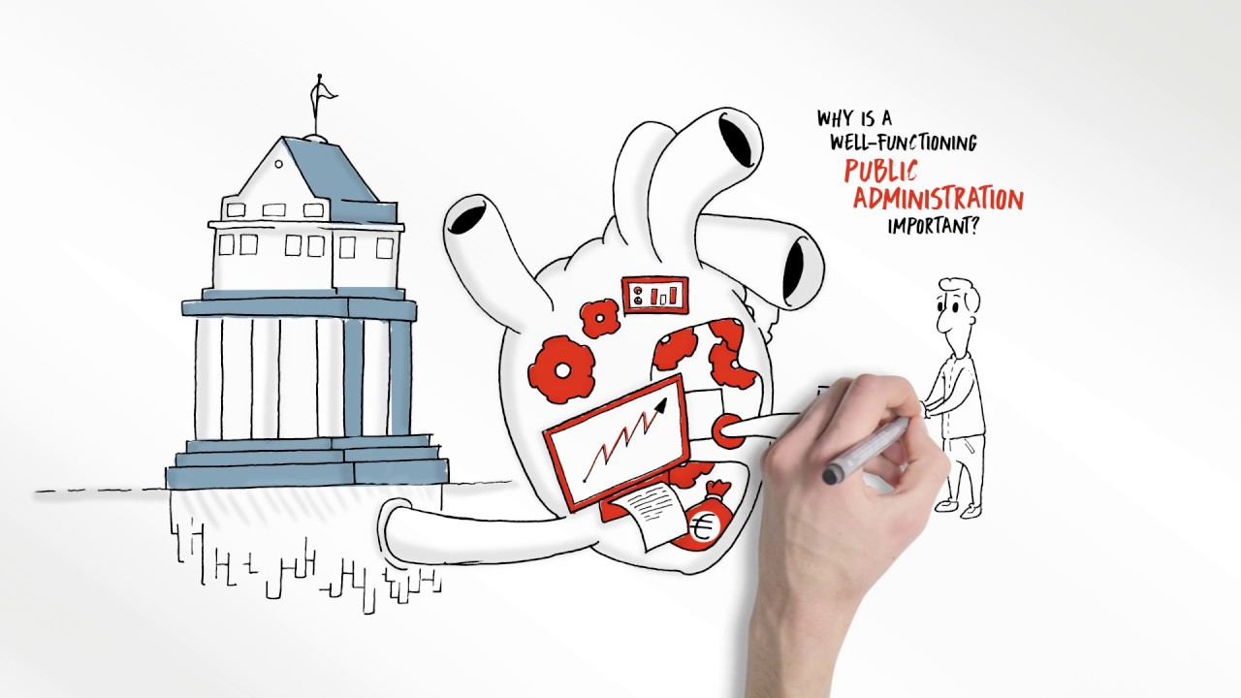
What is the New Right? And, why was it important in terms of the NPM?
The New Right was a combination of Christian religious leaders, conservative business men who claimed that environmental and labour regulations were undermining the competitiveness of American firms in the global market, and fringe political groups, during the 1960s onwards.
The New Rights (social conservatism) played a major role in the presidential election for Ronald Reagan in the year 1980, considering/debating cultural, social, economical, and moral problems.
Personal opinion, the emergence of NPM has not yet captured the vision of American economical policies and in simple terms the public sectors. This because, with the pre-elections of Reagan and the republican party, the public sectors were still in the hands of governmental control, opposing the NPM movement.

Slide 5

Factors behind the emergence of the NPM
On of the most influential factors leading to the emergence of the NPM was the shift in the state ideology since the 1970s.
But also another influential factor that helped in the emergence of the NPM was the incompetence of the old public sector performance system and the doubtful superiority of the government over markets.

Slide 6
The pros and cons of the NPM
Advantage's of NPM:
Corporatization- converting civil services departments into free-standing agencies or enterprises.
Decentralization- the transfer of control over a particular activity to sub-nations or local offices rather than elected-representatives.
Disadvanatges of NPM:
Centralization- putting all the decision makings on public managers making them seem more authorized.
Corruption- this suggests that NPM can undermine ethical standards and lead to corruption.

Slide 7
Conclusion
The purpose of this presentation is to create a sense of understanding when speaking about New Public Management. It is also an enlightening subject because it sets a light on other topics as well.

Slide 8
References
https://en.wikipedia.org/wiki/New_Public_Management New Public Management, Wikipedia, November 13, 2020.
Retrieved from:
https://www.ushistory.org/us/58e.asp The New Right, ushistory.org.
Retrieved from:
https://academicjournals.org/article/article1427736269_Islam.pdf
Retrieved from:
https://www.academia.edu/32301742/Discuss_the_advantages_and_disadvantages_of_New_Public_Management_implementation_in_South_Africa_docx

Slide 9

Thank you for listening!

