Slide 1



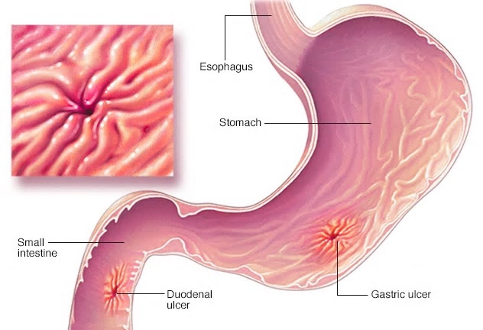
I Feel Pain In The Stomach! Peptic Ulcers
Hana Jamal Elghirani 2nd Year Medical Student
Faculty of basic medical science
Libyan International Medical University
Introduction
Treatment Of Helicobacter
Pylori Infection
Conclusions
Peptic ulcers are open sores that develop on the inside lining of your stomach and the upper portion of your small intestine. (1)
A comparative study was conducted, 180 patients were divided into three equal groups of 60 people, depending on the prescribed 10-day. Group 1 - the standard triple scheme (omeprazole, amoxicillin and clarithromycin); group 2 - four-component therapy with preparations of bismuth (omeprazole, tetracycline, metronidazole, bismuth tricalium dicitrate); group 3 - hybrid scheme (first 5 days: omeprazole and amoxicillin, the next 5 days: omeprazole, amoxicillin, clarithromycin, metronidazole). (2)
Hybrid therapy showed the greatest effectiveness in comparison with the triple and four-component , however, the incidence of side effects in patients receiving the hybrid scheme was higher, although it remained within the acceptable level for use in clinical practice. Pharmacoeconomic analysis also showed the advisability of designating a hybrid scheme. The obtained data allow to draw a conclusion about the necessity of further study of the efficiency and safety of the hybrid scheme. (3)
Figure1: The most common symptom is stomach
pain
The causes of peptic ulcers are infection with the bacterium Helicobacter pylori (H. pylori) and long-term use of aspirin and nonsteroidal anti-inflammatory drugs (NSAIDs) (Advil, Aleve, others). Stress and spicy foods do not cause peptic ulcers. (1)
Results
References
(1) Feldman M, et al. Peptic ulcer disease. In: Sleisenger and Fordtran's Gastrointestinal and Liver Disease: Pathophysiology, Diagnosis, Management. 10th ed. Philadelphia, Pa.: Saunders Elsevier; 2016.
(2) Song ZQ, Liu J, Zhou LY. Hybrid Therapy Regimen for Helicobacter Pylori Eradication. Chin Med J (Engl). 2016;129(8):992-999.
(3) Lv Z, Wang B, Zhou X, Wang F, Xie Y, Zheng H, Lv N. Efficacy and safety of probiotics as adjuvant agents for Helicobacter pylori infection: A meta-analysis. Exp Ther Med. 2015;9(3):707-716.
82.4%
91%
75.9%
Figure 2: Peptic ulcers include: gastric ulcers and duodenal ulcers
Figure 3: Hybrid therapy proved to be significantly more effective than standard triple therapy 91% confidence interval (CI)

