Slide 1


Libyan Medical International University
Faculty of Business Administration
Research Approaches and Strategies
Name: Saif Hamdi Rashed
ID:2963

Slide 2
Content
Introduction
Different Research Approaches and Strategies
Conclusion
Reference

Slide 3

Introduction
Research methods are specific procedures for collecting and analyzing data Developing your research methods is an integral part of your research design When planning your methods

Slide 4
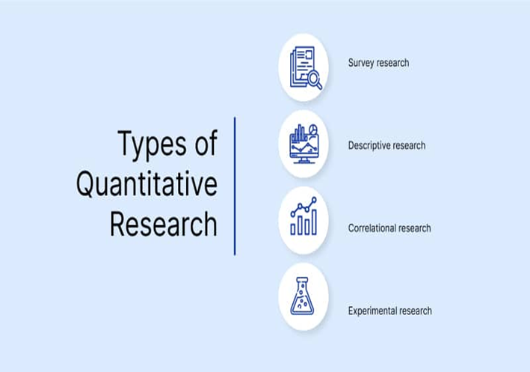
Different Research Approaches
Quantitative research
Quantitative research is expressed in numbers and graphs It is used to test or confirm theories and assumptions This type of research can be used to establish generalizable facts about a topic

Slide 5
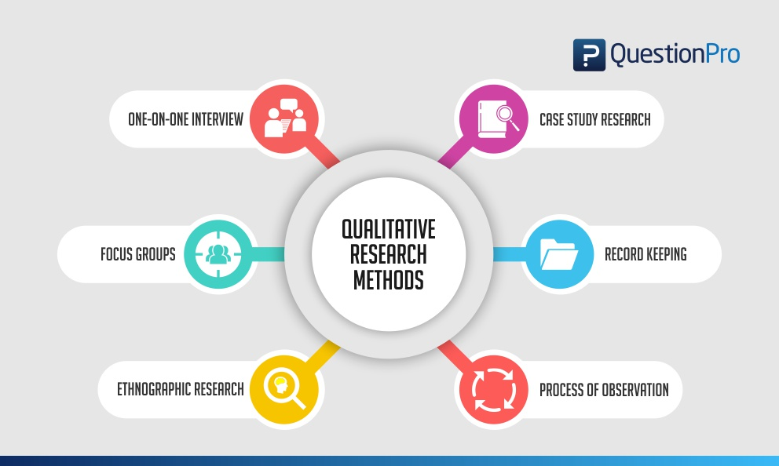
Qualitative research
Qualitative research is expressed in words It is used to understand concepts thoughts or experiences. This type of research enables you to gather in-depth insights on topics that are not well understood

Slide 6
different research strategies
Case Study This focuses deeply investigation of a single case (one organisation) or a small number of cases. In case study research generally
Qualitative interviews There are different types of qualitative interviews (structured, semi-structured, unstructured) and this is the most widely used method for collection data.
Quantitative survey This is a widely used method in business research and allows access to significantly high numbers of participants.

Slide 7
Conclusion
The conclusion is an chance to succinctly answer the question by placing the study within the context of past research about the topic

Slide 8
Reference
Quantitative Data: Definition, Types, Analysis and Examples | QuestionPro. (2020). Retrieved 5 April 2022, from
Your Bibliography: Types of Research Strategy. (2018). Retrieved 6 April 2022, from

Slide 9
Thank You All

