Slide 1



Libyan International Medical University
Faculty of
Business Administration
Types of Managers
Mohamed A.A Eldeep
Student Number : 2754
EMAIL : mohamed_2754@limu.edu.ly

Slide 2
Table of content
    . Types of managers
    . Their roles
    . Conclusion
    . Reference
1

Slide 3


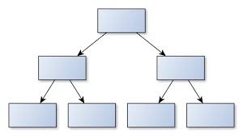
    Types of managers
We’ll talk about the differences between top managers, middle managers, first-line managers, and team leaders
2

Slide 4
Top managers
Top managers are ultimately responsible for the long-term success of the organization. They set long-term goals and define strategies to achieve them. They pay careful attention to the external environment of the organization: the economy, proposals for laws that would affect profits, stakeholder demands, and consumer and public relations. They will make the decisions that affect the whole company such as financial investments, mergers and acquisitions, partnerships and strategic alliances, and changes to the brand or product line of the organization
3

Slide 5
As you would expect, top-level managers (or top managers) are the “bosses” of the organization. They have titles such as
chief executive officer (CEO)
chief operations officer (COO)
chief marketing officer (CMO)
chief technology officer (CTO)
chief financial officer (CFO)
chief compliance officer (CCO)
4

Slide 6
Middle managers
Middle managers have titles like department head, director, and chief supervisor. They are links between the top managers and the first-line managers and have one or two levels below them.
Middle managers must be good communicators because they link line managers and top-level management.
5

Slide 7
First line manager
First-line managers are the entry level of management, the individuals “on the line” and in the closest contact with the workers. They are directly responsible for making sure that organizational objectives and plans are implemented effectively. They may be called assistant managers, shift managers they are the first to see problems with the operation of the business, such as untrained labor, poor quality materials, machinery breakdowns,It is essential that they communicate regularly with middle management.
6

Slide 8
Team leaders
A team leader is a special kind of manager who may be appointed to manage
a particular task or activity. and generally ensuring that the team is operating
at peak efficiency. Once the task is complete, the team leader position may
be eliminated and a new team may be formed to complete a different task.
7

Slide 9
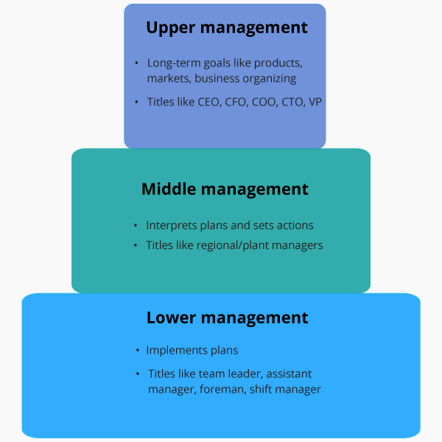
Conclusion
8

Slide 10
Reference
Learning, L. (n.d.). Principles of management. Retrieved April 14, 2021, from https://courses.lumenlearning.com/wmopen-principlesofmanagement/chapter/types-of-managers-and-their-roles/
9

Slide 11


