Slide 1



Small Talk, Definition and Examples
Libyan International Medical University Faculty of Business Administration
NAME:ZAKARIYA RASHWAN
ID:2991
DATE:2021-12-8
E-mail:zakariya_2991@limu.edu.ly

Slide 2

TABLE OF CONTENTS
01
02
Introduction
Examples
03
04
Conclusion
References

Slide 3
STUDY OBJECTIVES
To understand Small Talk
To understand examples of small talk

Slide 4
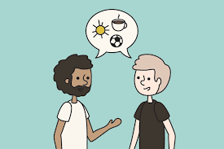
INTRODUCTION
Small talk is light, informal conversation. It’s commonly used when you’re talking to someone you don’t know very well and at networking and social events.

Slide 5
Examples
making introductions
excuses
advice
giving and receiving compliments

Slide 6

Conclusion
You are the one who chooses the way you communicate if it is short, and its content is an introduction, excuses, compliment, or giving advice. (You are the one to choose)

Slide 7

References
Merriam-Webster. (n.d.). Small talk definition & meaning. Merriam-Webster. Retrieved December 8, 2021, from https://www.merriam-webster.com/dictionary/small%20talk.

Slide 8

THANKS!
Do you have any questions?

