Slide 1


The Waves of Feminism
Libyan International Medical University
Faculty of Business Administration
By: Omar Bubtana
Student number: 2770
omar_2770@ limu.edu.ly

Slide 2
Four waves of feminism
The first wave (1830- early 1900s):
Women in the late 19th to early 20th centuries realized that they must first gain political power.
their political agenda expanded to issues concerning sexual, reproductive and economic matters.
Waves of feminism

Slide 3
The second wave (1960s-1980s)
World War II, the second wave of feminism focused on the sexuality, family and reproductive rights.
Many of the women supporters felt that in order to gain respect in co-ed organizations they first needed to address gender equality concerns.
Waves of feminism

Slide 4
The third wave (1990s - early 2000s):
It repaired the second wave's failures and focused more on gender equality.
It sees women’s lives as intersectional, demonstrating how race, ethnicity, class, religion, gender, and nationality are all significant factors when discussing feminism.
Waves of feminism

Slide 5

The fourth wave:
The main issues women fight for today are fueled by the previous battles of the women before them
The #MeToo movement – millions of women across the globe united, stepping up to share their own assault stories using the #MeToo hashtag.
Waves of feminism

Slide 6
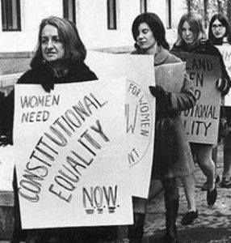


Slide 7
Reference
Cavanaugh.L.V.(2018). A brief history: The four waves of feminism.https://www.progressivewomensleadership.com/a-brief-history-the-four-waves-of-feminism
Humanities.O.(2018). Betty Friedan: The Three Waves of Feminism. http://www.ohiohumanities.org/betty-friedan-the-three-waves-of-feminism/?fbclid=IwAR2irdTJUYXJAARfsy8E5gCiKZOdORBF4nnoVVcGjZi_-6lPKUAlthLrpJ0#:~:text=Feminist%20history%20can%20be%20divided,equal%20legal%20and%20social%20rights

Slide 8


