Slide 1


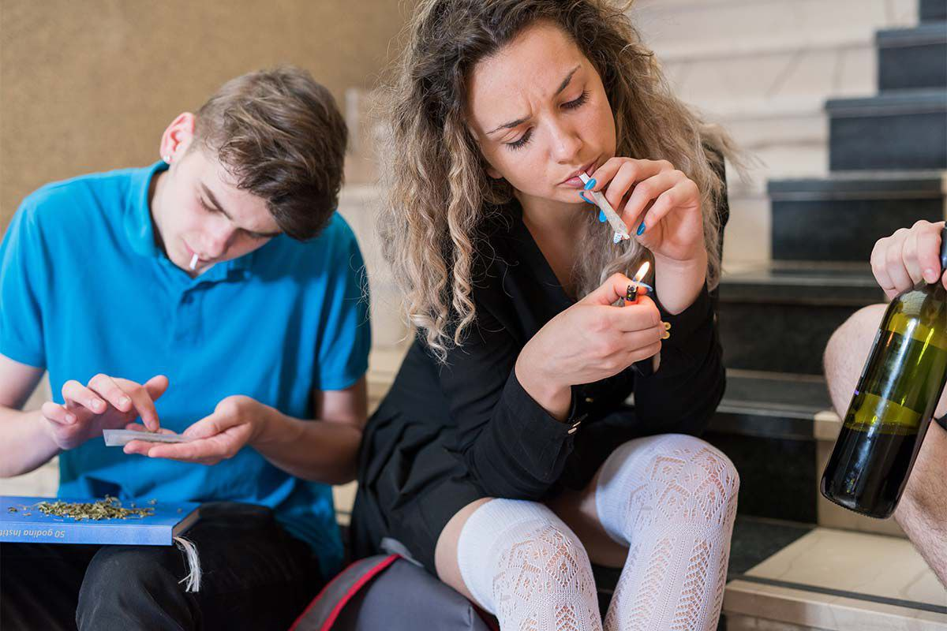
Teenager drug abuse
2nd Year AMS (2021-2022)
Presented by :
Dana Lashab 2941
PTS block
1

Slide 2
It’s important to know the difference between drug abuse and addiction. Many teens experiment with drugs but aren’t addicted.
2

Slide 3
Objectives
1
2
3
4
Define teenage drug abuse
Explain why teenagers Use Illicit drugs
Discuss consequences of teen drug use
Discuss how to help teenagers stay drug free
3

Slide 4
Define:
Substance abuse is when you use legal or illegal substances in ways you shouldn't use. Teens may do this out of experience or imitation, to feel good, to relieve stress, or to avoid reality.
4

Slide 5


The causes of teenage drug
family life
Witnessing adults take drugs
Pure curiosity
Believing taking drugs is cool
Social media
5

Slide 6
A study conducted by the National Center on Addiction and Substance Abuse at Columbia University found that teenagers who regularly use popular social media outlets were more likely to drink
Social Media
6

Slide 7
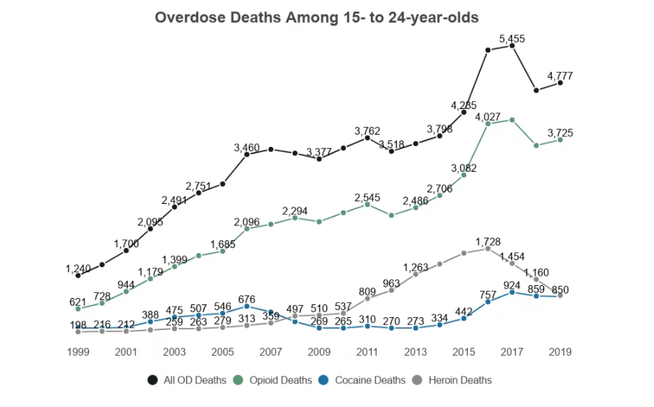
7

Slide 8
2,080,000
marijuana
83.88%
8

Slide 9
consequences
Drug dependence.
Poor judgment.
Sexual activity.
Mental health disorders. .
Impaired driving.
Changes in school performance.
9

Slide 10
What about the body ?
Immune System
Digestion
Respiratory and lung damage
Dehydration
10

Slide 11
- how to help teenagers
Clear communication by parents about the negative physical, emotional, and functional effects of drugs have been found to significantly decrease substance abuse in teens.
11

Slide 12
Other preventive strategies
Know your teen's activities.
Establish rules and consequences.
Know your teen's friends.
Keep track of prescription drugs.
Provide support.
Social media
12

Slide 13
Social networking sites also have a negative impact, they also have a positive effect on raising awareness about drug abuse for adolescents
Social Media
13

Slide 14
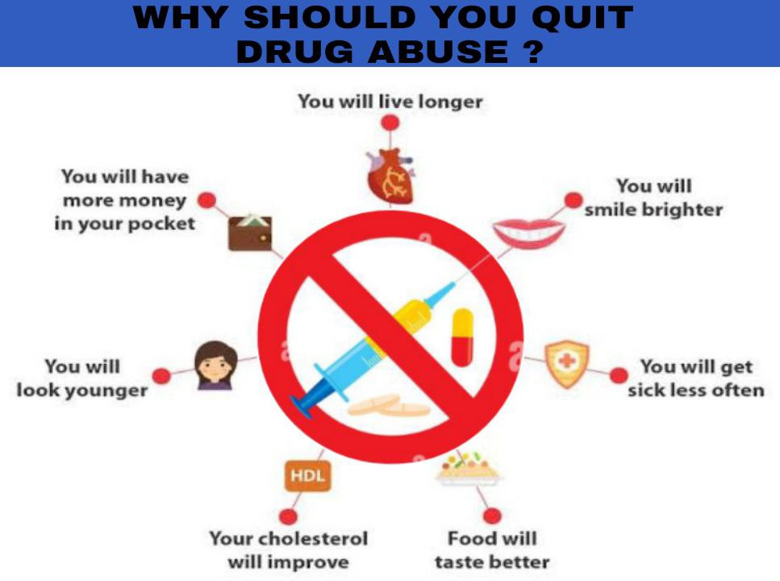
Conclusion
14

Slide 15
References
Serenity. 2022. Teenage Drug Abuse UK: Causes & Stats | Serenity. [online] Available at: <https://www.rehabclinic.org.uk/teenage-drug-abuse-in-the-uk/> [Accessed 4 March 2022].
[Internet]. Medicinenet.com. 2022 [cited 4 March 2022]. Available from: https://www.medicinenet.com/teen drug_abuse/article.htm
Consequences of Teenage Drug Addiction & Alcohol Abuse [Internet]. The Recovery Village Drug and Alcohol Rehab. 2022 [cited 4 March 2022]. Available from:
What parents should know about teen drug abuse [Internet]. Mayo Clinic. 2022 [cited 4 March 2022]. Available from: https://www.mayoclinic.org/healthy-lifestyle/tween-and-teen-health/in-depth/teen-drug abuse/art-20045921
15

Slide 16
Thank You Thank You
16

