Slide 1


Libyan International Medical University Faculty of Business Administration
Differentiating Between Interest Groups and Political Parties
Name : Nouri Founas
Student ID : 2733
E-mail : nouri_2733@limu.edu.ly
Date : 2021-December-8

Slide 2
Table of Contents
01
02
03
04
What is political parties
Introduction
Characteristics of Political Parties
05
06
What is interest groups
Characteristics of interest groups
Comparison chart
07
08
Conclusion
Reference
1

Slide 3
01
Introduction
2

Slide 4
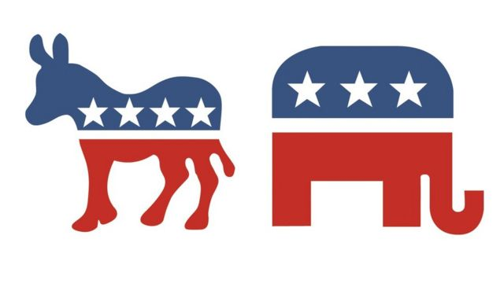
Introduction
The difference between political parties and interest groups is that political parties participate in and attempt to win elections. An interest group, on the other hand, does not participate in the political process and focuses on one or two specific problems.
3

Slide 5
02
What is Political Parties
4

Slide 6
A political party exists to win power by supporting one or more candidates in elections. For example, in the United States, the two largest political parties are Republicans and Democrats, and every four years, the two parties nominate new (or old) candidates to run for election. Political parties focus on a wide range of subjects, including (Social welfare – Equality of rights – Gun control – Taxes – Foreign relations – Health care).
5

Slide 7
Characteristics of Political Parties
1- a group of people who are well-organized. 2- The party's members have similar values and goals. 3- Attempts to gain political power through collective action. 4- Elections are used to gain power through constitutional and legal means. 5-Its goals are translated into government policies.
6

Slide 8
04
What is Interest Groups
7

Slide 9
Interest groups are groups of people who have similar viewpoints on a topic and band together to influence public opinion. Interest groups, on the other hand, do not run for office and do not necessarily support certain individuals, but instead lobby and campaign for the repeal or ratification of specific laws. Corporations, businesses, labor unions, social groups, and student unions are examples of interest groups.
8

Slide 10

Characteristics of Interest Groups
1-formally and voluntarily organized.
2- Their members are motivated and connected by specific mutual interests.
3-Members strive to attain, protect, and promote their goals.
4-Influence the formulation of public policies that affect its members, either directly or indirectly.
9

Slide 11
06
Comparison chart
10

Slide 12

Parameters of Comparison | Political Parties | Interest group
Meaning | A political party is a formally organized group of people who share common political views and objectives. | The interest group also serves as a liaison between the political sphere and the general public.
Function | Operating the government by winning elections. | Funding and coordinating initiatives to influence government leaders.
Nomination of candidates | Candidates are nominated for holding positions in government offices. | Does not nominate candidates.
Focuses on | Winning elections. | Influencing policy
Technique to pursue their agenda | Elections | Lobbying and litigation
Purpose | To facilitate in determining who holds government office. | To influence the policy choices made by the officeholders.
11

Slide 13
Conclusion
So, the main distinction between a political party and an interest organization is that an interest group tries to influence policymakers but does not try to take over government power. Political parties, on the other hand, focus on governance by contesting elections and winning a majority of seats in parliament in order to establish the government.
12

Slide 14
References
Squadrin, G. (2018, June 8). Difference between political parties and interest groups. Difference Between Similar Terms and Objects. Retrieved December 7, 2021, from http://www.differencebetween.net/miscellaneous/politics/difference-between-political-parties-and-interest-groups/.
S, S. (2021, April 19). Difference between political party and Interest Group (with functions, characteristics and comparison chart). Key Differences. Retrieved December 7, 2021, from https://keydifferences.com/difference-between-political-party-and-interest-group.html.
Ask any difference. Ask Any Difference. (2021, December 1). Retrieved December 7, 2021, from https://askanydifference.com/difference-between-political-parties-and-interest-group/.
13

Slide 15
Thank You
Do you have any questions?
14

