Slide 1


The Concept of Bureaucracy
Libyan International Medical University
Faculty of Business Administration
Name: Salim Mohammed
ID:2708
Email: Salim_2708@limu.edu.ly
1

Slide 2
TABLE OF CONTENTS
1. What is Bureaucracy?
2. Bureaucracy Functions
3. Models or Types of Bureaucracy
4. Conclusion
5. References
2

Slide 3
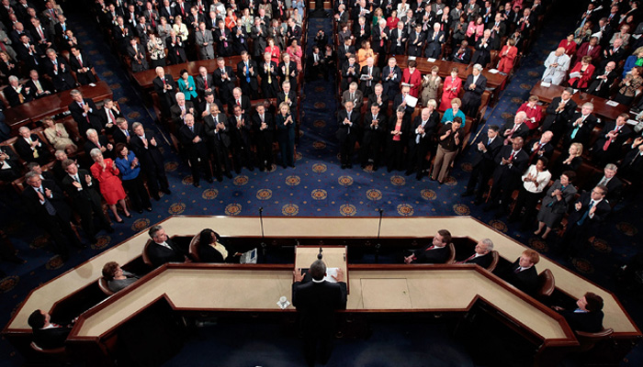
What is bureaucracy
Bureaucracy is a way of organizing large numbers of people who must work together, administratively. As organizations in the public and private sectors, including universities and governments, rely on bureaucracy in their work.
4

Slide 4
Bureaucracy Functions
One useful way to understand what bureaucrats do is to study the behavior of various government agencies. The following statement summarizes the main functions of government and provides examples of agencies that perform these functions:
4

Slide 5
Bureaucracy Functions
A- Protecting the Nation: the Armed Forces, the Coast Guard, the Intelligence
B-Maintaining a strong economy: the Federal Reserve (Central Bank), the Export-Import Bank, the Securities and Exchange Commission.
5

Slide 6
Models or Types of Bureaucracy
Monopolistic model: lack of competition - inefficiency
Acquisition model: expansion - competitiveness
The Weberian model: Hierarchy - idleness, lethargy and hibernation
6

Slide 7
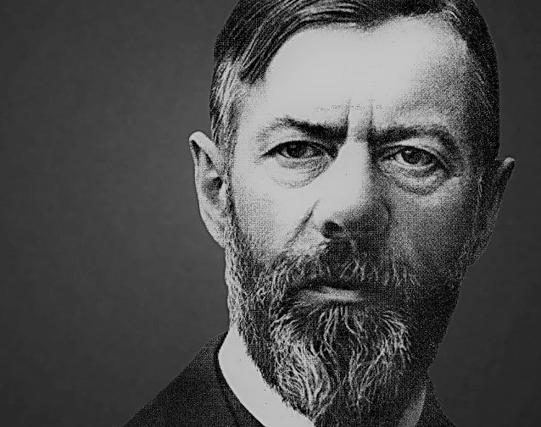
Conclusion
Bureaucracy, specific form of organization defined by complexity, division of labor, permanence, professional management, hierarchical coordination and control, strict chain of command, and legal authority. It is distinguished from informal and collegial organizations. In its ideal form, bureaucracy is impersonal and rational and based on rules rather than ties of kinship, friendship, or patrimonial or charismatic authority. Bureaucratic organization can be found in both public and private institutions.
7

Slide 8
References
Encyclopædia Britannica, inc. (n.d.). Bureaucracy. Encyclopædia Britannica. Retrieved October 19, 2021, from https://www.britannica.com/topic/bureaucracy.
13

Slide 9

9

