Slide 1



Keep it pink
Libyan International Medical University
Faculty of Applied Medical Science
Name Malak yakoub aamara
University number 3370
First year 2021 2022

Slide 2


Walt became a heavy smoker after World War I and can be seen in many pictures with a cigarette in hand. And, as many know, Disney passed away from lung cancer.

Slide 3

objectives
Do you know enough about lung cancer ?
How to make sure am not affected?
If you can't stop smoking cancer will !
Ways of treatment

Slide 4



.
Carcinoma happens in epithelial cells that lining the respiratory tract that can be mutated as cell starts piling upon each other and become a tumor mass

Slide 5

Cancer stage | 5-Year relative survival rate
Localized | 64%
Regional | 37%
Distant | 8%
All stages combined | 26%

Slide 6

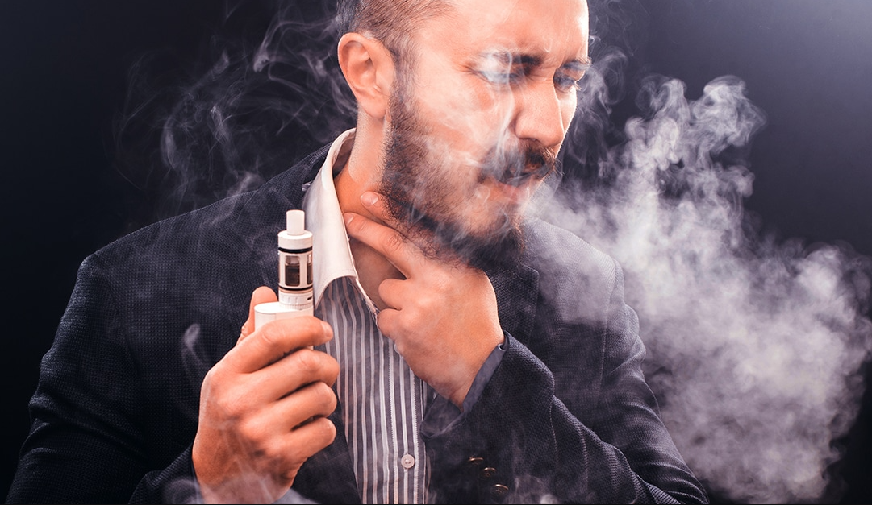

.
Signs and symptoms
A symptomatic in early disease
Constitutional symptoms
Coughing
Shortness of breath
Couching up blood

Slide 7
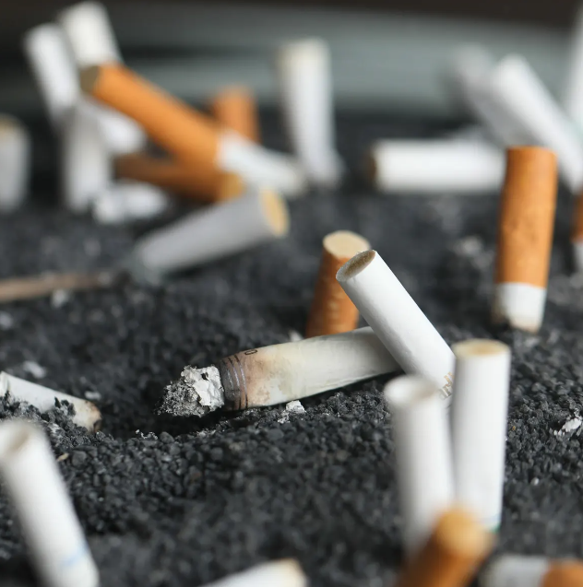

Risk factors
Smoking tobacco
Radon gas
X -ray
CT scan
Genetics
Air pollution

Slide 8
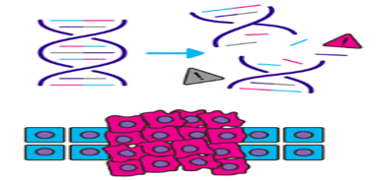
How can smoke cause lung cancer ?
Cigarette smoke releases over 5000 chemicals and many of these are harmful
The harmful chemicals enter our lungs and spread around the entire body.
Chemicals from cigarettes damage DNA.
Cigarette chemicals make it difficult for cells to repair any DNA damage. They also damage the parts of DNA that protect us from cancer.
This DNA damage can cause cancer in cells.

Slide 9
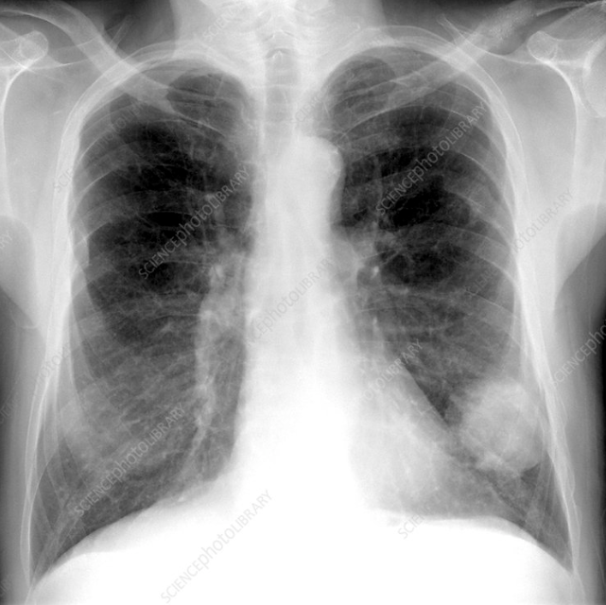
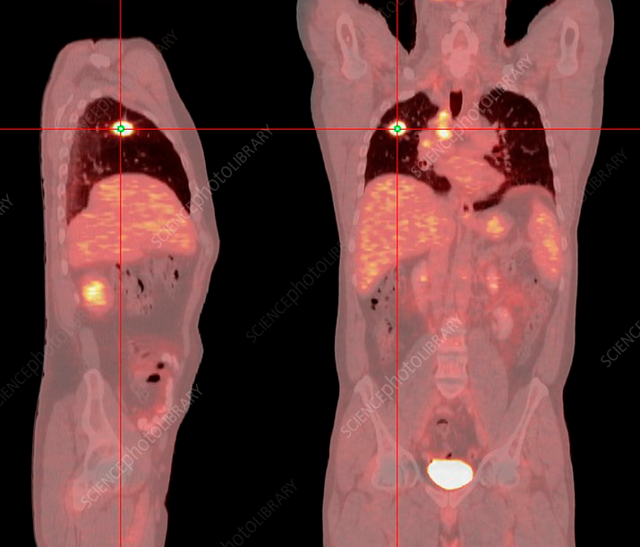
Diagnosis
Chest x ray
Ct scan
PET scan
Biopsy
Genomic testing

Slide 10

Treatment
Immunotherapy
Chemotherapy
Radiation therapy
Surgary

Slide 11
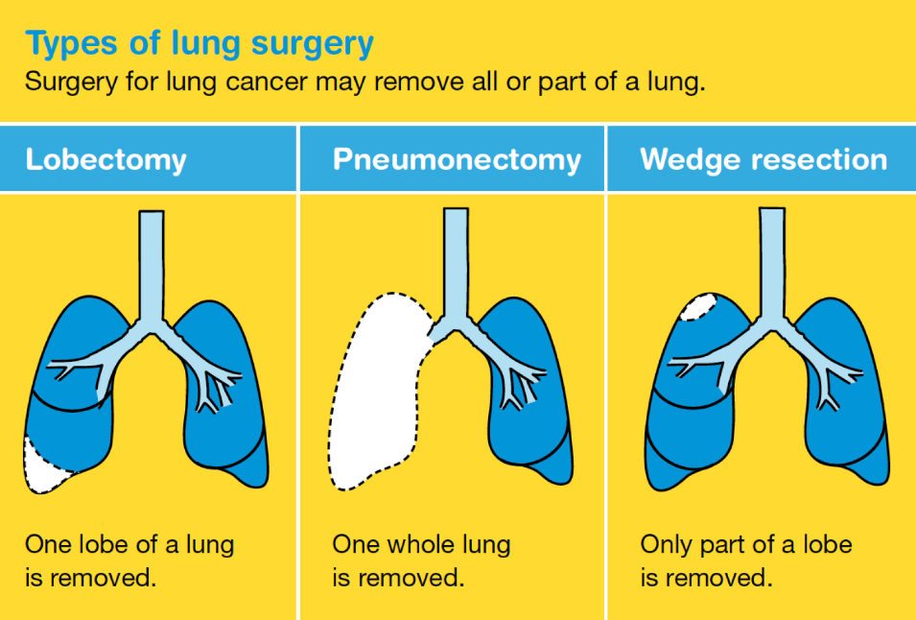

Slide 12
Conclusion
Lung cancer is leading of cancer deaths
Only prevention don’t smoke
Over all 5 year survival rate 26 %
Today you have the price of cigarettes Do you have the price of chemotherapy tomorrow

Slide 13
Reference
. Survival | Lung cancer | Cancer Research UK [Internet]. Cancerresearchuk.org. 2022 [cited 11 May 2022]. Available from: https://www.cancerresearchuk.org/about-cancer/lung-cancer/survival
Your Bibliography: 2. [Internet]. 2022 [cited 12 May 2022]. Available from: https://acsjournals.onlinelibrary.wiley.com/doi/full/10.3322/caac.21708
3. Survival | Lung cancer | Cancer Research UK [Internet]. Cancerresearchuk.org. 2022 [cited 12 May 2022]. Available from: https://www.cancerresearchuk.org/about-cancer/lung-cancer/survival
Your Bibliography: 4. [Internet]. 2022 [cited 12 May 2022]. Available from: https://www.osmosis.org/learn/Lung_cancer

