Slide 1



Libyan international medical university
Faculty of business administration
Target Market
Heba Elbanka
3788
hibah_3788@limu.edu.ly

Slide 2
objectives
Define Target market
2 . Define Market segmentation
1

Slide 3
Table of contents
01
03
02
04
Define Market Segmentation
Introduction
Define Target Market
conclusion
2

Slide 4
Introduction
A target market is segment of potential customers who are more likely to buy a product or service from you
3

Slide 5

Define target market
Target market is specific group of people with shared characteristic to whom a business market it is products or services
4

Slide 6
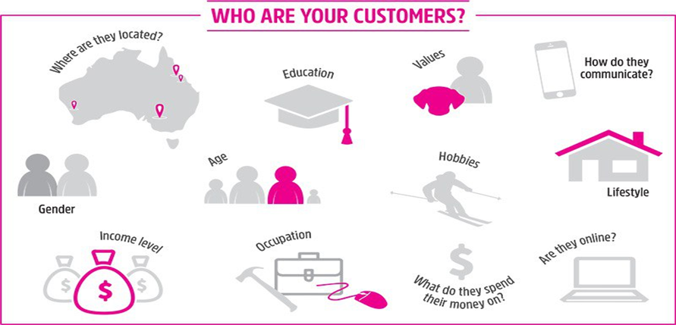
Business define their target market to know who they are selling to and how to reach those customers , now every product or service on the market today can be directed toward a specific target
5

Slide 7

Define Market segmentation
Market segmentation is the practice of dividing the target market into accessible groups and attracting only customers who need the product or service rather than targeting the entire audience with a general message.
6

Slide 8
1 .stronger marketing messages 2 .Tareted digital advertising 3 . Attracting the right customers 4 . Increasing brand loyalty 5 . Driving growth 6 . Product development
Six Benefits of market segmentation
7

Slide 9
Conclusion
Identification of target customers and market segmentation helps the product to succeed more and reach the customers who need it
8

Slide 10
References
Team, T. I. (2022, February 8). What is target market? Investopedia. Retrieved April 26, 2022, from https://www.investopedia.com/terms/t/target-market.asp
Tarver, E. (2021, May 19). Know how to target specific markets to bring in a large profit. Investopedia. Retrieved April 26, 2022, from https://www.investopedia.com/terms/m/marketsegmentation.asp
9

Slide 11

10

