Slide 1


Libyan International Medical University
Faculty of Business Administration
The Changes in the Marketing World
Name: Amal Ibrahim Edbey
ID Number: 2789
Email: Amal_2789@limu.edu.ly
http://www.free-powerpoint-templates-design.com

Slide 2
The objectives
01
Marketing evaluation before the internet .
02
Definition of Market change.
03
Digital Marketing.
1

Slide 3
The content
Introduction.
Definition of Market change.
Conclusion.
References.

Slide 4
Introduction
Over the last 10 years marketing has changed and becomes better and better. But what do you think marketing was like before the internet and the definition of market change lastly I will talk a little bit about Digital Marketing, how it is better than the old marketing, and how it started.

Slide 5
Marketing evaluation before the internet
Depends on :
Depended on :
-Social media .
-desktops .
-mobile smart devices .
Depended on :
-Mobile phones.
-Computers.
-Internet .
Depended on :
-Television.
-Telephone.
-Radio .
-Magazines.
-Posters.
-Billboards .
1920
1960
1990
2019
2

Slide 6

Definition of Market change
Market change is broadly defined as a shift or change in the way in which a market or economy functions or operates. Or
The different shifts and challenges the market faces in its history
3

Slide 7

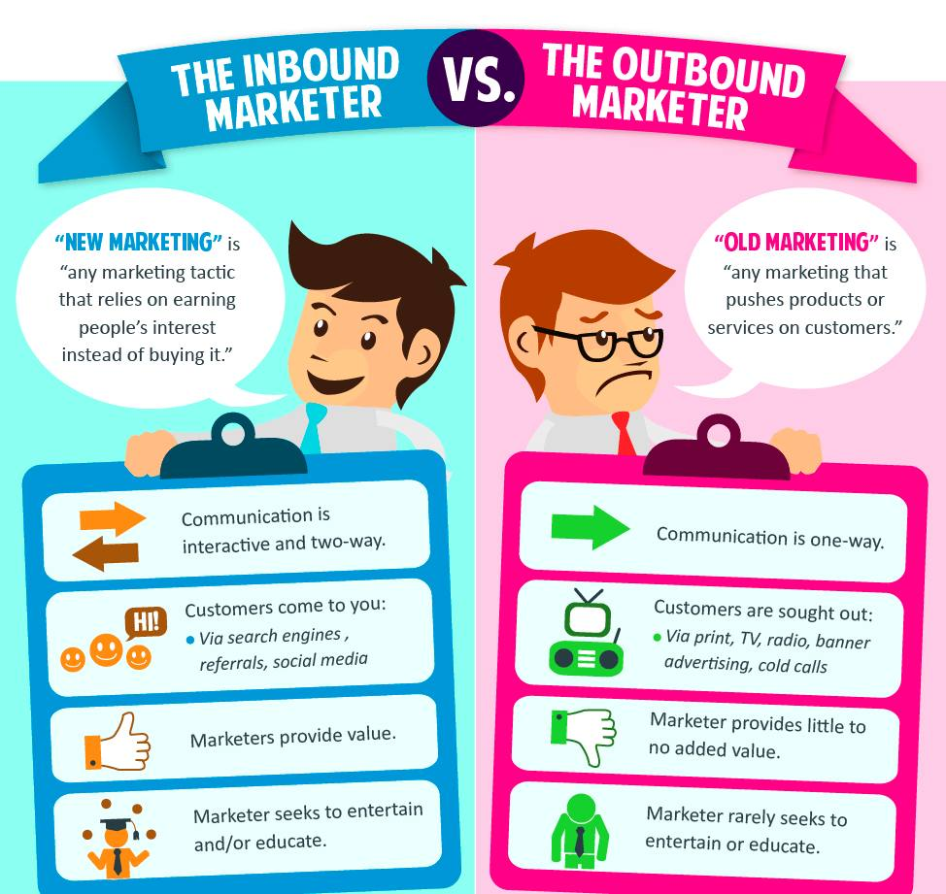
Digital Marketing
Marketing improvement :
- Lower costs.
-Precise targeting.
-Personalization.
-Brings more value. .
4

Slide 8
Conclusion
Over time, a business may adapt its marketing mix to suit the business climate , changes in trends relating to customers' wants and needs, changes in the size and scale of the business, changes in the business' aims and objectives , or changes in demand for a product or service.
5

Slide 9
References
Louth, J. D. (2020). The changing face of marketing. McKinsey & Company. https://www.mckinsey.com/business-functions/marketing-and-sales/our-insights/the-changing-face-of-marketing
6

Slide 10

Thank You
7

