Slide 1


Referencing Styles & The Differences Between Them
Libyan International Medical University
Faculty of Business Administration
Arwa Fawzi Ghaith 3275 Arwa_3275@limu.edu.ly
20th of April, 2022

Slide 2
Objectives
After this presentation you should be able to:
Know what referencing is.
List the different referencing styles.
Describe the difference in Apa, Harvard, Mla, and Chicago styles.

Slide 3
Table of Contents
01.
02.
03.
Introduction
The different Referencing Styles
The Difference Between The Referencing Styles
04.
Conclusion
What is referencing?
05.
References

Slide 4

01
Introduction

Slide 5
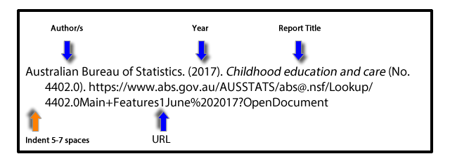
What Is Referencing?
Referencing acknowledges the books, articles, websites, and any other material used in the writing of a paper, essay or thesis.

Slide 6
The different Referencing Types
A Referencing Style is a set of rules telling you how to reference in a particular way. There are a variety of different styles including:
MLA (Modern Languages Association) Style
APA (American Psychological Association) Style
Harvard Style
Chicago Style

Slide 7
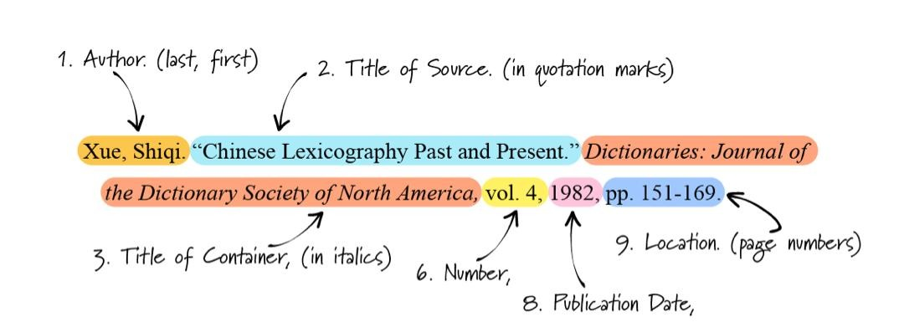
The Difference Between The Referencing Styles
MLA (Modern Languages Association) Style
Title is underlined; all major words are capitalised
Sources page is titled “Works cited”
Full name of author is used
In text citation contains authors name and page numbers (Smith 25)
7

Slide 8
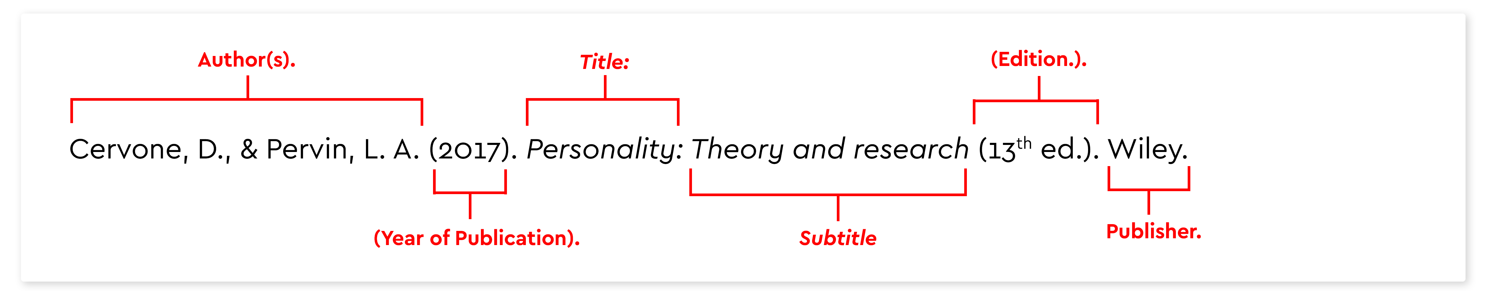
APA (American Psychological Association) Style
Source page is titled as “References”
Last name of the author is used
In text citations contain author’s name and year of publication ex. (Smith, 2022)
Commas are used in in-text citation
Title is in italics
7

Slide 9
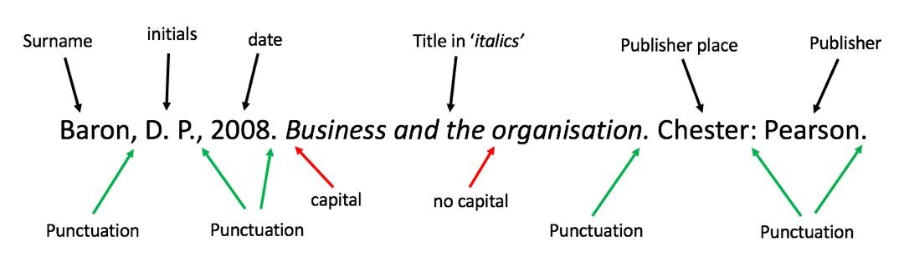
Harvard Style
Source page is titled as “Reference List”
Last name of the author and is initial is used
In text citations contain author’s last name and year of publication and a page number if relevant ex. Smith and Paula (2022, p.8)
Commas are used in in-text citation
Title is in italics
7

Slide 10
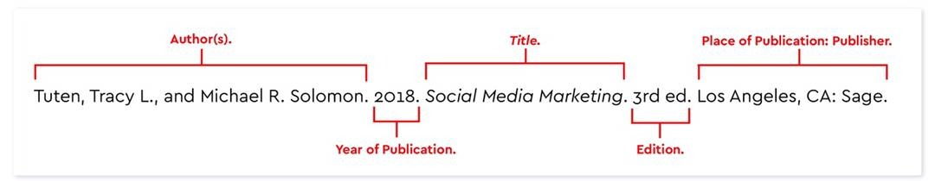
Chicago Style
Source page is titled as “References”
Full name of the author is used
In text citations contain author’s surname(s), year of publication and page(s) number ex. (Cyrus 2009, 12)
Commas are used in in-text citation
Title is in italics
7

Slide 11
Conclusion
It is important to acknowledge the source of your ideas (reference) to avoid plagiarism. Anything that is not common knowledge must be cited (referenced). There are a variety of different styles of referencing that were mentioned in this presentation.

Slide 12
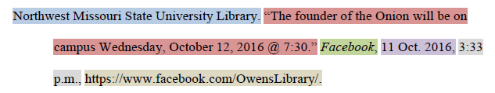
Question
Can you guess what referencing style is used for this reference?
MLA Style

Slide 13
References
McCombes, S. (2021, October 12). Apa vs MLA: The key differences. Scribbr. Retrieved April 20, 2022, from https://www.scribbr.com/citing-sources/apa-vs-mla/
MLA style citation examples: Media. Research Guides. (n.d.). Retrieved April 20, 2022, from https://libguides.nwmissouri.edu/mla/media
Reference list (harvard) - academic English referencing system. Academic English UK. (2022, February 2). Retrieved April 20, 2022, from https://academic-englishuk.com/reference-list/
Referencing & avoiding plagiarism: What's referencing? LibGuides. (n.d.). Retrieved April 20, 2022, from https://nuim.libguides.com/referencing

