Slide 1


Libyan International Medical University Faculty of Busines Administration
The Interpersonal Conflict
Name : Nouri founas
Student ID : 2733
Email : nouri_2733@limu.edu.ly

Slide 2
Table of content
01
Introduction
02
Interpersonal Conflict Definition
03
Types of Interpersonal Conflict
04
Summary
05
References
1

Slide 3
01
Introduction
2

Slide 4

Interpersonal conflict occurs when two or more individuals disagree in some way, whether it's emotional, physical, personal, or professional. Families, companies, and society as a whole are rife with such conflicts.
Flipflopfreelance@gmail.com. (2018, December 4). Handling interpersonal conflict – what's your style? Concentia Group. Retrieved December 21, 2021, from https://concentiagroup.com/handling-interpersonal-conflict-whats-your-style/
3

Slide 5
Interpersonal Conflict Definition
4

Slide 6
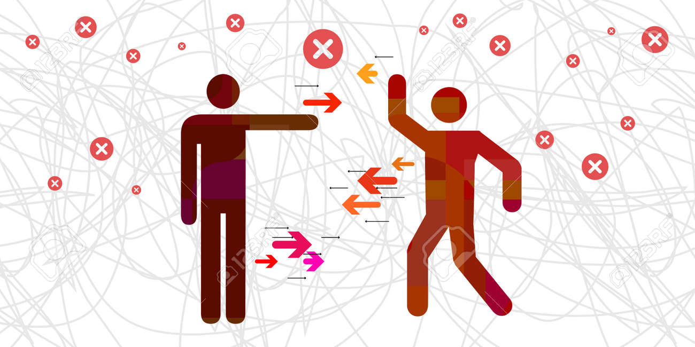
Interpersonal conflicts are disagreements between two or more persons in any situation; they can occur at work or among friends. These kinds of confrontations are widespread, but what's even more prevalent is how often we don't settle them.
Vector illustration of interpersonal conflict or two individual opposing visual. 123RF. (n.d.). Retrieved December 21, 2021, from https://www.123rf.com/photo_162798080_stock-vector-vector-illustration-of-interpersonal-conflict-or-two-individual-opposing-visual.html
5

Slide 7
Types of Interpersonal Conflict
6

Slide 8
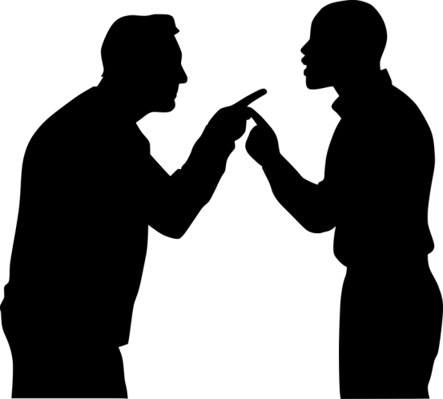
2- LACK OF TRUST
1- PERSONALITY CLASHES
3- INEFFECTIVE COMMUNICATION
4- DIFFERENT INTERESTS
5- INCOMPATIBLE GOALS
7

Slide 9
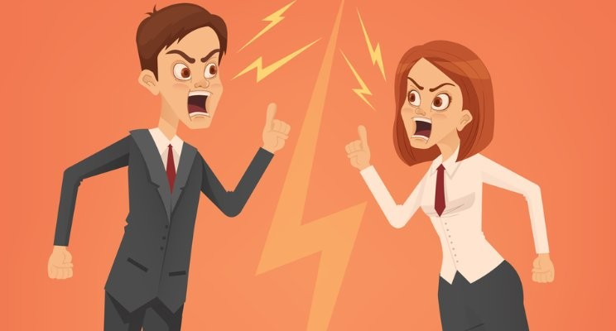
1- PERSONALITY CLASHES
This is an internal component that might lead to interpersonal conflict. Personality clashes occur when two people who are essentially opposed to each other find it difficult to agree on anything.
Ramos, J. (2018, March 9). Personality clashes at work. LinkedIn. Retrieved December 22, 2021, from https://www.linkedin.com/pulse/personality-clashes-work-jay-ramos
8

Slide 10
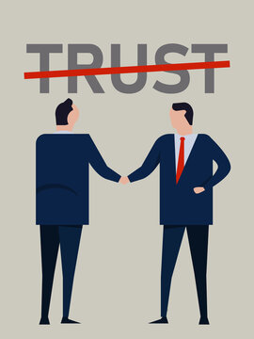
2- LACK OF TRUST
When coworkers don't trust each other, it can lead to conflict. One of the cornerstones of teamwork is interdependence, which has an impact on how well you get along with one another.
19 Beste Afbeeldingen, Stockfoto's en vectoren voor "Trust no one". Adobe Stock. (n.d.). Retrieved December 22, 2021, from https://stock.adobe.com/nl/search/?k=%22trust+no+one%22
9

Slide 11
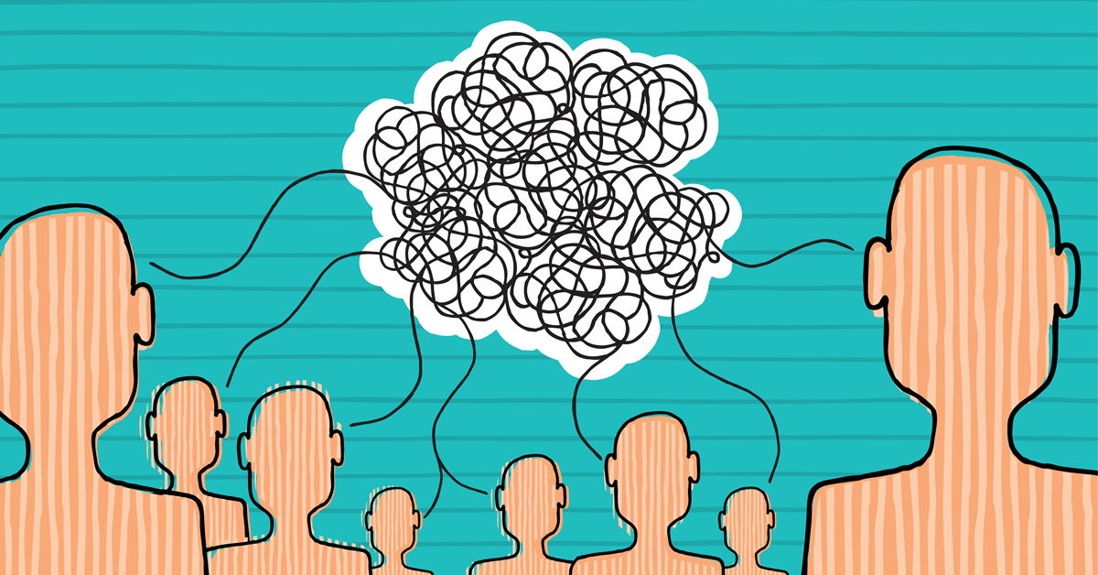
3- INEFFECTIVE COMMUNICATION
For example, someone sent an email to a coworker regarding a new work schedule, and they missed it the first time. He followed up the next day and received no response. This type of poor communication can lead to frustration at work. Not only will you experience disagreement in the future, but it will also have an impact on your professional relationships.
Poor communication hurts performance. CFA Institute Enterprising Investor. (2016, October 11). Retrieved December 22, 2021, from https://blogs.cfainstitute.org/investor/2016/10/10/poor-communication-hurts-performance/
10

Slide 12
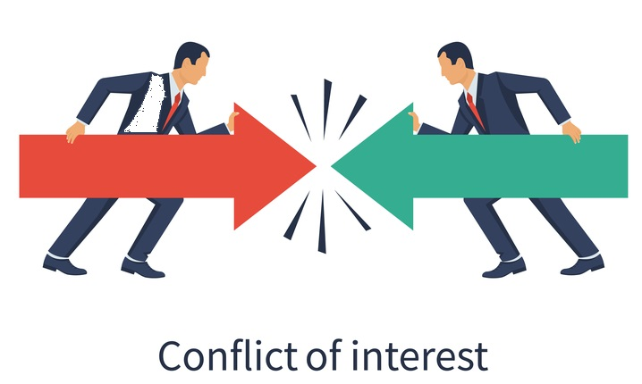
4- DIFFERENT INTERESTS
Different interests can cause interpersonal conflicts, especially when they come at the expense of someone else's.
Conflicts of interest. MMPI. (2018, March 15). Retrieved December 22, 2021, from https://mmpi.ie/conflicts-of-interest/
11

Slide 13

5- INCOMPATIBLE GOALS
To avoid conflict, personal aspirations should be linked with organizational goals. Different interests are the source of incompatible goals. If you and your coworker share similar objectives, you'll be more willing to collaborate to obtain better results. If your definition of success is different, it will almost always lead to conflict.
Admin, R. P. M. (2016, July 5). 4 common sources of workplace conflict - resource performance management. RPM. Retrieved December 22, 2021, from https://rpmconsultancy.com/this-is-not-a-dispute/
12

Slide 14
— Conclusion
These interpersonal conflicts always occur in the workplace and usually occur between employees and the reason is differences in views or decisions that are taken or work policies.
13

Slide 15

Flipflopfreelance@gmail.com. (2018, December 4). Handling interpersonal conflict – what's your style? Concentia Group. Retrieved December 21, 2021, from https://concentiagroup.com/handling-interpersonal-conflict-whats-your-style/
Interpersonal conflict. Interpersonal Conflict definition | Psychology Glossary. (n.d.). Retrieved December 21, 2021, from https://www.alleydog.com/glossary/definition.php?term=Interpersonal%2BConflict
Vector illustration of interpersonal conflict or two individual opposing visual. 123RF. (n.d.). Retrieved December 21, 2021, from https://www.123rf.com/photo_162798080_stock-vector-vector-illustration-of-interpersonal-conflict-or-two-individual-opposing-visual.html
Dealing with interpersonal conflict at work. Indeed Career Guide. (n.d.). Retrieved December 21, 2021, from https://www.indeed.com/career-advice/career-development/interpersonal-conflict
14

Slide 16
Thank you all ! Any questions !
15

