Slide 1

Concept of Community Medicine
Dr. Amina Elsaid
Community Medicine

Slide 2
Learning objectives
To understand
- Concept of health.
- Concept of disease.
- Concept of control
- Concept of prevention.

Slide 3
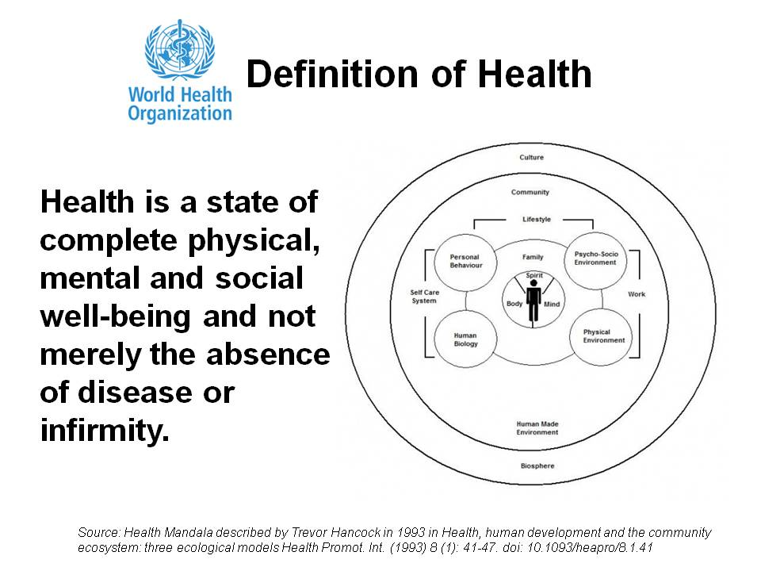
(WHO 1948)
WHO definition of health (1998)
"Health is a dynamic state of complete physical, mental, spiritual and social well – being and not merely the absence of disease or infirmity"
Notes:
WHO 1948

Slide 4
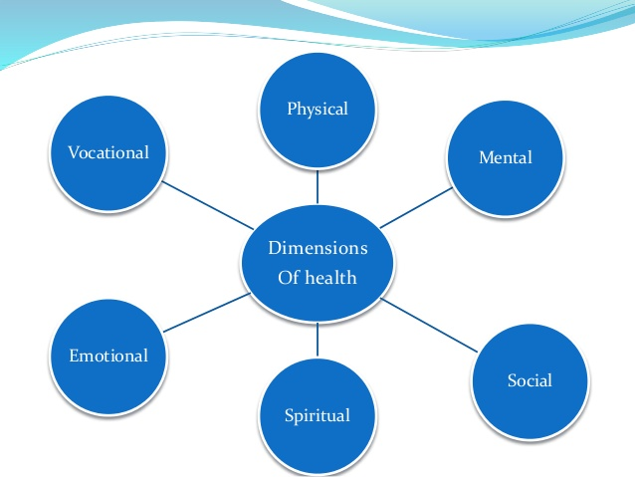
Dimensions of health

Slide 5
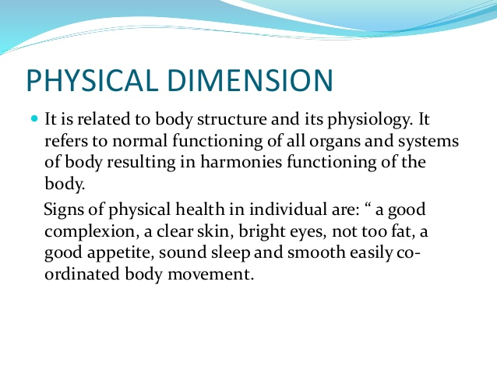
The major tools for the assessment of physical health are:
a) Clinical examination
b) Nutritional assessment
c) Various investigations

Slide 6
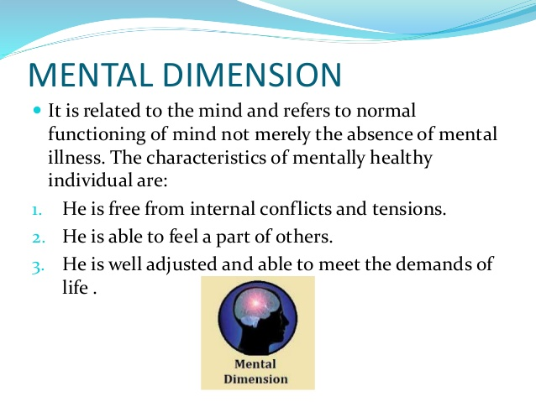

Slide 7
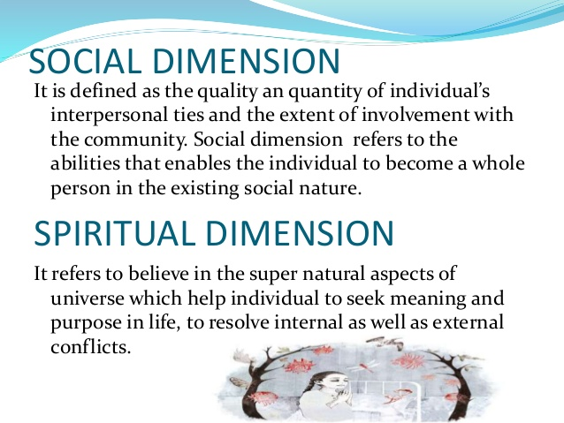

Slide 8
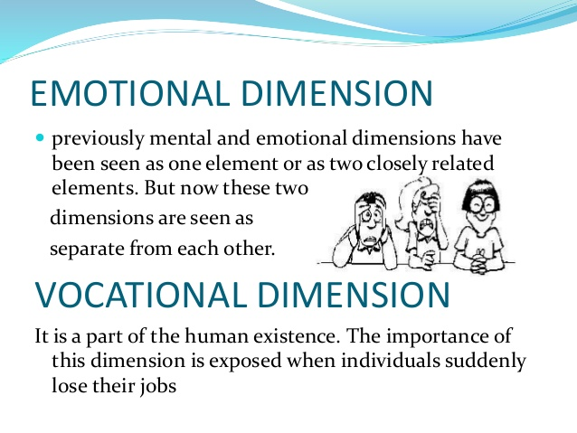

Slide 9
Health indicators
Indicators:
“They are variables which help to measure changes.”
An Ideal Indicator is
1- valid صالحة
2. Reliable & objective موثوقة وموضوعية
3. Sensitive دقيقة
4. Specificمحددة
5. Feasibleمجدية
6. Relevantذات الصلة

Slide 10
Because health is multidimensional, it can not be measured by single indicator and must be classified as:
(1) Mortality indicators.
(2) Morbidity indicators.
(3) Disability rates.
(4) Nutritional status indicators.
(5) Health care delivery indicators.
(6) Health care services utilization indicators .
(7) Indicators of social and mental health.
(8) Environmental indicators.
(9) Socio– economic indicators.
(10) Health policy indicators.
(11) Indicators of quality of life.

Slide 11
Mortality indicators
a- Crud Death Rate
Defined as the total number of deaths in a calendar year per 1000 mid year estimated population
Total No. of deaths during the calendar year
Mid – year estimated population
CDR =
X 1000

Slide 12

b) Expectation of life: Global health indicator
The average number of years that will be lived by those born alive in to a population
Life expectation = Improvement health status
Good indicator of socio-economic development

Slide 13
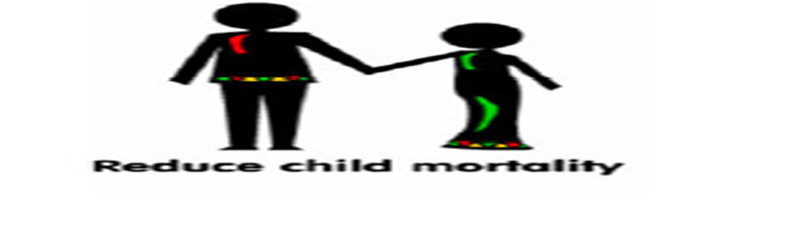
c) Infant mortality rate:
- It is the ratio of deaths under 1 year of age in a given year to the total number of live births in the same year;
d) Child mortality rate:
It is defined as the number of deaths at ages 1-4 years in a given year, per 1000 children in that age group.
-Is also used to evaluate the mother and child health services,

Slide 14
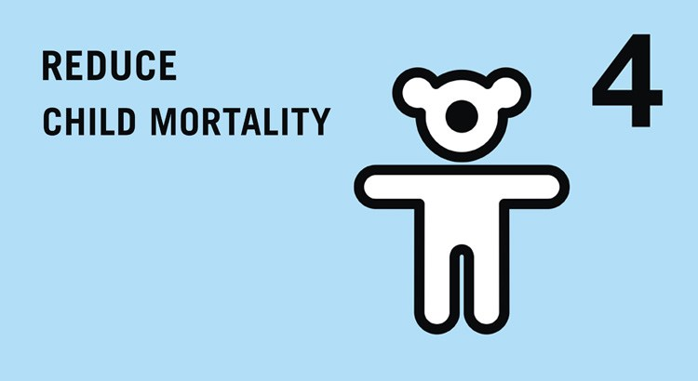
e) Under – 5 proportionate mortality rate:
It is the proportion of total deaths occurring in the under -5 age group, high rate reflects high birth rates, high child mortality rates and shorter life expectancy.

Slide 15

f ) Maternal (puerperal) mortality rate
- It measures the maternal and child health service and affected by the socio – economic status of the countries.
- Number of maternal death (death due to pregnancy, child birth, and with in 42 days of child birth) per 1000 live birth.

Slide 16
g) Disease – specific mortality rate:
Mortality rates can be computed for specific diseases e.g. mortality rates due to cancer, due to accidents …etc
h) Proportional mortality rate:
It is the simplest measure of estimating the burden of a disease in the community e.g. coronary heart disease is the cause of 25 to 30 % of all deaths in most western countries.

Slide 17
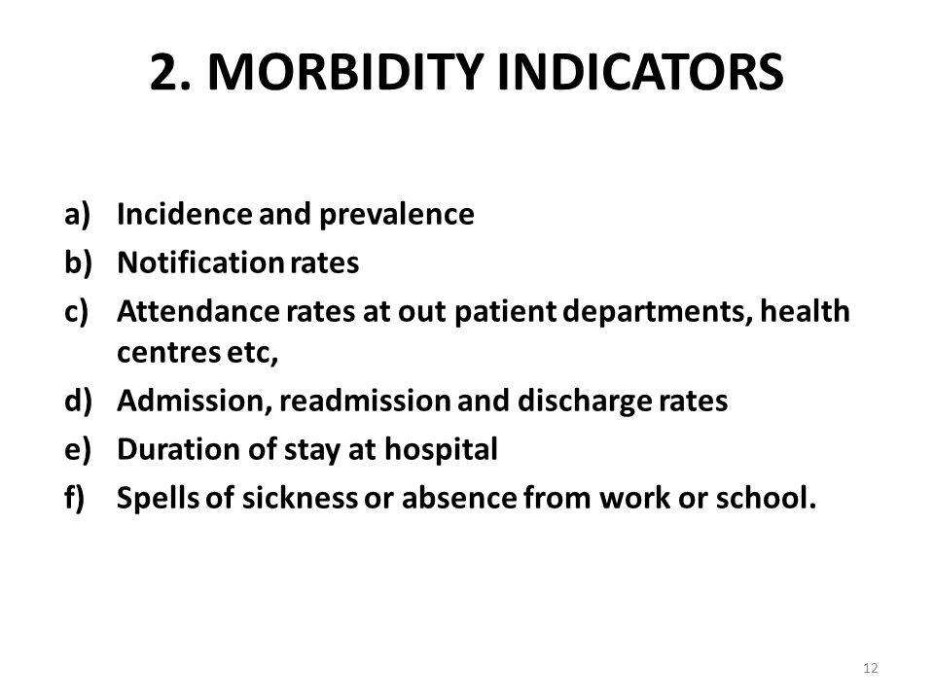

Slide 18
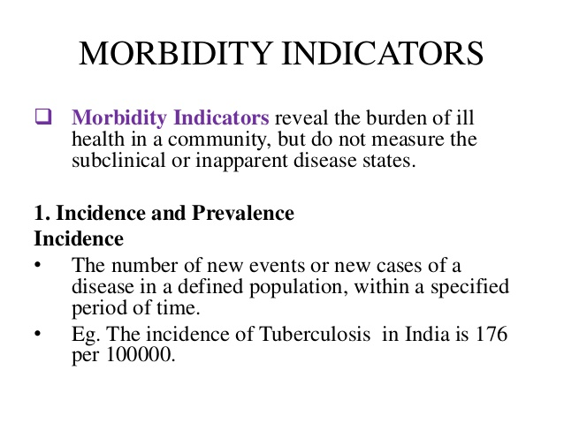

Slide 19
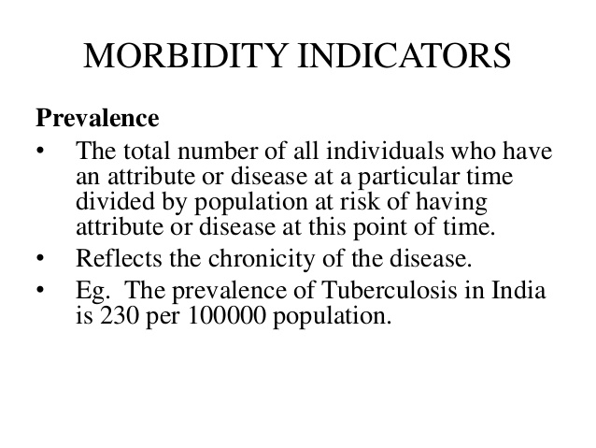

Slide 20
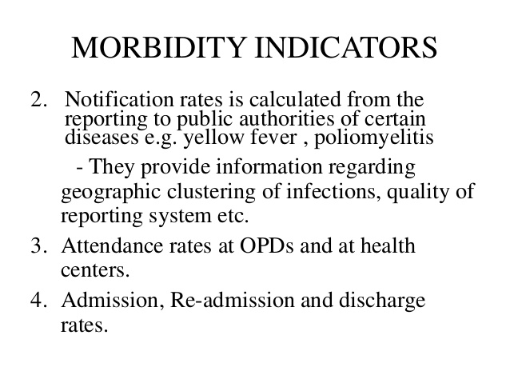

Slide 21
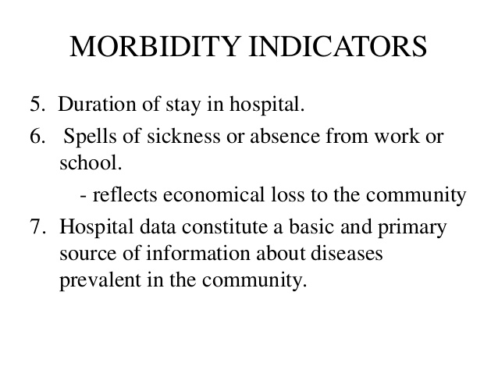

Slide 22
3 – Disability indicators
Commonly used indicators: number of days of restricted activity, bed disability days, work-loss days…etc.
4- Nutritional status indicators
These include
-Anthropometric measurements of pre – school children.
-Heights of children at school entry.
-Prevalence of low birth weight

Slide 23
5 – Health care delivery indicators
- Doctor – population ratio.
- Doctor – Nurse ratio.
-Population- bed ratio.
6- Utilization rates
-Proportion of infants who are "fully immunized" against the EPI (expanded program of immunization) diseases.
-Bed – occupancy rate.
-Bed turn – over ratio.

Slide 24
7- Indicators of social and mental health
These include suicide, homicide, violence, road traffic accidents, alcohol and drug abuse, battered – baby and battered-wife syndromes prevalence rates.
8- Environmental indicators
Include indicators relating to pollution of air and water, radiation, solid wastes, noise, e.g. percentage of people having access to safe water and sanitation facilities.

Slide 25
9- Socio – economic indicators
Literacy rate.
Family size.
Per capita GNP. (gross national product)
Per capita "calorie" availability.
نصيب الفرد من الناتج القومي الإجمالي. (الناتج القومي الإجمالي
10 – Health policy indicators
Proportion of GNP spends on health.
Proportion of total health resources denoted to PHC

Slide 26

Thank you

Slide 27
Concept of disease
Dr. Amina Elsaid
Community Medicine

Slide 28
Learning objectives
- Definition of disease
- Epidemiological Triad
- Multi-factorial Causation and web causation
- Natural history of diseases
- Risk factors and risk groups

Slide 29
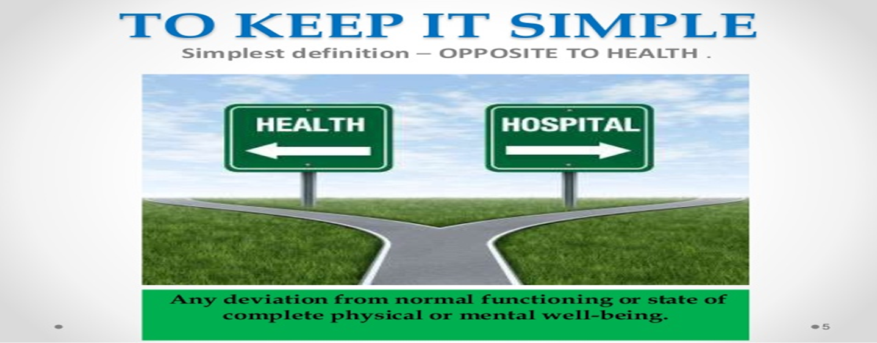
The simplest definition
disease = opposite of health.
= dis- ease = no ease
i.e. any deviation from normal functioning or state of complete physical or mental well – being.

Slide 30
Sickness
Illness
A state of social dysfunction. likes to remain away from social activities
a subjective state of person who feels aware of not being well with evident sign and symptoms.
Disease process
Disease
An objective state of physiological/ psychological dysfunction

Slide 31
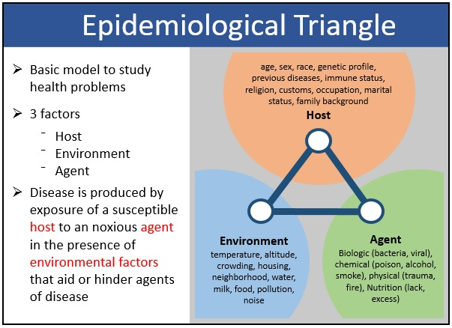

Slide 32
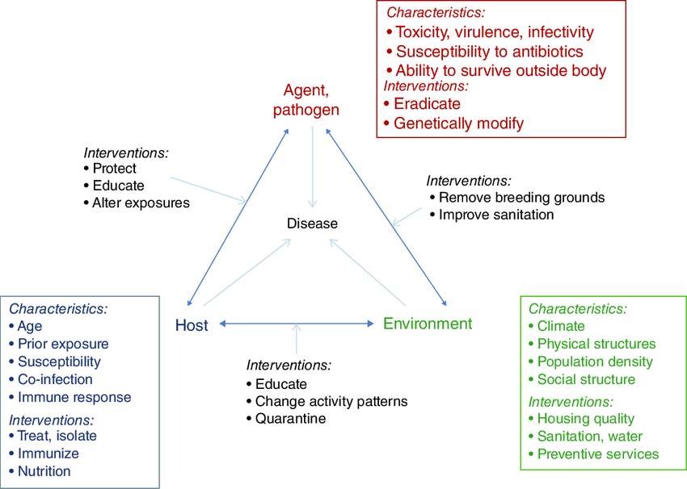

Slide 33
Changes in life style stress
Abundance lack of
Of food physical smoking emotional Aging
Exercise disturbances and other factors
Obesity
hypertension
Increased catecholamine
Thrombotic tendency
Hyperlipidemia changes in walls of arteries
Coronary atherosclerosis Coronary occlusion
Myocardial ischemia
Myocardial infarction
Multiple
causation
and web of
causation

Slide 34
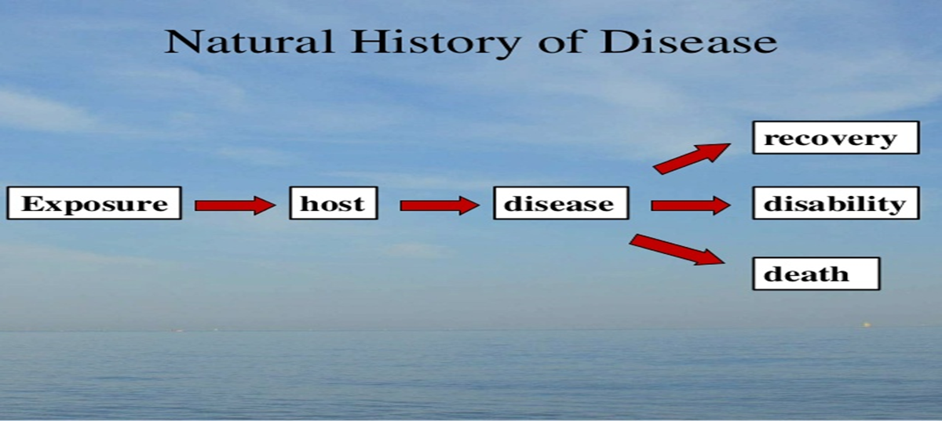
Natural History of Disease
Complex interaction between man, an agent & environment Disease
The way in which a disease evolves over time from the earliest stage of its pre-pathogenesis phase to its termination as :

Slide 35
Natural history of diseases
The Natural history of the diseases consists of
three phases
*Pre– pathogenesis (i.e. the process in the environment).
*Pathogenesis (i.e. the process in man). e.g. infections
disease.
*Termination phase the disease result into Recovery or Death or Disability.

Slide 36
Pathogenesis phase:
begins with the entry of the disease '' agent "in the susceptible human host.
Early pathogenesis phase there are tissue and physiological changes, but no symptoms and signs of the disease. At this phase early diagnose of the disease and proper management are needed (secondary level of prevention) to prevent the occurrence of disease's complications (acute & chronic).
After the early pathogenesis phase, Clinical symptoms and signs of the disease occur, and the disease well advanced in to the late pathogenesis, disability limitation and rehabilitation (tertiary prevention) are needed.

Slide 37
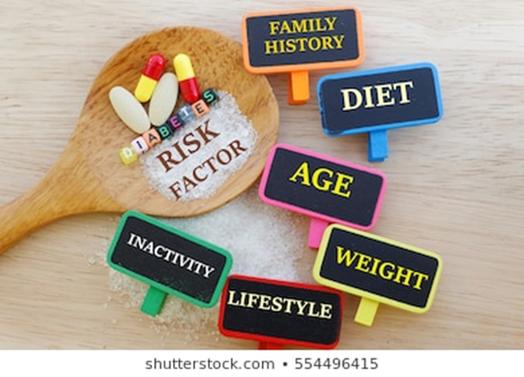
Risk Factors
is an exposure that significantly associated with the development of a disease.
*Risk Factors are often suggestive, but absolute proof of cause and effect between risk factors and disease is usually lacking.
*Presence of risk factors does not imply that disease will occur , & its absence – disease will not occur.

Slide 38
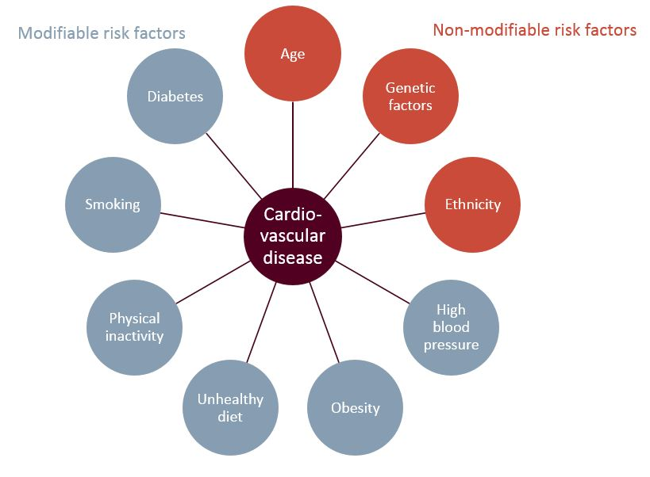

Slide 39
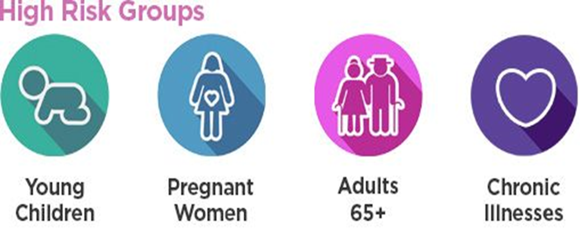
Risk groups
WHO considers the following groups to be vulnerable:
children, pregnant women, elderly people, malnourished people, ..etc
WHO developed & promoted approach to identify risk groups / target groups in the population by certain defined criteria & direct appropriate action to them first risk approach.

Slide 40
Thank you

Slide 41
Concept of control
Dr. Amina Elsaid
Community Medicine

Slide 42

Concepts of control describes (ongoing) operations aimed at reducing:
(i) The incidence of disease.
(ii) The duration of disease, and consequently the risk of transmission.
(iii) The effects of infection/ disease/ health related event, including both the physical and psychosocial complications.
(iv) The financial burden to the community.

Slide 43
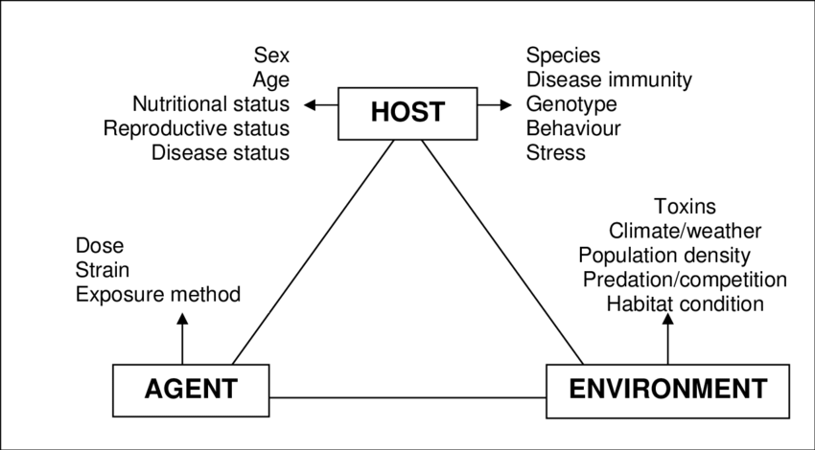
In disease control, "agent" is permitted to persist in the community at level where it ceases to be a public health problem according to the tolerance of the local population.
a stale of equilibrium

Slide 44
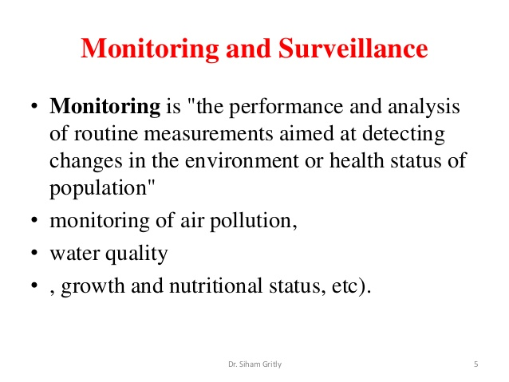

Slide 45
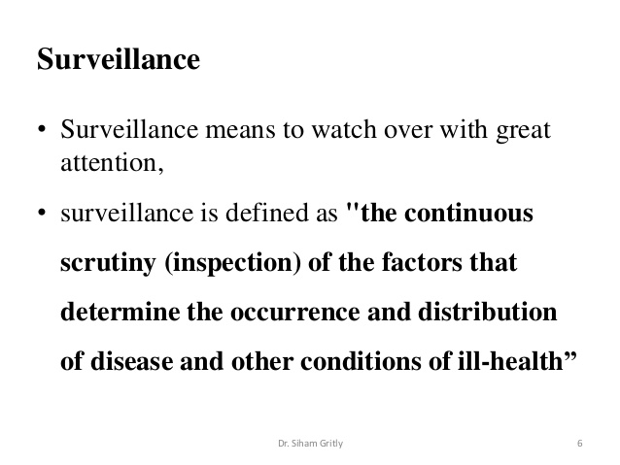
Notes:
Monitoring and surveillance

Slide 46
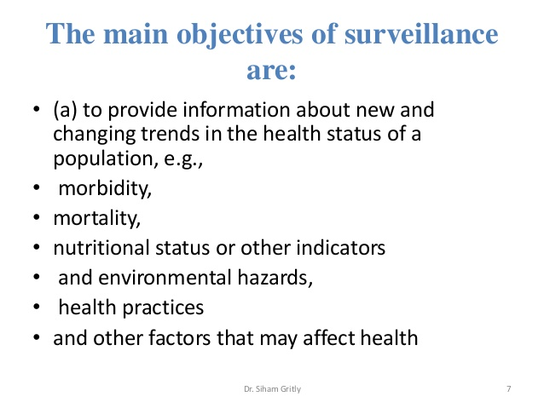

Slide 47
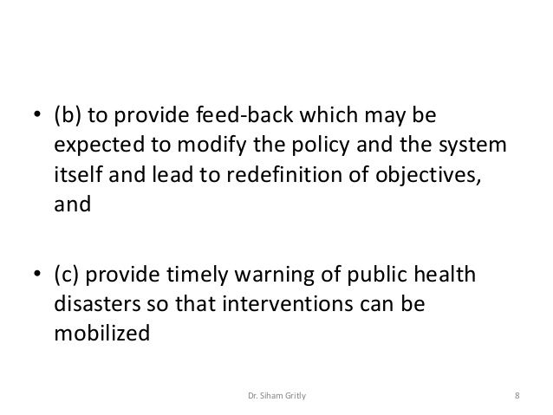

Slide 48
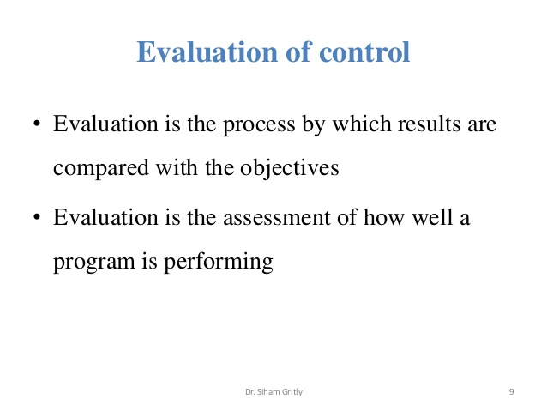

Slide 49
Thank you

Slide 50

Concepts of prevention
Dr. Amina Elsaid
Community Medicine

Slide 51
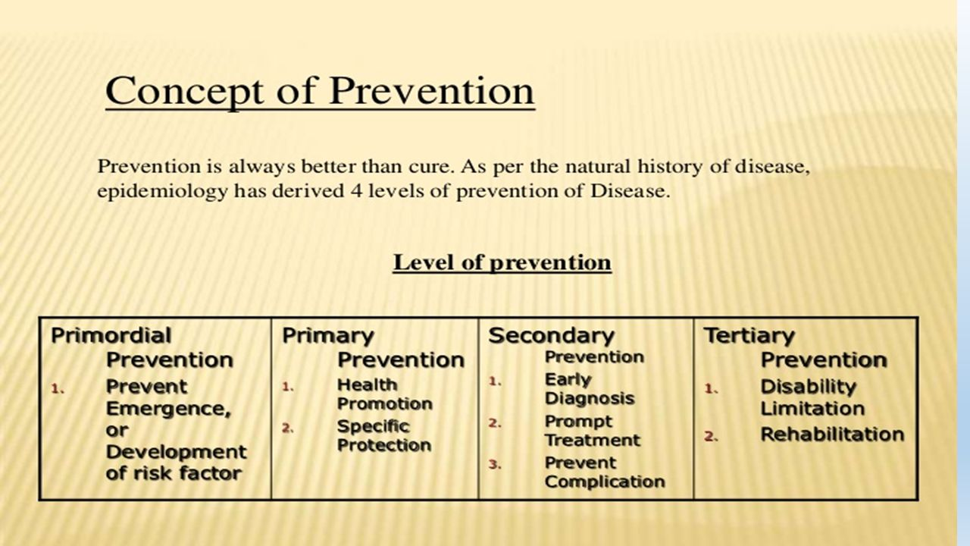
Concept of prevention
Definition
Actions aimed at eradicating, eliminating or minimizing the impact of disease and disability,

Slide 52
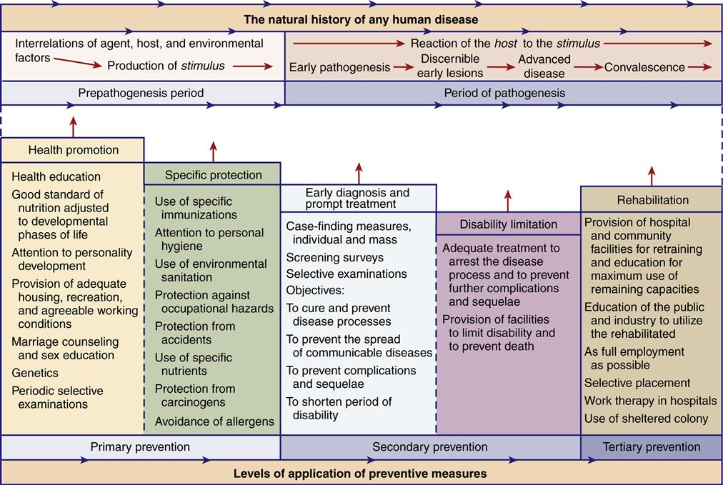

Slide 53
Approaches for primary prevention:
WHO has recommended the following approaches for the primary prevention of chronic disease:
a) Population (mass) strategy.
- It is directed at the whole population irrespective of individual risk levels.
The population approach is directed towards socio – economic, behavioral and lifestyle changes.
b) High-risk strategy.
It aims to bring preventive care to individuals at special risk.
This requires detection of individuals at special risk by the optimum use of clinical methods.

Slide 54
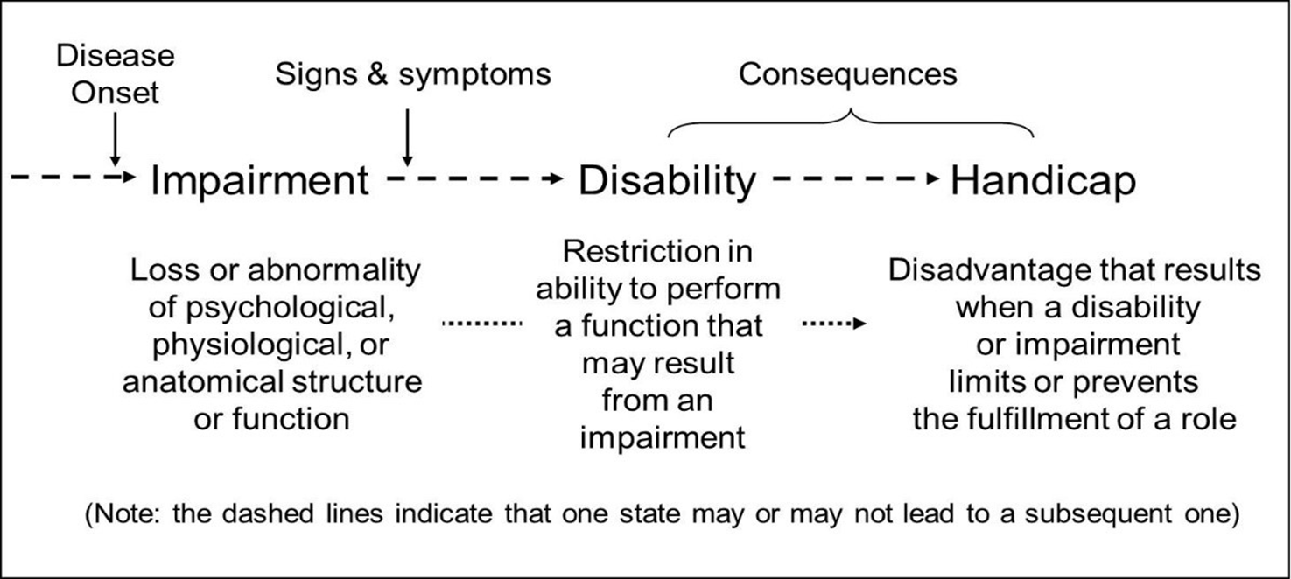
Disability Limitation
The objective of this intervention is to prevent the transition of the disease process from impairment to handicap.

Slide 55
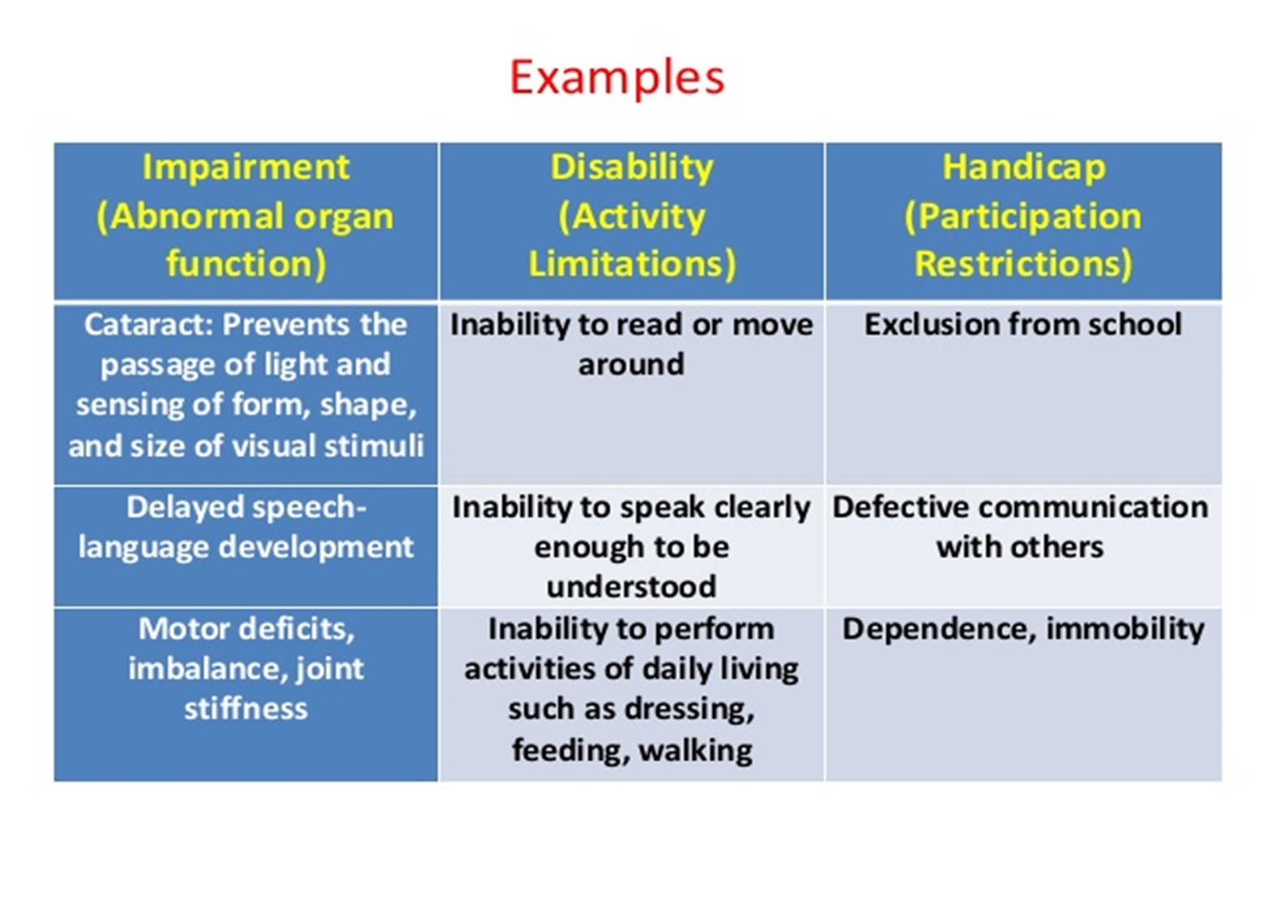

Slide 56
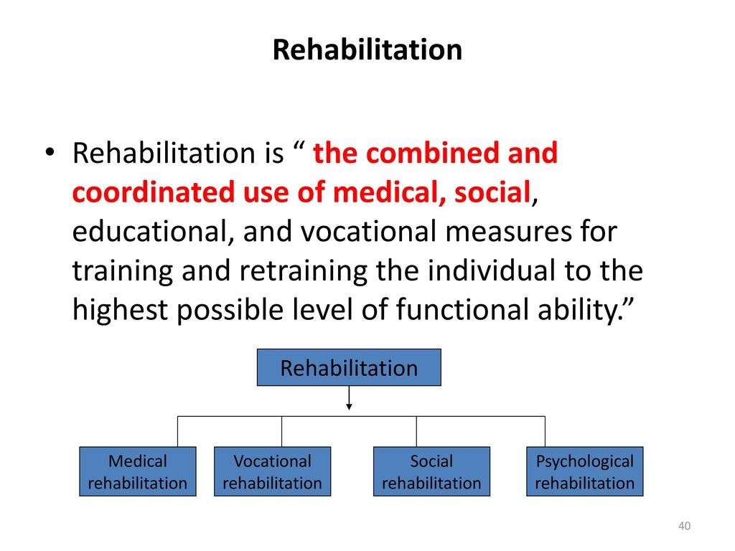
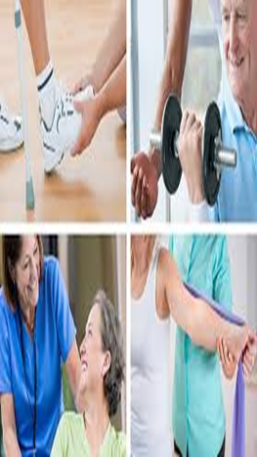

Slide 57
Thank you

