Slide 1
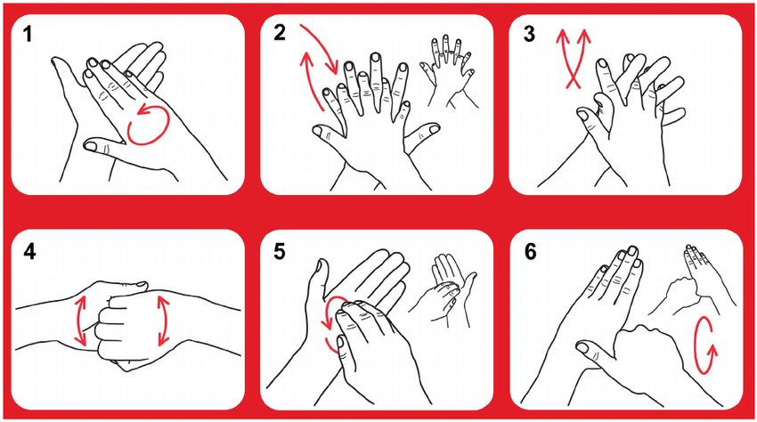
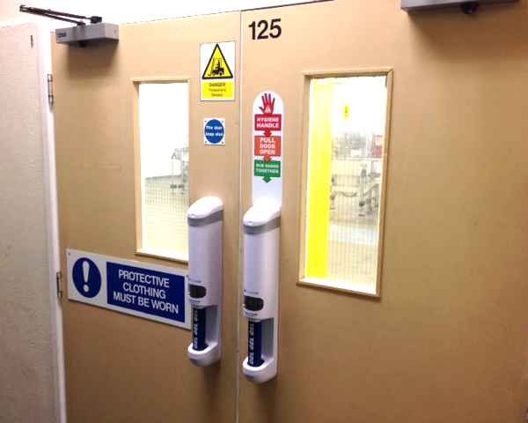
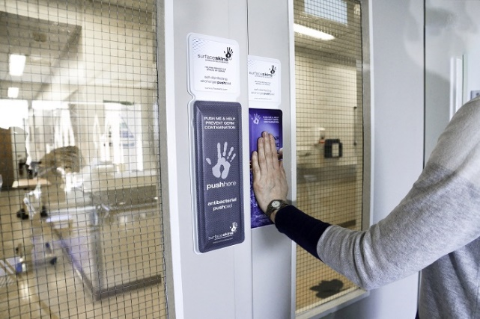

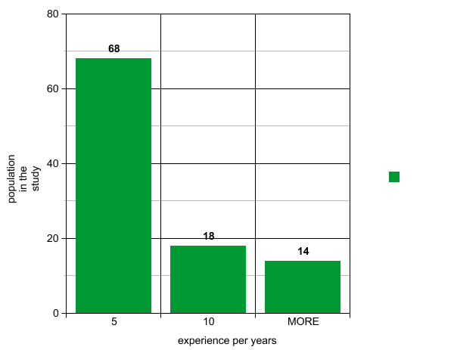
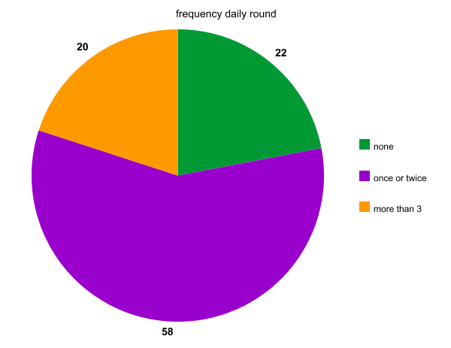
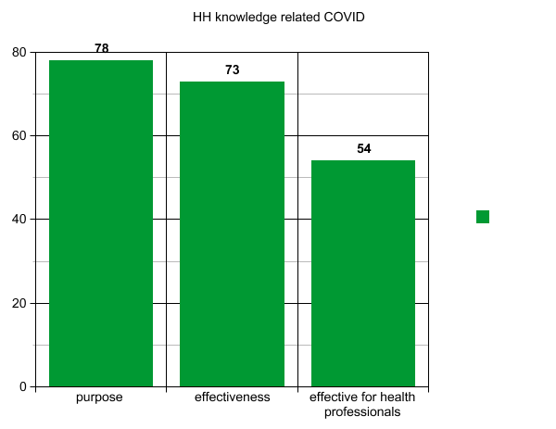
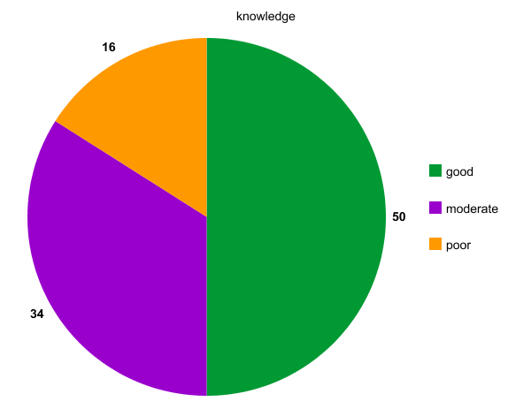
Awareness of Hand Hygiene Among physicians at Benghazi Medical Center during COVID-19 Pandemic. A cross sectional study
By: Dr. Khaled D Alsaeiti . Sanad M A Benali 237
Abstract
The aim of the current study is to describe the physicians knowledge and practice regarding HH and their compliance to that during their daily round.
Introduction
Hygiene according to WHO refers to conditions and practices that help to maintain health and prevent the spread of diseases.
Medical hygiene therefore includes a specific set of practices associated with this preservation of health,
Hands of the physicians play a significant role in the transmission of nosocomial infections(2)
in usual situations before COVID-19 pandemic physicians wash their hands less than half of the times they should (4).
When is HH most needed?
When should we use gloves?
Conclusion:
Hand hygiene is an important tool for the prevention of COVID19 pandemic. The overall knowledge and practice of hand hygiene were moderate to good among study subjects and few numbers of physicians had attended formal training about hand hygiene in the last three years. These findings indicate that our physicians require increased emphasis on hand hygiene.
Materials and method:
A cross-sectional study of 100 participants was conducted among physicians working at Benghazi Medical Center during May 2020. Verbal consent was taken from the participating physicians working in the medical department
WHO’s hand hygiene questionnaire for healthcare workers
A self designed questionnaire for the practice assessment reviewed by the infection control team BMC
References
2.Kampf G, Kramer AJCmr. Epidemiologic background of hand hygiene and evaluation of the most important agents for scrubs and rubs. 2004;17(4):863-93
Centre for Disease Control and Prevention. (2016). HH in healthcare
results

