Slide 1
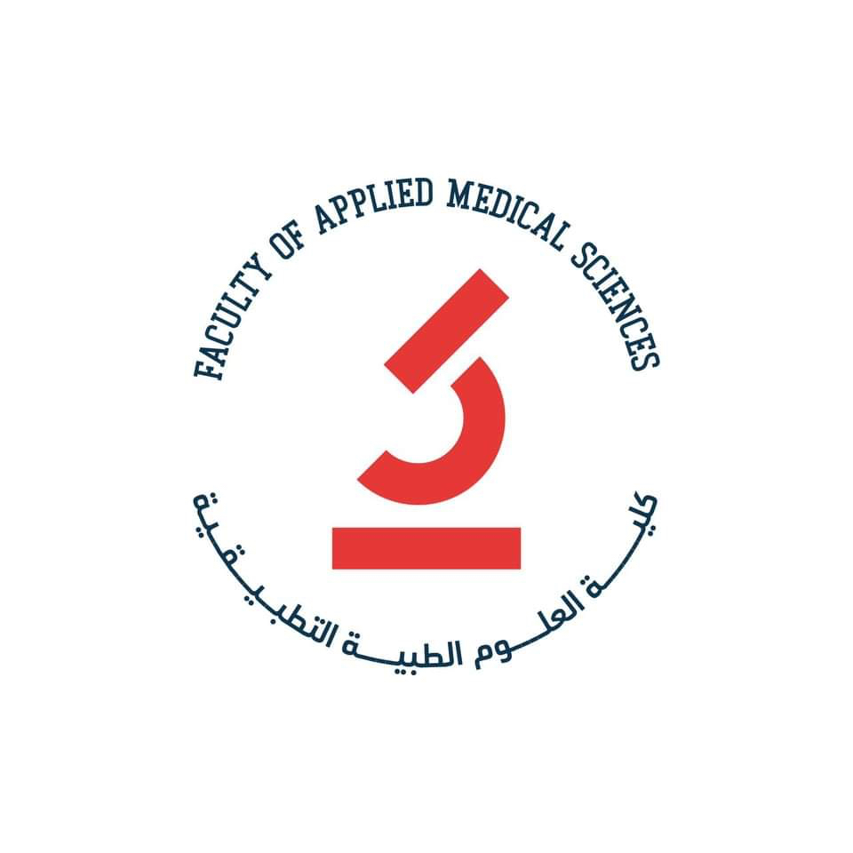

THREAT OF antimicrobial resistance
Tuberculosis Drug Resistance
name mabrouka Ramadan
Student number 2342

Slide 2
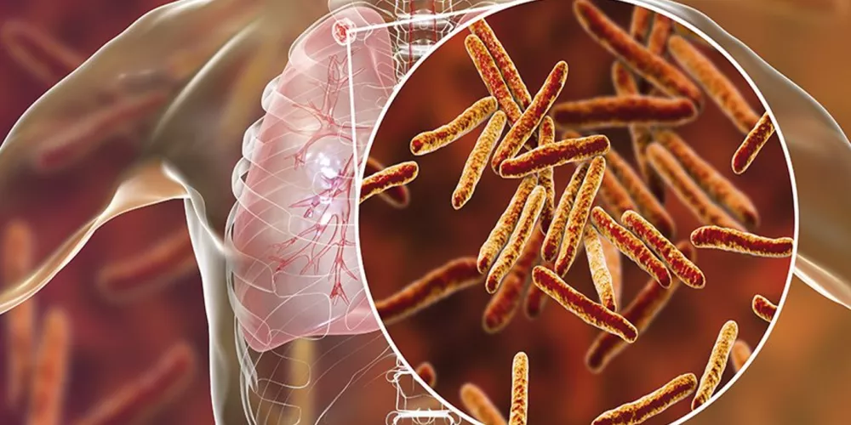
Introduction

Slide 3
OBJECTIVES
Introduction
Define Tuberculosis Drug Resistance
Outline types of Tuberculosis Drug Resistance
List Causes of Tuberculosis Drug Resistance
How to Prevent Tuberculosis Drug Resistance
How to treat Tuberculosis Drug Resistance

Slide 4
introduction
Tuberculosis (TB) is a disease caused by bacteria that are spread from person to person through the air. TB usually affects the lungs, but it can also affect other parts of the body, such as the brain, the kidneys, or the spine.
In most cases, TB is treatable and curable; however, people with TB can die if they do not get proper treatment.
Sometimes drug-resistant TB occurs when bacteria become resistant to the drugs used to treat TB

Slide 5
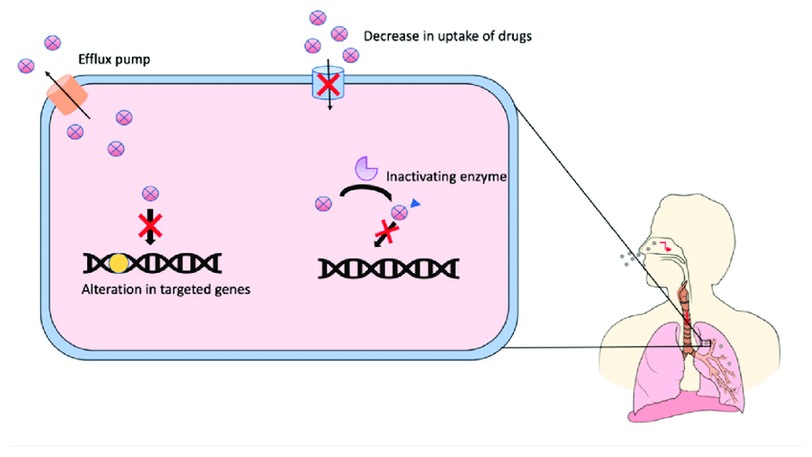
tb Drug Resistance
Multidrug-resistant TB (MDR TB) is caused by TB bacteria that are resistant to at least isoniazid and rifampin, the two most potent TB drugs. These drugs are used to treat all persons with TB disease.

Slide 6
Pre-Extensively Drug-resistant TB
Pre-Extensively Drug-resistant TB (pre-XDR TB) is a type of MDR TB caused by TB bacteria that are resistant to isoniazid, rifampin, and a fluroquinolone OR by TB bacteria that are resistant to isoniazid, rifampin, and a second-line injectable (amikacin, capreomycin, and kanamycin).

Slide 7
Extensively Drug-resistant TB (XDR TB)
Extensively drug-resistant TB (XDR TB) is a rare type of MDR TB caused by TB bacteria that are resistant to isoniazid and rifampin, a fluroquinolone, and a second-line injectable (amikacin, capreomycin, and kanamycin) OR by TB bacteria that are resistant to isoniazid, rifampin, a fluroquinolone, and bedaquiline or linezolid.

Slide 8
causes of drug resistance
Drug-resistant TB can occur when the drugs used to treat TB are misused or mismanaged. Examples of misuse or mismanagement include
People do not complete a full course of TB treatment
Health care providers prescribe the wrong treatment (the wrong dose or length of time)
Drugs for proper treatment are not available
Drugs are of poor quality

Slide 9
Drug-resistant TB is more common in people who
Do not take their TB drugs regularly
Do not take all of their TB drugs
Develop TB disease again, after being treated for TB disease in the past
Come from areas of the world where drug-resistant TB is common
Have spent time with someone known to have drug-resistant TB disease

Slide 10
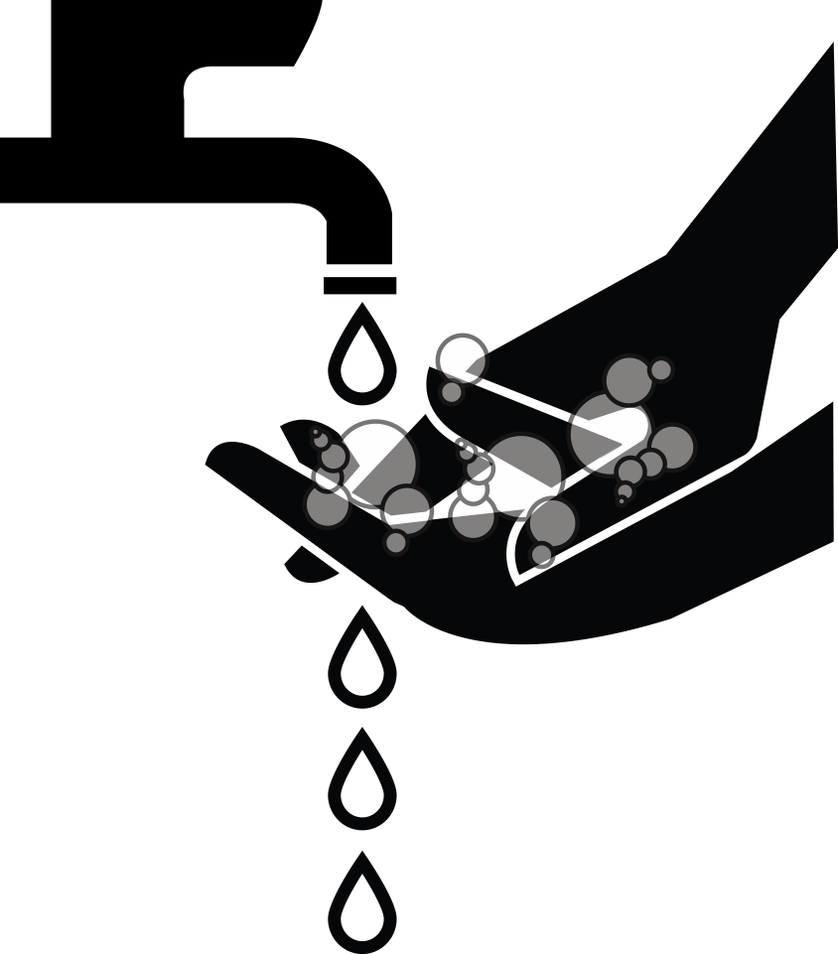
PREVENTION
The most important way to prevent the spread of drug-resistant TB is to take all TB drugs exactly as prescribed by the health care provider.
No doses should be missed and treatment should not be stopped early.
Another way to prevent getting drug-resistant TB is to avoid exposure to known drug-resistant TB patients in closed or crowded places such as hospitals, prisons, or homeless shelters

Slide 11
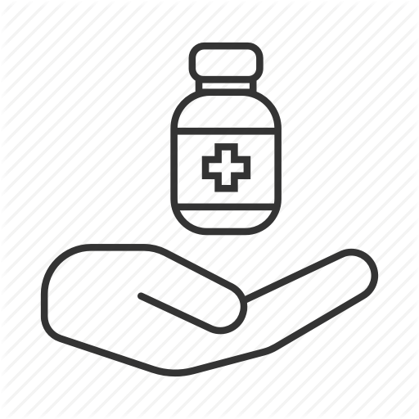
TREATMENT
Treating and curing drug-resistant TB is complicated. Inappropriate management can have life-threatening results. Drug-resistant TB should be managed by or in close consultation with an expert in the disease.
fluoroquinolone antibacterial drugs are absolutely necessary for some patients who have drug-resistant TB disease or drug-resistant latent TB infection or who cannot tolerate first-line TB drugs.

Slide 12
Summary
Antibiotics that have become critical for human health should be clearly identified and their use restricted to humans only in order to avoid cross-resistance.

Slide 13
references
1. The threat – Antibiotic resistance – ReAct [Internet]. ReAct. 2022 [cited 16 May 2022]. Available from: https://www.reactgroup.org/antibiotic-resistance/the-threat/
Shallcross L, Howard S, Fowler T, Davies S. Tackling the threat of antimicrobial resistance: from policy to sustainable action. 2022.

