Slide 1



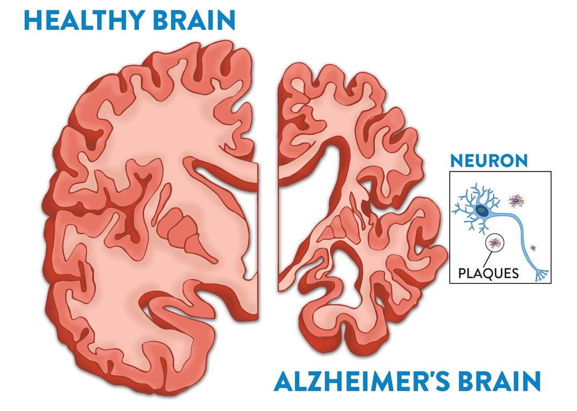
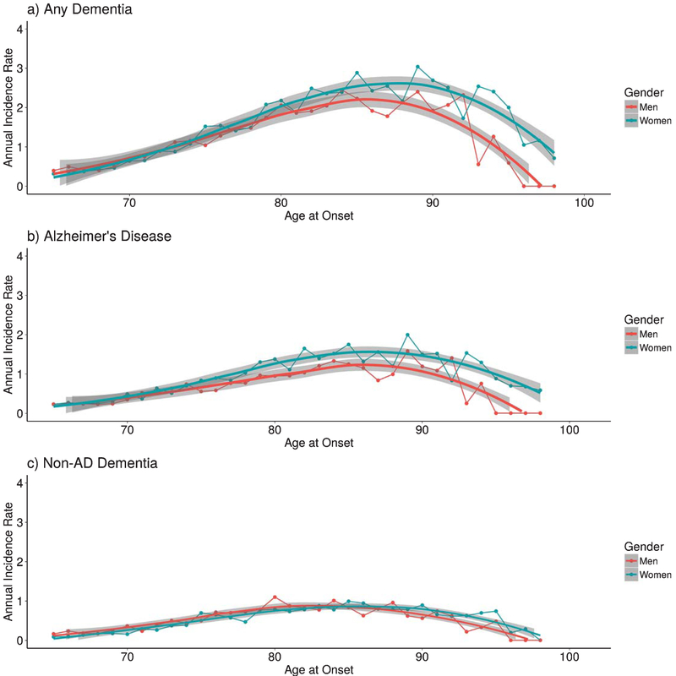
Alzheimer's & Women: Why us ??
Dr. Tala S. Alaujali - 769
Dr. Raghda A. Al-Sharif - 1029
Dr. Lina S. Shueb – 1058
Libyan International Medical University - Faculty of Medicine
Introduction :
Risk Factors:
Neuropathology mechanism:
After advanced age, female sex is the major risk factor for late-onset Alzheimer’s Disease. Women compose about two thirds of AD dementia patients; postmenopausal women account for more than 60% of affected individuals.
Also, women at the age of 60 are twice more likely to develop AD than breast cancer .
Previously, the higher proportion of women affected by AD was attributed to their longer life expectancy relative to men, but several emerging lines of evidence point to sex- and gender-specific AD risk factors, such as :
Genetic risks (family history & APOE genotype),
Medical conditions ( depression, stroke, and diabetes mellitus),
Hormone-related risks (menopause and thyroid disease) and
Lifestyle factors (smoking, diet, exercise, and intellectual activity).
The neurotoxic Aβ peptide from sequential amyloid precursor protein (APP) proteolysis is the crucial step in the development of AD. APP is a single-pass trans-membrane protein expressed at high levels in the brain and metabolized in a rapid and highly complex fashion by a series of sequential proteases, including the intra-membranous γ-secretase complex.
New Research Theories:
Decrease in estrogen level is involved in the AD biomarker abnormalities in women. The pattern of gray matter loss in particular shows anatomic overlap with the brain estrogen network, which includes estrogen receptors widely found in, among other regions, the prefrontal cortex, hippocampus, amygdala, and posterior cingulate cortex.
Mitochondria from young females are protected against amyloid-beta toxicity, generate less reactive oxygen species, and release less apoptogenic signals than those from males. Since estrogenic compounds protect against mitochondrial toxicity of amyloid-beta, all this advantage is lost in mitochondria from old females.
Alzheimer’s-related protein tau spreads in the brain like an infection, moving from neuron to neuron and turning other proteins into abnormal tangles that result in the death of brain cells. Structure of tau networks is different in both genders, having a larger number of "bridging regions" in women that connect various areas of the brain. This may enable tau to spread more easily between brain regions, increasing the speed at which it accumulates and putting women at greater risk for Alzheimer's disease.
Conclusion:
We now have some serious biomarkers that indicate this is a phenomenon we need to understand; the hormonal environment that influences AD. Identifying the mechanism by which this occurs would be an important step in developing new treatments.. As such, more experiments and clinical trials are warranted to find conditions in which estrogenic compounds may be useful to prevent or treat AD, without potential side effects.
References:
Differences Between Women and Men in Incidence Rates of Dementia & Alzheimer’s Disease; Christopher R. Beam,^{a,*} Cody Kaneshiro,^{a,1} Jung Yun Jang,ª Chandra A. Reynolds,^{b} Nancy L. Pedersen,^{a,c} and Margaret Gatz^{a,c}
https://pubmed.ncbi.nlm.nih.gov/20442496
https://www.alzheimers.net/8-12-15-why-is-alzheimers-more-likely-in-women
https://www.webmd.com/alzheimers/news/20190717/clues-to-why-women-have-higher-odds-for-alzheimers

