Slide 1
Joint disease
Dr.Nadeia Elbagermi

Slide 2
Plain film radiographs
The plain film examination remains important for imaging
joint disease .

Slide 3
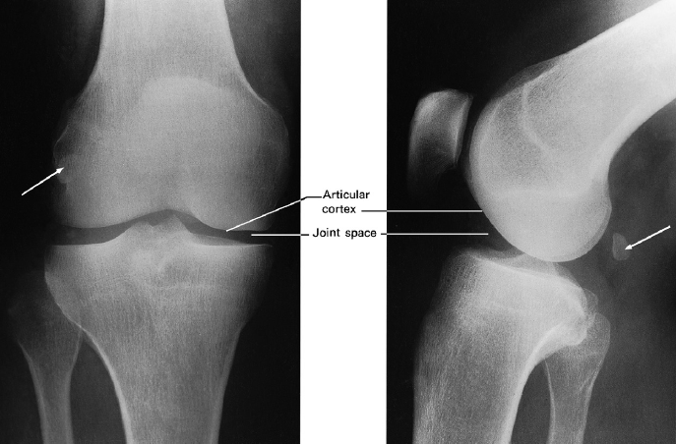

Slide 4
Magnetic resonance imaging
Magnetic resonance imaging (MRI) is widely used for joint
imaging. It is widely used for:
• meniscal and ligamentous tears (e.g. in the knee)
• rotator cuff tears of the shoulder.
Normal tendons are clearly defined, smooth and return
no signal and therefore appear black on MRI sequences.

Slide 5
Arthrography
Arthrography involves injecting contrast medium into the joint space directly and then performing magnetic resonance.

Slide 6
Ultrasound
Ultrasound is used to image the soft tissues of joints and is
also used to inject local anesthetic and steroid solutions
to treat inflammatory conditions.

Slide 7
Diagnosis of arthritis
When considering an arthritis it is important to have the
following information:
1- Is more than one joint involved? Certain diseases typically
involve several joints, e.g. rheumatoid arthritis, while
others rarely do, e.g. infections and synovial tumors.

Slide 8
2 Which joints are involved? Many arthropathies have a predilection
for certain joints and spare others:
• Rheumatoid arthritis virtually always involves the hands
and feet, principally the metacarpo- and metatarsophalangeajoints, the proximal interphalangeal joints and the wrist joint.
Psoriatic arthritis usually affects the terminal interphalangeal joints.
• Gout characteristically involves the metatarsophalangeal
joint of the big toe.

Slide 9
Rheumatoid arthritis
Rheumatoid arthritis is a polyarthritis caused by The overgrowth of synovium known as pannus.
earliest change is periarticular soft tissue swelling and osteoporosis.
This osteoporosis is believed to be due to a combination of disuse and synovial hyperemia.

Slide 10
Destruction of the articular cartilage by pannus leads toi joint space narrowing and to small bony erosion which occur initially, at the joint margins .
These erosions are often seen first around the metatarso- or metacarpophalangeal joint , proximal interphalangeal joints and
the styloid process of the ulna. Later, extensive erosions may disrupt joint surface. Ulnar deviation is usually present at this stage
.

Slide 11
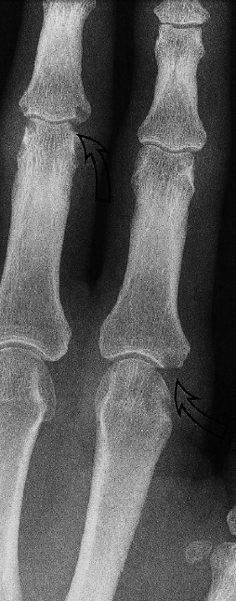
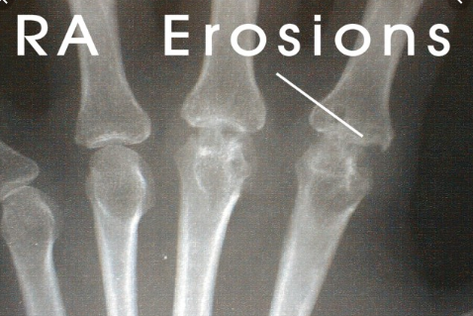

Slide 12
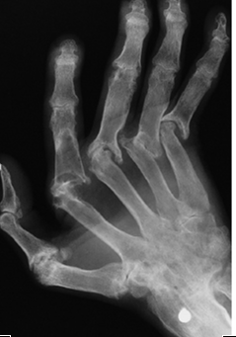

Slide 13
Gout
In gout, the deposition of urate crystals in the joint and in the adjacent bone gives rise to an arthritis that most commonly affects the metatarsophalangeal joint of the big toe.
The earliest change is soft tissue swelling. At a later stage, erosions occur that, unlike rheumatoid arthritis, may be at a distance from the articularcortex .
.

Slide 14
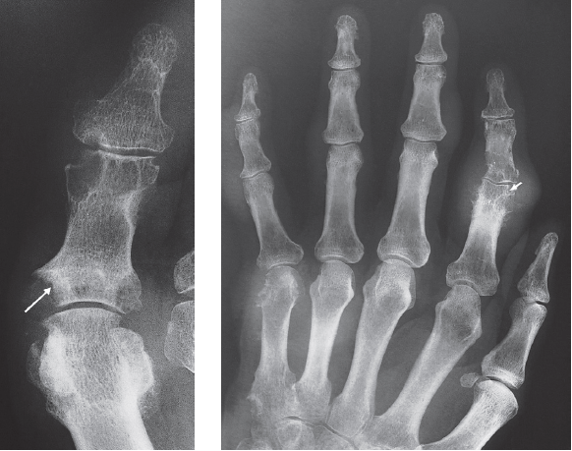

Slide 15
Ankylosing spondylitis
Ankylosing Spondylitis (AS) is an inflammatory process,
which causes sclerosis and fusion of the SI joints (sacroiliitis) Erosion and ankylosis of the sacroiliac joints are the hallmarks of AS characteristically bilateral and symmetrical
The vertebrae become bridged by ligamentous calcifications(syndesmophytes), which gives a bamboo stick appearance to the spine

Slide 16
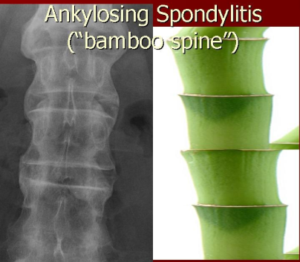
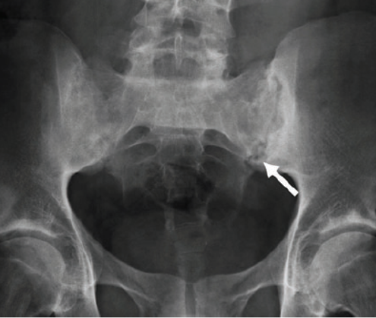

Slide 17
Osteoarthritis
Osteoarthritis is the commonest form of arthritis.
In osteoarthritis, a number of features can usually be
seen :
- Joint space narrowing.
-Osteophytes.
-Subchondral sclerosis usually occurs on both sides of the joint; it is often worse on one side.
-Subchondral cysts may be seen beneath the articular
cortex, often in association with subchondral sclerosis.
-Loose bodies.

Slide 18
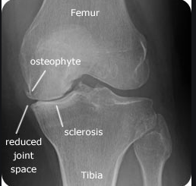
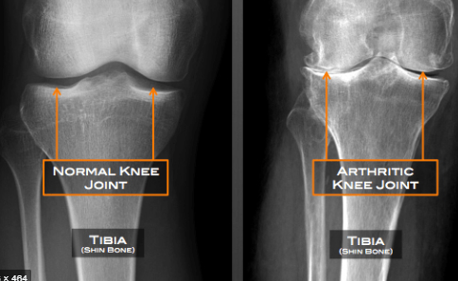
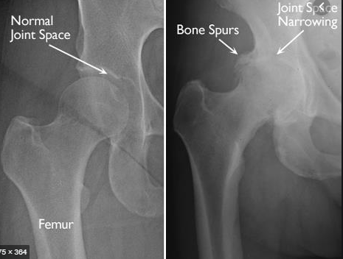

Slide 19
Joint infections
Joint infection is most often due to pyogenic bacterial infection
or tuberculosis.
Usually only one joint is affected.
Synovial biopsy or examination of the joint fluid is necessary
in order to identify the infecting organism

Slide 20
Internal derangement of the knee
.
Menisci
The menisci, which are composed of fibrocartilage, are well
demonstrated on MRI.
The normal menisci are of uniform low signal on all sequences and have the appearance on sagittal images described as a ‘bow tie
Tear can be recognized as a break in the meniscus
disrupting the articular surface and allowing synovial
fluid, which has a higher signal intensity, to enter the substance of the meniscus
Meniscal high signal not disrupting the articular surface are caused by intra substance degeneration

Slide 21
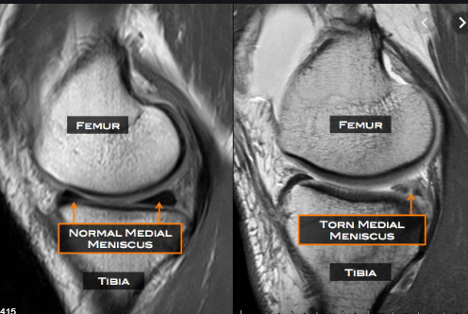
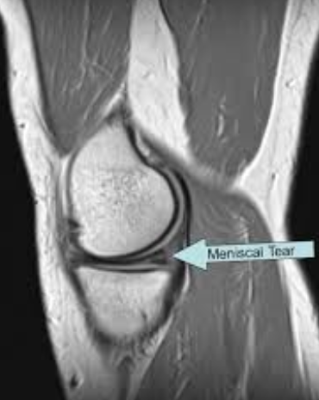
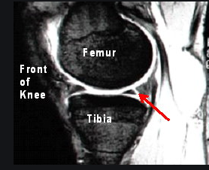

Slide 22
Supraspinatus tendon tears
Of the four muscles, the supraspinatus is the one that most
commonly causes significant clinical problems. Tears of the
supraspinatus tendon are thought to be due to impingement
between the acromion and greater tuberosity of the
humours, and can lead to acute or chronic symptoms. MRI
and/or ultrasound) can be useful.

Slide 23
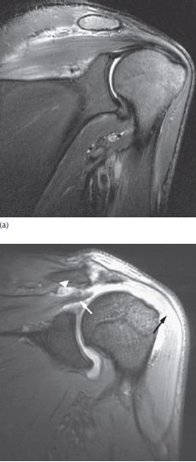

Slide 24
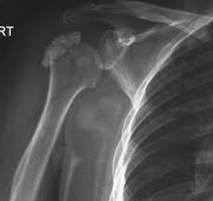
Calcific tendonitis
Calcification occurs in the periarticular regions and is most
commonly seen in the shoulder, in the supraspinatus
tendon, as amorphous calcification adjacent to the greater
tuberosity of the humours .

Slide 25
THANK YOU

