Slide 1


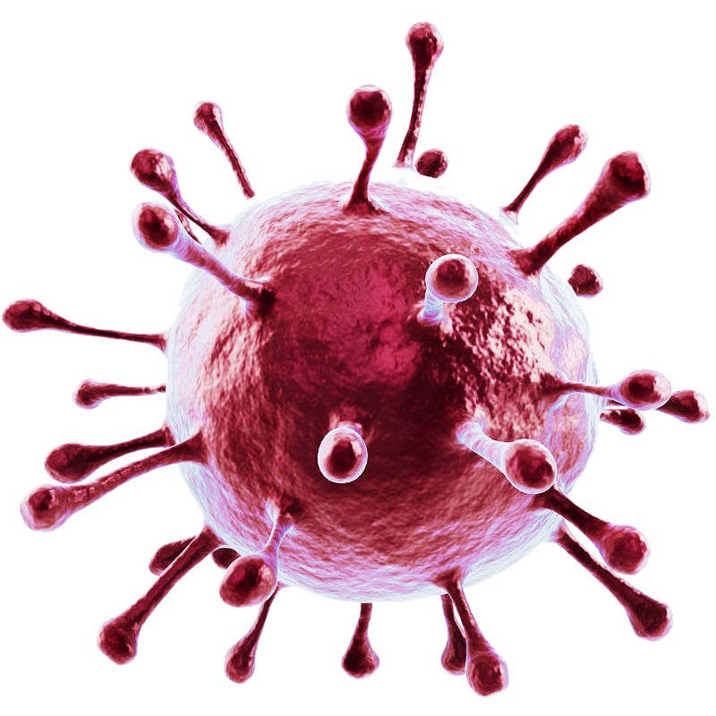
The impacts of COVID-19 on malaria
NAME : Arwa ahmed
STUDENT NO. :2688
BLOCK : PTS
DATE : 16/5/2022

Slide 2
Objectives :
01
02
03
04
Overview on malaria disease
Discuss the similarity between malaria infection and COVID-19
Describe relationship of COVID-19 Infection and malria with Age
Malaria prophylaxis approach during COVID-19 pandemic
05
The prevalence of COVID-19 in malaria-endemic countries
06
Outline prevention of both malaria and covid -19 infections
1

Slide 3
Malaria overview
2

Slide 4

Malaria is a severe disease by parasites belonging to Plasmodium species
Malaria affected an estimated 219 million people causing 435,000 deaths
Transmitted to humans by a bite of an infected female mosquito of the species Anopheles.
Malaria can last for three and
up to five years, if left untreated, and depending on the cause,
it may recrudesce
Malaria is the most common disease in Africa and some countries in Asia with the highest number of indigenous cases
3

Slide 5
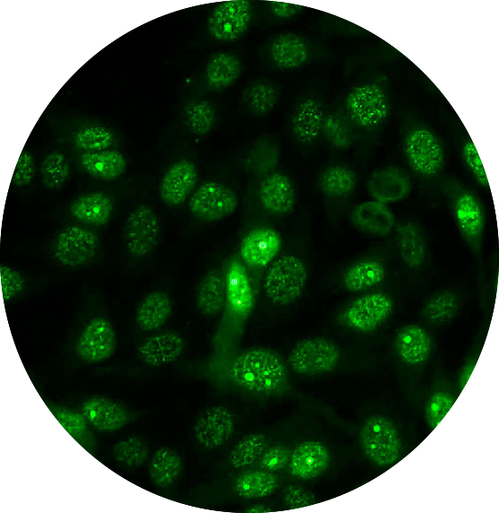
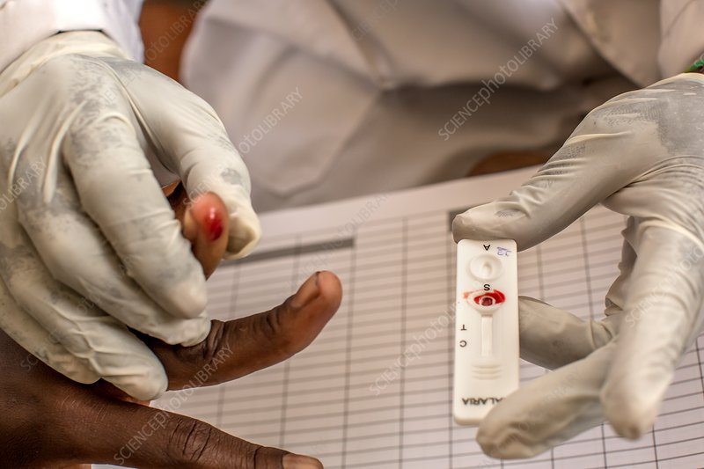
Diagnostic tests for proving malaria
Light microscopy of stained
blood films by Giemsa
2. immunofluorescence antibody testing (IFA).
3. Rapid Diagnostic Tests (RDT)
4

Slide 6
The similarity between malaria infection and COVID-19
5

Slide 7
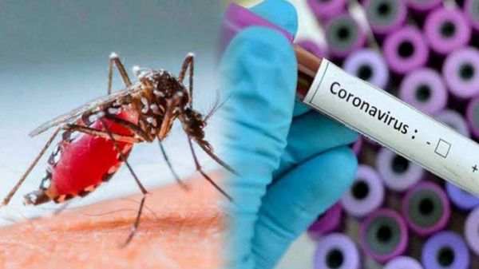
Currently, people with fever may be tested for COVID-19 and then sent home due to a negative result, ignoring the possibility of malaria. Overlooking a malaria case can lead to fatal malaria
The use of RT-PCR to detect covid-19nucleic acid in sputum or throat swabs and lower respiratory tract
Early symptoms
covid -19infection could be confused with symptoms of malaria, leading to problems in early clinical diagnosis, especially where malaria is endemic.
The gold standard diagnosis for malaria is the microscopic examination,
6

Slide 8
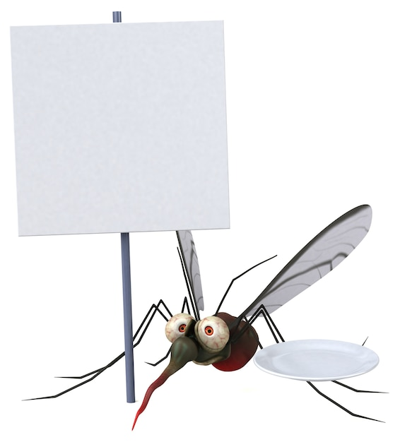
Can mosquitoes
transmit the new corona virus ??
7

Slide 9
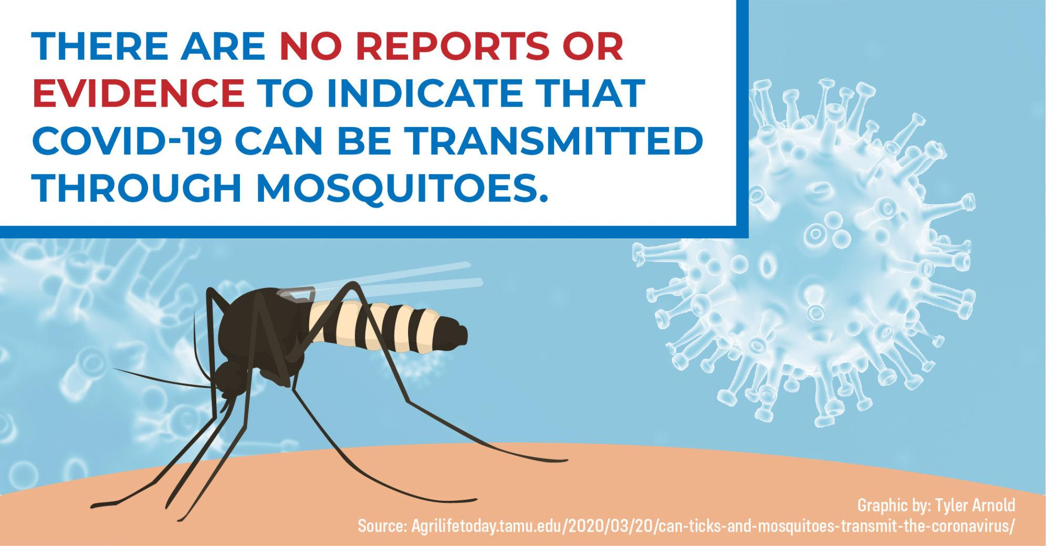
8

Slide 10
Relationship of COVID-19 Infection and malaria with Age
9

Slide 11

The COVID-19 mortality risk is highly focused at older ages, especially those 80 + years of age
For malaria, children, especially those under 5 years of age, are unfortunately the most affected age-group.
It is currently believed that covid-19 infection is less aggressive in children
The young COVID-19 patients are usually asymptomatic or have mild symptoms
As adults and elderly are more susceptible to infected with COVID-19 virus
10

Slide 12
Malaria prophylaxis approach during COVID-19 pandemic
11

Slide 13
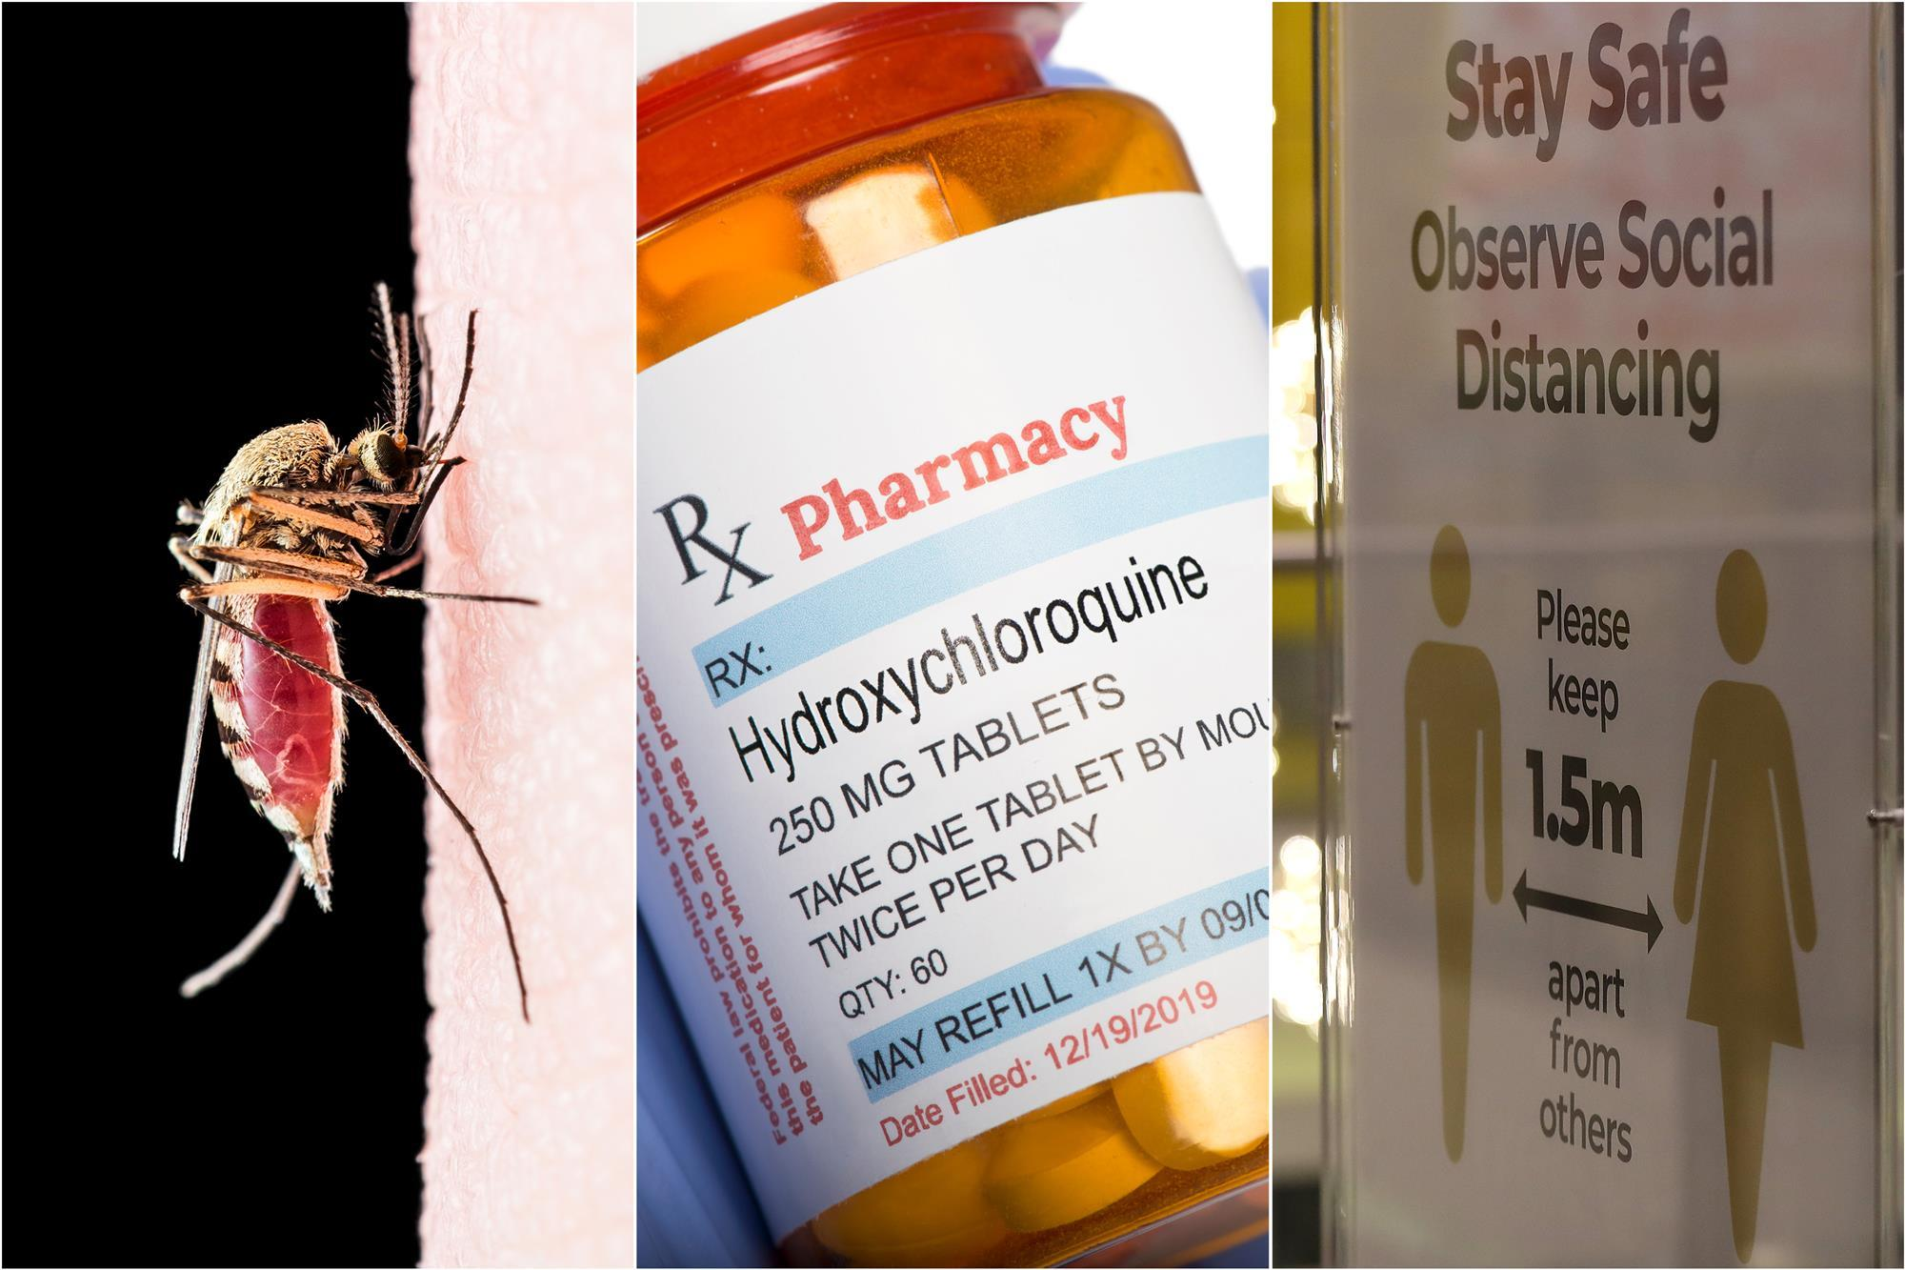
It is important to point out that malaria drugs chloroquine and hydroxychloroquine have the efficacy in the treatment of coronavirus diseases and that has been studied since the first SARS epidemic
Some old studies highlighted the importance of HCQ
in the management of SARS-COV2 and suggested
that 400 mg of HCQ per day for 10 days can be
used as an optimal regimen
Recent clinical studies have considered HCQ for
SARS-Cov-2 to be used at a dose of 400 mg twice
in the first day as a loading dose, followed by 200 mg
every 12 h for a period of 4 days
12

Slide 14
The prevealence of COVID-19 in malaria-endemic countries
13

Slide 15
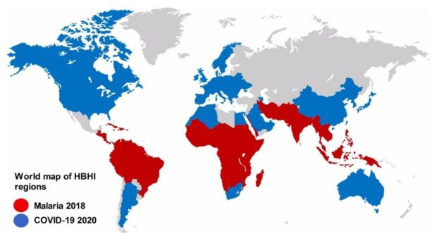
13
14

Slide 16
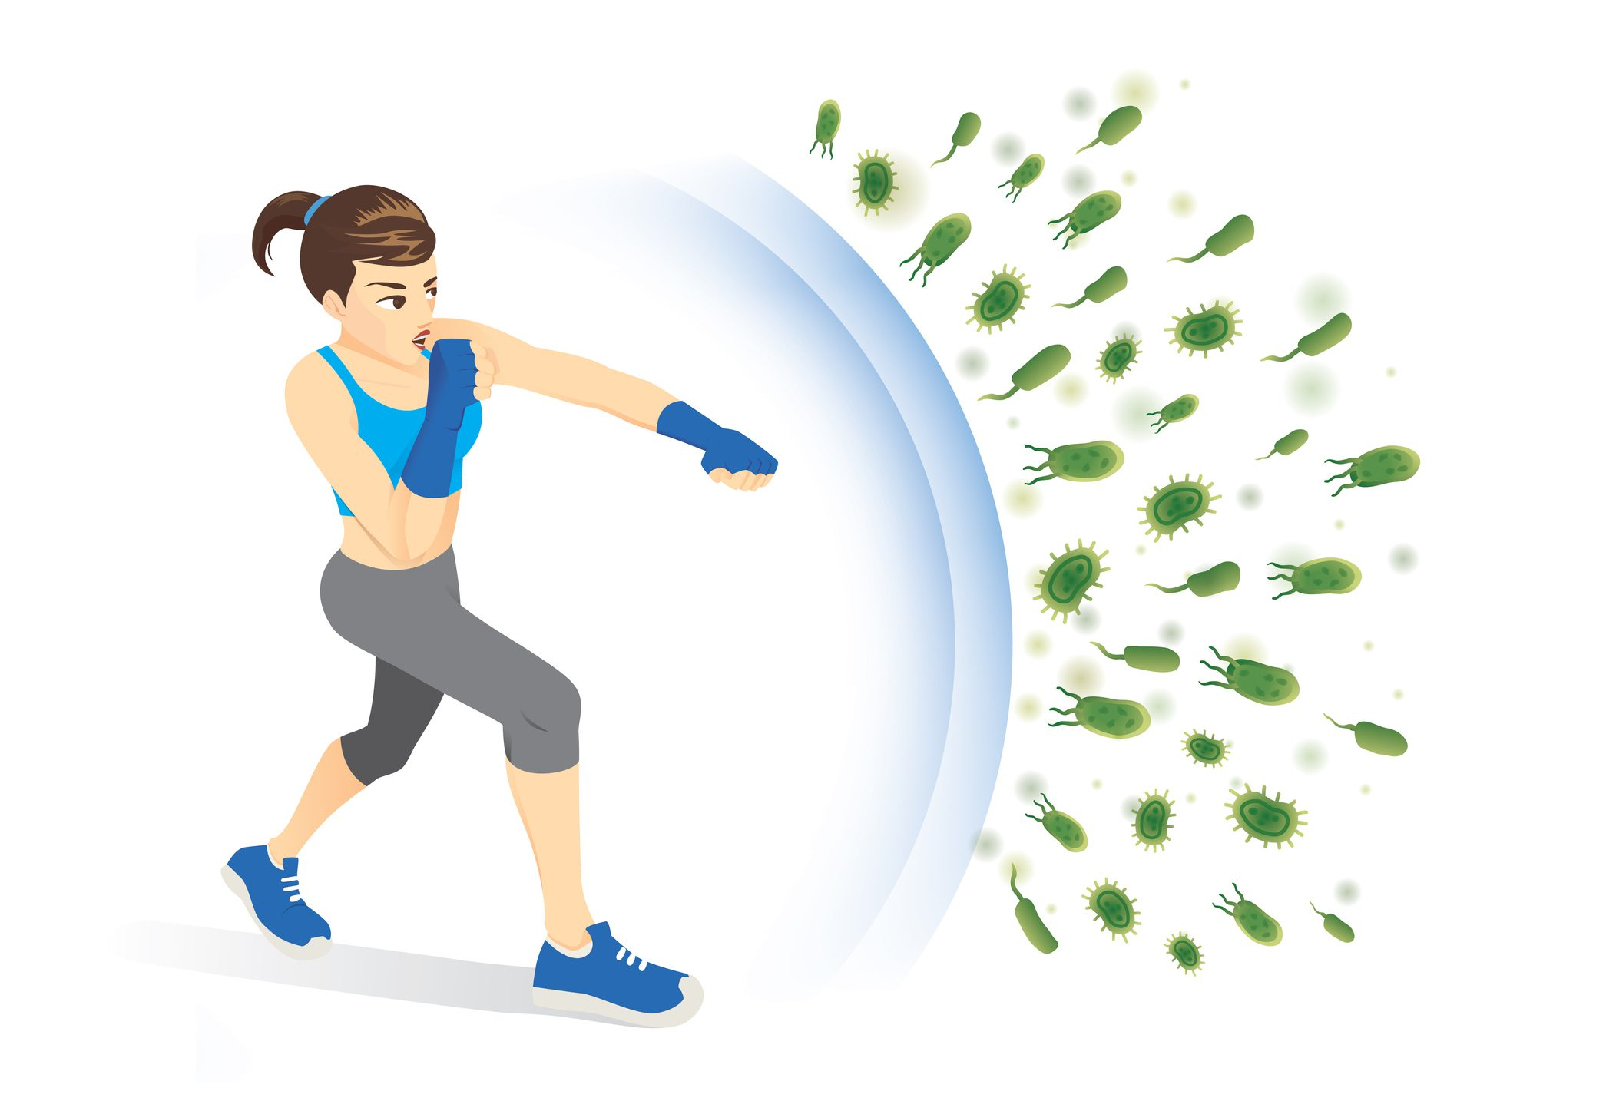
HOW TO IMPROVE YOUR IMMUNITY
1
Stay up-to-date on recommended vaccines
2
Maintain a healthy diet
3
Exercise regularly
4
Hydrate
5
Minimize stress
6
15
Get plenty of sleep

Slide 17
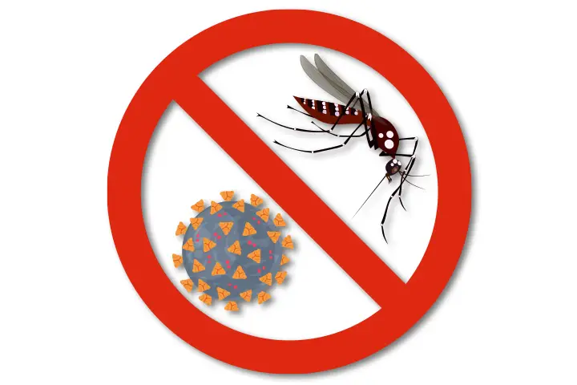
Prevention of malaria and covid -19 infections
16

Slide 18
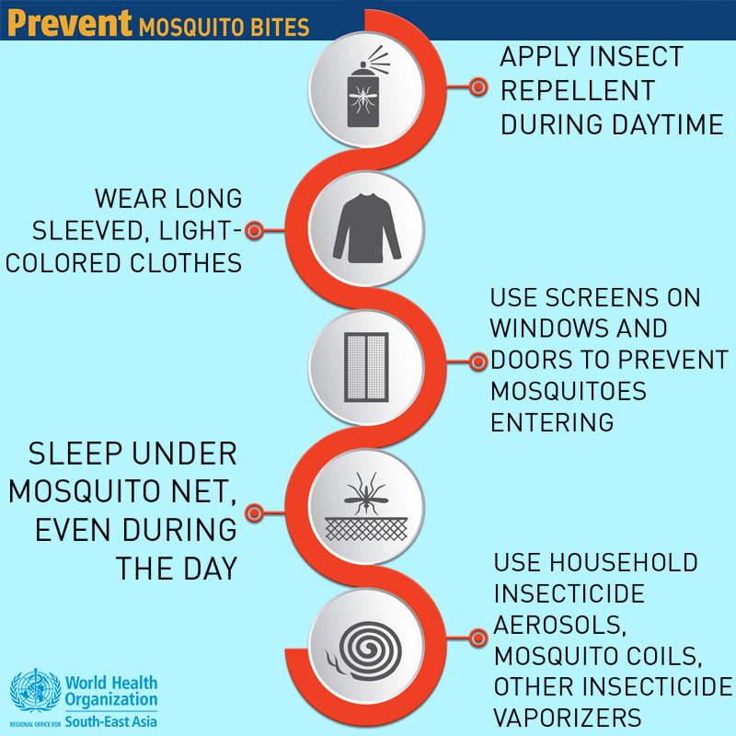
17

Slide 19
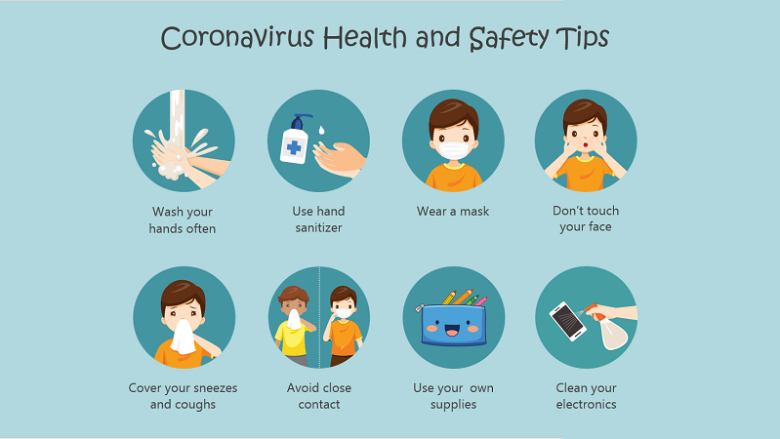
18

Slide 20
conclusion
Malaria is a severe disease caused by parasites of the Plasmodium species
For malaria it affects especially those under 5 years of age while covid-19 is less aggressive in children and affect adults and elderly people
Early symptoms of covid-19 infection such as fever, fatigue could be confused with symptoms of malaria
Malaria prophylaxis drugs being used as as active treatments against covid-19 virus.
19

Slide 21


Slide 22
References
Talapko, J., Škrlec, I., Alebić, T., Jukić, M., & Včev, A. (2019, June 21). Malaria: The past and the present. MDPI. Retrieved May 14, 2022, from https://www.mdpi.com/2076-2607/7/6/179/htm
Hussein, M. I. H., Albashir, A. A. D., Elawad, O. A. M. A., & Homeida, A. (2020, December 23). Malaria and COVID-19: Unmasking their ties - malaria journal. BioMed Central. Retrieved May 14, 2022, from https://malariajournal.biomedcentral.com/articles/10.1186/s12936-020-03541-w#Sec4
https://m.daily-bangladesh.com/english/Covid-19-or-dengue-–-how-to-differentiate/62707
https://www.dailytoreador.com/news/lack-of-evidence-disproves-covid-19-mosquito-transmission/article_d55bd8b8-7775-11ea-b78f-27d3adc6e2ff.html
https://blogs.biomedcentral.com/bugbitten/2021/02/05/is-the-low-incidence-of-covid-19-in-africa-due-to-co-infection-with-plasmodium-falciparum/
https://www.onemedical.com/blog/healthy-living/7-ways-to-prevent-mosquito-bites/
https://www.houstonmethodist.org/blog/articles/2020/mar/5-ways-to-boost-your-immune-system/
https://www.medpagetoday.com/infectiousdisease/covid19/85621
https://www.iforher.com/quotes/famous-people/23-dalai-lama-quotes-bring-peace-to-your-life/
https://www.publichealthmdc.com/blog/a-message-of-thanks-from-public-health-madison-dane-county
22

Slide 23

23

Slide 24

24

