Slide 1



The Bases of Market Segmentation
Libyan International Medical University
BY: Marwan Fouad Abed Eloshipi
ID: 3782
EMAIL: marwan_3782@limu.edu.ly

Slide 2
TABLE OF CONTENTS
Market Segmen-tation
01
02
Conclusion
03
04
Reflection
References
-Segmenting consumer markets
-Segmenting business markets
2

Slide 3
Market Segmentations
01
-Segmenting Consumer Markets
-Segmenting Business Markets
3

Slide 4

Market Segmentation
Market segmentation allows businesses to break down huge, diversified markets into smaller groups that can be reached more efficiently and effectively with products and services that matches to their specific requirements.
M
4

Slide 5
—Donald Norman
“Market segmentations are a natural result of the vast differences among people.”
5

Slide 6
Consumer Markets Segmentation
The following are the main 4 forms of consumer market segmentation:
Demographic segmentation
It divided the market into segments based on factors such as age, gender, life stage, and income.
However, even thought it’s easier to gather demographic data, it may not be the ideal strategy because it’s limited to what it can disclose about consumers.
Geographic segmentation
It divided the market into different geographic units such as countries, regions, and cities.
Companies are now customizing their products to match the needs of a specific geographic unit.
6

Slide 7
Consumer Markets Segmentation
Psychographic segmentation
It divided the market into segments based on factors such as lifestyle or personality characteristics.
Demographic variables help in developing strategies but it doesn’t paint the full picture of consumer needs. While the psychographics provide vital info that is much useful for delivering a marketing message.
Behavioral segmentation
It divided the customers into groups based on their behavior patterns or behavioral data.
These behaviors may relate to the customer lifecycle.
7

Slide 8
Business Markets Segmentation
Business market segmentation is a marketing strategy that involves identifying specific groups of customers so that certain items or product lines can be presented to them in a way that satisfies their preferences.
The bases of business markets segmentation:
Demographic segmentation population statistics
Behavioral segmentation behavior patterns
Geographic segmentation location
Psychographic segmentation personality or lifestyle
Benefit segmentation product features
Volume segmentation amount purchased
8

Slide 9
Conclusion
M
Marketers use markets segmentation to identify, evaluate and separate the different layers of a market by using factors that separates the consumers or businesses by their geographic, demographic, psychographic and behavioral differences.
9

Slide 10
Reflection
Both business and consumer markets segmentation uses the same segments, but in a different way. Businesses segments are based on the use of a product, size of clients, consumer buyer behavior and industries. Meanwhile, consumer segments are based on smaller factors such as age, lifestyles, behavioral data and location.
M
10

Slide 11
References
Gitman, L., McDaniel, C., Shah, A., Reece, M., Koffel, L., Talsma, B., & Hyatt, J. (2022). Market Segmentation. Retrieved 27 April 2022, from https://opentextbc.ca/businessopenstax/chapter/market-segmentation/.
Know How to Target Specific Markets to Bring in a Large Profit. (2022). Retrieved 27 April 2022, from https://www.investopedia.com/terms/m/marketsegmentation.asp.
4 Types of Market Segmentation With Examples - Alexa Blog. (2022). Retrieved 27 April 2022, from https://blog.alexa.com/types-of-market-segmentation/amp/.
You can replace the image on the screen with your own work. Just right-click on it and select “Replace image”
11

Slide 12
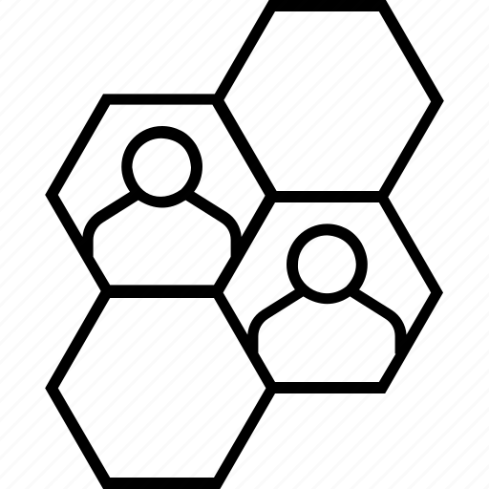
THANKS!
Do you have any questions?
Email: marwan_3782@limu.edu.ly
+218 910 9879 52

