Slide 1


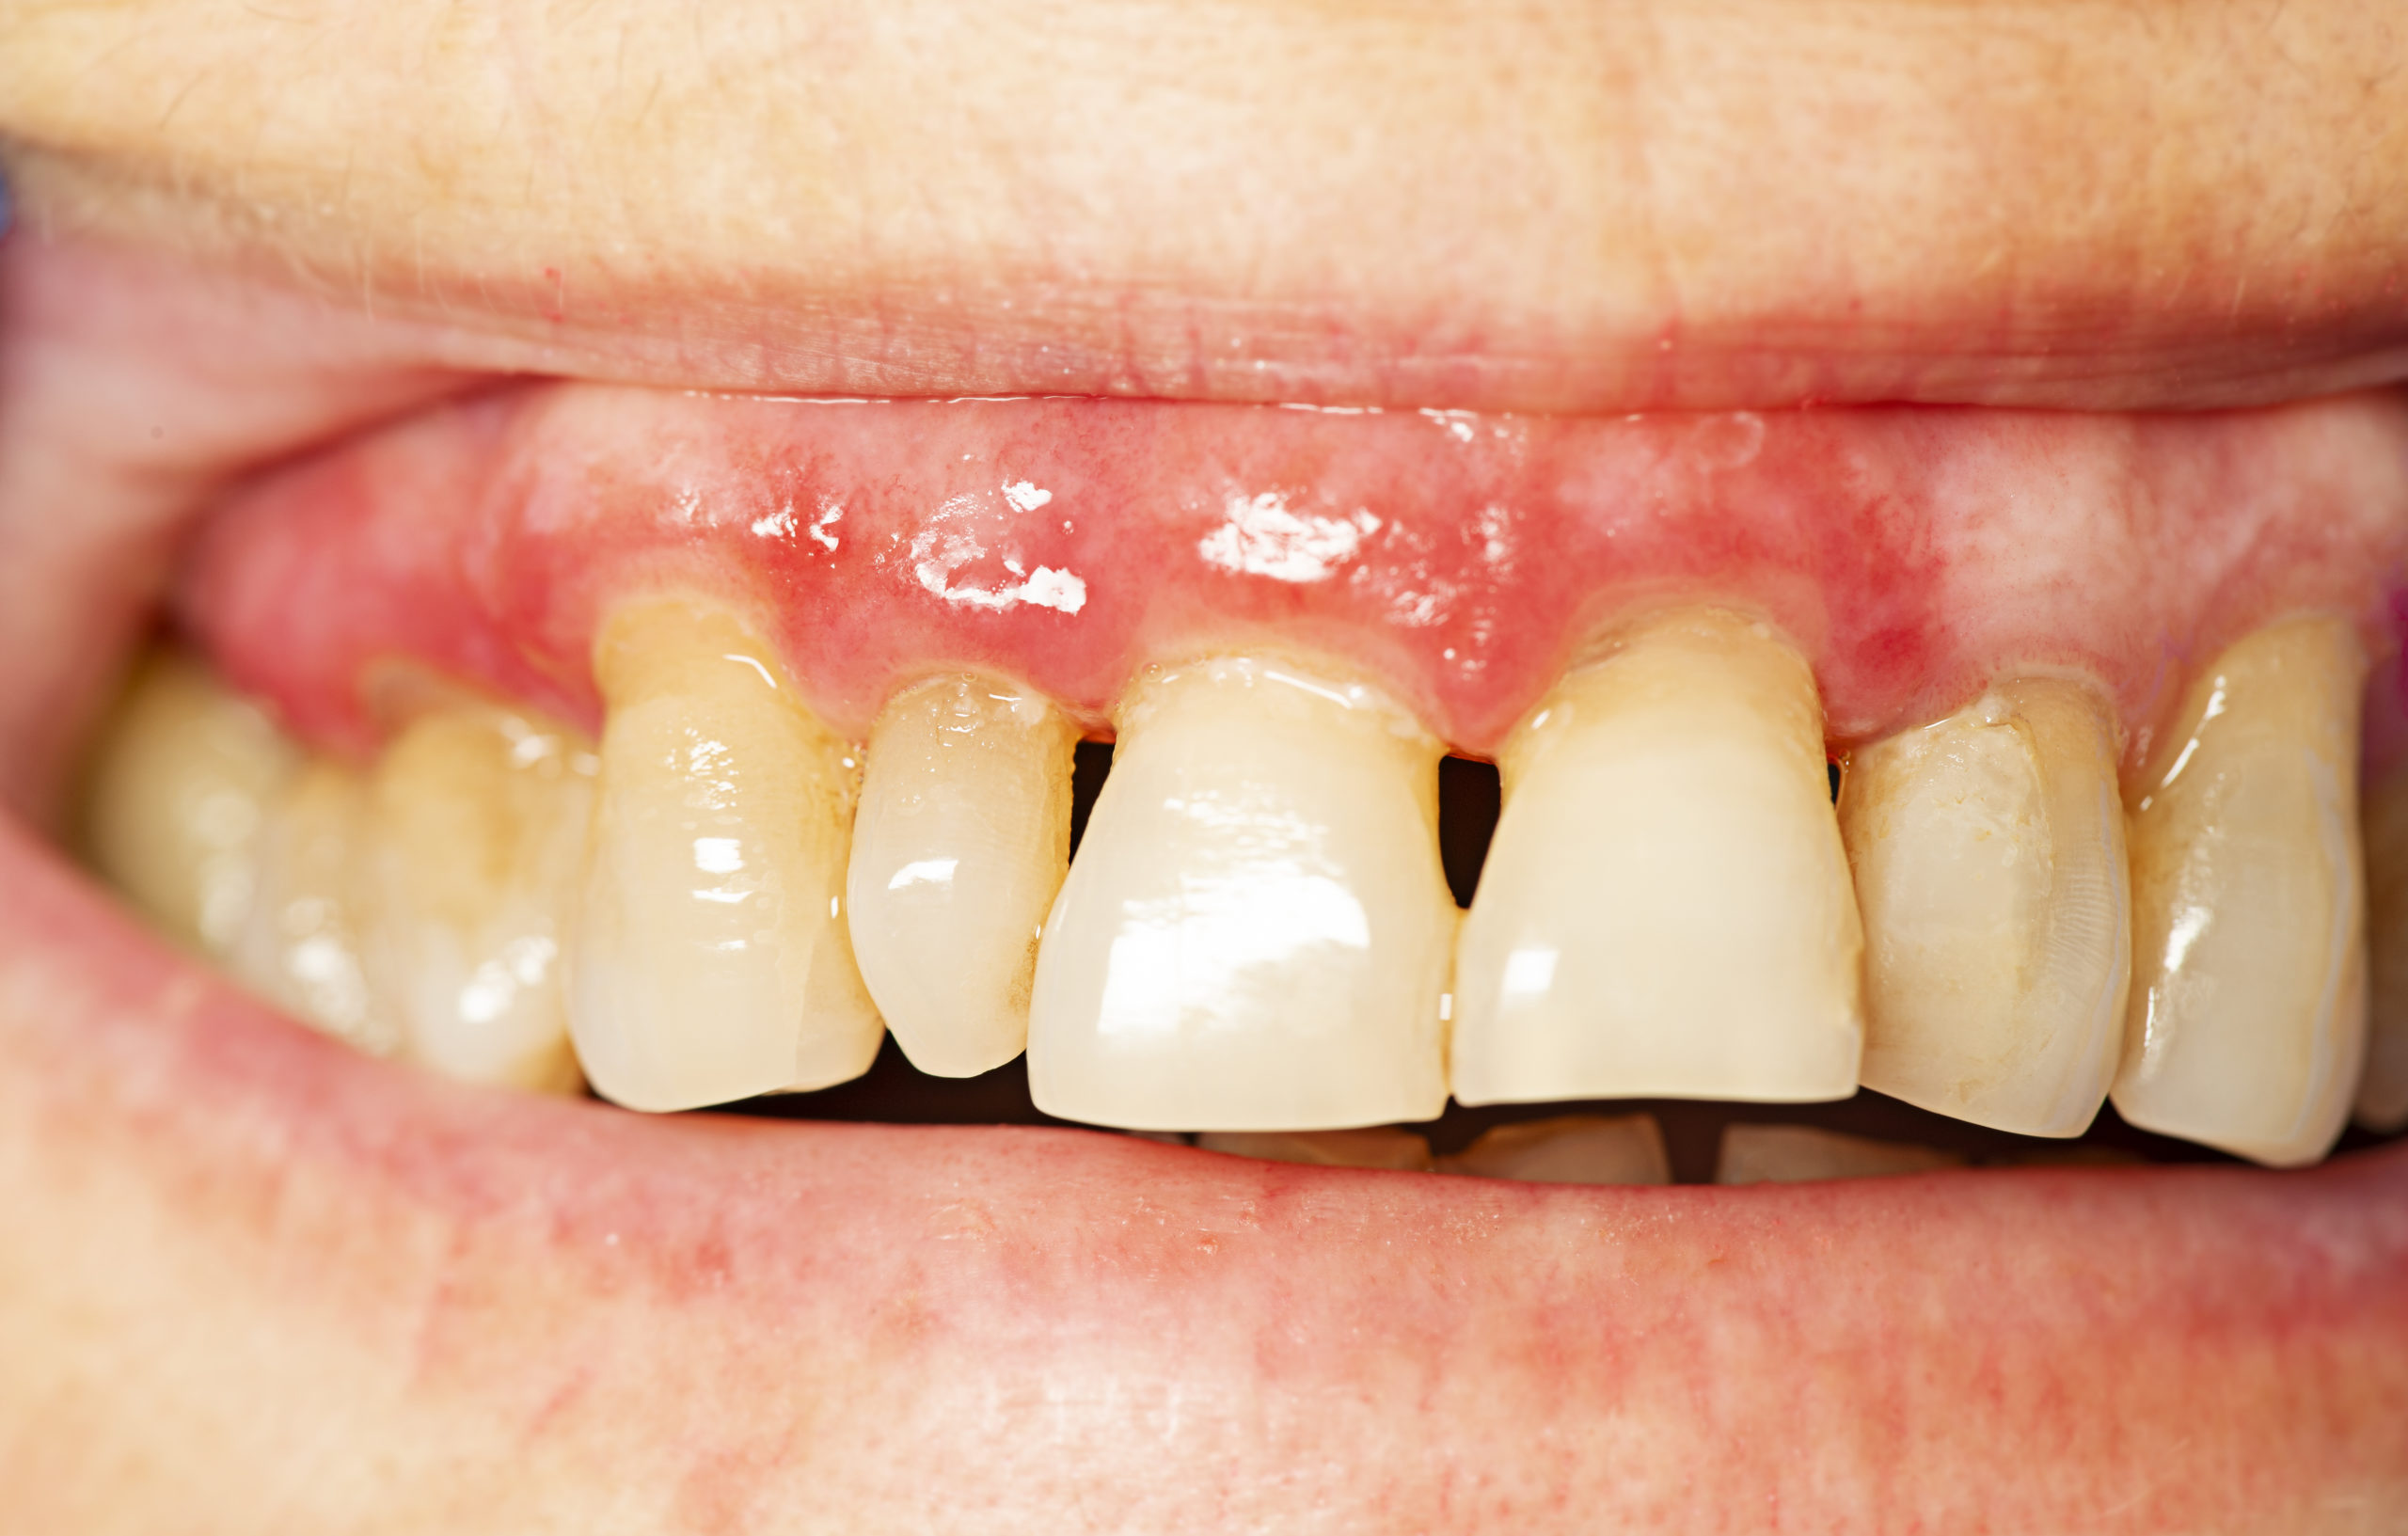
Libyan International Medical University
Faculty Of Applied Medical science
Second year student – academic year 2021/2022
Periodontal Tissues on Diabetic
Student Name : Rawan Elarfee
Student Number : 2938
INTRODUCTION
RESULTS / DISCUSSION
Periodontal disease is a leading cause of tooth loss among adults. It develops when the gum tissue, particularly the tissue and bone surrounding teeth, becomes infected and inflamed. in the early stage of the gum disease ( gingivitis ) then come periodontitis and the last stage is advanced.
Studies show that Diabetic people who do not have sufficient blood sugar control seem to develop gum disease more frequently and more severely than non-diabetic people.
Because the diabetic have slows circulation, which can render gum tissue susceptible to infection and the High glucose levels in saliva promote the growth of bacteria that cause gum disease.
The mean number of extracted teeth per person was significantly higher in the diabetic ( 12.3 ) than control number ( 9.7 ) and between the mean numbers of teeth with caries and fillings higher in the diabetic ( 54% ) than in the control group ( 35.9%) and The mean number of missing sextants was also significantly higher in the diabetic than in the control subjects. (figure 1 )
60/
Figure 3
CONCLUSION
40/
In our study, the mean number of extracted tooth was founding to be higher in the diabetics than in the control group subjects.
Our study has confirmed that the prevalence and severity of periodontal disease increase with age in both healthy and diabetic subjects.
The data obtained have also indicated that periodontal disease occurs earlier and assumes mores severe forms in diabetic patients than in non-diabetics.
Thus, at the age of 20, periodontal pockets of 4-5 mm (Pi) were founding in 12% of the diabetics and in none of the control subjects.
20/
0/
E
CF
M
MATERIAL / METHOD
Figure 1 : the mean number of extracted teeth (E), caries or fillings (CF) missing sextant per person in diabetic and non-diabetic
Two groups : 222 diabetic patients and 189 control subjects , The diabetic 109 insulin dependent (type I) and 113 non-insulin dependent (type II).
(type I) diabetes mellitus is characterized by diminished insulin secretion , (type II) diabetes mellitus is characterized by normal or elevated serum insulin .
The mean age of the diabetics was 46.9 years, whereas in the healthy control group it was 43.9 years.
The assessment of the diabetic patients was based on :
C-peptide findings, duration of diabetes, mean blood glucose (MBG), HbAic, the recordings were based on the highest treatment need observed after examination of all the remaining teeth in a sextant.
Statistical data processing was done by the STATJOB program package
And According to age, the prevalence of deep pockets in ( 20-29 ) year the diabetic ( 8.5% ) and non-Diabetic group ( 5% ) , while in the ( 34-44 ) year group deep pockets were almost twice as frequent in the diabetics (1.8:1). In the ( 55-64 ) year group, the corresponding ratio was ( 2.3:1 ) , whereas in the (65) year and older subjects the prevalence of P2 was three times as high in the diabetics compared to the control group. ( Figure 2 )
So the risk of a deep pocket increases as life age increases. And the type I & type II diabetic patients. Neither was any relationship founding between the duration of diabetes and mean blood glucose or hemoglobin values, have any effect on the severity of periodontal disease.
REFERENCES
1. Bačić M, Plančak D, Granić M. CPITN Assessment of Periodontal Disease in Diabetic Patients. Journal of Periodontology. 1988;59(12):816-822.
21-29
21.3%
34-44
47.5%
ACKNOWLEDGMENT
55-64
75%
I would like to express my appreciation to Dr. Alaa Benali for her efforts and all the support and tips she gives for me
Figure 2 : percentage of subject with pathologic pocket
65
100%

