Slide 1
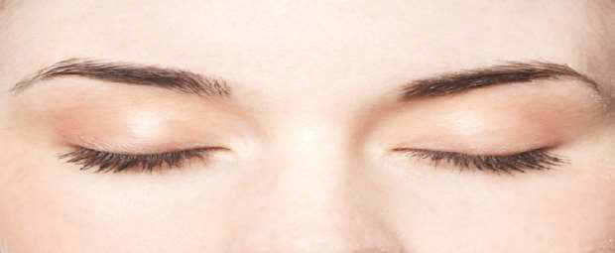
THE EYELIDS
THE EYELIDS
By Dr NAHLA ELMUFTY

Slide 2
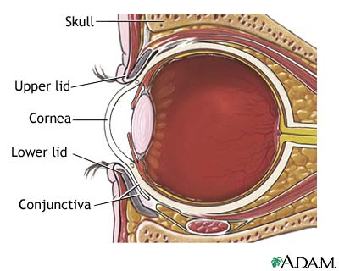
Eyelids and Eyelashes
The eyelids serve to protect the eye from foreign matter, such as dust, dirt, and other debris, as well as bright light that might damage the eye. When you blink, the eyelids also help spread tears over the surface of your eye, keeping the eye moist and comfortable.
The eyelashes help filter out foreign matter, including dust and debris, and prevent it from getting into the eye.

Slide 3
Anatomy of the eyelid

Slide 4
The Ocular Adnexa
Eyebrows
Eyelids
Lacrimal Apparatus

Slide 5
Eyelids

Slide 6
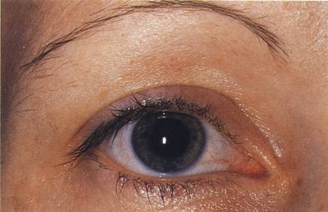
SURFACE ANATOMY
Superior Palpebral Sulcus
Lateral Canthus
Medial Canthus
Palpebral Fissure

Slide 7
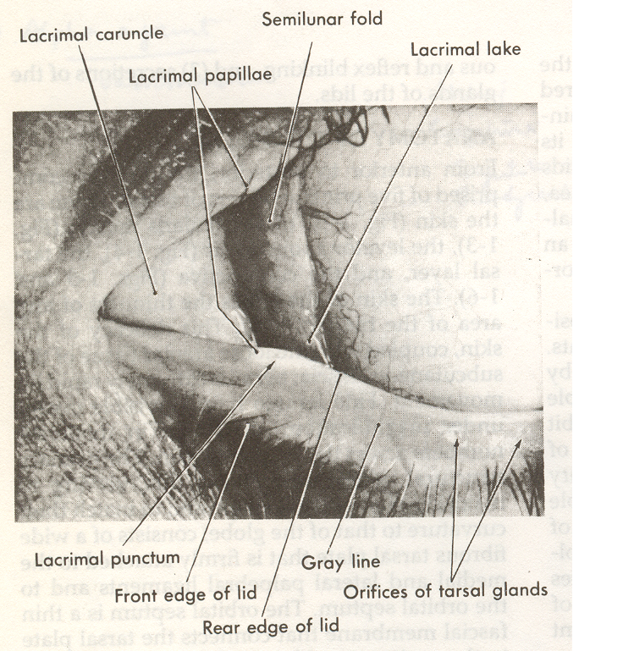
ON THE MEDIAL SIDE
Lacus lacrimalis
Caruncula lacrimalis
Plica semilunaris

Slide 8
From superficial to deep they are :
The skin layer.
A layer of striated muscle (orbicularis oculi).
The areolar tissue.
The fibrous tissue (tarsal plates).
A layer of mucous membrane (palpebral conjunctiva).

Slide 9
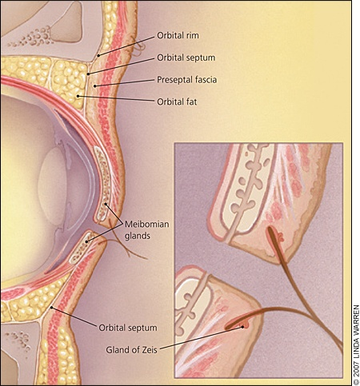
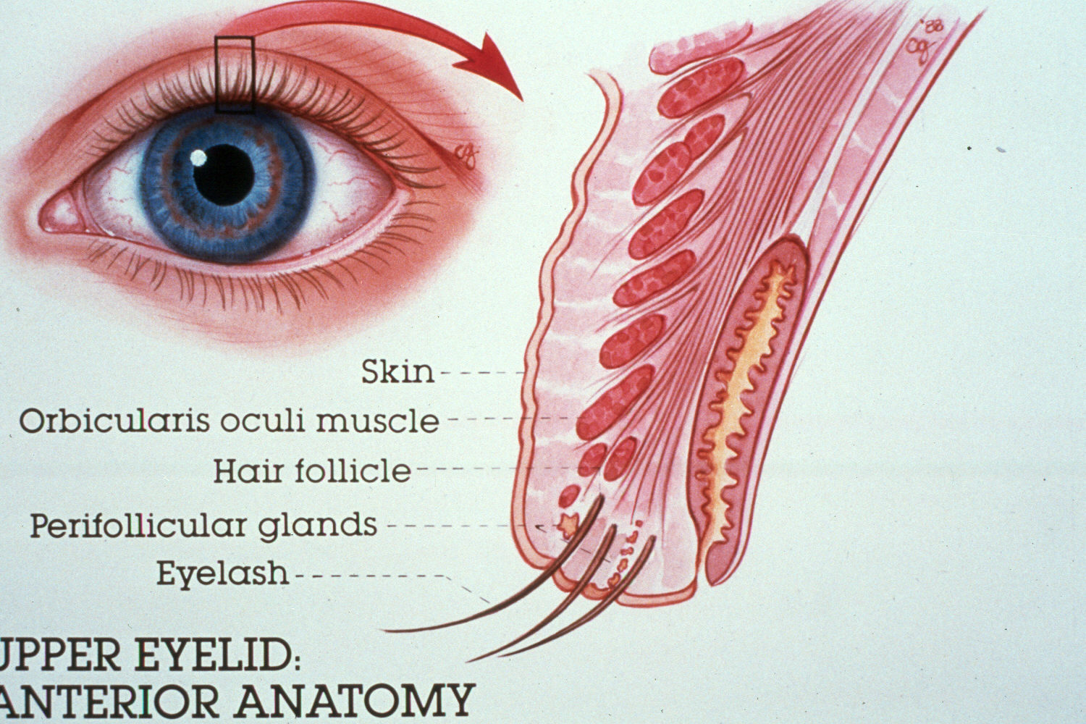

Slide 10
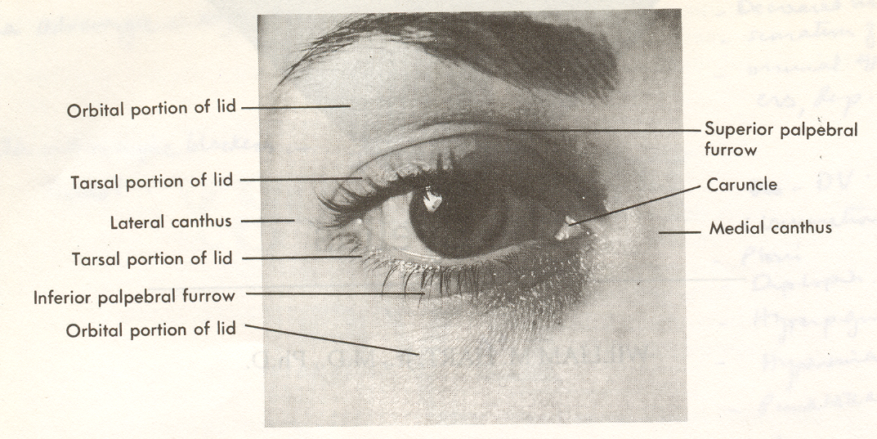
THE SKIN
It is thinnest and marked by sulci.
The superior sulci is due to aponeurosis of levalor palpebrae superior inserted into the skin.
The less obvious lower sulci is due to the skin being tethered to the underlying periosteum.
Histologically it consist of epidermis, sebaceous and sweat gland and melanocytes.

Slide 11
THE ORIBICULARIS OCULI
Part Position Function
Orbital Surrounds the orbital Forced lid closure rim
Preseptal In front of the orbital pull lacrimal fascia
Septum laterally and create a relative vacuum in lacrimal sac.
Pretarsal in front of the tarsal Close lid and pull Plate lacrimal puncta medially

Slide 12
THE SUBCUTANEOUS AREOLAR TISSUE
It is a loose connective tissue containing no fat.
It is absent at medial and lateral angles, ciliary margin and at sulci.

Slide 13
CONJUNCTIVA
Thin mucous membrane lined by non keratinized stratified squamous epithelium.
It has a richly vascularized Substantia propria
At the margin of the eyelids it is continuous with the skin.

Slide 14
EYE LASHES
100 in upper lid
50 in lower lid
Originate from anterior lamella in two or three irregular rows.
The upper lid lashes are directed upward, and outwards
The lower lid lashed are directed downward and outwards

Slide 15
THE LIGAMENTS
The medial palpebral ligament attaches the medial end of tarsi to lacrimal crest and frontal process of maxilla.
The lateral palpebral ligament attach the lateral end of tarsi to margin tubercle on marginal tubercle of zygomatic bone.

Slide 16
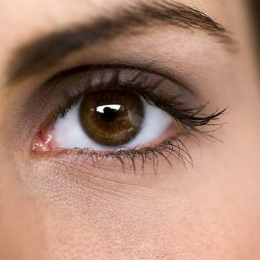
The palpeberal fissure:
The elliptical distance between the eye lids.

Slide 17
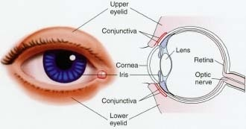

Slide 18
Lid Margins
Anterior Margin :
Eyelashes
Glands of Zeis
Glands of Moll
Posterior Margin :
Small orifices of modified sebaceous glands (meibomian, or tarsal, glands).

Slide 19
Orbital Septum
The fascia behind that portion of the orbicularis muscle that lies between the orbital rim and the tarsus and serves as a barrier between the lid and the orbit.

Slide 20
Lid Retractors :
The lid retractors are responsible for opening the eyelids.
In the upper lid: levator palpebrae superioris & Muller's (superior tarsal) muscle
In the lower lid: the main retractor is the inferior rectus
The smooth muscle components of the lid retractors are innervated by sympathetic
nerves.
The levator and inferior rectus muscles are supplied by the third cranial (oculomotor)
nerve.
Ptosis is thus a feature of both Horner's syndrome and third nerve palsy

Slide 21
Sensory Nerve Supply
First and second divisions of the trigeminal nerve (V).

Slide 22
Blood Supply & Lymphatics
The lacrimal and ophthalmic arteries by their lateral and medial palpebral branches.
Venous drainage :
from the lids empties into the ophthalmic vein and the veins that drain the forehead
and temple
Lymphatics :
From the lateral segment of the lids run into the preauricular and parotid nodes.
Lymphatics draining the medial side of the lids empty into the submandibular
lymph nodes.

Slide 23
Disorders of eyelids

Slide 24
BENIGN EYELID LESIONS
1. Nodules
Chalazion
Acute hordeola
Molluscum contagiosum
Xanthelasma
2. Cysts
Cyst of Moll
Cyst of Zeiss
Sebaceous cyst
Hidrocystoma
3. Tumours
Viral wart
Naevi
Keratoacanthoma
Capillary haemangioma
Port-wine stain
Pyogenic granuloma

Slide 25
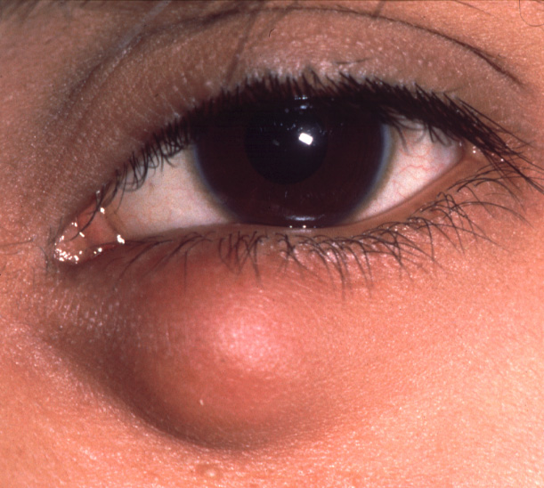
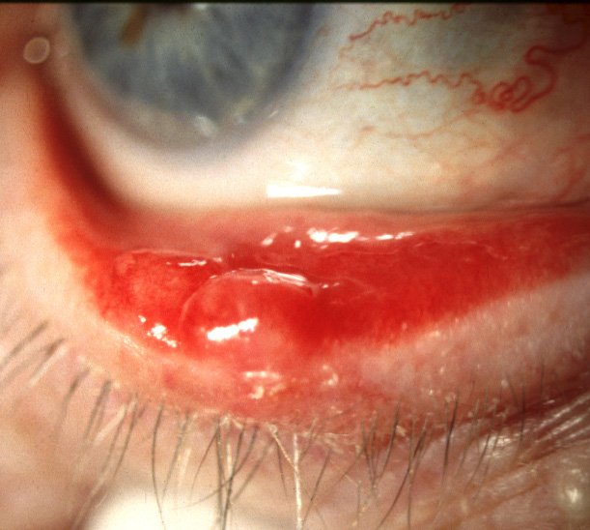
Chalazion (meibomian cyst)
Def : its a chronic , sterile , lipogranulomatous inflammatory lesion caused by blockage of meibomian gland orifices & stagnation of sebaceous secretion.
Painless, roundish, firm lesion
within tarsal plate
May rupture through conjunctiva
and cause granuloma

Slide 26
Chalazia occur after gland blockage, which can be associated with the following:
Poor lid hygiene (the precise causal role has not yet been established)
Seborrhea
Acne rosacea
Chronic blepharitis
High blood lipid concentrations (possible risk from increased blockage of sebaceous glands)
Leishmaniasis
Tuberculosis
Immunodeficiency
Viral infection
Carcinoma
Stress (causality has not been proved, and the mechanism by which it might act is unknown).

Slide 27
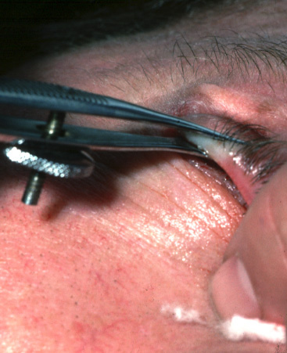
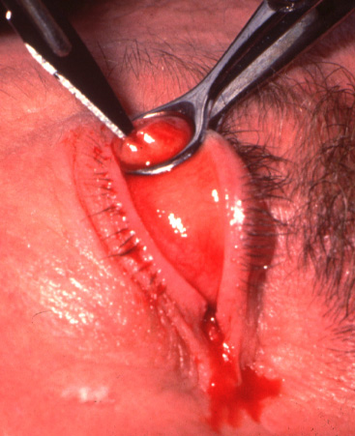
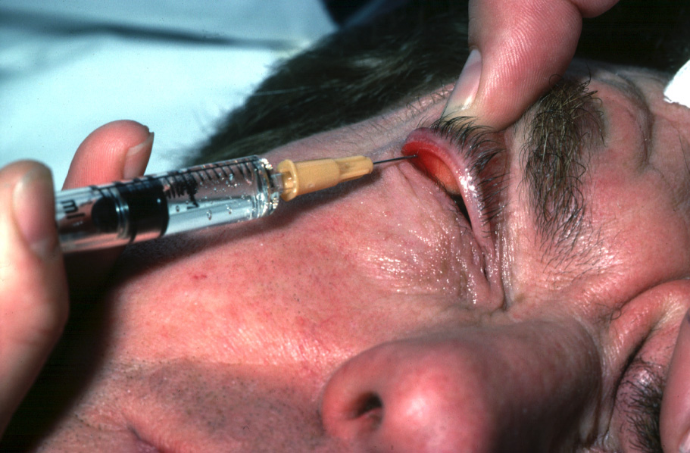
Treatment of chalazion
1- surgery. 2- steroid injection. 3- systemic tetracycline.
Injection of local anaesthetic
Insertion of clamp
Incision and curettage

Slide 28
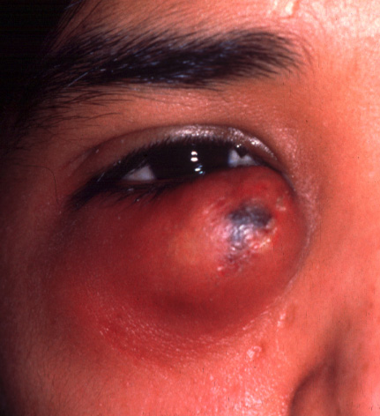
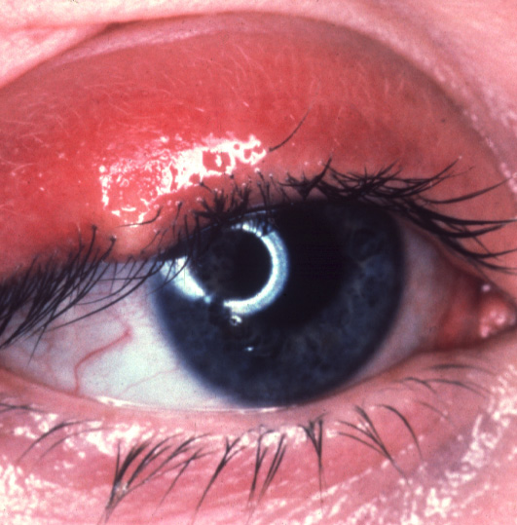
Acute hordeola
Internal hordeolum
( acute chalazion )
External hordeolum (stye)
Staph. abscess of meibomian
glands
Staph. abscess of lash follicle and
associated gland of Zeis or Moll
Tender swelling within tarsal plate
Tender swelling at lid margin
May discharge through skin or conjunctiva
May discharge through skin

Slide 29
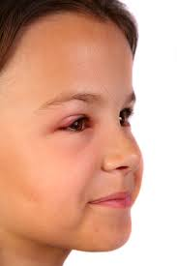

Slide 30
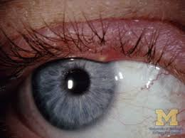

Slide 31
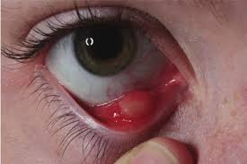

Slide 32
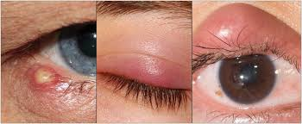

Slide 33
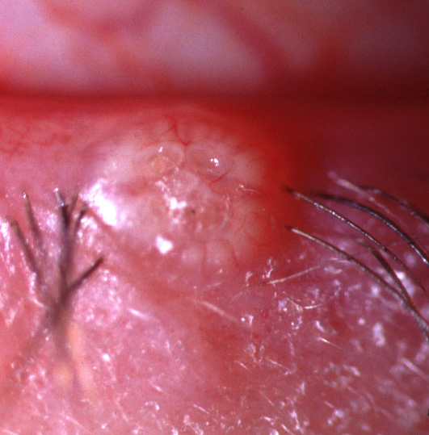
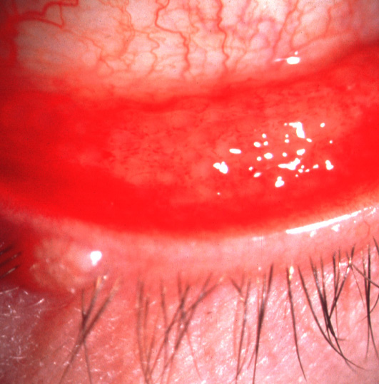
Molluscum contagiosum
Signs
Complications
Painless, waxy, umbilicated nodule
Chronic follicular conjunctivitis
May be multiple in AIDS patients
Occasionally superficial keratitis

Slide 34
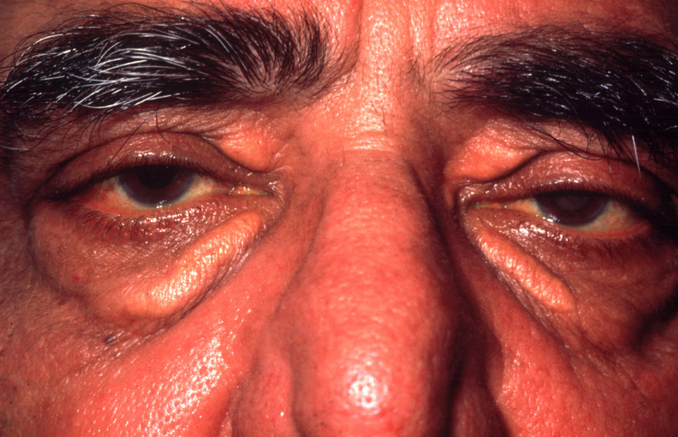
Xanthelasma
Common in elderly or those with
hypercholesterolaemia
Yellowish, subcutaneous plaques
containing cholesterol and lipid
Usually bilateral and located medially

Slide 35
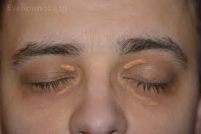

Slide 36
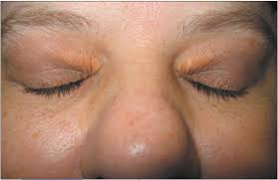

Slide 37
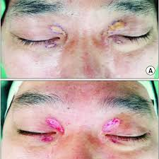

Slide 38
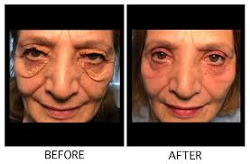

Slide 39
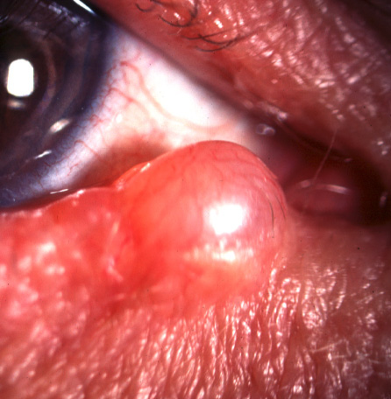
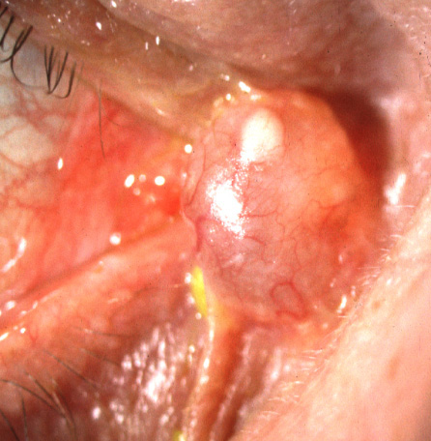
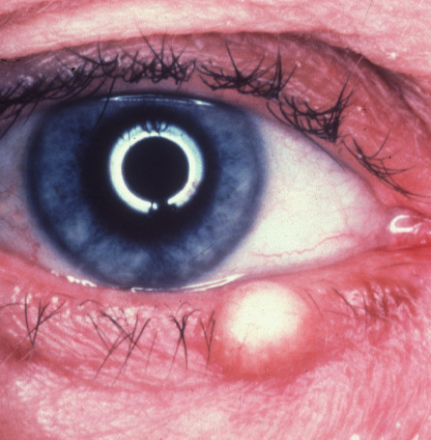
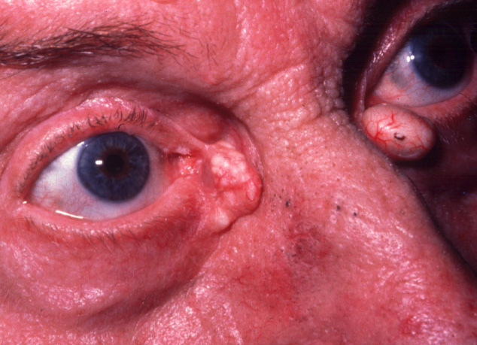
Eyelid cysts
Cyst of Moll
Eccrine sweat gland
hidrocystoma
Translucent
On anterior lid
margin
Similar to cyst of Moll
Not confined to lid
margin
Cyst of Zeis
Sebaceous cyst
Opaque
On anterior lid
margin
Cheesy contents
Frequently at
inner canthus

Slide 40
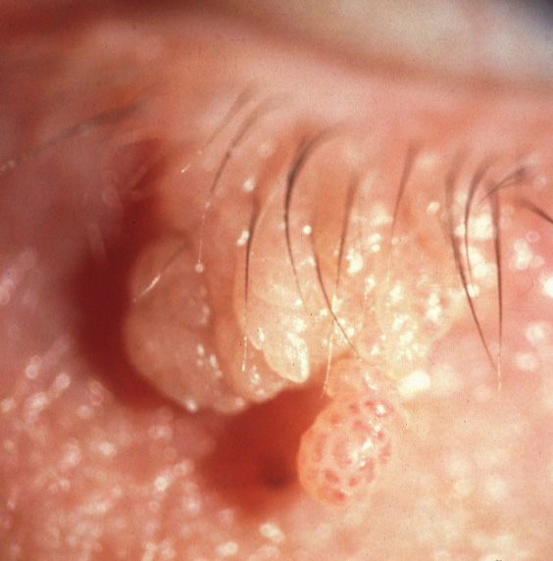
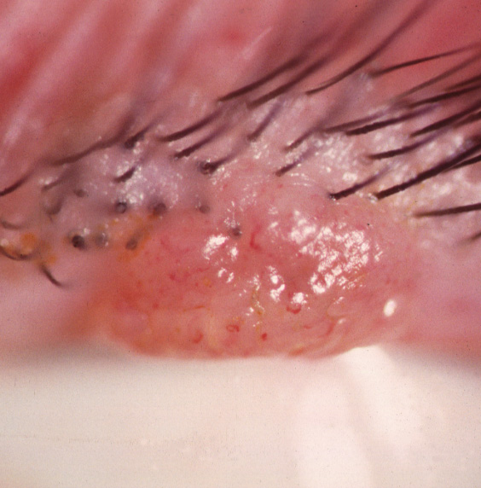
Viral wart (squamous cell papilloma)
Most common benign lid tumour
Raspberry-like surface
Pedunculated
Sessile

Slide 41
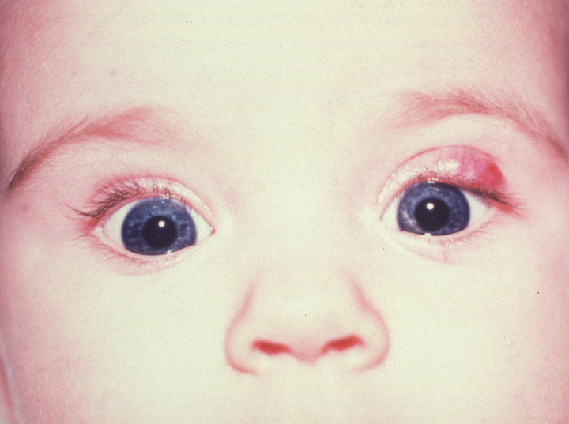
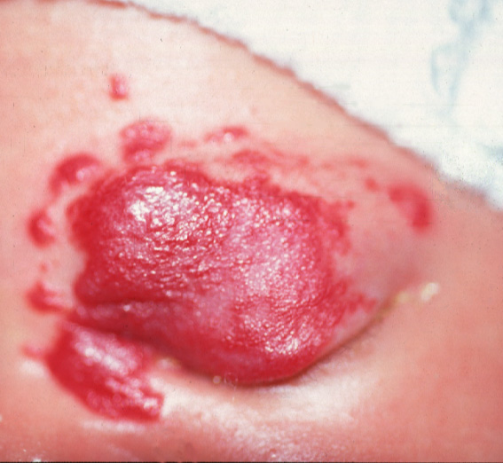
Capillary haemangioma
Rare tumour which presents soon after birth
May be associated with intraorbital extension
Starts as small, red lesion, most frequently
on upper lid
Grows quickly during first year
Blanches with pressure and swells on crying
Begins to involute spontaneously
during second year

Slide 42
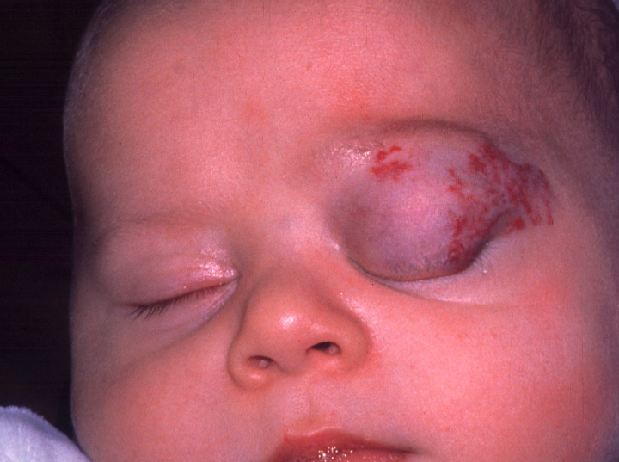
Periocular haemangioma
Treatment options
Steroid injection in
most cases
Surgical resection in
selected cases

Slide 43
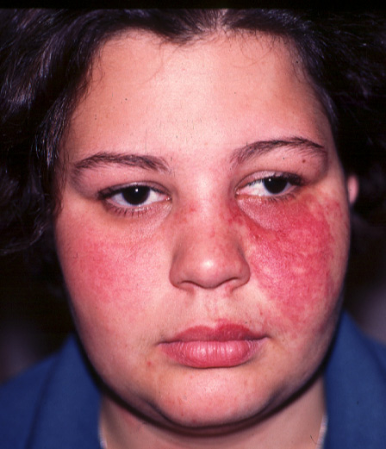
Port-wine stain (naevus flammeus)
Rare, congenital subcutaneous lesion
Segmental and usually unilateral
Does not blanch with pressure
Associations
Ipsilateral glaucoma in 30%
Sturge-Weber or
Klippel-Trenaunay-Weber
syndrome in 5%

Slide 44
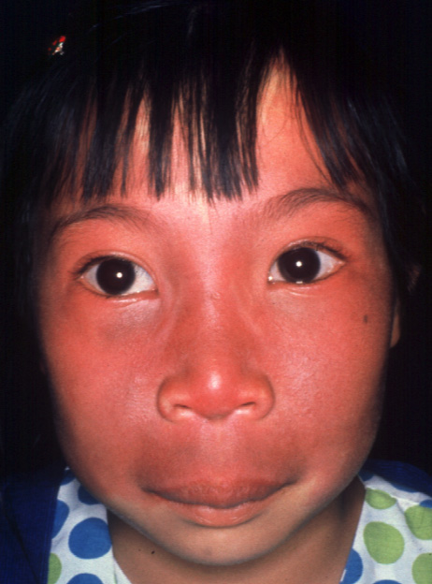
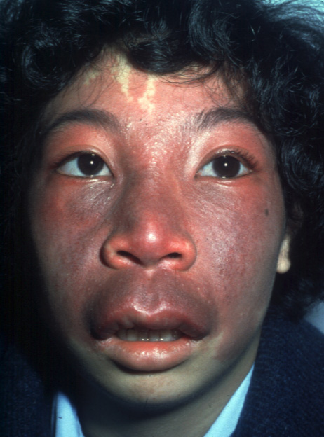
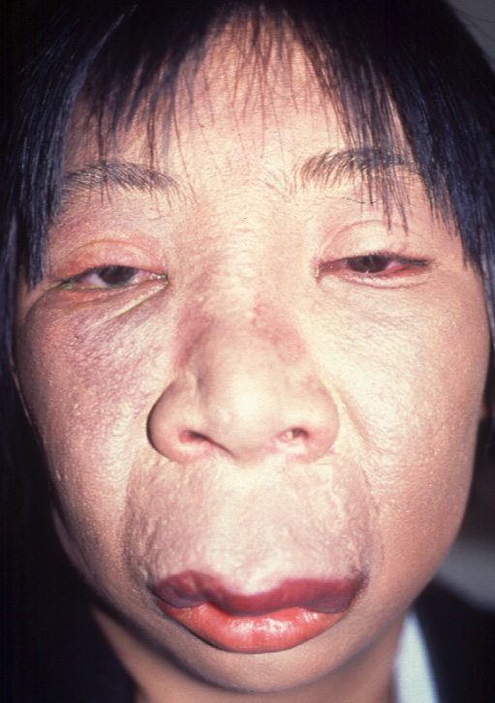
Progression of port-wine stain
Initially red and flat
Subsequent darkening
and hypertrophy of skin
Skin becomes coarse,
nodular and friable

Slide 45
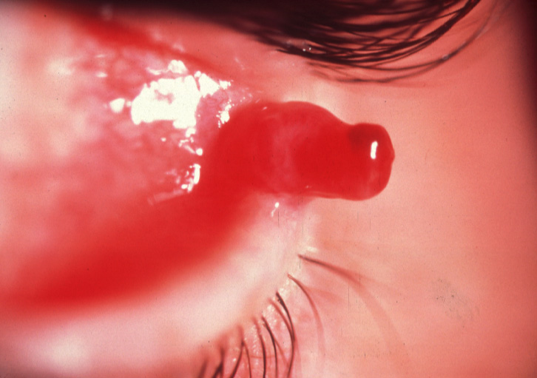
Pyogenic granuloma
Usually antedated by surgery or trauma
Fast-growing pinkish, pedunculated or
sessile mass
Bleeds easily

Slide 46
CHRONIC MARGINAL BLEPHARITIS
1. Anterior
Staphylococcal
Seborrhoeic
2. Posterior
Meibomianitis
Meibomian seborrhoea
3. Treatment

Slide 47
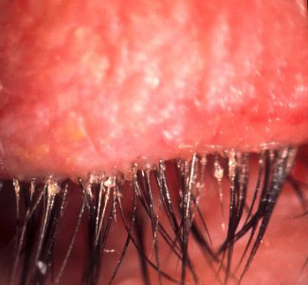
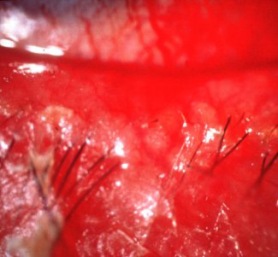
Staphylococcal blepharitis
Chronic irritation worse in mornings
Hyperaemia and telangiectasia of anterior
lid margin
Scales around base of lashes
(collarettes)
Scarring and hypertrophy if longstanding

Slide 48
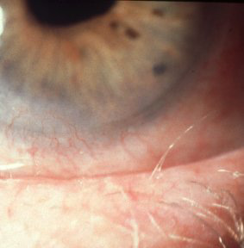
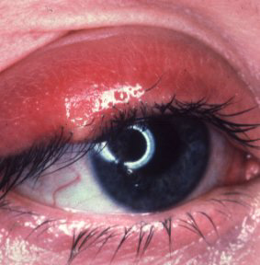
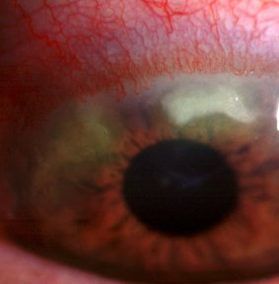
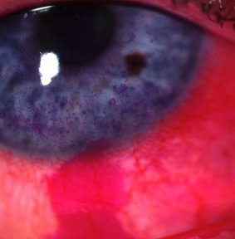
Complications of staphylococcal blepharitis
Trichiasis, madarosis , poliosis
Recurrent styes
Marginal keratitis
Tear film instability

Slide 49
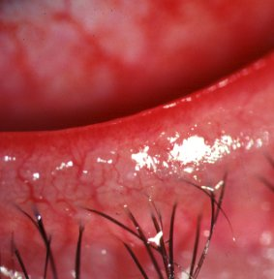
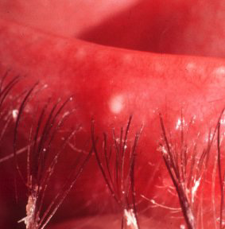
Seborrhoeic blepharitis
Shiny anterior lid margin
Greasy scales
Hyperaemia of lid margin
Lashes stuck together

Slide 50
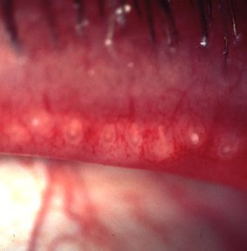



Meibomianitis
Inflamed and blocked
meibomian gland orifices
Toothpaste-like plaques
from meibomian glands
Thickened posterior lid margin
Meibomian cyst formation

Slide 51


Meibomian seborrhoea
Oil globules over meibomian gland orifices
Oily and foamy tear film

Slide 52
Treatment of Chronic Blepharitis
1. Lid hygiene - with 25% baby shampoo
2. Tear substitutes - for associated tear film instability
3. Systemic tetracyclines - for severe posterior blepharitis
Warm compresses - to melt solidified sebum in
posterior blepharitis

Slide 53
DISORDERS OF LASHES
1. Trichiasis
2. Metaplastic lashes
3. Distichiasis
4. Phthiriasis palpebrarum
5. Madarosis
6. Poliosis

Slide 54


Trichiasis
Signs
Complications
Posterior misdirection of normal lashes
Most frequently affects lower lid
Inferior punctate epitheliopathy
Corneal ulceration and pannus

Slide 55
Treatment Options for Trichiasis
Epilation - but recurrences within few weeks
Electrolysis - but frequently repeated treatments required
Cryotherapy - for many lashes
Laser ablation - for few scattered lashes
Surgery - for localized crop resistant to other methods

Slide 56


Distichiasis
Signs
Treatment
Second row of lashes arising
from meibomian gland orifices
Division into anterior and posterior
lamellae
Congenital
Cryotherapy to posterior lamella
Reapposition of lamellae

Slide 57


Phthiriasis palpebrarum
Infestation of lashes by pubic crab louse and its ova (nits)
Typically affects children in poor hygenic conditions
Lice gripping base of lashes
Nits and empty shells adhere to base of lashes
Treatment - removal, destruction and delousing

Slide 58

Madarosis
Decrease in number or complete loss of lashes
Local causes
Chronic anterior
lid margin disease
Infiltrating tumours
Burns, radiotherapy
or cryotherapy
Systemic causes
Generalized alopecia
Myxoedema
SLE
Syphilis
Leprosy
Following removal

Slide 59

Poliosis
Premature localized whitening of hair
Ocular associations
Chronic anterior blepharitis
Sympathetic ophthalmitis
Systemic associations
Vogt-Koyanagi-Harada
syndrome
Waardenburg syndrome

Slide 60
DIFFUSE EYELID DISEASE
1. Allergic
  Acute oedema
  Contact dermatitis
  Atopic dermatitis
  Blepharochalasis
2. Infections
  Preseptal cellulitis
  Herpes simplex
  Herpes zoster ophthalmicus
  Impetigo
  Erysipelas
  Necrotizing fasciitis
3. Miscellaneous
  Fat herniation
  Systemic causes

Slide 61

Acute allergic oedema
Causes - insect bites, urticaria and angioedema
Unilateral or bilateral
Painless, red, pitting oedema
Chemosis may be present
Self-limiting

Slide 62

Contact dermatitis
Sensitivity to topical medication
Unilateral or bilateral
Painless oedema and erythema
Vesiculation and crusting
Thickening if chronic

Slide 63


Atopic dermatitis
Associated with asthma and hay fever
Chronic itching and scratching
Facial - in young children
Flexural - knees, elbows, wrists and ankles

Slide 64




Ocular associations of atopic dermatitis
Thickening, crusting and
fissuring
Staph. blepharitis
Angular blepharitis
Vernal disease in children

Slide 65




Ocular associations of atopic dermatitis
Keratoconjunctivitis
Keratoconus
Shield - like cataract
Retinal detachment

Slide 66

Preseptal cellulitis
Causes
Skin trauma or insect
bites of lids or eyebrows
Spread from local
infection
Upper respiratory
or ear infection
Signs
Usually unilateral
Tender and red
Periorbital oedema
Treatment - systemic
antibiotics

Slide 67

Herpes simplex
Signs
Crops of small vesicles
Rupture and crust
Heal without scarring
after 7 days
Complications
Follicular conjunctivitis
Keratitis
Treatment - topical
antivirals

Slide 68


Herpes zoster ophthalmicus
Painful vesicles and pustules
Periorbital oedema - may be
bilateral
Crusting ulceration
Treatment - oral antivirals

Slide 69

Necrotizing fasciitis
Skin gangrene caused by
Staph. or Strep.
Affects elderly or
debilitated
May cause bilateral
lid necrosis
Treatment - surgical
debridement and systemic
antibiotics

Slide 70

Fat herniation
Age-related,
usually bilateral
Pockets of fat
herniating into
upper lids, especially
medially
Treatment
- blepharoplasty

Slide 71

Systemic causes of lid oedema
Myxoedema
Renal disease
Congestive
heart failure
Obstruction of
superior vena
cava
Fabry disease

Slide 72
MALIGNANT EYELID TUMOURS
1. Basal cell carcinoma
2. Squamous cell carcinoma
3. Meibomian gland carcinoma
4. Melanoma
5. Kaposi sarcoma
6. Merkel cell carcinoma
7. Treatment

Slide 73
Basal Cell Carcinoma - Important Facts
1. Most common human malignancy
2. Usually affects the elderly
3. Slow-growing, locally invasive
4. Does not metastasize
5. 90% occur on head and neck
6. Of these 10% involve eyelids
7. Accounts for 90% of eyelid malignancies

Slide 74




Frequency of location of basal cell carcinoma
Lower lid - 70%
Medial canthus - 15%
Upper lid - 10%
Lateral canthus - 5%

Slide 75


Nodular basal cell carcinoma
Early
Advanced
Shiny, indurated nodule
Slow progression
Surface vascularization
May destroy large portion of eyelid

Slide 76


Ulcerative basal cell carcinoma
(rodent ulcer)
Early
Advanced
Chronic ulceration
Raised rolled edges and bleeding

Slide 77


Squamous cell carcinoma
Less common but more aggressive than BCC
Predilection for lower lid
Nodular
Ulcerative
Hard, hyperkeratotic nodule
Red base
May develop crusting fissures
Borders sharply defined, indurated
and elevated
No surface vascularization

Slide 78


Kaposi sarcoma
Vascular tumour occurring in patients with AIDS
Usually associated with advanced disease
Very sensitive to radiotherapy
Early
Advanced
Pink, red-violet lesion
May ulcerate and bleed

Slide 79

Merkel cell carcinoma
Highly malignant with frequent metastases at presentation
Fast-growing, violaceous, well-demarcated nodule
Intact overlying skin
Predilection for upper eyelid

Slide 80
Treatment Options
1. Surgical excision
Method of choice
2. Radiotherapy
Small BCC not involving medial
canthus
Kaposi sarcoma
3. Cryotherapy
Small and superficial BCC
irrespective of location
Adjunct to surgery in selected cases

Slide 81
ECTROPION AND ENTROPION
1. Ectropion
Involutional
Cicatricial
Paralytic
Mechanical
2. Entropion
Involutional
Cicatricial
Congenital
Epiblepharon

Slide 82

Involutional
Affects lower lid of elderly patients
May cause chronic conjunctival inflammation
and thickening

Slide 83


Causes of cicatricial ectropion
Contracture of skin pulling lid away from globe
Unilateral or bilateral, depending on cause
Unilateral ectropion due to
traumatic scarring
Bilateral ectropion due to severe
dermatitis

Slide 84


Paralytic ectropion
Caused by facial nerve palsy which,
if severe, may give rise to the following:
Exposure keratopathy caused by
lagophthalmos
Epiphora caused by combination of:
Failure of lacrimal pump
mechanism
Increase in tear production
resulting from corneal exposure

Slide 85

Mechanical ectropion
Mechanical lid eversion by tumour
Treatment
Removal of the cause, if possible
Correction of significant horizontal lid laxity

Slide 86


Involutional entropion
Affects lower lid because upper lid
has wider tarsus and is more stable
If longstanding may result in corneal
ulceration

Slide 87


Pathogenesis of involutional entropion
Horizontal lid laxity
Overriding of preseptal over
pretarsal orbicularis during lid
closure
Canthal tendon laxity
Weakness of lower lid retractors

Slide 88

Cicatricial entropion
Severe scarring of palpebral conjunctiva
which pulls lid margin towards globe
May affect lower or upper eyelid
Causes include cicatrizing conjunctivitis,
trachoma and chemical burns

Slide 89

Congenital entropion
Very rare - not to be confused with epiblepharon
Inturning of entire lower eyelid and lashes
Absence of lower lid crease
When skin is pulled down lid also pulls away from globe
Does not resolve spontaneously

Slide 90
PTOSIS

Slide 91
CLASSIFICATION OF PTOSIS
1. Neurogenic
Third nerve palsy
Third nerve misdirection
Horner syndrome
Marcus Gunn jaw-winking syndrome
2. Myogenic
Myasthenia gravis
Myotonic dystrophy
Ocular myopathies
Simple congenital
Blepharophimosis syndrome
3. Aponeurotic
4. Mechanical

Slide 92
PTOSIS
1. Evaluation
Pseudoptosis
True ptosis
2. Classification
Neurogenic ptosis
Myogenic ptosis
Aponeurotic ptosis
Mechanical ptosis
3. Treatment options

Slide 93





Causes of pseudoptosis
Lack of lid support
Contralateral lid retraction
Ipsilateral hypotropia
Brow ptosis - excessive
eyebrow skin
Dermatochalasis - excessive
eyelid skin

Slide 94

Marginal reflex distance
Distance between upper lid
margin and light reflex (MRD)
Mild ptosis (2 mm of droop)
Moderate ptosis (3 mm)
Severe ptosis (4 mm or more)

Slide 95

Upper lid excursion
Reflects levator function
Normal (15 mm or more)
Good (12 mm or more)
Fair (5-11 mm)
Poor (4 mm or less)

Slide 96

Vertical fissure height
Distance between upper and lower lid margins
Normal upper lid margin rests about 2 mm below upper limbus
Normal lower lid margin rests 1 mm above lower limbus
Amount of unilateral ptosis is determined by comparison

Slide 97


Upper lid crease
Pretarsal show
crease
fold
Distance between lid margin and lid
crease in down-gaze
Distance between lash line and skin fold in primary position of gaze
Normals - females 10 mm; males 8 mm
Absence in congenital ptosis indicates
poor levator function
High crease suggests an aponeurotic
defect

Slide 98



Marcus Gunn jaw-winking syndrome
Accounts for about 5% of all cases of congenital ptosis
Retraction or ‘wink’ of ptotic lid in conjunction with
stimulation of ipsilateral pterygoid muscles
Opening of mouth
Contralateral movement of jaw

Slide 99




Simple congenital ptosis
Developmental dystrophy of levator muscle
Occasionally associated with weakness of superior rectus
Unilateral or bilateral ptosis of varying
severity
In downgaze ptotic eyelid is slightly
higher
Frequent absence of upper lid crease
Usually poor levator function

Slide 100


Blepharophimosis syndrome
Rare congenital disorder
Dominant inheritance
Moderate to severe symmetrical ptosis
Short horizontal palpebral aperture

Slide 101




Aponeurotic ptosis
Weakness of levator aponeurosis
Causes - involutional, postoperative and blepharochalasis
Mild
High upper lid crease
Good levator function
Severe
Absent upper lid crease
Deep sulcus

Slide 102




Mechanical ptosis
Causes
Dermatochalasis
Large tumours
Severe lid oedema
Anterior orbital lesions

