Slide 1



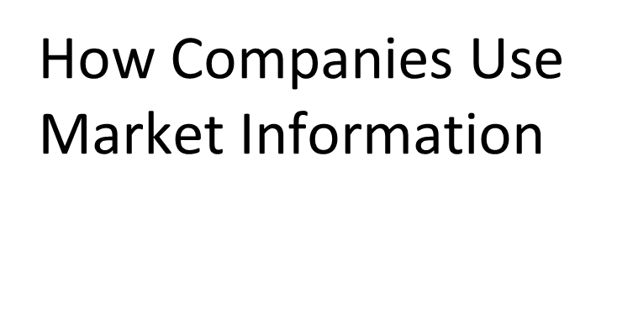


Slide 2
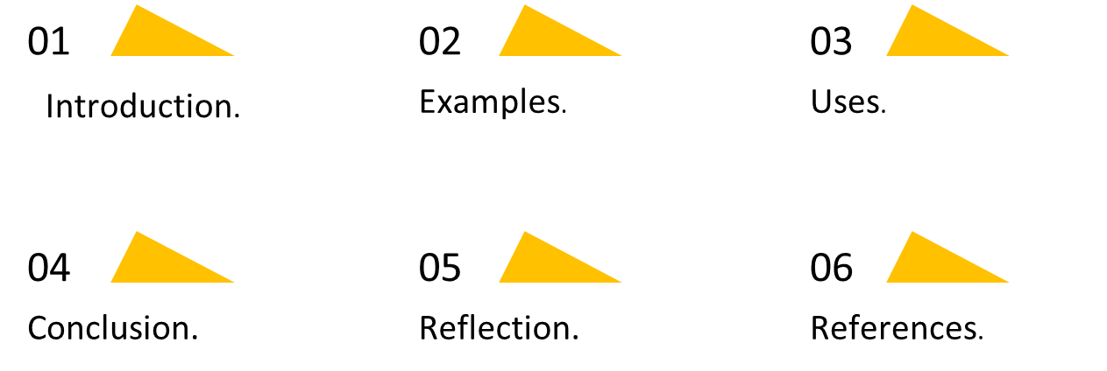
Table Of Contents
2

Slide 3
Introduction
Companies use market Information to test the viability of a new product or service by communicating directly with a potential customer. With market information, companies can figure out their target market and get opinions and feedback from consumers in real-time.
3

Slide 4
Examples
Company sizes and resources.
Campaign and communication data.
Website traffic and SEO.
Email campaigns.
Social media.
Sales information.
Customer review information.
Customer support data.
4

Slide 5
Uses
Marketing information and research address the need for quicker, yet more accurate, decision making by the marketer. These tools put marketers close to their customers to help them understand who they customers are, what they want, and what competitors are doing.
5

Slide 6
Conclusion
Marketing information the need for quicker, yet more accurate, decision making by the marketer. These tools put marketers close to their customers to help them understand who they customers are, what they want, and what competitors are doing.
6

Slide 7
Reflection
Market information is an effective tool to assist your business planning. It is about collecting information that provides an insight into your customers thinking, buying patterns, and location. In addition, market research can also assist you to monitor market trends and keep an eye on what your competition is doing.
7

Slide 8
References
Pope, Lauren. “Keep Your Data Clean with Marketing Information Management.” Learn.g2.com, learn.g2.com/marketing-information-management.
“What Market Research Tells Companies about New Products and Services.” Investopedia, www.investopedia.com/terms/m/market-research.asp#:~:text=Companies%20use%20market%20research%20to. Accessed 10 May 2022.

