Slide 1
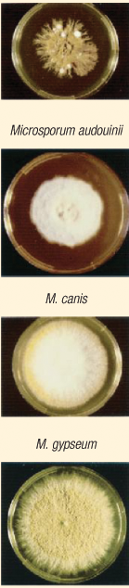
Fungal Skin Diseases
Ali M. Gargoom
MB,ChB., MSc., MD
Professor of Dermatology
Faculty of Medicine
Benghazi University
LIMU

Slide 2
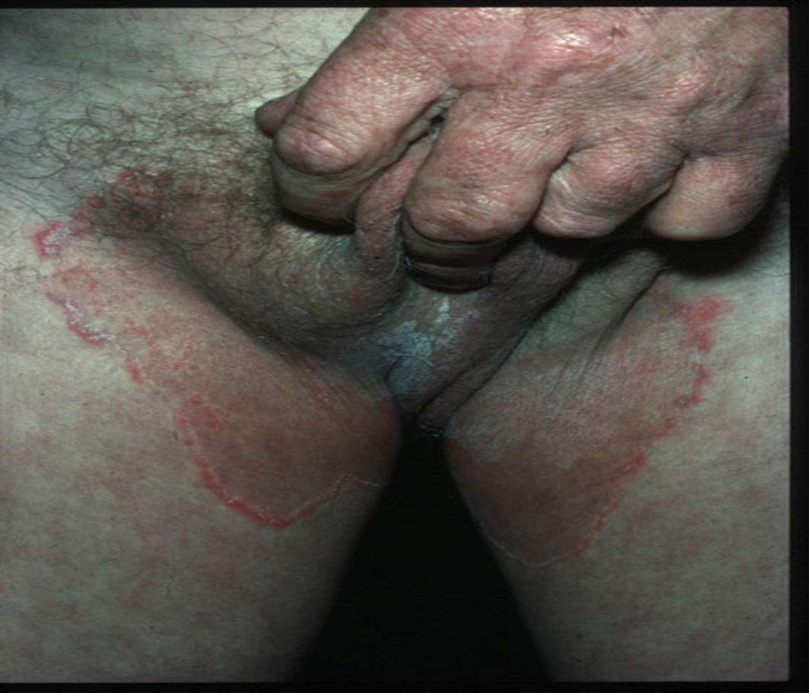
Tinea cruris
Dermatophytic infection of the groin, pubic and upper thighs.
Clinically, characterized by itchy, erythematous, arciform patches with sharp raised margin covered by papules, vesicles, crusting and scaling.
T. cruris is more common in adult male than female

Slide 3
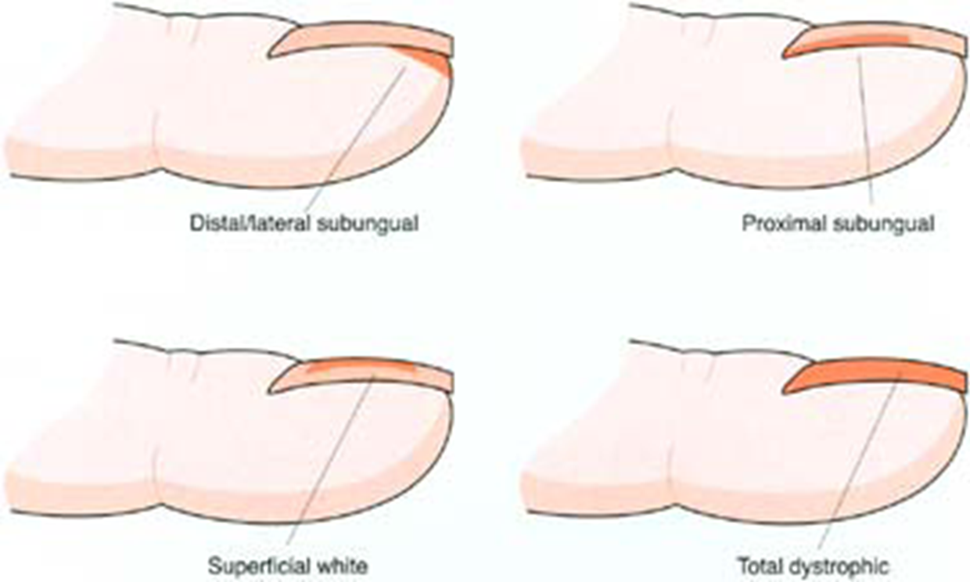
Tinea Unguium:
Onychomycosis is a fungal infection of nails by dermatophytes or candida.
Tinea unguium refer to subtype of onychomycosis caused by dermatophyts species only.

Slide 4
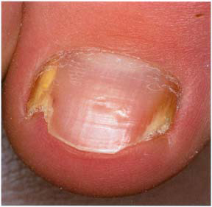
Distal & lateral subungual onychomycosis (DLSO)

Slide 5
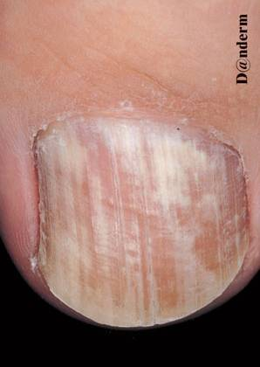
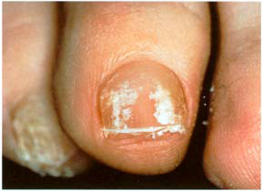
Superficial white onychomycosis (SWO).

Slide 6
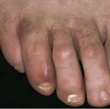
Proximal subungual onychomycosis (PSO).

Slide 7
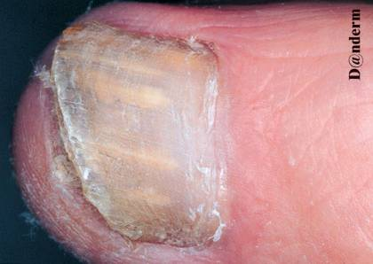
Candidal onychomycosis

Slide 8
Diagnosis of dermatophytosis ( Tinea)
Three steps in the diagnosis of fungal infection.
1. Wood's lamp examination.
2. Direct microscopy using KOH preparation.
3. Fungal culture.

Slide 9
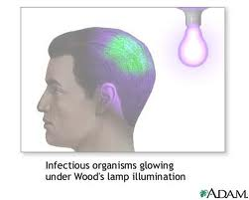
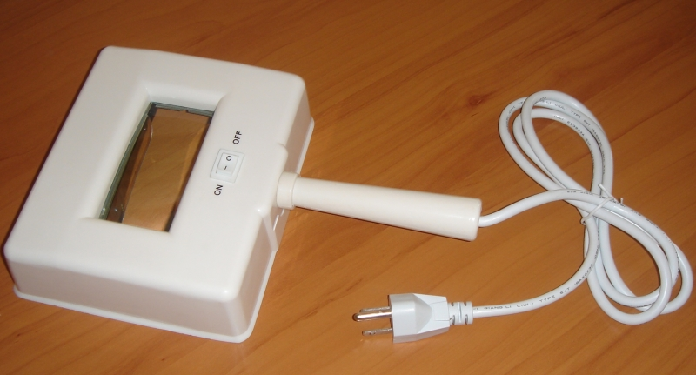
1.Wood' lamp examination:
This step aids in the diagnosis of tinea capitis only.
Green fluorescence will confirm the diagnosis.
Negative wood' lamp examination does not exclude the diagnosis.
Only certain dermatophyts species fluorescence by wood' lamp.

Slide 10
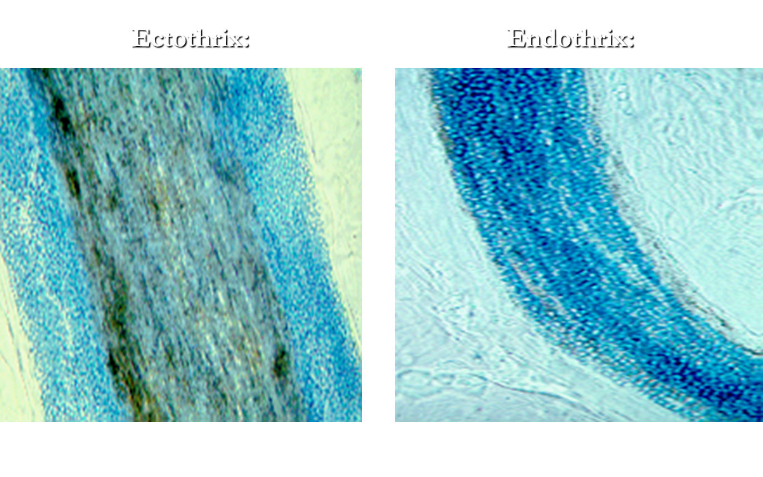
2.Direct microscopy using KOH preparation:
KOH exam. The most important diagnostic tool in all dermatophytosis.
In tinea capitis there are two types of hair invasions by dermatophytes
1. Endothrix: Where the spores present inside the hair shaft.
2. Ectothrix: Where the spores present outside the hair shaft.

Slide 11




3.Fungal culture:
Fungal culture will not only confirm the diagnosis of tinea, but it will identify the species of the causative dermatophytes.
Sabouraud's Dextrose Agar is the ideal media for fungi.

Slide 12
Treatment of Tinea
Wide range of topical and systemic antifungals are available but systemic antifungal is essential in the following clinical types of tineas.
1. Tinea Capitis.
2. Tinea Barbae.
3. Tinea Unguium.
4. Extensive other tineas e.g. tinea corporis, tinea cruris.

Slide 13
Topical antifungal:
1. Imidazole derivatives includes:
Ketoconazole.
Clotimazole.
Econazole.
Miconazole.
Other topical antifungals
2. Ciclopirox olamine
3. Topical terbinafine.

Slide 14
Systemic antifungals:
Griseofulvin.
Itraconazole.
Fluconazole.
Terbinafine.

Slide 15
1. Griseofulvin
Available since 1958 and FDA approved for dermatophytosis
Safe and effective for different types of tinea.
It is a fungistatic effective only against dermatophytes.
Absorption is increase after fatty meals.
Associated with minimal side effects.
LFT, prior treatment in long courses therapy is advisable.

Slide 16
Dosage of Griseofulvin ( 15 - 20 mg / kg / day)
Tinea capitis (The drug of 1st. Choice)….....6 - 8 weeks.
Tinea unguium…………………………….6 - 12 months.
Tinea cruris or Tinea corporis……….......... 2 - 4 weeks.

Slide 17
2. Itraconazole and 3.Fluconazole.
Fungistatic broad-spectrum oral antifungal.
They are effective against dermatophytosis (tinea), candidiasis, and pityrasis versicolor.
Used as a continuous regimen or by pulse therapy.

Slide 18
5.Terbinafine
The only available fungicidal oral antifungal.
Narrow-spectrum antifungal.
Effective only against dermatophytes
Ineffective agains candida nor M. furfur.
Well tolerated & associated with minimal side effects

Slide 19
Candidiasis
Common superficial fungal infection of the skin and mucous membranes caused by the yeast Candida albicans.
Predisposing Factors for Candidiasis:
•Excessive humidity and continuous friction.
•Wearing tight nylon underwear.
•Diabetes mellitus.
•Pregnancy and oral contraceptive.
•Prolonged antibiotic therapy.
•Iron deficiency anemia.

Slide 20
Candidiasis
1. Oral Candidiasis.
A. Oral thrush.
B. Angular chelitis.
Cutaneous Candidiasis.
A. Candidal intertrigo.
B. Candidal N.K.D
C. Candidal paronychia.
3. Genital Candidiasis.
Male: Candidal balanitis.
Female: Candidal VulvoVavanitis

Slide 21
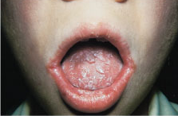
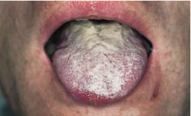
Oral thrush
Angular chelitis

Slide 22
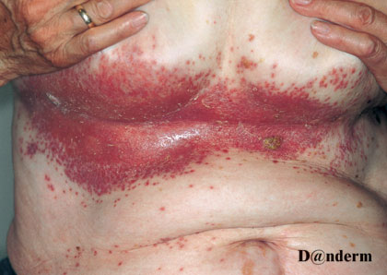
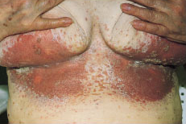
Candidal intertrigo
Note the satellite lesions

Slide 23
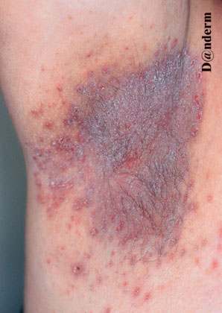
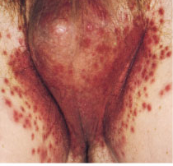
Candidal intertrigo
Note the satellite lesions

Slide 24
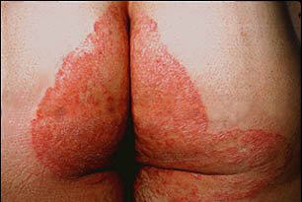
DD of erythematous scaly patches in the groin and intergluteal clefts:
Candidal intertrigo.
Tinea cruris
Erythrasma.
Contact dermatitis.
Flexural psoriasis.

Slide 25
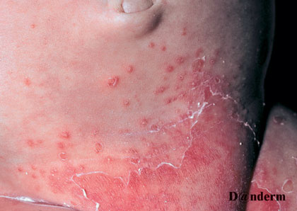
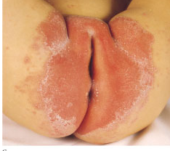
Candidal N.K.D

Slide 26
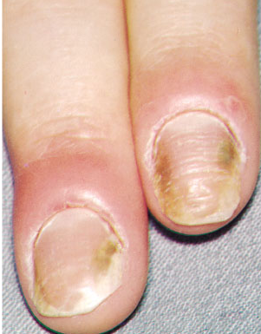
Candidal Paronychia

Slide 27
Genital candidiasis:
It may affects male or females
Candidal balanitis:
Which affect the glans penis.
Clinically presented with erythema and oozing sometimes lead to erosions.
Candidal vulvovaginitis:
Present with vaginal erythema and vaginal discharge.

Slide 28
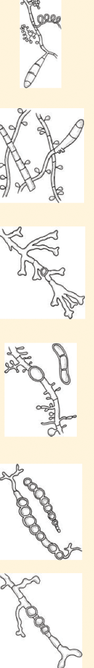

Thanks !!!

