Slide 1


COVID-19
Its Pathogenesis & Prevention​ ​
By: Tasneem Hakeem
3566

Slide 2
01
02
INTRODUCTION
SYMPTOMS
03
04
PATHOGENESIS
PREVENTION
Objectives
Outline the structure of Coronavirus .
Outline the main symptoms of Corona infection .
Discuss the pathogenesis of Corona.
How can we protect ourselves ?​

Slide 3
01
INTRODUCTION
Outline the structure of the Coronavirus .

Slide 4
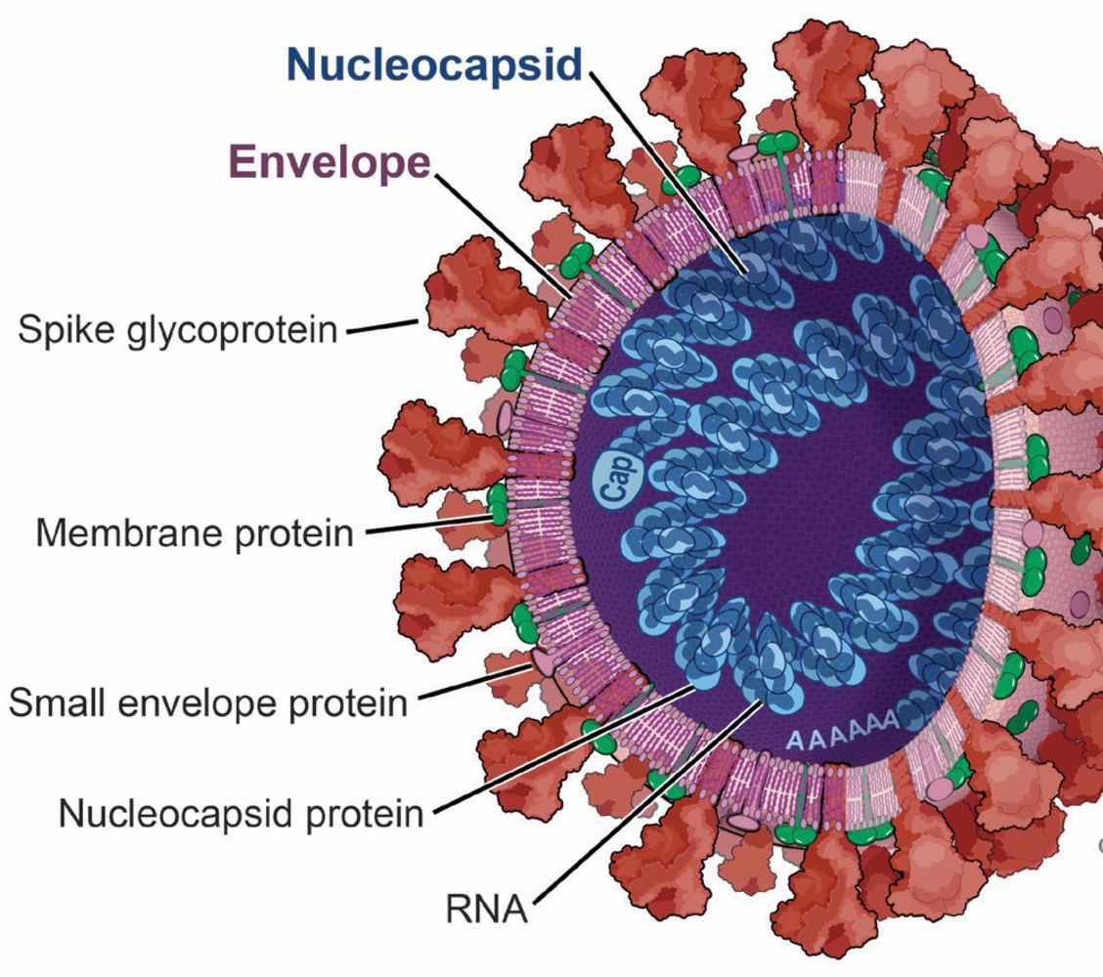
Structure of Corona Virus
Corona = Crowns due to spikes
Main features:
Medium-sized virus size, but largest mRNA genome
Glycoprotein Spike (S) Peptomer to allow it to attach to human cells receptors in upper or lower airway

Slide 5
02
SYMPTOMS
Outline the main symptoms of Corona infection .

Slide 6
COMMON SYMPTOMS OF THE DISEASE
HIGH FEVER
DRY COUGH
TIREDNESS

Slide 7
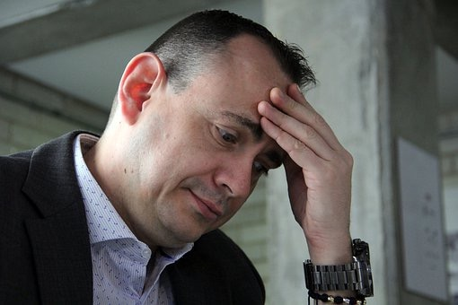
LESS COMMON SYMPTOMS
Sore throat
Headache
Aches and pains
Diarrhea
A rash on skin, or discoloration of fingers or toes
Red or irritated eyes

Slide 8
03
Pathogenesis
Discuss the pathogenesis of Corona.

Slide 9
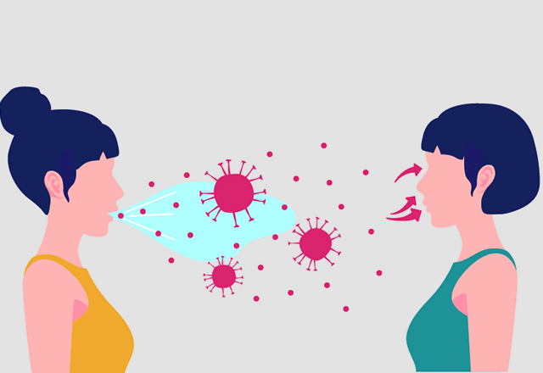
Stage 1: Asymptomatic state (initial 1–2 days of infection)
The inhaled virus SARS-CoV-2 likely binds to epithelial cells in the nasal cavity and starts replicating. There is local propagation of the virus but a limited innate immune response. At this stage the virus can be detected by nasal swabs. The viral burden may be low but these individuals are infectious.

Slide 10
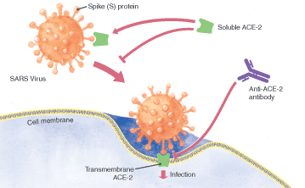
Stage 2: Upper airway and conducting airway response (next few days)
The virus propagates and migrates down the respiratory tract and a more robust innate immune response is triggered. Nasal swabs or sputum should yield the virus (SARS-CoV-2) as well as early markers of the innate immune response.

Slide 11
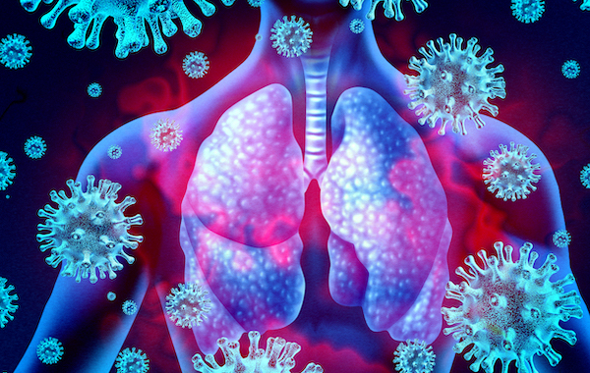
Stage 2: Upper airway and conducting airway response (next few days) CONT..
At this time, the disease COVID-19 is clinically manifest. For about 80% of the patients, the disease is mild & restricted to the upper and conducting airways.
These individuals may be monitored at home with conservative symptomatic therapy

Slide 12
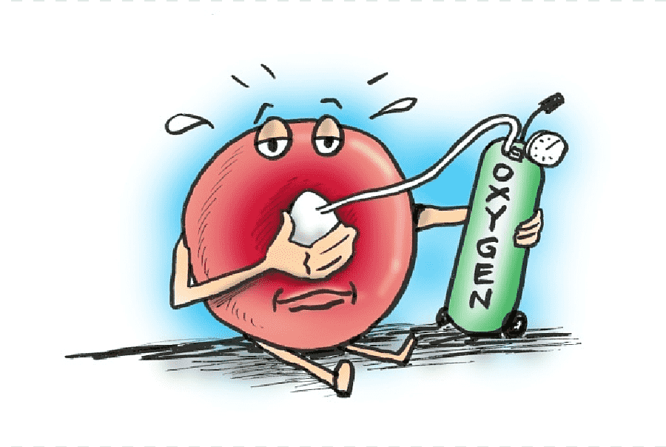
Stage 3: Hypoxia, ground glass infiltrates, and progression to ARDS
About 20% of the infected patients will progress to stage 3.
The virus now reaches the alveoli and infects alveolar type II cells.
large number of viral particles are released, and the cells undergo apoptosis and die.
Areas of the lung will likely lose most of their type II cells. Recovery will require a vigorous innate and acquired immune response and epithelial regeneration.

Slide 13
04
Prevention
How can we protect ourselves ?​

Slide 14
MAKE YOUR TRAVEL SAFE
Wear masks in public
Keep your distance
Cough and sneeze on your elbow
Do not crowd lifts or escalators
Check capacity before boarding
Stay home if you are sick
Check capacity before boarding

Slide 15
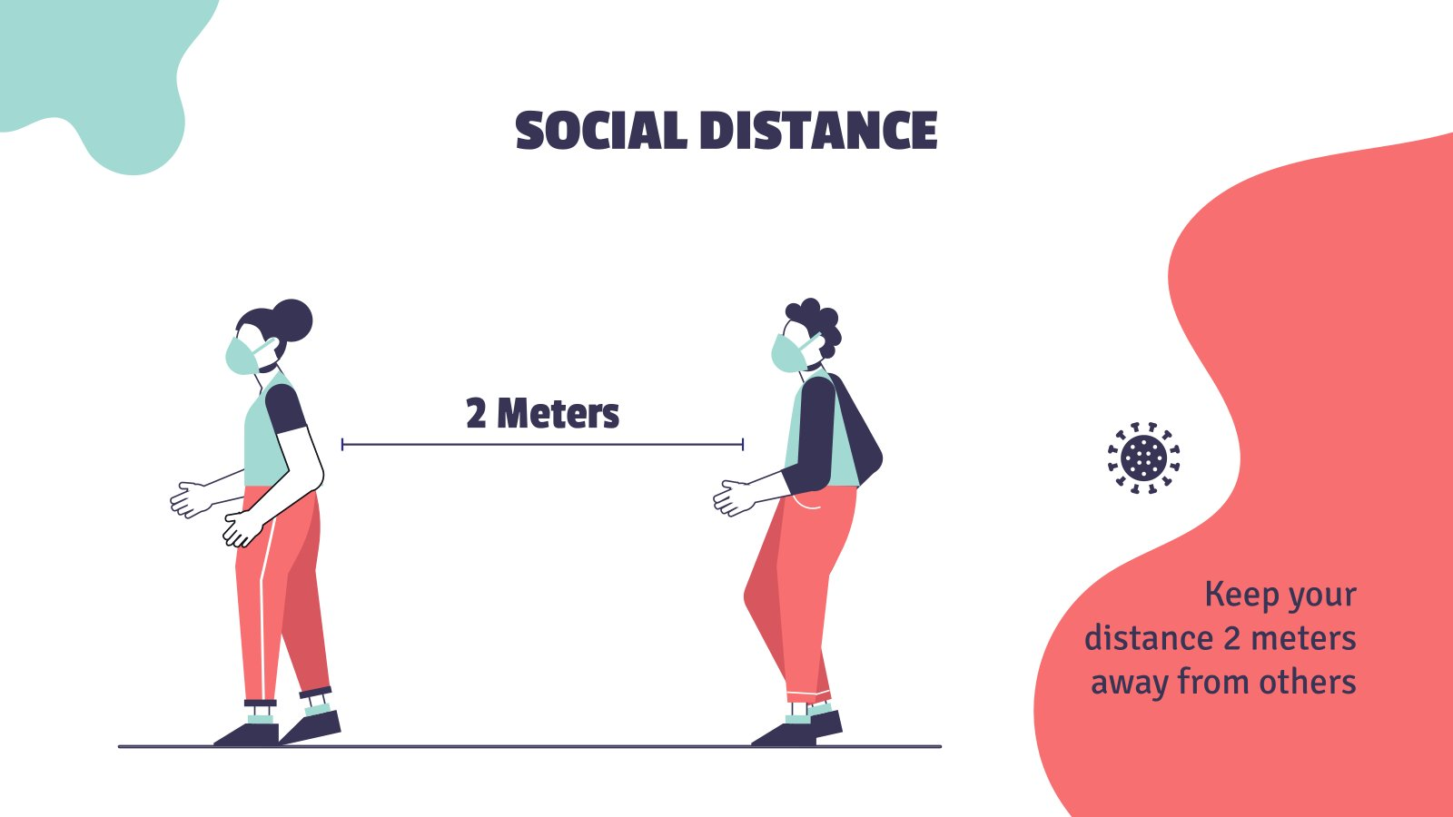

Slide 16
conclusion:
In the end you must protect
Yourself from injury because if you have elderly people at home they are more susceptible to disease.

Slide 17
References
Huang C. et al. Clinical features of patients infected with 2019 novel coronavirus in Wuhan, China.Lancet. 2020; 395: 497-506
Xu Z, Shi L, Wang Y, et al. Pathological findings of COVID-19 associated with acute respiratory distress syndrome. Lancet Respir Med 2020; 8: 420–422. https://emcrit.org/ibcc/COVID19/
UpToDate on Coronaviruses, SARS, MERS, COVID-19
CDC: https://www.cdc.gov/coronavirus/2019-ncov/index.html
WHO: https://www.who.int/health-topics/coronavirus
https://www.worldometers.info/coronavirus/
https://coronavirus.1point3acres.com/en?fbclid=IwAR3A3clE1Ztxi-fNBgTWtVOobWuUBGFJ1S3NBPFlAaYVruBcAtzeOcqpIjQ

Slide 18
THANKS!

