Slide 1



Customer-Oriented Strategy
Libyan International Medical University
Faculty of Business Administration
NAME : Maha Motaz Bennasser
ID NUMBER : 3153
EMAIL : maha_3153@limu.edu.ly

Slide 2

Contents
What are the elements of a customer – oriented marketing strategy ?
Target your market.
Meet customer needs.
Building customer loyalty.
Use customer feedback.
Earning customer referrals.

Slide 3

Introduction
In a highly competitive business environment , focusing on the needs of your customers can give you an advantage over your competitors.
Satisfied customer are more likely to repeat and direct new business to your organization.
The marketing strategy should be geared towards reaching those will benefit.
More than your product or service , a customer-oriented marketing strategy includes elements such as defining your target market and interacting with their needs.
It should also detail the customer retention and use methods to help you get additional business.

Slide 4
What are the elements of a customer-oriented marketing strategy ?
The elements of a customer – oriented marketing strategy are as follows :
Target your market .
Meet customer needs .
Building customer loyalty .
Use customer feedback .
Earning customer referrals .

Slide 5

Target your market :
A customer-led marketing strategy targets a specific market segment, Use marketing research to identify common demographics within your customer base , such as age, gender , occupation and income level.

Slide 6
Meet customer needs :
A customer-oriented marketing strategy focuses on meeting the needs of your customers and
Examines how your products or services can meet those needs, suppose that your initial research tells you that your customers are very interested in receiving a high level of service, you may be able to meet this need by offering free deliveries or hours a long business, ega doctor with an office in a crowded area, where parking spaces are few, met the specific needs of his patients by offering free pick-up and drop-off

Slide 7
Building customer loyalty :
Customer-based marketing helps build loyalty, which can lead to repeat sales in addition to referral business one method marketers use is to implement a rewards program where customers receive points every time they make a purchase, points accrual leads to free or discounted products or services, this is not only an option for large traders, even medium-sized companies can offer an attractive rewards program

Slide 8


Use customer feedback:
Use feedback from your customers to make changes or improvements to help you continue to meet customers’ needs in the future For example your customer may indicate they want a different store , mix of products or a better
Customer return policy Make any necessary changes and use your marketing
Strategy to get the word out To show your focus on serving your customer .

Slide 9
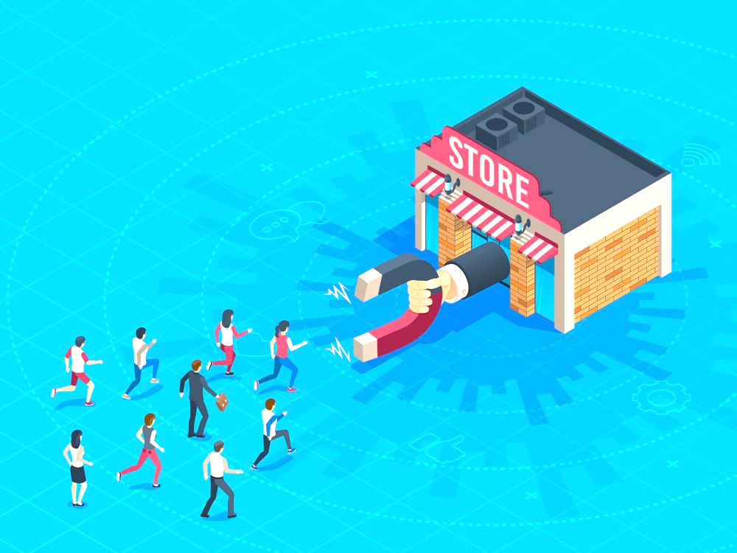
Earning customer referrals
Make referral generation a part of your marketing strategy that customers rely on Encourage your existing customer to spread the word about your business to gain
New customers Implement a referral program where customers are rewarded for
Sending new business your way by giving them additional discounts or free merchandise You can even run a contest to find out Any customer can send you the
Most referrals in a given period of time .

Slide 10
References
What is Customer Orientation? - Definition | Meaning | Example. (n.d.). My Accounting Course. Retrieved April 1, 2022, from https://www.myaccountingcourse.com/accounting-dictionary/customer-orientation#:~:text=Definition%3A%20Customer%20orientation%20is%20a

