Slide 1




Slide 2
Learning objectives
- Definition of EBM
Explain its importance
Describe the steps of EBM
Produced a focused question

Slide 3
A 21 st. century clinician who can not critically read the study is as unprepared as one who can not take a blood pressure or examine a cardiovascular system.
BMJ 2008 :337:704-705

Slide 4
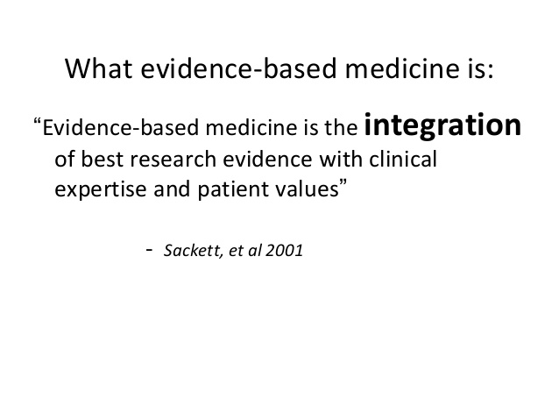

Slide 5
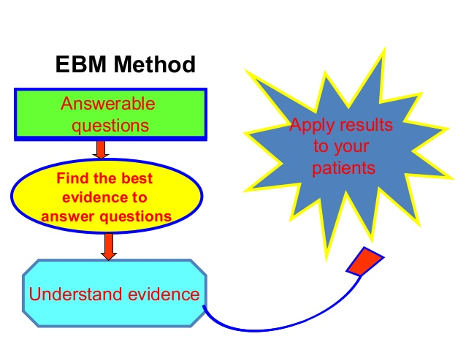

Slide 6
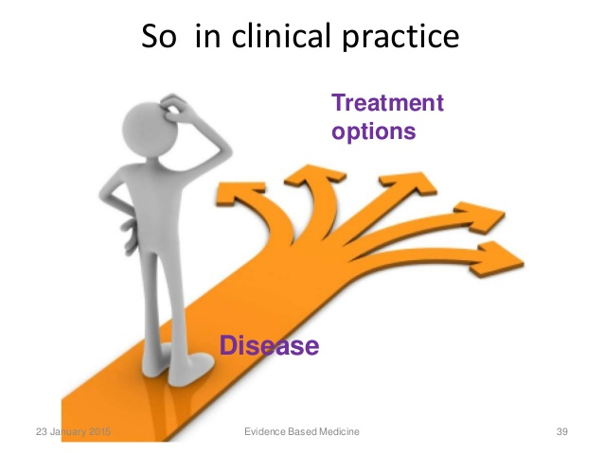

Slide 7
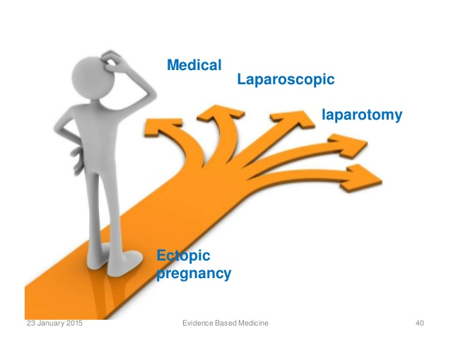

Slide 8


Slide 9
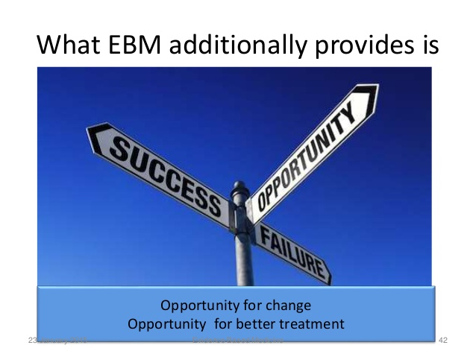

Slide 10
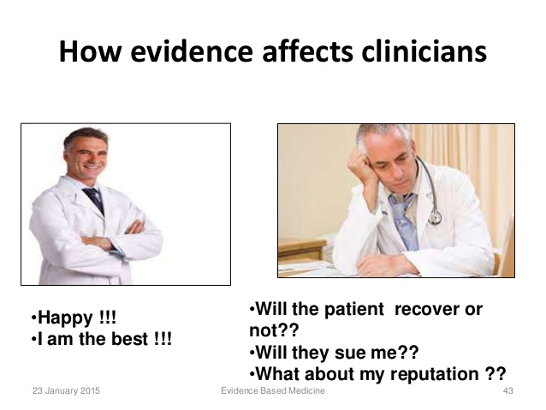

Slide 11
Why EBM is important ?
Practicing EBM is important in today's healthcare environment because this model of care offers clinicians a way to achieve the Triple Aim's objectives of ;
- Improved quality
- Improved patient satisfaction
- Reduced costs.

Slide 12
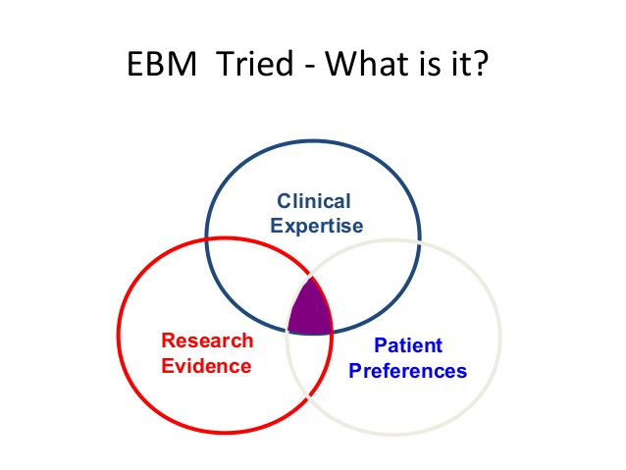

Slide 13
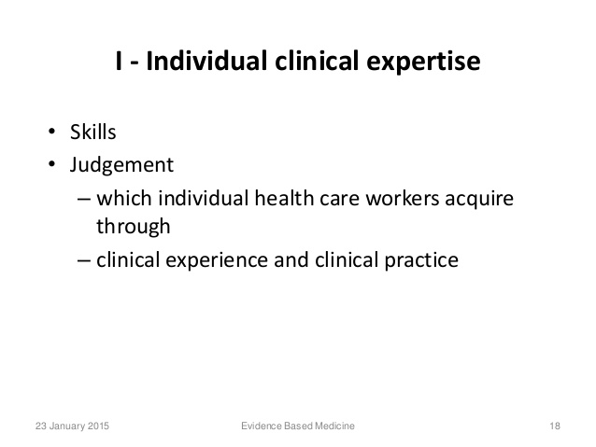

Slide 14


Slide 15
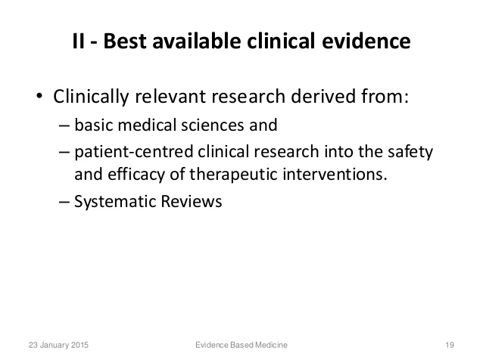

Slide 16
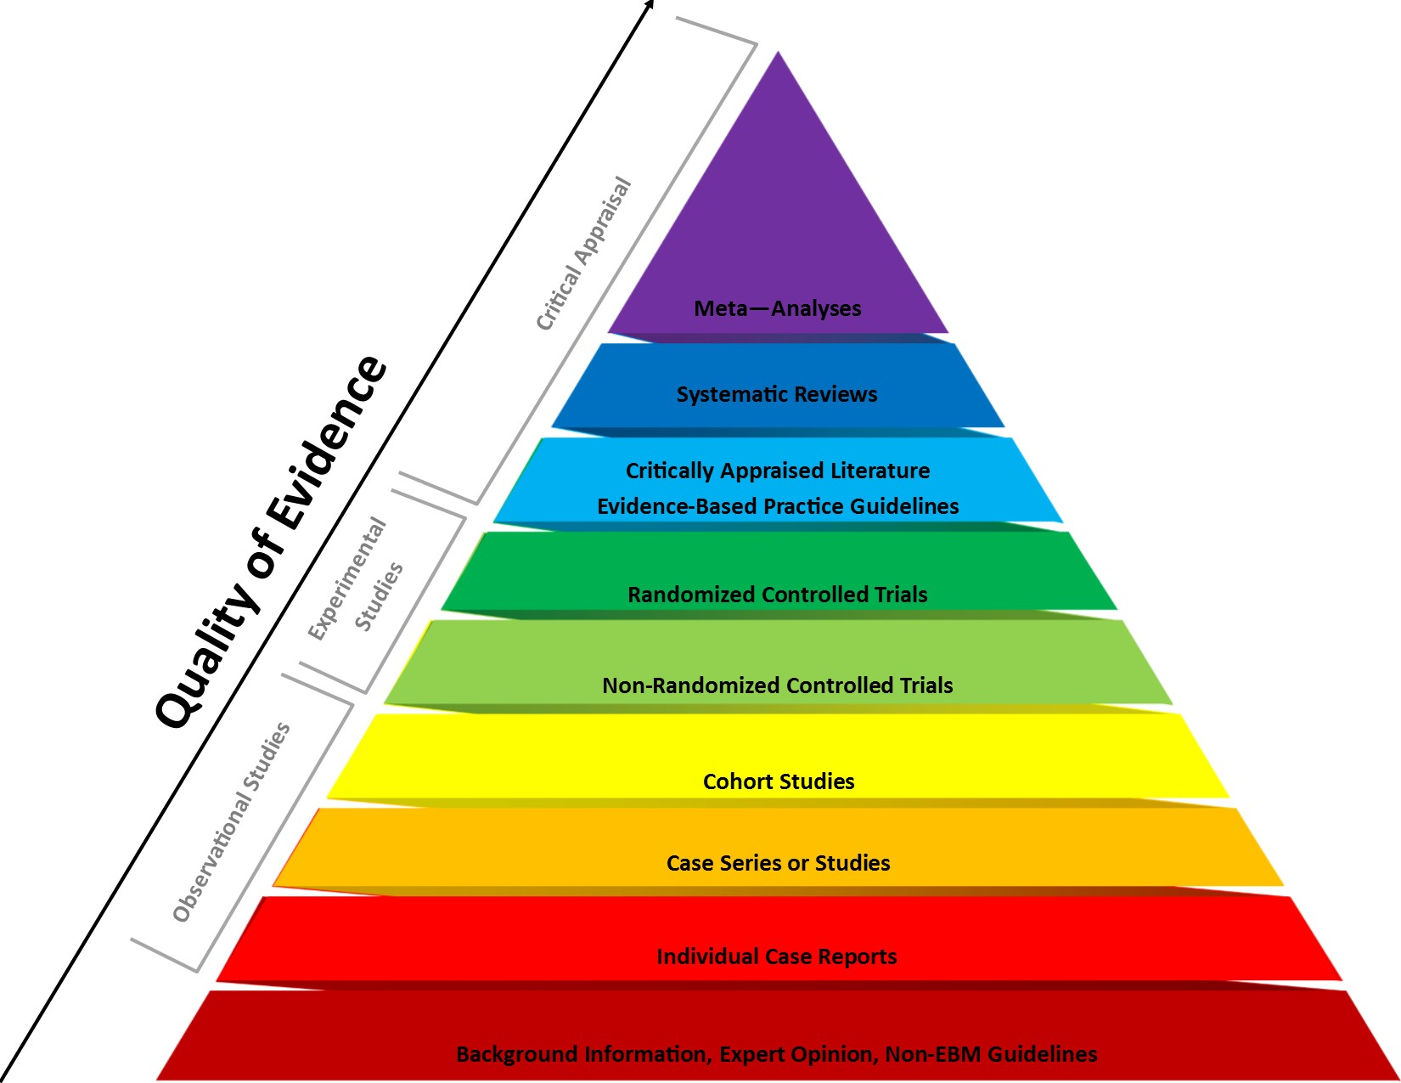

Slide 17
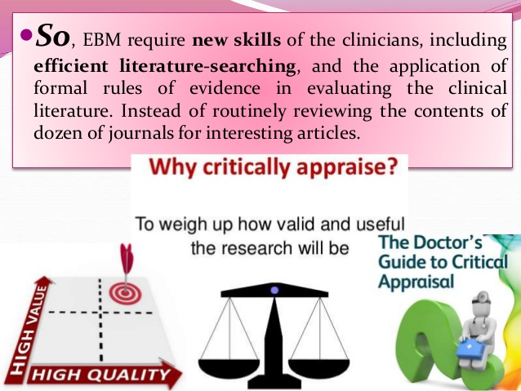

Slide 18
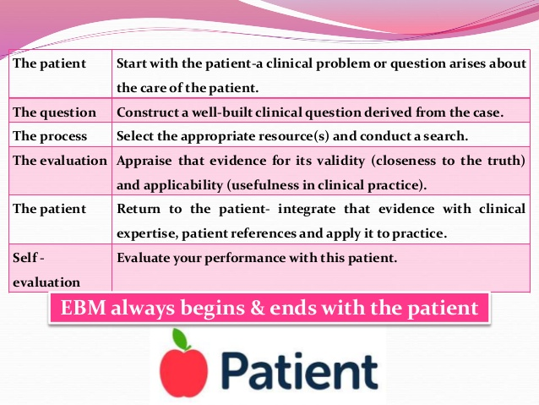
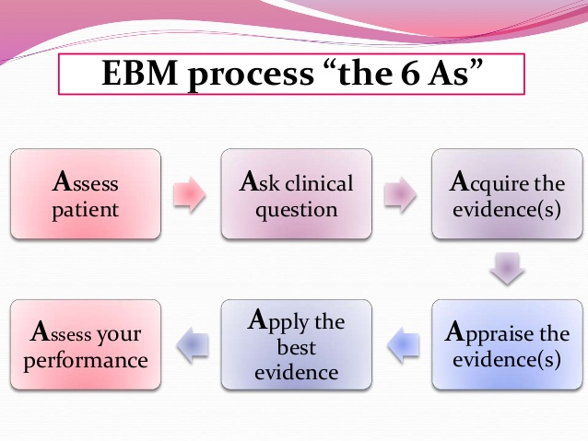

Slide 19
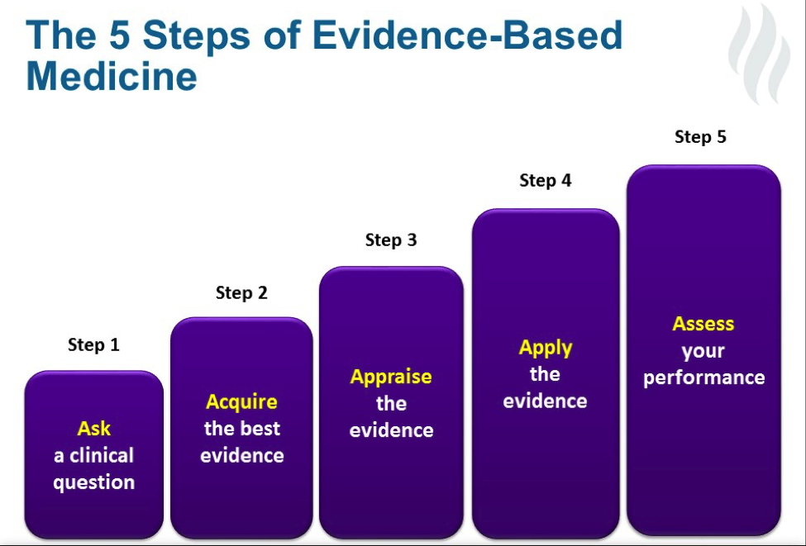

Slide 20
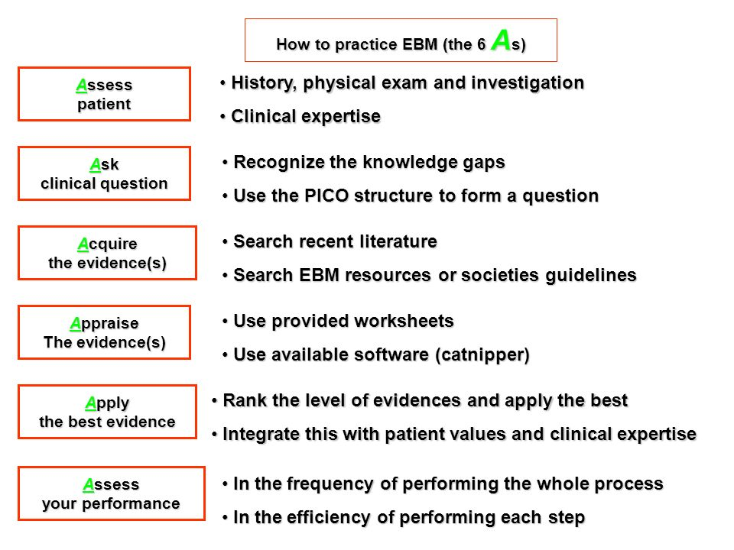

Slide 21
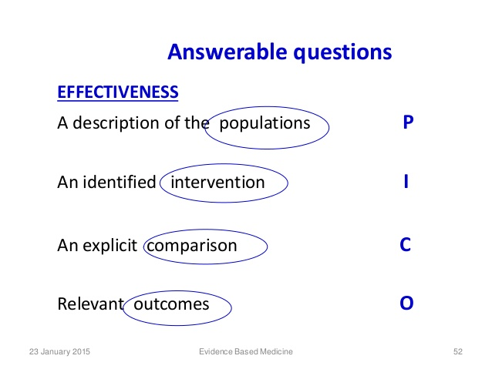

Slide 22
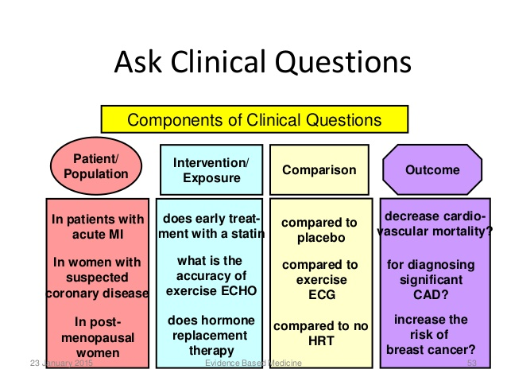

Slide 23
A 28 patient years old man has had episode of chest pain
ECG ,echocardiogram and cardiac MRI changes confirm a diagnosis of pericarditis ( P)
The symptoms subside with NSAIDs such as aspirin however the patient is asking for preventive measures to avoid further pain attacks (I)
You advised the patient to starting colchicine, however the patient wants to know if this is more effective in preventing his pericarditis than aspirin or ibuprofen before starting the treatment (C)
(O)

Slide 24
Clinical Question
How effective is colchicine with NSADs compared to NSADs alone in preventing recurrent episode of pericarditis in a young man ?
P = Young man with repeated episodes of pericarditis
I = Colchicine
C = NSADs (aspirin or ibuprofen )
O = Preventing further pericarditis

Slide 25
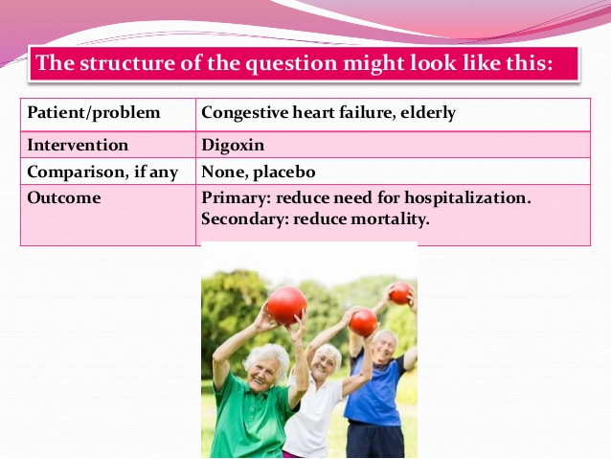

Slide 26
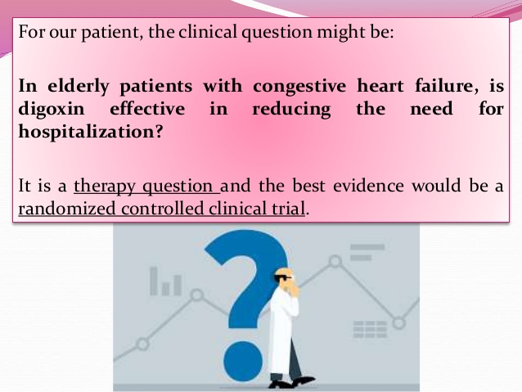

Slide 27
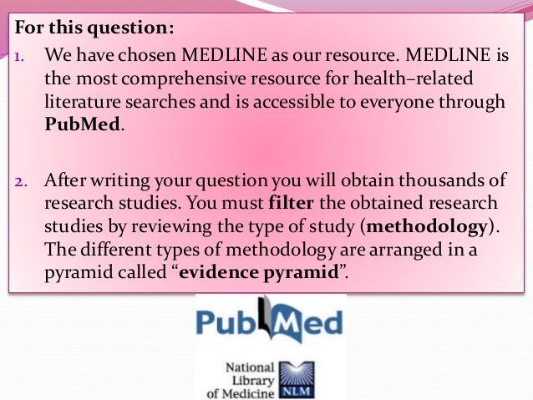

Slide 28
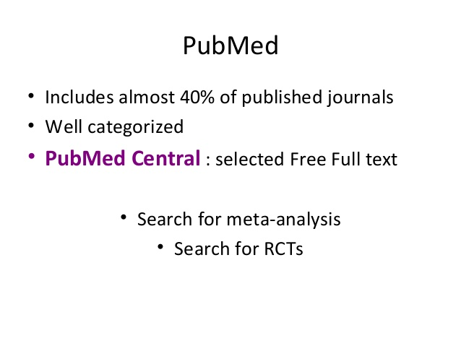

Slide 29
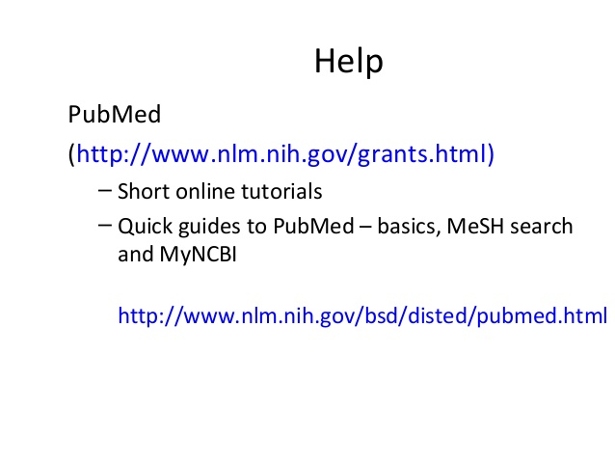

Slide 30
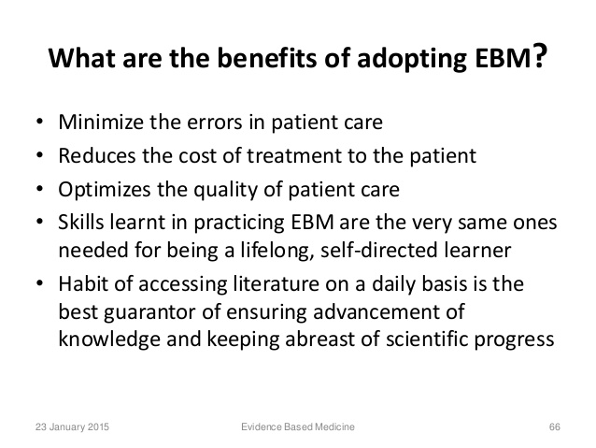

Slide 31
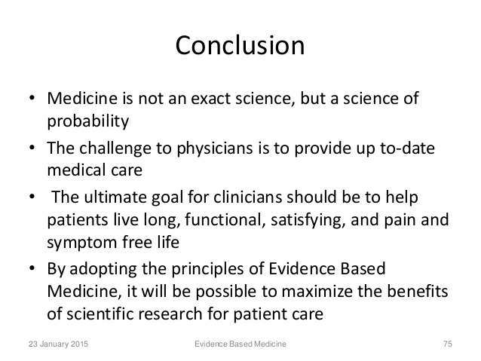

Slide 32


Slide 33

Association & Causation
Dr. Amina Elsaid
Community medicine

Slide 34
Learning objectives
To understand
1- Meaning of association and causation
2- Types of association
3- Criteria for causal association (Hill’s criteria)

Slide 35
Epidemiological principles stand on two basic assumptions
Human disease does not occur random
- The disease and its causal as well as preventive factors can be identified by a full investigation of population
Identification of causal relation between a disease and suspected risk factor forms part of epidemiological research.

Slide 36
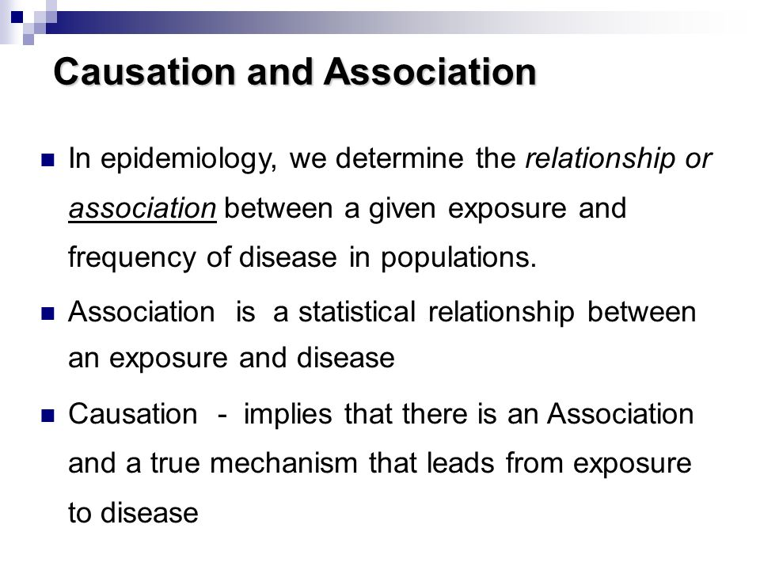

Slide 37
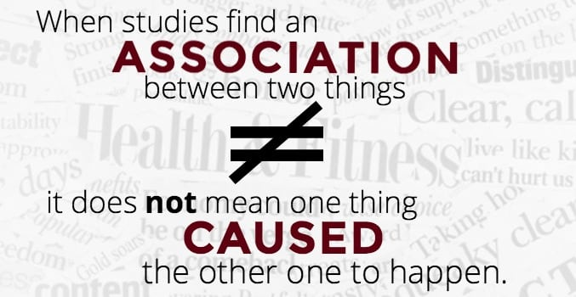

Slide 38
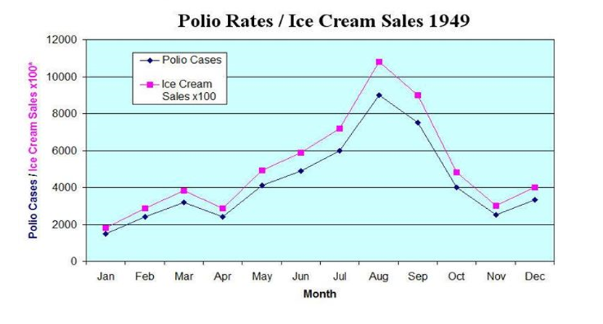
The figure shows the monthly number of new cases of polio and the consumption of ice cream for the year 1949.
The two curves move in lock step, exhibiting a very high correlation.
In fact, children were instructed to refrain from ice cream in order to reduce their chances of contracting the deadly disease

Slide 39
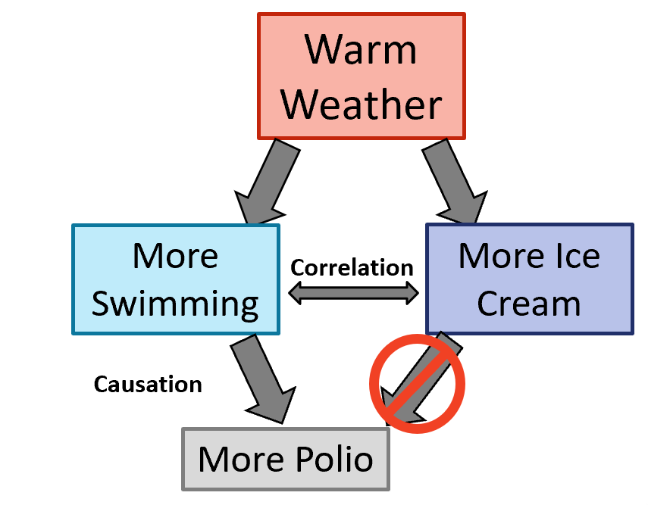

Slide 40
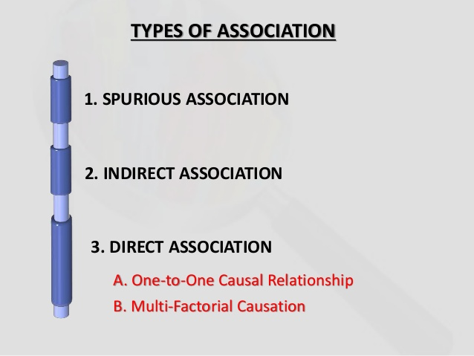

Slide 41
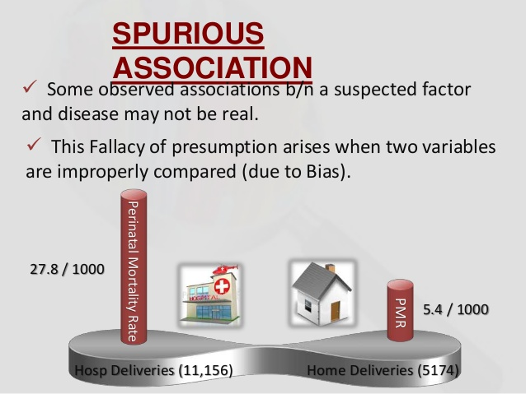

Slide 42
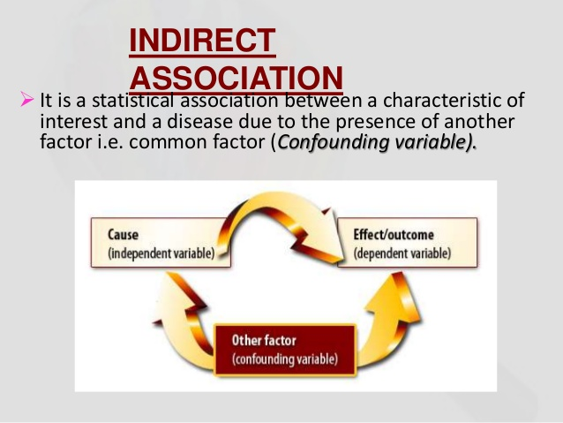

Slide 43
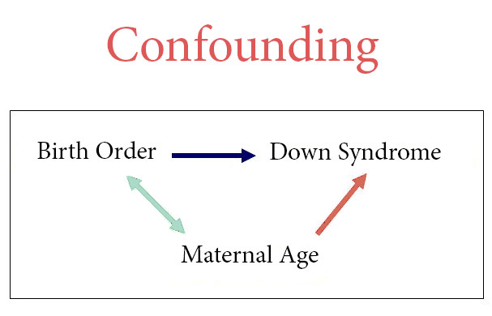

Slide 44
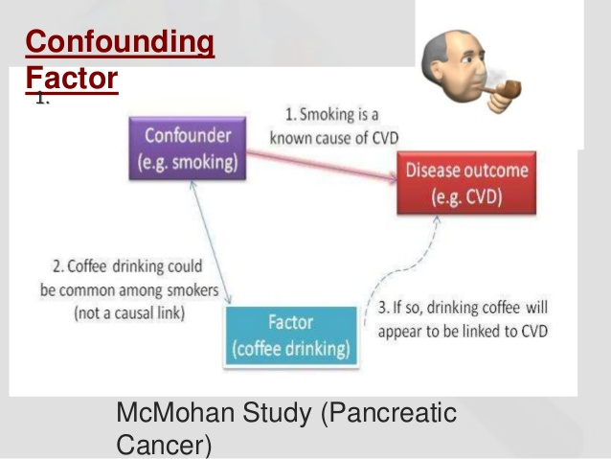

Slide 45
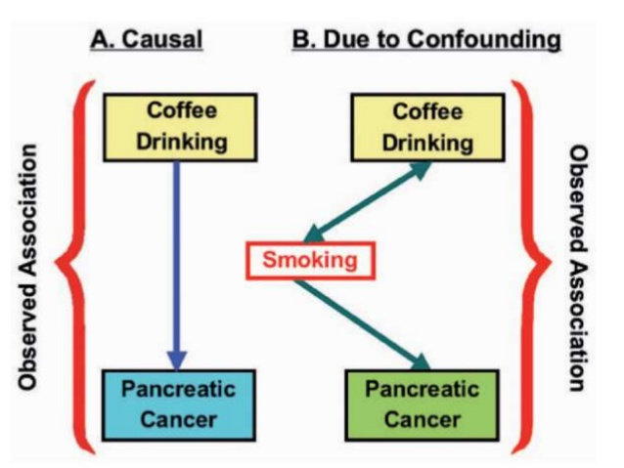

Slide 46
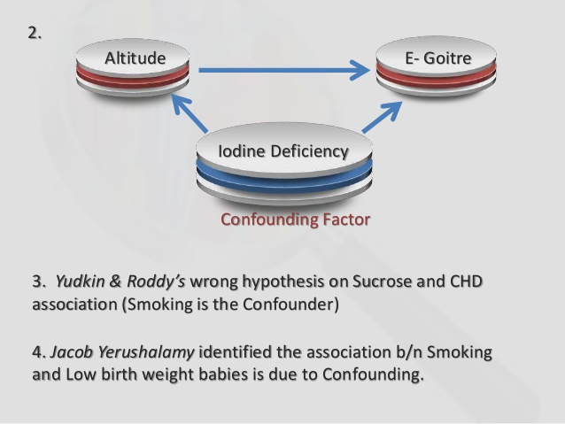

Slide 47
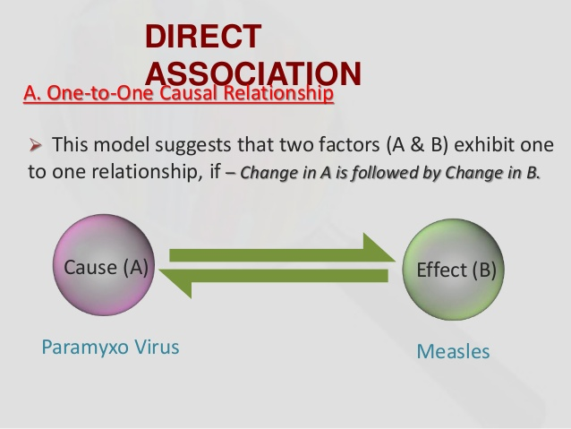

Slide 48
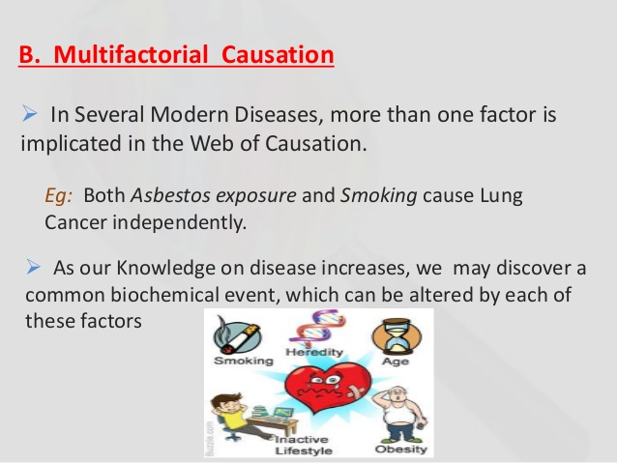

Slide 49
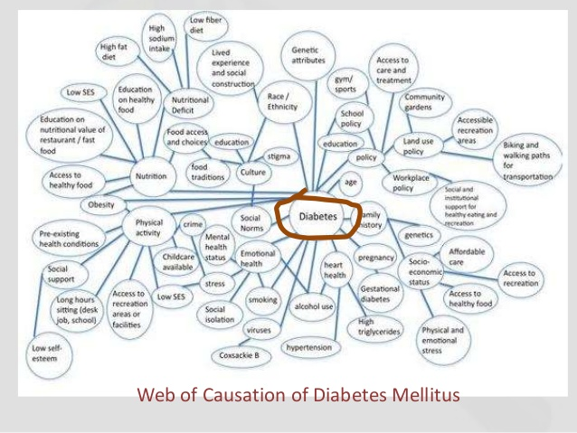

Slide 50
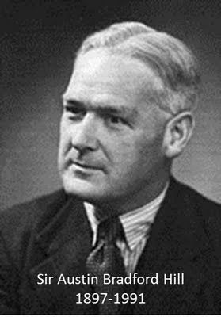
1965

Slide 51
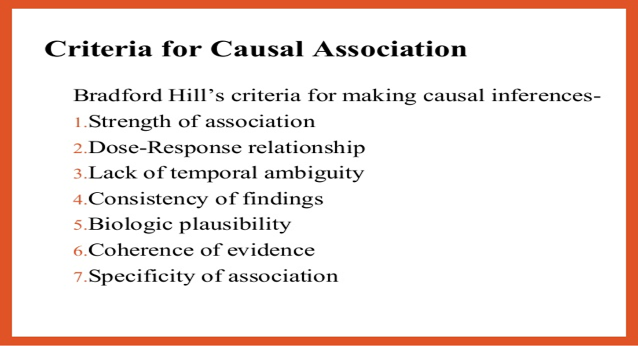

Slide 52
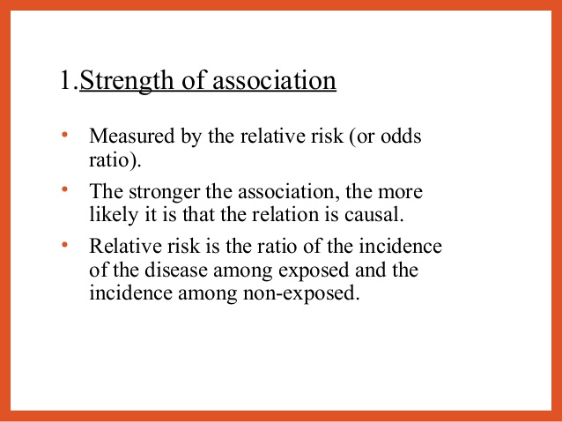

Slide 53
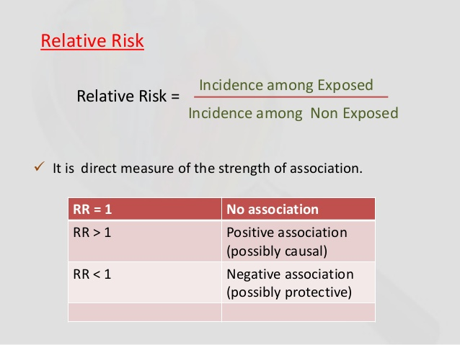

Slide 54
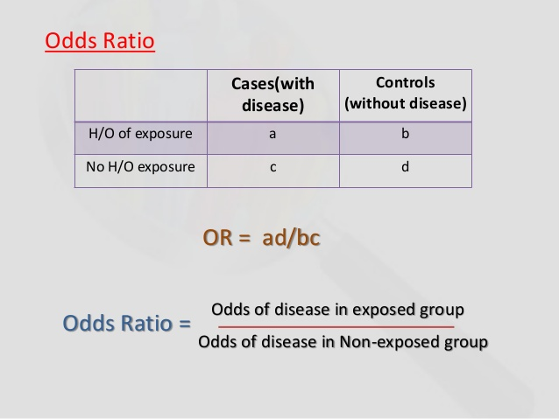

Slide 55
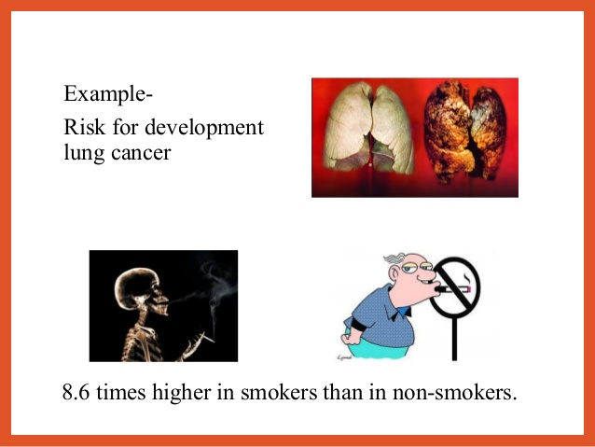

Slide 56
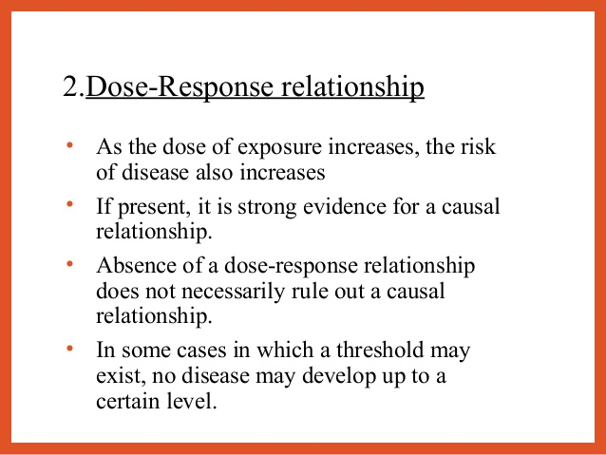
Notes:
Threshold may exist no disease may develop up to a certain level

Slide 57
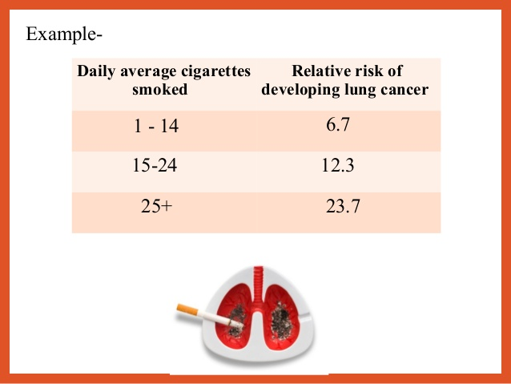

Slide 58
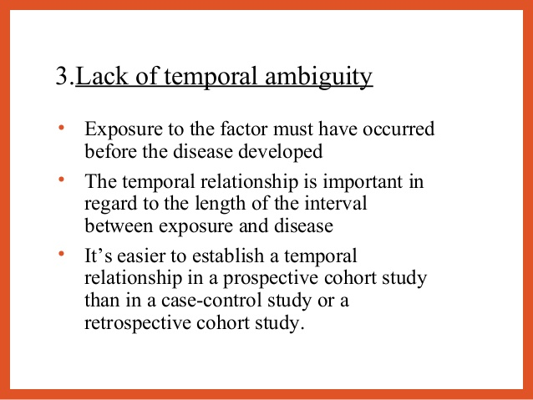

Slide 59
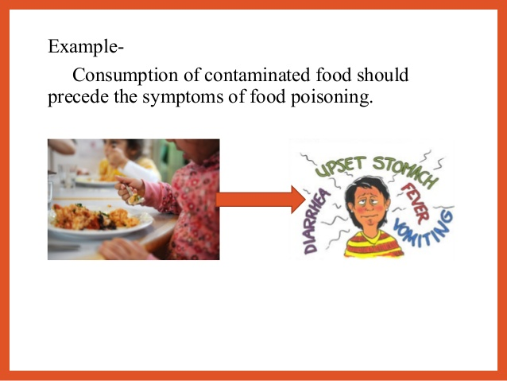

Slide 60
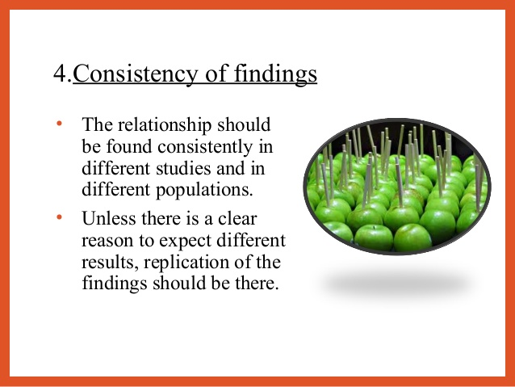
Notes:
Consistency

Slide 61
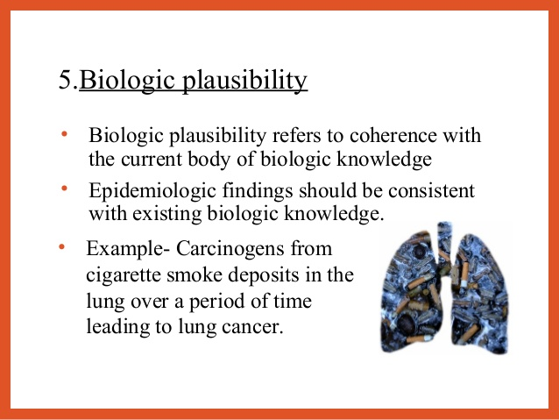
Notes:
Biologic plausibility

Slide 62

Notes:
Coherence of evidence

Slide 63


Slide 64


Slide 65


Slide 66

Thank you

Slide 67
Screening for disease
Dr.Amina Elsaid
Community Medicine

Slide 68
Learning objectives
To understand
1- Definition of screening
2-Criteria of screening test
3-Differences between screening and diagnostic test
5-Objectives of screening
6- Uses of screening
7- Types of screening
8- Measure of validity

Slide 69

Screening for disease
defined as “search for unrecognized disease or defect by means of rapidly applied tests, examinations or other procedures in apparently healthy individuals”.
Ex : Screening of tuberculosis
Syphilis
Antenatal mothers
School children
Occupational groups

Slide 70


Slide 71


Slide 72

Notes:
Continuing process and not a once for all project

Slide 73
Objective of screening
the main objective early detection of those diseases for which early treatment has been shown to be effective.
Screening test | Diagnostic test
1- done on apparently healthy 2-applied on group or population. 3- test results are arbitrary and not final 4- based on one criteria or cut-off point. 5- less accurate (less valid ) 6- less expensive. 7- not the basis for treatment. 8-the initiative comes from investigator. 9- mostly non or minimally invasive | 1-done on those with indication or risk. 2- applied on single patient when all diseases are under consideration. 3- diagnosis is final but modified in light of new evidence, diagnosis is sum of all evidence 4- based on evaluation of a number of symptoms, signs and lab findings. 5- more accurate(more valid) 6-more expensive. 7- used as a basis for treatment. 8-the initiative comes from patient. 9- mostly invasive

Slide 74
Examples of some diseases, screening tests and diagnostic tests
Disease | Screening test | Diagnostic test
Diabetes | Urine sugar & Blood sugar | Oral Glucose Tolerance Test
Hypertension | Measurement of Blood pressure | Measurement of Blood Pressure
Cervical cancer | PAP smear | Biopsy
Tuberculosis | Mass Miniature Radiography (MMR) | Sputum examination
HIV | ELISA test | Western blot test

Slide 75


Slide 76

Types of screening: Three types of screening have been described
Mass screening This refers to screening when it is offered to all people (irrespective of special risk)

Slide 77



Slide 78




Slide 79

B) high risk screening
(most common)
Is selective and is offered to those thought to be at special risk
e.g screening of close relatives of known diabetics, hypertension, breast cancer.
high risk screening greater No. of cases can be
identified at less cost.

Slide 80


C) multiphase screening
to screen for a variety of diseases at one time than to carryout separate screening tests for a single diseases.
Multiphase screening is a well established procedure in antenatal care and pre-school examination
More than one test is applied at same time

Slide 81
Criteria For Screening
Based on two factors:
a) The disease ( criteria for the disease to be screened )
It should an important public health problem (has high prevalence).
2. Has latent pre-symptomatic stage.
3. Must be clearly distinguishable from normality.
4- Must be reversible or controllable by treatment if diagnosed early

Slide 82
b) The test (criteria of the test used for screening)
1- Safe, easy and cost effective
2- capable of being applied to a large number of people rapidly.
3- valid ( accurate )
4- reproducible ( consistent results)- repeatability
5- acceptable to the people at whom it aimed

Slide 83

Measures of validity
Validity : It expresses the ability of a test to differentiate between those who have the disease from do not.
It refers to the closeness with which measured values agree with true values.

Slide 84

Evaluation of a screening test can be done by measuring the following :
1- Sensitivity
it is the ability to detect a high proportion of true positives that is to give very few false negative results.
(the percentage of sick people who are correctly identified as having the condition).
i.e test has 80% sensitivity mean 20% of diseased people screened by it will give false negative results.
If the test not sensitive , it gives a very large no. of false - ve and these patients will not be treated.
So sensitivity represent + ve cases among diseased
Or
The ability of screening test to detect true +ve among all +ve .

Slide 85
2- Specificity:-
the ability to detect or identify the true negatives that is to give very few False + ve results.
( the percentage of healthy people who are correctly identified as not having the condition).
i.e. test 80% specific False + ve results in 20% of non- diseased persons
Specificity True – ve cases among healthy
Or
Ability of screening test to detect – ve among all negative

Slide 86
True positive: Sick people correctly identified as sick
False positive: Healthy people incorrectly identified as sick
True negative: Healthy people correctly identified as healthy
False negative: Sick people incorrectly identified as healthy
Therefore:
True positive = correctly identified
False positive = incorrectly identified
True negative = correctly rejected
False negative = incorrectly rejected

Slide 87
3- Positive and Negative predictive value
Positive predictive value
is the probability that subjects with a positive screening test truly have the disease.
Negative predictive value is the probability that subjects with a negative screening test truly don't have the disease
The more sensitive a test is the better will be the negative predictive value of the test ( more confident the clinician can be that a patient with a negative test result does not have the disease being sought.

Slide 88


Slide 89


Slide 90
Thank you

