Slide 1
COPD

Slide 2
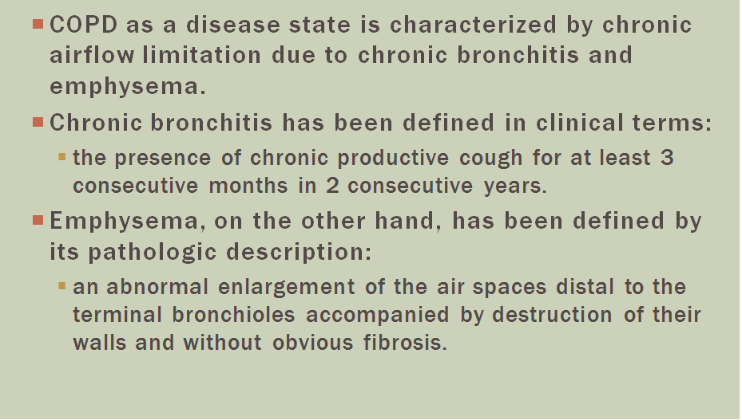
definition

Slide 4
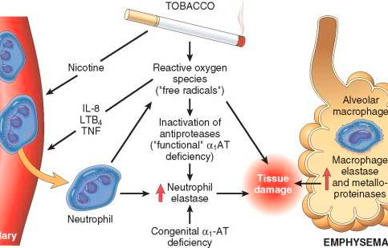
Pathogenesis

Slide 5
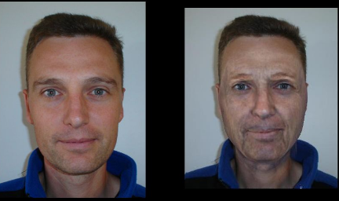
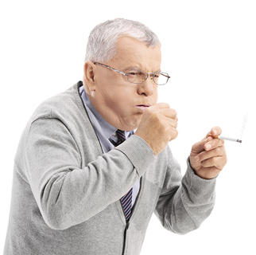

Slide 7
In Alpha-1 antitrypsin deficiency panacinar emphysema is generally maximal at the base.
The pt. is < 40 years with emphysema ± liver cirrhosis.
Centriacinar emphysema is commonest in the upper zones of both upper and lower lobes and has a closer relationship to cigarette smoking than panacinar disease.

Slide 8
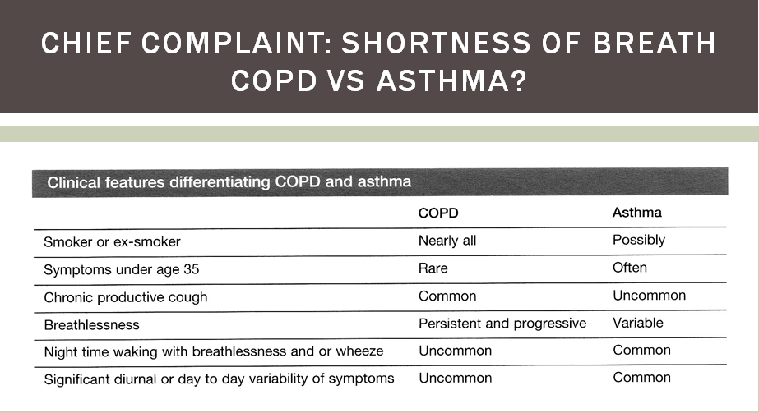

Slide 9
Clinical Picture `
Symptom:
Dyspnea
  (emphysema > chronic bronchitis).
Productive cough with whitish mucoid sputum
  (chronic bronchitis > emphysema).
Wheeze
  Mainly in chronic bronchitis.
  emphysema usually not causing wheeze unless coexists with bronchitis.

Slide 10
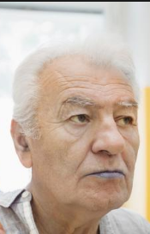
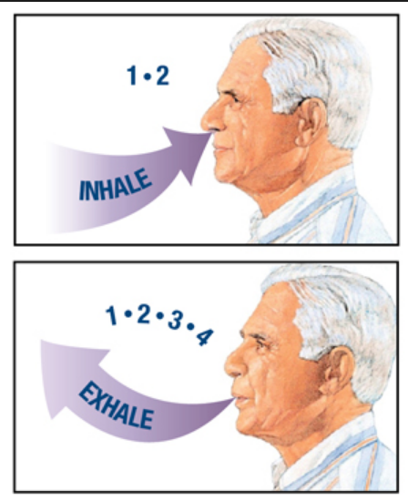
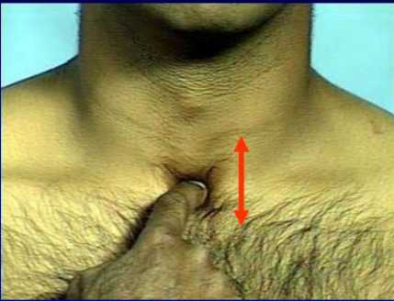
Signs:
Pursed lip breathing, cyanosis or plethoric face, nicotin stain, cricosternal distance <3cm

Slide 11
Chest exam.:
Use of accessory muscles with supra-sternal and intercostal recession.
↓chest expansion bilaterally, ↓ TVF, impalpable apex beat , hyper-resonance especially in emphysema, ↓ cardiac & liver dullness.
↓breath sounds bilaterally + rhonchi & crepitation in chronic bronchitis.

Slide 12
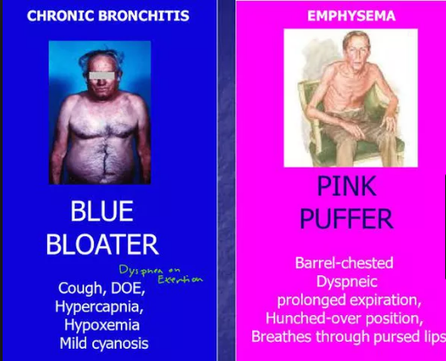

Slide 13
Chronic bronchitis (Blue bloater) | Emphysema (Pink puffer)
Obese | Thin | Built
prominent | Absent | Cyanosis
+ | ++ | Dyspnea
+ | +++ | Hyperinflation
Often [↑JVP, P. odema] | rarely | Cor pulmonale
Type 2 | Type 1 | Resp. Failure
Early | late | ABG Disturbance

Slide 14
Investigation
CXR
Hyperinflation
Bullae
Prominent broncho vascular markings
Pneumothorax
CT
For Emphysema the best diagnostic method is CT scan.

Slide 15
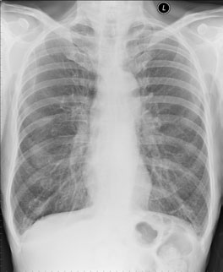
Signs of hyperinflation on X-ray
Tubular heart.
Flat diaphragm.
Prominent broncho-vascular marks.
Ant. Ribs > 6 & Post. Ribs > 10.

Slide 16
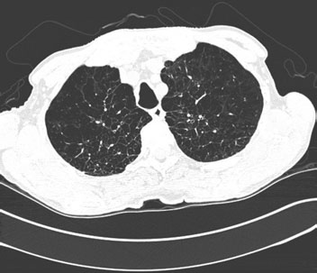
CT chest (Emphysema)
Bullae

Slide 17
ABG
Ch. Bronchitis → RF type II.
Emphysema →Resp. failure type I.
PFT
(obstructive pattern)
↓ FEV1 < 80% of predicted.
↓ FEV 1/FVC < 70%. BUT (Bronchodilator reversibility <15 %) → differentiate from bronchial asthma.
↓ DLCO: decreased in emphysema.
Notes:
VC (vital capacity) = volume of air expelled from the lungs during a maximum expiration

Slide 18
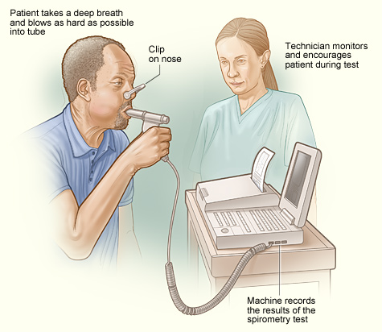
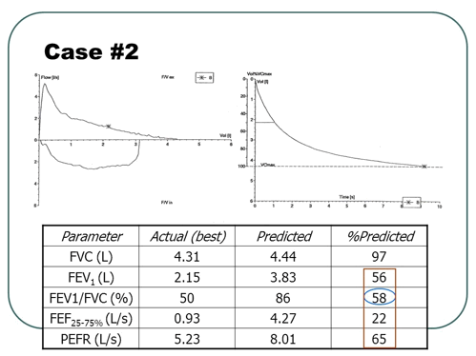

Slide 19
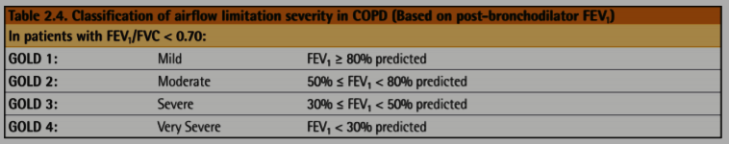
Classification of severity

Slide 20
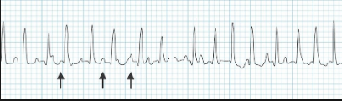
ECG:
Multifocal atrial tachycardia (MAT)
CBC:
Polycythemia
Leukocytosis

Slide 21
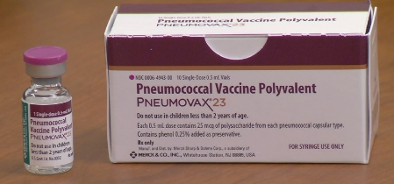
RX general
Smoking cessation: stops the progression of disease and ↓mortality.
Exercise REHAB
Mucolytics
Influenza & pneumococcal vaccine
Nutrition

Slide 22
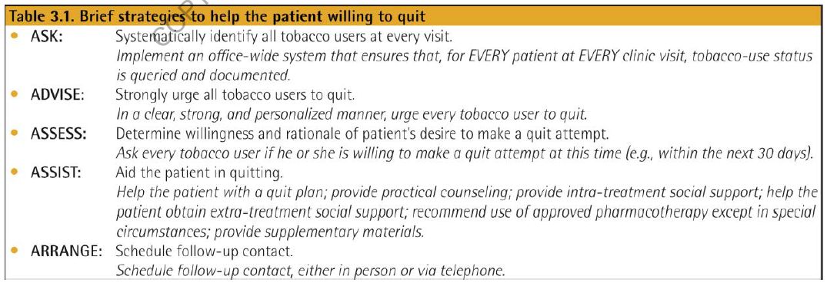

Slide 23
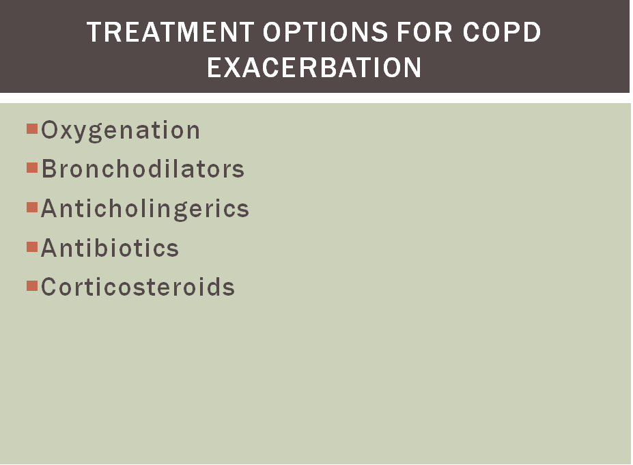

Slide 24
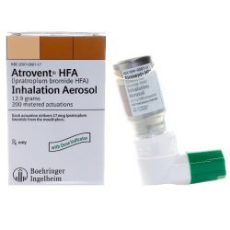
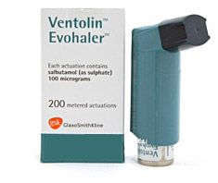
bronchodilators
Beta two agonist
Anticholinergic
Salbutamol (short acting) oral and inhaled
Salmeterol, formeterol (long acting) inhaled
Ipratropium bromide ATROVENT
VENTOLIN

Slide 25
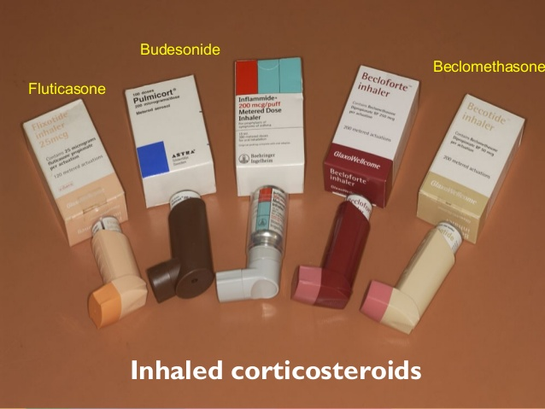
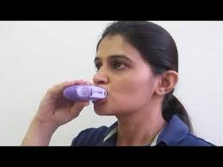
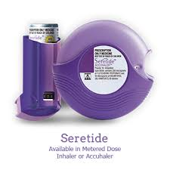
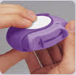
ANTI INFLAMMATORY
Steroids systemic i.v or oral tab
Inhaled steroids

Slide 26
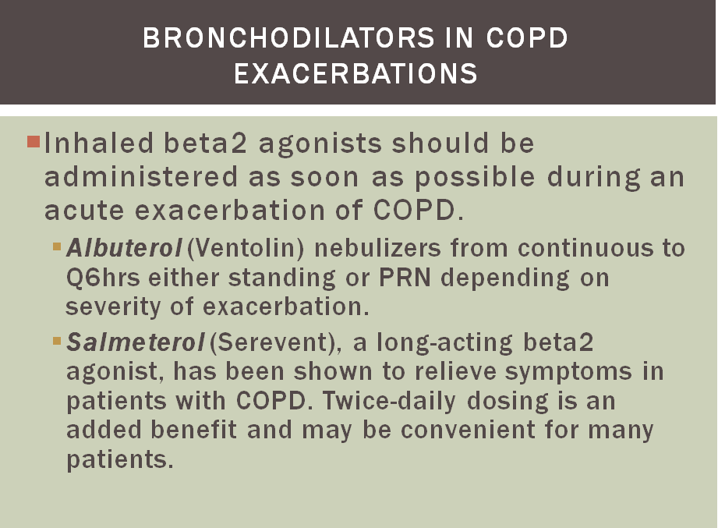

Slide 27
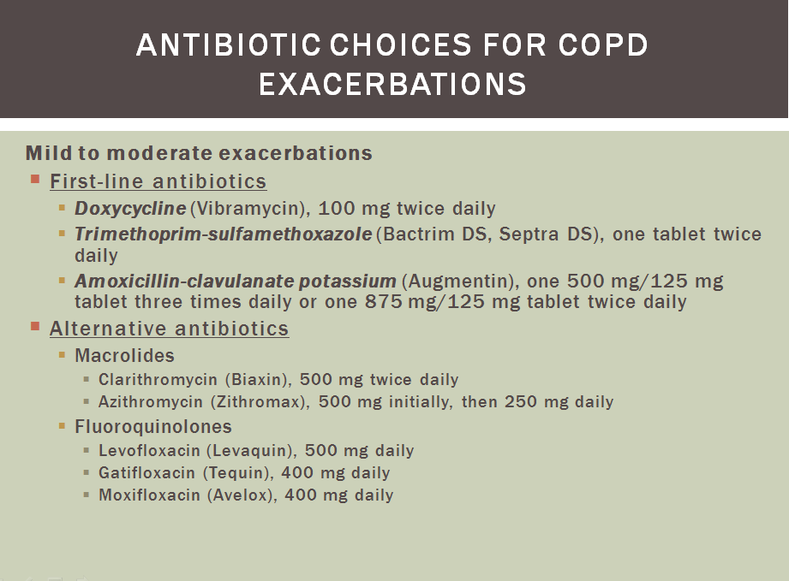

Slide 28
Long term O2 therapy
It improves survival.
Indications:
PO2 <55mmHg.
PO2 55-60mmHg + pulmonary HTN and\or polycythemia.
Terminally ill patient.

Slide 29
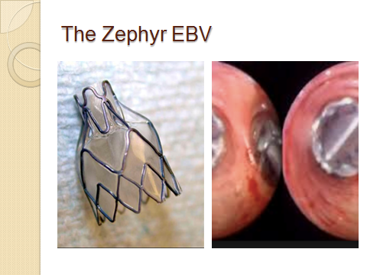
Surgery and Minimally Invasive (Non-Surgical) Approaches
Bullectomy
Lung Volume Reduction Surgery
Minimally Invasive approaches
Endobronchial Blockers
Bronchial Fenestration and Airways Bypass
Endobronchial Valves
Biological Lung Volume Reduction (Sealants)

Slide 30
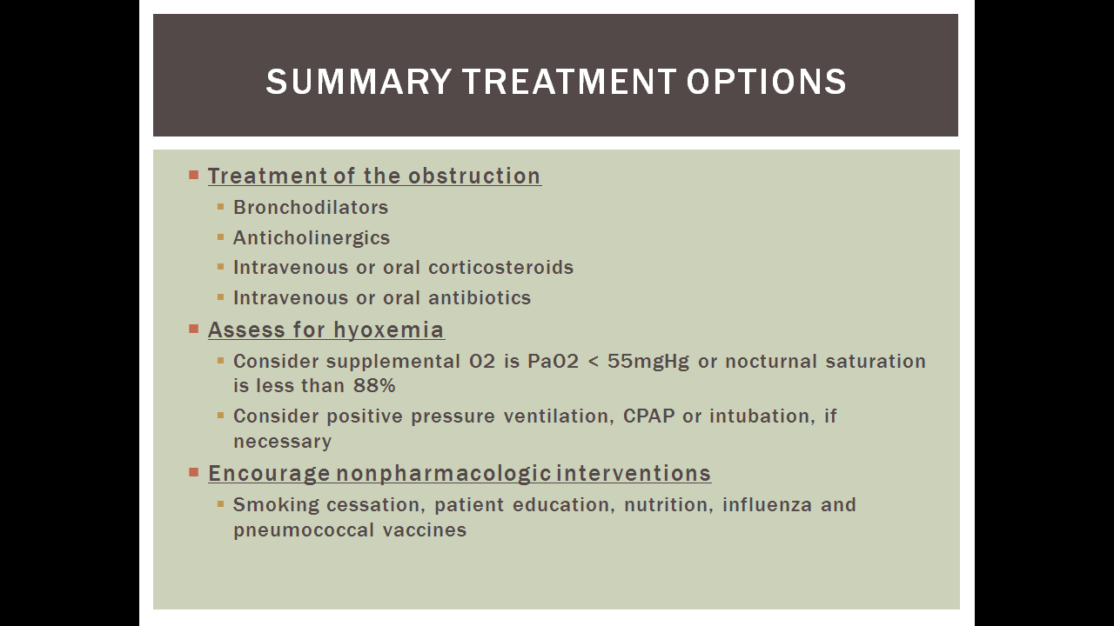

Slide 31
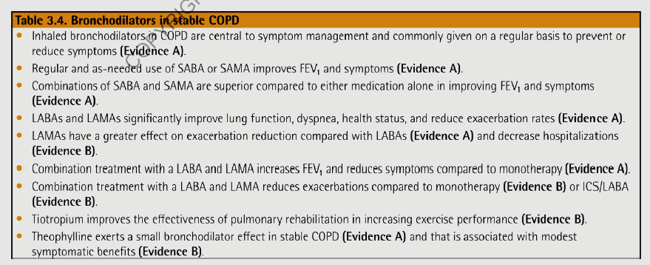

Slide 32
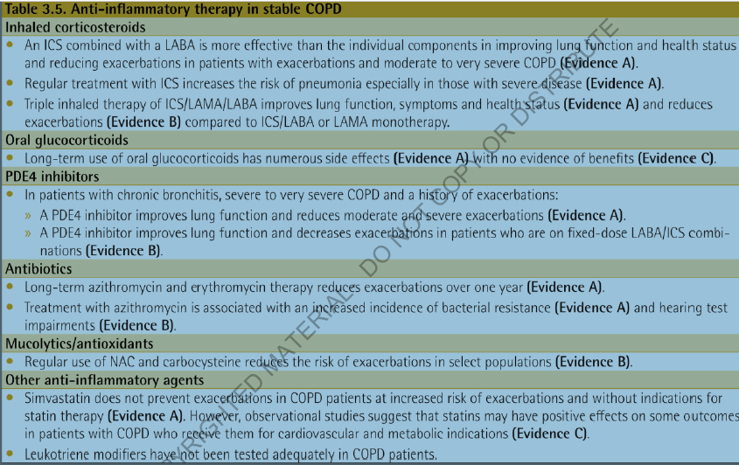

Slide 33


