Slide 1


Health Care Sanitation
Done by GHOFRAN HUSSIN
Block : PTS
S.N : 2749

Slide 2

Introduction :
Health Care Sanitation plays a vital role in preventing the spread of communicable diseases and infection in health care facilities , thus it is important to have a good background on the essentials of health care sanitation in order to achieve a safe and healthy working environment.
2

Slide 3
Benefits Of Health Care Sanitation :
-Prevent the spread of communicable diseases.
-Ensure the health and safety of everyone including both
the medical staff and the patients.
-Ensure a healthy environment.
-Ensure the proper functioning of the health care center or
hospital.
- Which country has sanitation problems?
3

Slide 4

Definition Of Health Care Sanitation :
-The promotion of hygiene and prevention of disease by maintenance of sanitary conditions…
-Defind as the way in which human promote healthy living and good health by preventing human contact with wast and other forms of microorganisms that cause disease
4

Slide 5
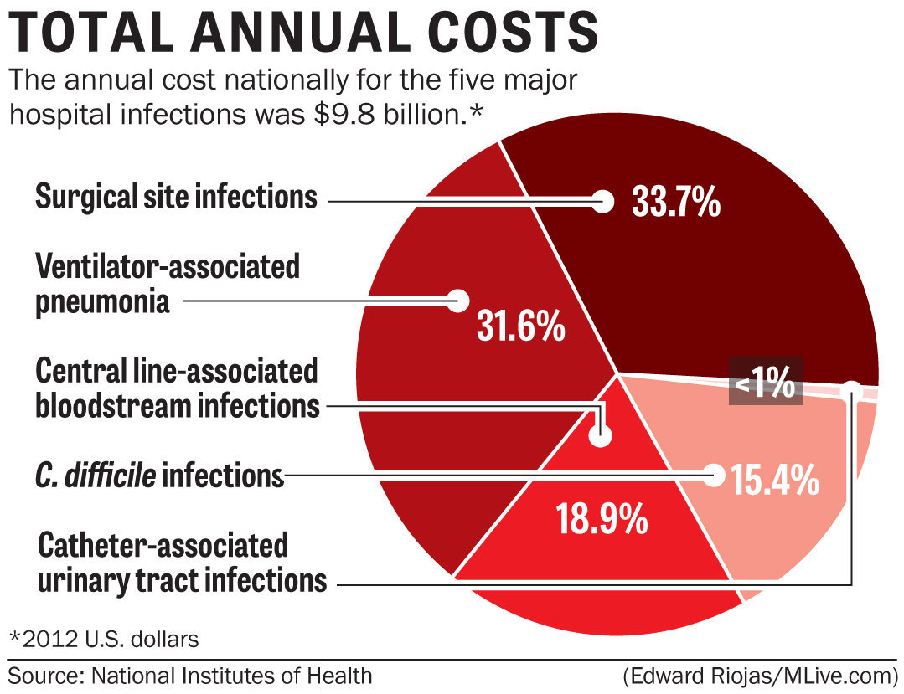
5

Slide 6
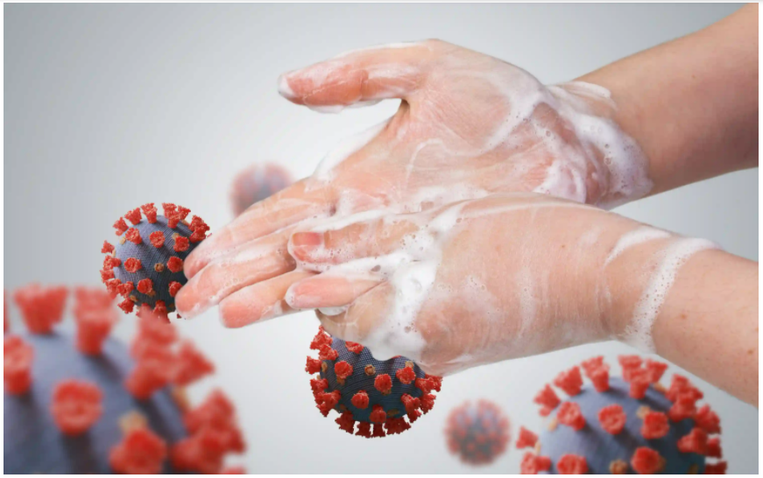

Hand washing ( Hand hygiene )
Is the act of cleaning one's hands with soap and water to remove viruses/bacteria/microorganisms, dirt, grease, or other harmful and unwanted substances stuck to the hands , it’s essential when preparing for surgical procedures and before and after dealing with patients.
6

Slide 7
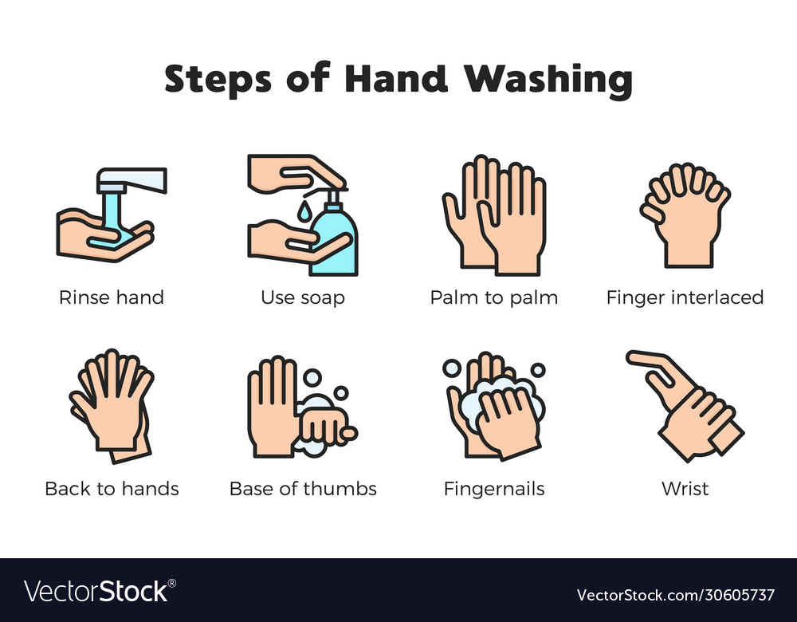
7

Slide 8
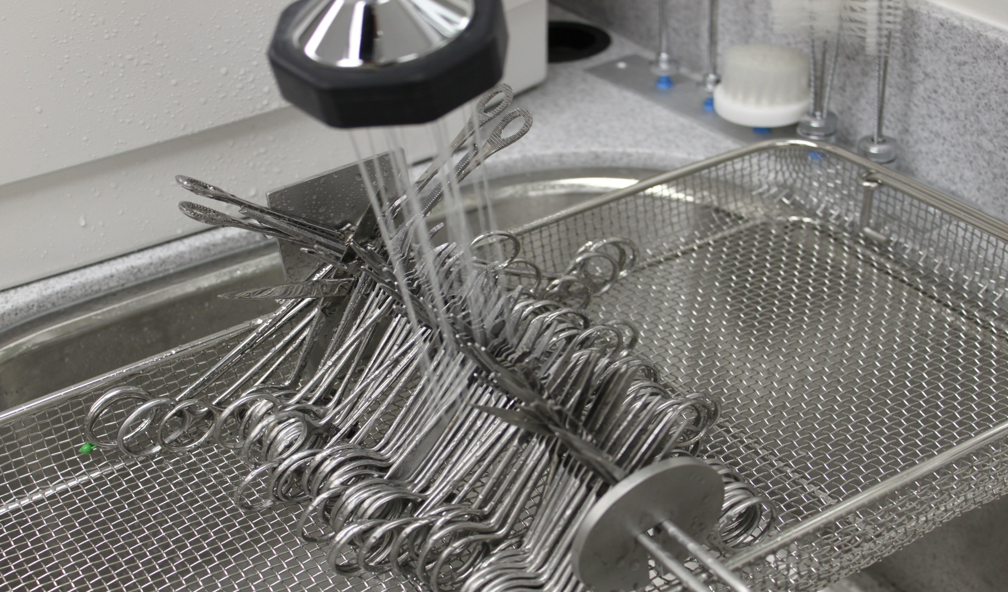
Instrument sanitation
Step 1
Cleaning :
Removal of any visible and non- visible debris / blood or dirt with water and detergents either manually or with an ultrasonic cleaner.
8

Slide 9

Step 2
Inspection : make sure the instrument cleaned is free of any debris.
9

Slide 10
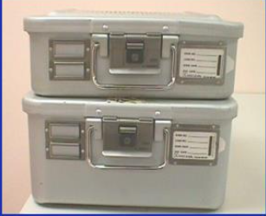

Step 3
Packaging : pack instruments in sterile wrap and afterwards in containers.
10

Slide 11
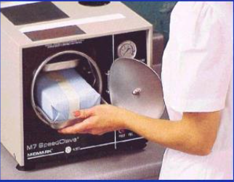
Step 4
Sterilization : sterilize instruments using steam sterilizers.
11

Slide 12


Floor cleansing and the changing of bed sheets is also an important part of health care sanitation.
12

Slide 13

Ensuring clean water source is important in preventing the spread of water born communicable diseases such as travler’s diarrhea and cholera.
13

Slide 14


Ensuring food hygiene is important in preventing the spread of dangerous organisms such as E.coli and Salmonella.
14

Slide 15
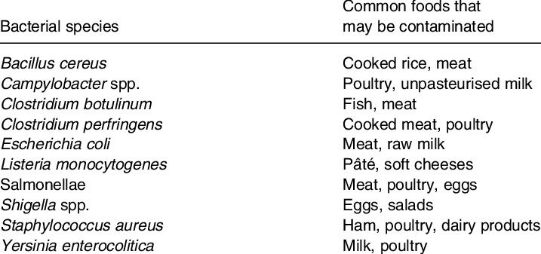
15

Slide 16
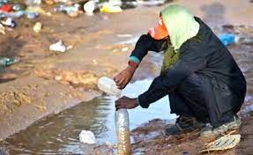
Which country has sanitation problems?
Ethiopia, Uganda, Kenya and Tanzania, have by far the largest number of people in the region with no access to basic sanitation services, while countries like Eritrea, South Sudan and Ethiopia have the largest proportions and numbers of people practising open defecation.
16

Slide 17

DO you think Libya suffer from sanitation problems ?
17

Slide 18
*Bacteria often contaminates each of Libya’s water sources. In fact, coliform bacteria has contaminated piped, well and transported water sources at a certain level. Piped water presents the largest risk, making up 55% of contaminated water samples. Additionally, 26% of contaminated samples came from well water, with the remaining 19% coming from transported water. In this environment, finding a reliable clean source of water is a struggle for many Libyans.
18

Slide 19
Conclusion : by understanding the essentials of health care sanitation , we can play a crucial role in reducing the number of hospital acquired infections
19

Slide 20
Sources / references :
1- Https://www.cdc.gov/handwashing/index.html.
2- Https://www.cdc.gov/infectioncontrol/guidelines/
disinfection/cleaning.html
3- Http://www.medscape.com/medicalstudens

Slide 21
THANK YOU …..

