Slide 1


ADHD
IN CHILDREN
Student name : Essra Jalal
Student number : 2834
Block : PTS
Date : 16/5/2022
1

Slide 2
Objective
01
02
03
Define ADHD
Outline Causes of ADHD
Outline Indication for ADHD in children
04
List Difficulties of ADHD in children
05
Discuss the Treatment of ADHD in children
2

Slide 3

-Attention deficit hyperactivity disorder (ADHD) is a childhood-onset neurodevelopmental disorder s the commonest disorder presenting to Child .
-affects 5–7% of children It is more common in boys than girls.
-High heritable and multifactorial.
3

Slide 4
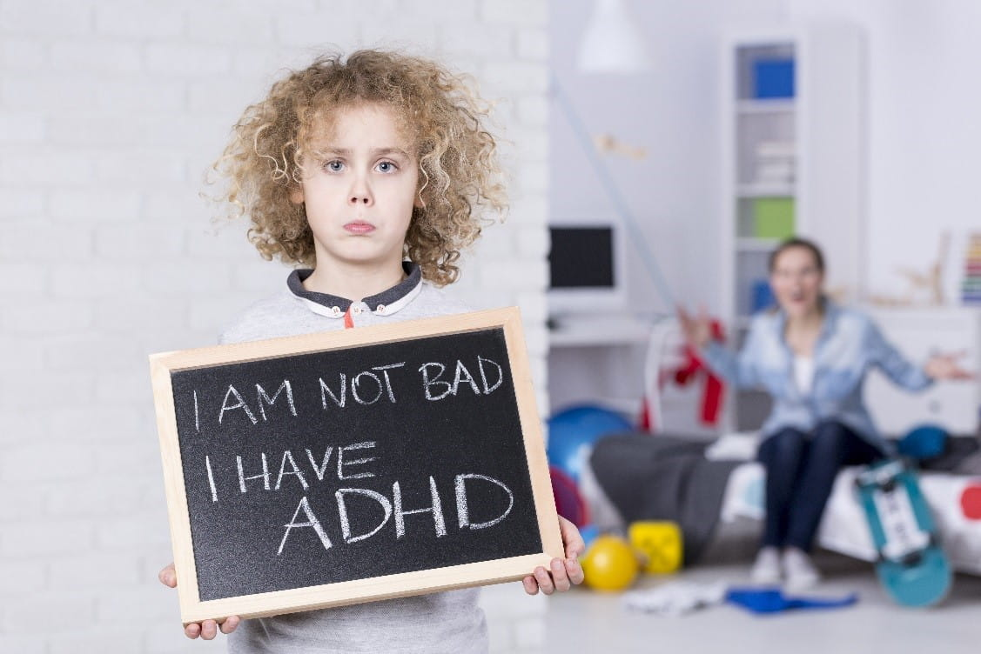
Causes of ADHD in children
- Brain anatomy and function
- Genes and hereditary
- Significant head injury
- prematurity
-maternal drinking
- Toxins in the environment (rare )
4

Slide 5
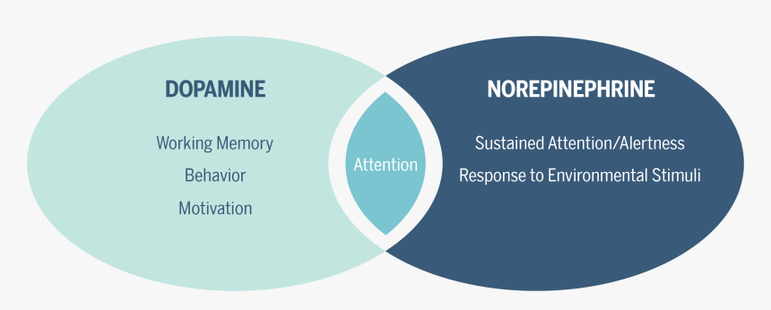

Slide 6
INDICATION OF ADHD
Predominantly inattentive presentation
Predominantly hyperactive /impulsive presentation
Combined presentation
6

Slide 7

Difficulties at home
-Completing chores
- Problems following the home rules
- Make excessive noise
-Interrupting family activities
- Can't Regulate their emotions
-Can't keep their room neat
7

Slide 8

School-related difficulties
-keeping track of school materials
-adjusting to school schedule (e.g. A days and B days)
-turning in homework assignments
-focusing on lectures
-Planning and completing projects
8

Slide 9

Social difficulties
-regarding and responding to social cues
-peer rejection
-Repairing relationship
9

Slide 10
Prognosis
-Children with ADHD are at risk for potentially serious problems academic underachievement school failure difficulty getting along with peers and problems dealing with authority .
-Further more up to 67% percent of children will continue to experience symptoms of ADHD in adulthood .
10

Slide 11



Treatment of ADHD
Monitoring
Diet therapy
PHARMACOLOGIC TREATMENT
Herbal therapy
Behavior therapy
11

Slide 12
BENEFITS
Ability to hyperfocus
Creativity
Perceptiveness
Curiosity
Energetic
Intelligence
Resilience
Unlimit energy
12

Slide 13
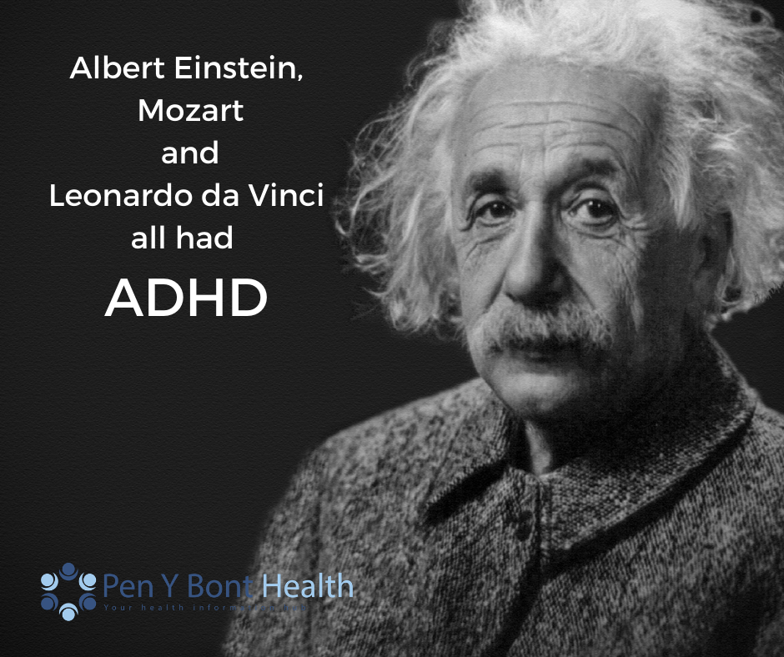
13

Slide 14

Conclusion
-ADHD is one of the most common neurodevelopmental disorders of childhood .
-When child has ADHD ,the parent ,teacher doctors need to work together as a team to understand and develop an appropriate learning plan .
14

Slide 15
Do you have any question ?
15

Slide 16
Resources
Montagna, A., Karolis, V., Batalle, D., Counsell, S., Rutherford, M., Arulkumaran, S., Happe, F., Edwards, D., &amp; Nosarti, C. (2020, March 3). ADHD symptoms and their neurodevelopmental correlates in children born very preterm. PloS one. Retrieved May 16, 2022, from https://www.ncbi.nlm.nih.gov/pmc/articles/PMC7053718/
Pelsser LM;Frankena K;Toorman J;Rodrigues Pereira R; (n.d.). Diet and ADHD, reviewing the evidence: A systematic review of Meta-analyses of double-blind placebo-controlled trials evaluating the efficacy of diet interventions on the behavior of children with ADHD. PloS one. Retrieved May 16, 2022, from https://pubmed.ncbi.nlm.nih.gov/28121994/
Drechsler R;Brem S;Brandeis D;Grünblatt E;Berger G;Walitza S; (n.d.). ADHD: Current concepts and treatments in children and adolescents. Neuropediatrics. Retrieved May 16, 2022, from https://pubmed.ncbi.nlm.nih.gov/32559806/
Felt BT;Biermann B;Christner JG;Kochhar P;Harrison RV; (n.d.). Diagnosis and management of ADHD in children. American family physician. Retrieved May 16, 2022, from https://pubmed.ncbi.nlm.nih.gov/25369623/
16

Slide 17

17

