Slide 1


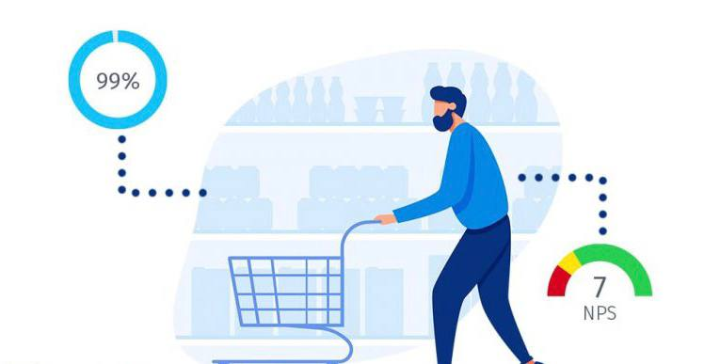
Business Buyer Behavior
Libyan International Medical University
Faculty of Business Administration
By: Rudena Bettamer
ID:2886
Student email: rudena_2886@limu.edu.ly

Slide 2
Table of Content
01
02
03
04
INTRODUCTION
FACTORS AFFECTING BUSINESS BUYING BEHAVIOUR
CONCLUSION
REFERENCE
2

Slide 3
INTRODUCTION
Business Buyer Behaviour refers to the buying behaviour of organizations that buy goods and services for use in the production of other products and services that are sold, rented or supplied to others. also Buying is defined as a process by which a company or organization establishes a need for purchasing products, collects information and evaluates product and services among competing brands and suppliers to take a final purchase decision.
3

Slide 4
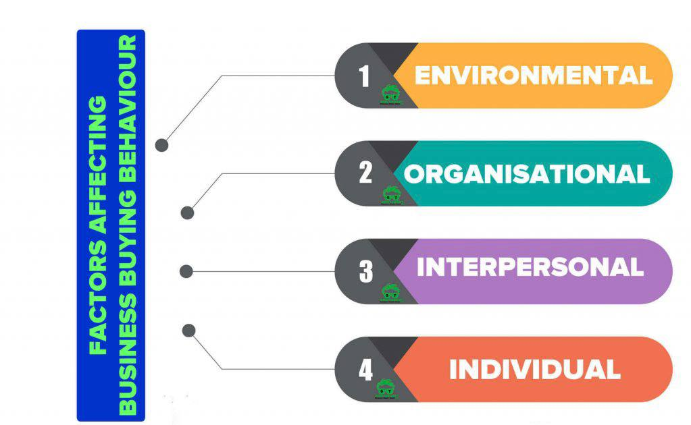
4

Slide 5
1_Environmental factors:
There are many factors includes in environment factors, these are economic development, supply conditions, technological changes, political and regulatory developments, competitive development and culture and customs. These have impact on business market directly or indirectly.
5

Slide 6
2_Organizational factors:
Organizational factors such as the company’s objectives, purchasing policies, and resources can influence the buying process. The size and composition of the buying center also plays a role in the business buying decision process.
6

Slide 7
3_ Interpersonal factors:
The interpersonal relationships between people working in the company’s buying center can hinder the buying process. Buying center members need to trust each other and operate under full disclosure.
7

Slide 8
4- Individual factors:
The personal characteristics of people in the buying center can influence the buying decision process. Individual factors including: age, education level, personality, job tenure, and position within the company all play a role in how a person influences the buying process.
8

Slide 9
CONCLUSION:
The Behavior of a Business Buyer is a concept of understanding the needs and desires of a business buyer and making appropriate purchases that will ultimately benefit the company.
Business Buying Behavior is influenced by many factors such as Environmental, Organizational, Interpersonal, and Individual factors.
9

Slide 10
REFERENCE:
13 common management challenges and how to overcome them. Fellow.app. (2021, August 13). Retrieved April 7, 2022, from https://fellow.app/blog/management/most-common-management-challenges/
American InterContinental University. (2020, October 22). The four functions of management: What managers need to know. American Intercontinental University - A member of the American InterContinental University System. Retrieved March 22, 2022, from https://www.aiuniv.edu/degrees/business/articles/functions-of-management
Carolina VargasConsultora en marketing digital. Tengo más de 10 años de experiencia en el área de gerencia de marketing y de marketing digital. Ayudo a empresarios a construir y potenciar sus marcas online. Generando visibilidad y nuevos prospectos de neg, Arteaga, A., &amp; Vargas, C. (2019, December 4). 5 stages of the&nbsp;consumer buying decision process • imagine hub. Imagine Hub. Retrieved April 13, 2022, from https://imagine-hub.com/en/blog/consumer-buying-decision-process/
Ketchen, D., Short, J., Try, D., &amp; Edwards, J. (2014, September 12). Evaluating the general environment. Environmental influence on business. Small Business - Chron.com. Retrieved April 6, 2022, from https://smallbusiness.chron.com/environmental-influence-business-68718.html
Team, M. B. A. S. (2021, August 4). Task environment meaning, factors &amp; example. MBA Skool. Retrieved March 31, 2022, from https://www.mbaskool.com/business-concepts/marketing-and-strategy-terms/7289-task-environment.html
techthug99. (2021, August 8). Business buyer behaviour - type, process, factors, roles. Geektonight. Retrieved April 19, 2022, from https://www.geektonight.com/business-buyer-behaviour-type-process-factors-roles/
10

Slide 11
Thanks

