Slide 1
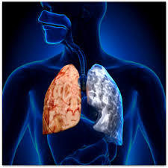
Diffuse Lung disease & Air Way Disease
Dr. Nadya Ben Geweref

Slide 2

حرر القلب من الكره...والعقل من القلق...
عش ببساطة..واعطي بكرم...وقلل توقعاتك من الاخرين...
تكن سعيدا

Slide 3
Diffuse Lung Lesions
Reticular Interstitial Pattern
b) Air space Filling (alveolar pattern)
c) Nodular Pattern
d) Cystic Pattern

Slide 4
NB:
1- most of the DLD cannot be solved with out the help of HRCT
2- Cystic pattern is difficult to be seen in CXR
3- No pure isolated form , most of the time it is mixed form but it is described according to the predominant form

Slide 5
A- Interstitial lung disease
Pulmonary fibrosis
-Diffuse lung pathology showing multiple widespread reticular infiltrations
Peribronchial cuffing (bronchial wall thickening + perivascular wall thickening)
Septal lines (Kerley B) : short lines perpendicular to the pleura
Honey combing : multiple peripheral and subpleural cysts (mm-cm) , thick walls
Traction bronchiectasis

Slide 6
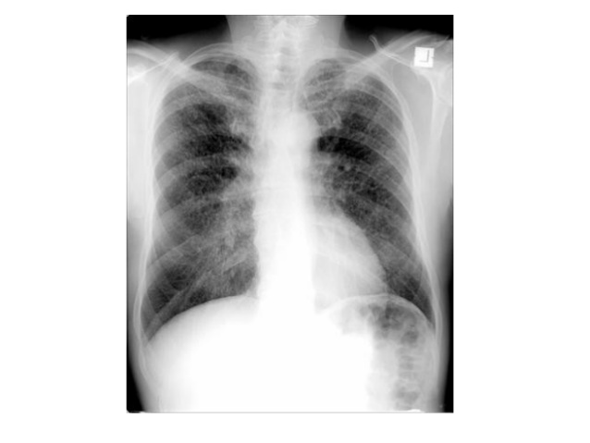

Slide 7
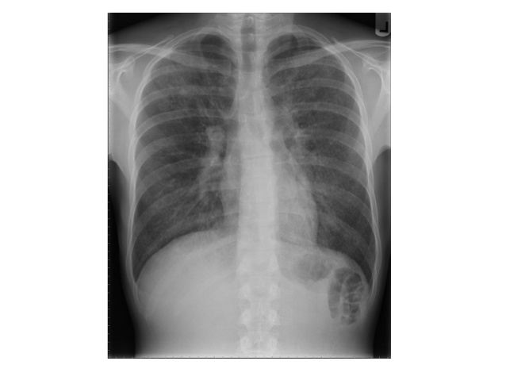

Slide 8
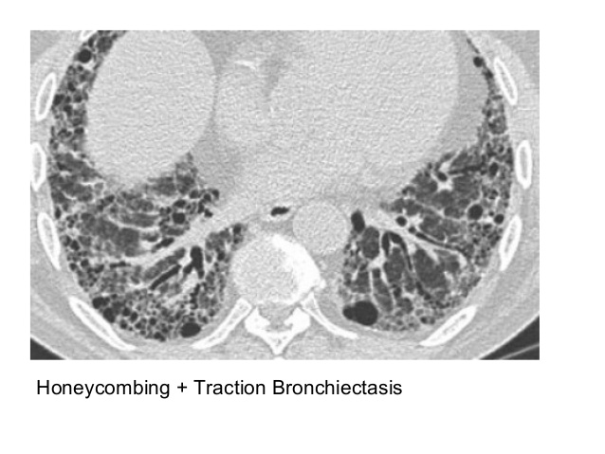

Slide 9
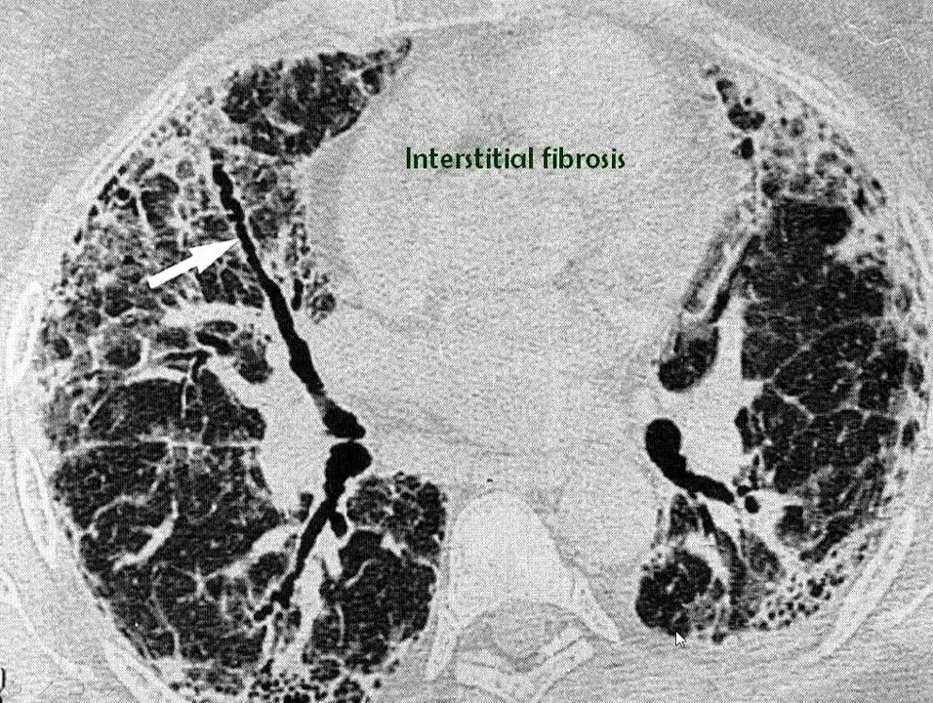

Slide 10
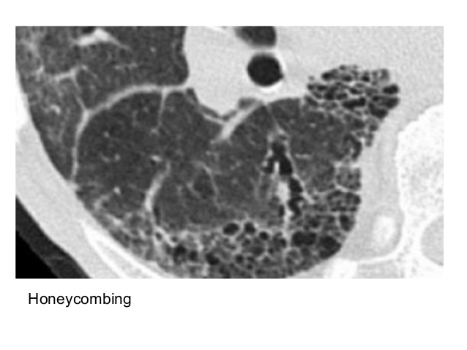

Slide 11
Pulmonary fibrosis
Causes :
-significant acute insult to the lungs ,adult respiratory distress syndrome .
-Interstitial pulmonary Edema ((enlarged cardiac shadow mainly
left ventricle))
-Idiopathic Interstitial Pneumonia
  --inhaled substances
  coal/silica: progressive massive fibrosis
  asbestos: asbestos related pulmonary fibrosis
-radiation: radiation-induced pulmonary fibrosis
-congenital conditions
  cystic fibrosis
-autoimmune conditions
connective tissue disorders
-granulomatous conditions
  sarcoidosis: pulmonary manifestations of sarcoidosis
  tuberculosis: pulmonary manifestations of tuberculosis
  granulomatosis with polyangiitis: pulmonary manifestations of granulomatosis with polyangiitis
-others
  chronic conditions
    chronic hypersensitivity pneumonitis
    chronic eosinophilic pneumonia
  polymyalgia rheumatica
  -medications: drug-induced lung disease combined pulmonary fibrosis and emphysema
  -Lymphangitis carcinomatosis (Asymmetrical Adenopathy ).

Slide 12
Radiographic features
HRCT chest
There are many features that can imply underlying pulmonary fibrosis, these include
honeycombing
traction bronchiectasis
lung architectural distortion
reticulation
interlobular septal thickening: this feature is not specific for fibrosis

Slide 13
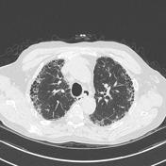

Slide 14
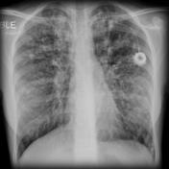
chest X-ray manifests as a reticular pattern

Slide 15
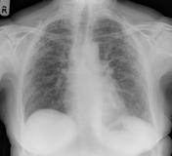

Slide 16
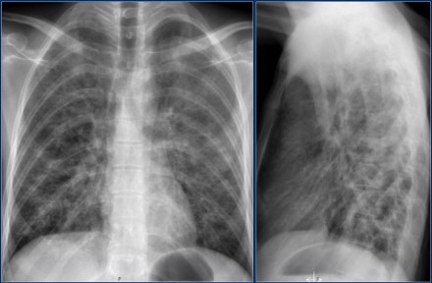

Slide 17
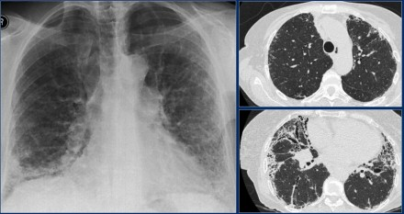
The CXR demonstrates a reticular interstitial pattern with a preference at the lung bases.
The HRCT demonstrates honeycombing and traction bronchiectasis.

Slide 18

سامح ودع الخلق للخالق... فهم ...وانت ..ونحن راحلون

Slide 19
Sarcoidosis:
is a non-caseating granulomatous multi-system disease with a wide range of clinical and radiographic manifestations.
Individual systemic manifestations are discussed individually:
pulmonary and mediastinal manifestations
cardiac manifestations
musculoskeletal manifestations
head and neck manifestations
central nervous system manifestations
abdominal manifestations
cutaneous manifestations

Slide 20
Pulmonary and mediastinal involvement of sarcoidosis is extremely common and is seen in over 90% of patients.
Radiographic features are variable depending on the stage of the disease.
stage 0: normal chest radiograph
  5-10% of patients at presentation
stage I: hilar or mediastinal nodal enlargement only
  45-65% of patients at presentation
  60% go onto complete resolution
stage II: nodal enlargement and parenchymal disease
  25-30% of patients at presentation
stage III: parenchymal disease only
  15% of patients at presentation
stage IV: end-stage lung (pulmonary fibrosis)

Slide 21
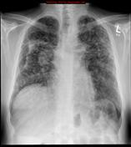
Parenchymal features are varied depending on the individual patient and the stage of the disease. They include:
reticulonodular opacities
airspace-like opacities (alveolar sarcoidosis)
  peripheral cavitation: cavitatory pulmonary sarcoidosis
end-stage fibrosis

Slide 22
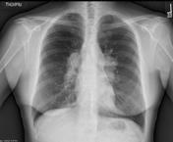

Slide 23
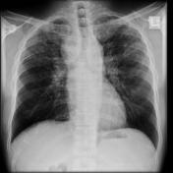

Slide 24


Slide 25
B) Air space filling (alveolar pattern):
-Air space filling disease
-A hazy area of increased attenuation in the lung with preserved bronchial and vascular markings
-Filling of the alveolar spaces with pus , edema , hemorrhage , inflammation or tumor cells
-Ground glass in itself is very unspecific

Slide 26
-Etiology :
a) Pneumonia
b) Pulmonary Edema
c) Pulmonary Hemorrhage
d) Bronchoalveolar Carcinoma
e) Alveolar Proteinosis

Slide 27
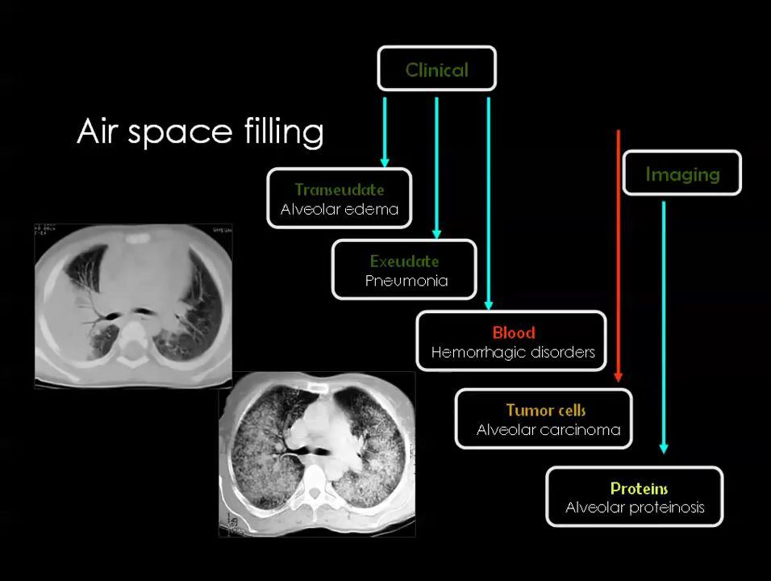
Air Space Filling

Slide 28
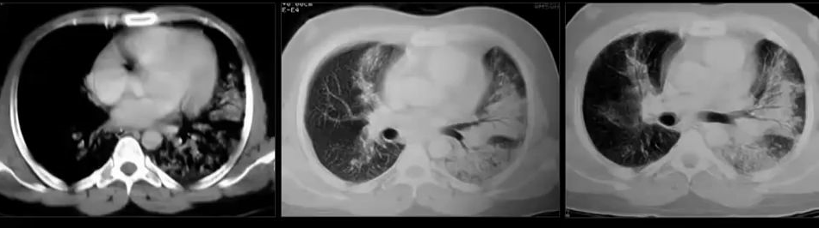
a) Pneumonia :
-Peripherally located lesion

Slide 29
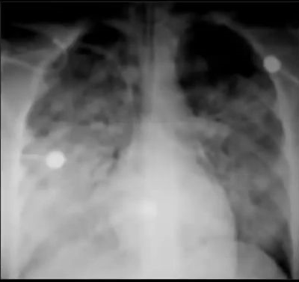
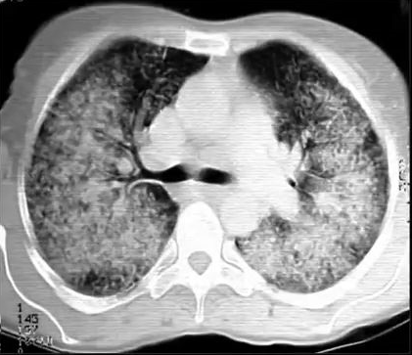
pulmonary edema

Slide 30
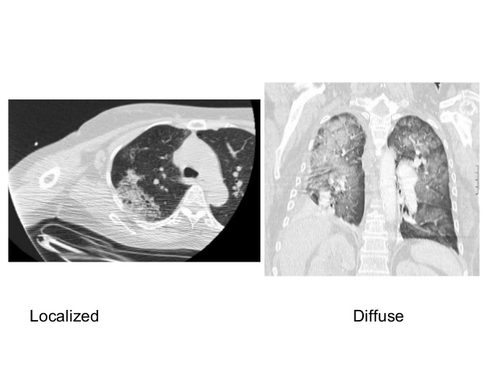

Slide 31
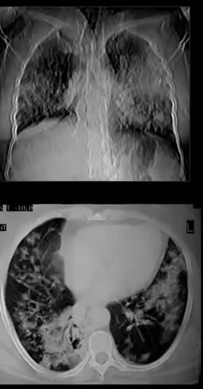
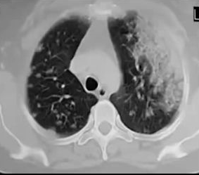
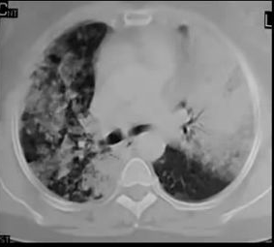
Bronchoalveolar Carcinoma
61

Slide 32
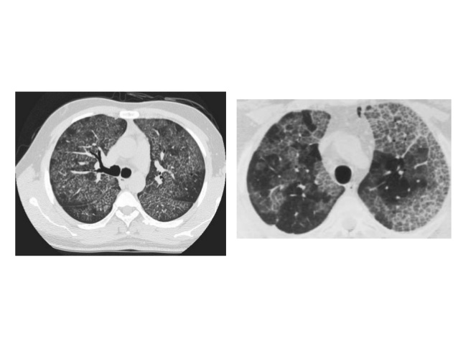

Slide 33

تغافل مرة وتغابى مرات ... فليس كل شئ يستحق ان نقف عنده

Slide 34
c) Nodular Pattern :
-Multiple rounded opacities 1-10 mm (miliary = 1-2 mm)
-In most cases small nodules can be placed into one of three
categories : (PCR)
a) Random distribution
b) Centrilobular distribution
c) Perilymphatic distribution

Slide 35
-Etiology :
a) Miliary T.B.
b) Miliary Mets
c) Pneumoconiosis
d) Wegner’s Granulomatosis
e) Pulmonary Alveolar Microlithiasis

Slide 36
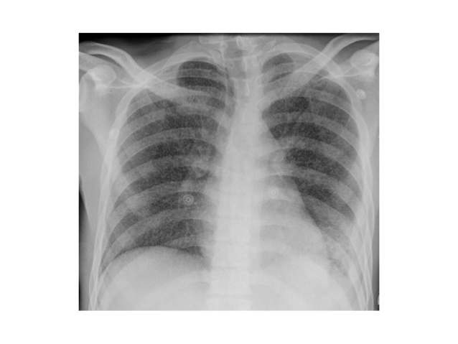

Slide 37
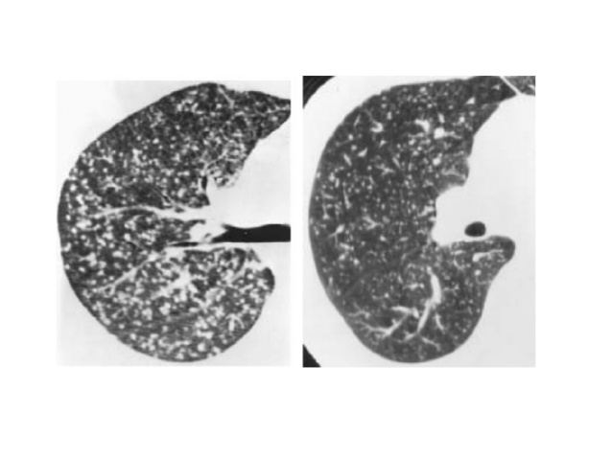

Slide 38
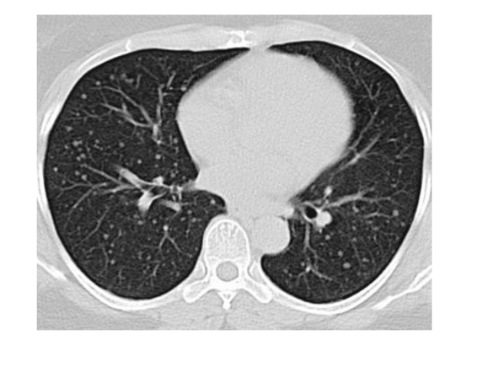
Thyroid ca. metastasis

Slide 39
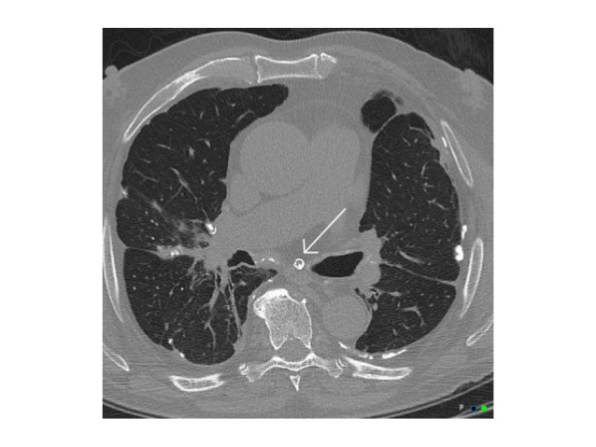
Pneumoconiosis

Slide 40
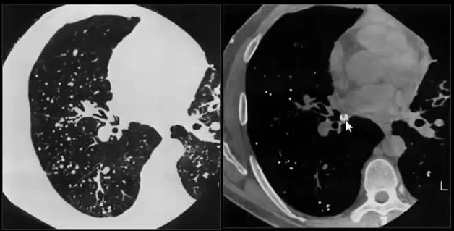
silicosis

Slide 41
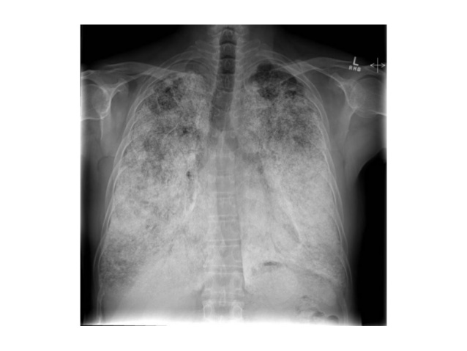
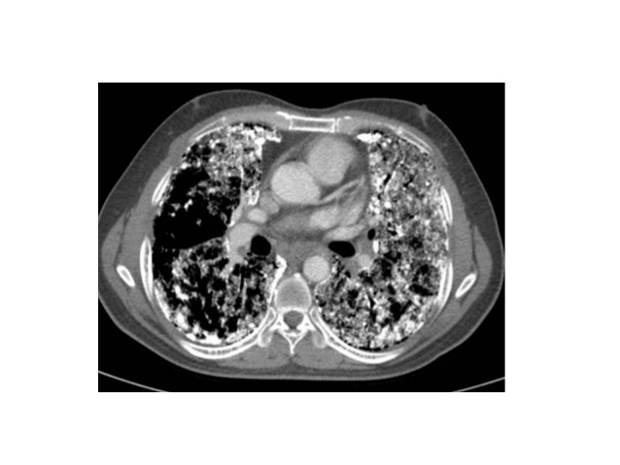
Pulmonary Alveolar Microlithiasis

Slide 42


الكلام الجميل مثل المفاتيح...تفتح به القلوب

Slide 43
d) Cystic Pattern :
-Defined as radiolucent areas with a wall thickness of less than 4mm
-Multiple thin walled air containing lesions 1 cm or more
(Not seen by x-rays except for bronchiectasis)

Slide 44
3-Etiology :
a) Langerhan’s Cell Histiocytosis (LCH)
b) Lymphangioleiomyomatosis (LAM)
c) TuberousSclerosis (TS)
d) Emphysema
e) Cystic Bronchiectasis
f) Lymphocytic Interstitial Pneumonia (LIP)

Slide 45
Bronchiectasis :
refers to abnormal dilatation of the bronchial tree and is seen in a variety of clinical settings. CT is the
most accurate modality for diagnosis. It is largely considered irreversible.
Causes:
post-infective (most common)
congenital
bronchial obstruction
loss of surrounding lung volume
Others
:Subtypes:
cylindrical bronchiectasis
  bronchi have a uniform calibre, do not taper and have parallel walls (tram track sign and signet ring sign)
  commonest form
varicose bronchiectasis
  relatively uncommon
  beaded appearances where dilated bronchi have interspersed sites of relative narrowing
cystic bronchiectasis
  severe form with cyst-like bronchi that extend to the pleural surface
  air-fluid levels are commonly present

Slide 46
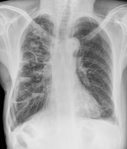
Radiographic features
Plain radiograph
Chest x-rays are usually abnormal, but are inadequate in the diagnosis or quantification of bronchiectasis. Tram-track opacities are seen in cylindrical bronchiectasis, and air-fluid levels may be seen in cystic bronchiectasis. Overall there appears to be an increase in bronchovascular markings, and bronchi seen end on may appear as ring shadows .

Slide 47
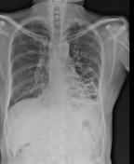

Slide 48
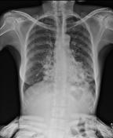

Slide 49
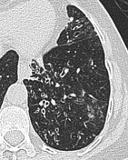
CT
CT and HRCT especially excels at demonstrating the airways, and is able to a greater or lesser degree to distinguish some of the various underlying causes.
increased bronchoarterial ratio
bronchial wall thickening
mucoid impaction
air-trapping
cylindrical bronchiectasis

Slide 50
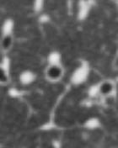
signet ring sign

Slide 51
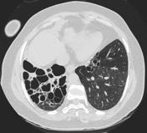
cystic bronchiectasis

Slide 52
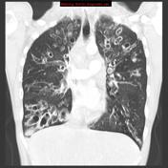

Slide 53
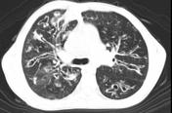

Slide 54
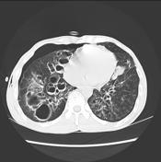

Slide 55

وانت فى طريقك للبحث عن الحياة ...لا تنسى ان تعيش

Slide 56
Pulmonary emphysema
is defined as the "abnormal permanent enlargement of the airspaces distal to the terminal bronchioles accompanied by destruction of the alveolar wall and without obvious fibrosis". Emphysema is one of the entities grouped together as chronic obstructive pulmonary disease. Emphysema is best evaluated on CT, although indirect signs can be noticed on conventional radiography in a proportion of cases.

Slide 57
morphologic subtypes
centrilobular emphysema (most common)
panlobular emphysema
paraseptal emphysema

Slide 58
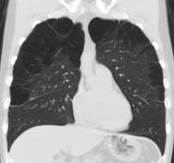
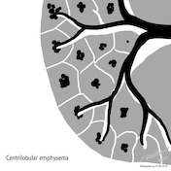
The three morphologic subtypes of emphysema are named according to their relationship to the secondary pulmonary lobule:
Centrilobular emphysema is the most frequently encountered type and affects the bronchioles, particularly of the upper zones. It is strongly associated with smoking in a dose-dependent way

Slide 59
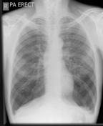
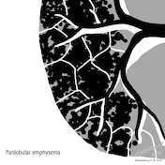
Panlobular emphysema in contrast, affects the entire secondary pulmonary lobule and is more pronounced in the lower zones, matching areas of maximal blood flow. It is seen particularly in alpha-1-antitrypsin (AAT) deficiency (exacerbated by smoking)

Slide 60
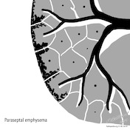
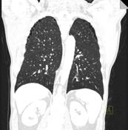
Paraseptal emphysema affects the peripheral parts of the secondary pulmonary lobule, and is usually located adjacent to the pleural surfaces (including pleural fissures) . It is also associated with smoking, and can lead to the formation of subpleural bullae and spontaneous pneumothorax

Slide 61
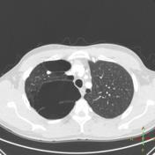
bullous emphysema

Slide 62
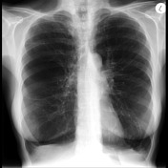

Slide 63
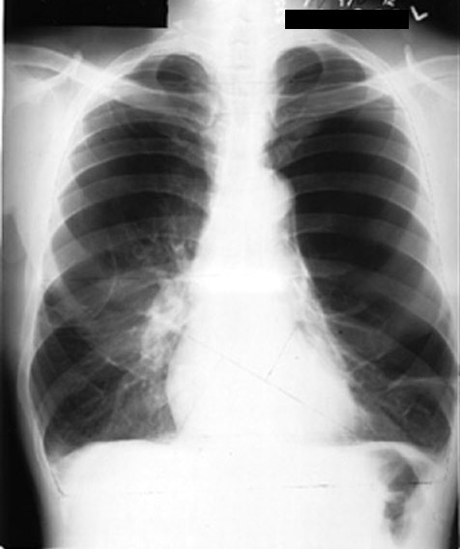
Emphysema
-over-inflation of the lungs.
-abnormally increased chest diameter.
-Increase intercostal space
-The diaphragm may appear depressed or flattened.
-patients with advanced emphysema may show a smaller or vertical heart.

Slide 64

Thanks god , there is no radiology

Slide 65
Cystic fibrosis (CF) :
is an autosomal recessive genetic disease that affects the exocrine function of the lungs, liver, pancreas and small bowel resulting in progressive disability and multi-system failure

Slide 66
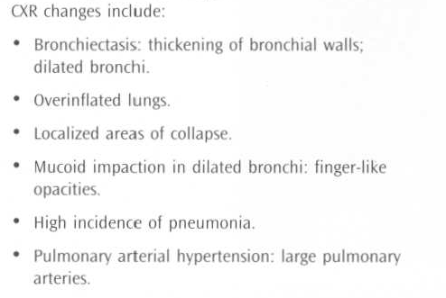

Slide 67
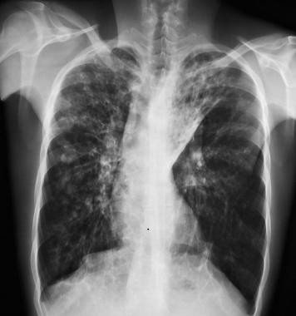

Slide 68

17-year-old female patient with cystic fibrosis : extensive areas of bronchiectasis predominantly involving upper lung zones.

Slide 69

ذاكر فكر انطلق..اكتشف مداك وقدرتك

Slide 70
GOOD LUCK

