Slide 1
Brucellosis

Slide 2
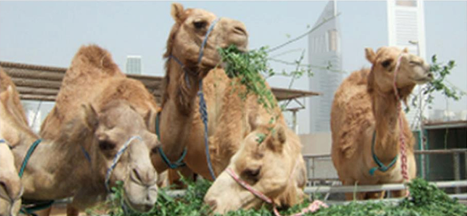
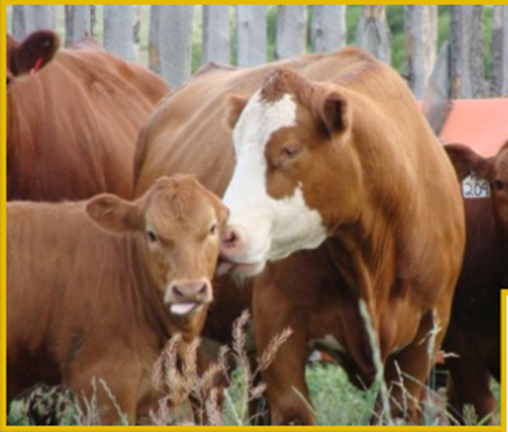

Brucellosis
Brucellosis is a zoonosis primarily of domestic animals, causing a chronic septicemic disease leading to abortion.

Slide 3
named brucellosis after discovery by David Bruce, also called Malta fever, and Mediterranean fever)because it common in the region.

Slide 4
Microbiology
Brucellae are:
aerobic Gram negative, intracellular coccobacilli bacteria.
Non-motile, non-capsulated, non-spore
forming.

Slide 5
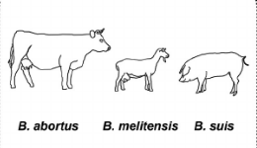
The brucella species are:
All are the predominant cause of disease in humans and animals.

Slide 6
Transmission
Brucellosis is transmitted to humans by direct contact with:
Infected animals,and by ingestion of unpasteurized milk or milk products.
Through skin cuts and abrasions or by inhalation of aerosols.
Person–person transmission is extremely rare.

Slide 7
Transmission

Slide 8
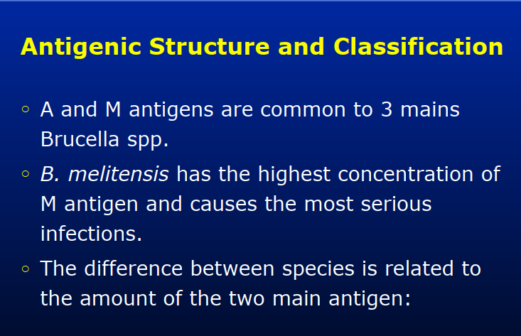

Slide 9
pathogenesis
Animal tissues and products, such as
Placenta and milk, that are rich in
erythritol (a growth factor for brucellae) can be heavily contaminated and highly
infectious.
Spread in the body occurs via lymphatics,
replication within lymph nodes, and then wide hematogenous spread to organs and tissues.

Slide 10
Intracellular parasitism: brucellae have a
particular tendency to persist ntracellularly,
notably in the reticuloendothelial system.

Slide 11
Who is at Risk?
Occupational Disease:
• Cattle ranchers/dairy farmers.
• Veterinarians.
• Abattoir workers.
• Meat inspectors.
• Consumers of unpasteurized dairy products.

Slide 12
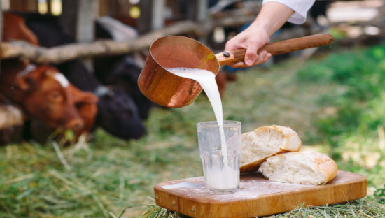
Raw milk increse the risk

Slide 13
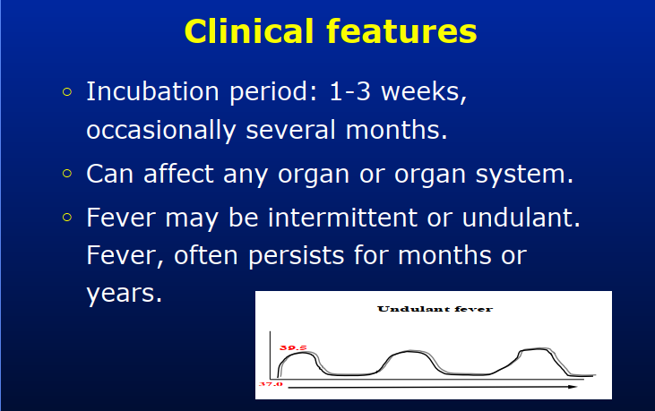

Slide 14
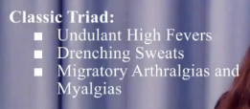
Non specific symptoms: sweating,
anorexia, constipation, rigor and
weakness.
Osteoarticular complications e.g. arthritis,
osteomyelitis.

Slide 15

Brucellosis is a well-documented cause of fever of unknown origin with varied and nonspecific symptoms.

Slide 16
O/E
lymphadenopathy .
Hepatomegaly - Splenomegaly,
A septicemic disease
abortion can occur.
any organ system can be involved !

Slide 17
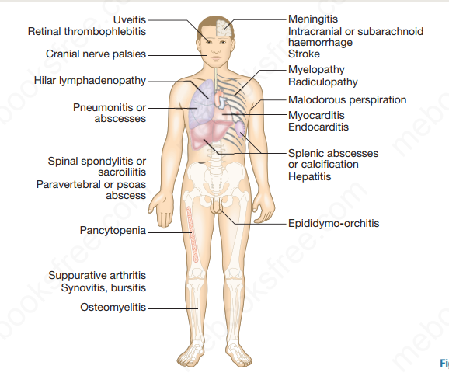

Slide 18

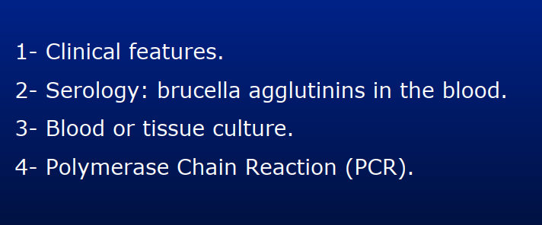

Slide 19
Diagnosis
The diagnosis of brucellosis should be considered in an individual with :
Unexplained chronic fever and nonspecific complaints.
Ask about exposure to Brucella including contact with animal tissues or ingestion of unpasteurized milk .

Slide 20
Routine laboratory studies are nonspecific.
White blood cell counts are usually normal to low (pancytopenia can occur) & minor disturbances in hepatic enzymes are relatively common.
Studies such as xrays , bone scans, computerized tomography, magnetic resonance imaging, and echocardiography may be helpful in isolating or delineating focal disease, but do not provide a definitive diagnosis.

Slide 21
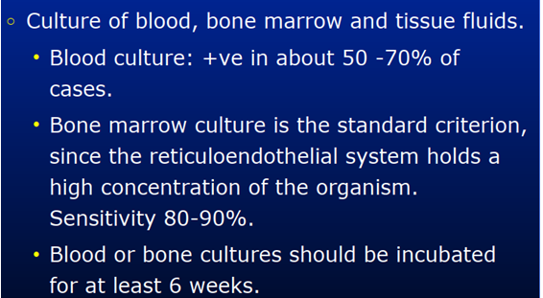
Cultures

Slide 22
Other usefull test depend on focal invilvment eg liver biopsies, aspiration or biopsy of pleural fluid or tissue, and occasionally CSF.

Slide 23
Serologic test
are based upon the detection of antibody. They include:
Serum agglutination .
Complement fixation Rose Bengal agglutination.
Antibrucella Coombs.
ELISA (enzyme-linked immunosorbent assay)
High IgM in acute infection.
High IgG in chronic infection.

Slide 24
Tube agglutination testing.
A single titer of >1:160 in the presence of a compatible illness supports the diagnosis.
Demonstration of a fourfold or greater increase/decrease in agglutinating antibodies over 4 to 12 weeks provides even stronger evidence for the diagnosis.

Slide 25
ELISA.
More sensitive and specific than agglutination test.

Slide 26
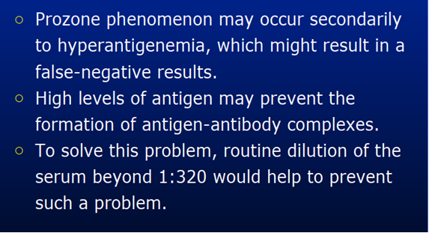

Slide 27
Treatment of Choice
Combination therapy has the best efficacy.
Doxycycline for six weeks in
combination with streptomycin for 2-3
weeks or rifampicin for 6 weeks
About 5% of treated cases relapse

Slide 28
Prevention
Education about risk of transmission.
Wear of protective attire in dealing with possible infected animals (Gloves, masks, goggles)
Largely through vaccination of domesticated herds and flocks, and serologic testing and slaughter of infected animals.
Pasteurization of milk .
Brucella vaccine for human use is not currently available.

