Slide 1



Long Life For All
Libyan International Medical University
2021/2022
Montha habib saad
3535
18/may/2022

Slide 2
Objectives :
Define immunization .
Discuss important of vaccinations .
Common diseases that vaccines prevent .

Slide 3
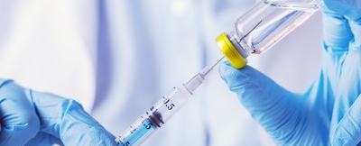
What is immunization ?
“ Protection from diseases “

Slide 4
Introduction
Immunization is a global health and development success story,
saving millions of lives every year .
Immunization is a key component of primary health care
and an indisputable human right.
Vaccines are critical to the prevention and control of infectious disease outbreaks.
And will be a vital tool in the battle against antimicrobial resistance.

Slide 5
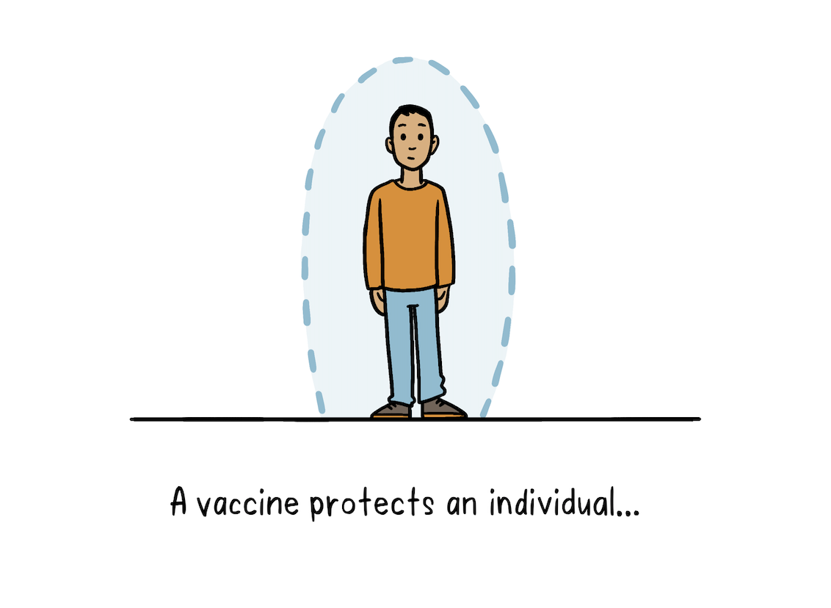

Immunization “ vaccination “
is the process by which a person
becomes protected from diseases
By giving a vaccine .
This happens when a person contacts
With the organism causing a disease
Or receives antibodies .

Slide 6
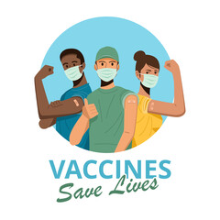
Important of vaccinations
Vaccination protects us from many
diseases and infections that have no treatment .
So it Protects from deadly diseases ,
and enhances the body is immunity against it .

Slide 7
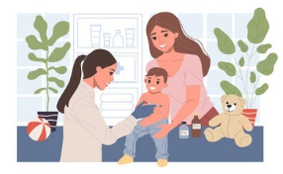
Important during childhood

Slide 8
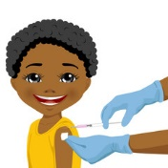
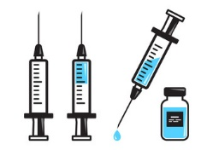
It helps provide immunity before children
are exposed to potentially life-threatening diseases.

Slide 9

Vaccine Preventable Diseases :
Cholera Malaria
COVID-19 Measles
HPV Influenza
Diphtheria Meningitis
HBV Pertussis

Slide 10

Vaccinated people have a low or no risk of developing epidemic diseases .

Slide 11
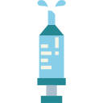
Conclusion
Vaccines have safely reduced the scourge of
diseases, They save lives every minute – preventing up to
three million deaths a year .
Vaccination saves children each
year from deadly diseases.
So due to immunization efforts worldwide
we are able to live immune to diseases
And children are able to walk, play, dance and learn .
Get your vaccine

Slide 12
References
1. Vaccines and immunization. Who.int. https://www.who.int/health-topics/vaccines-and-immunization#tab. Published 2022. Accessed May 13, 2022.
2. Healthcare M. Importance of Immunization - Midland Healthcare. Midland Healthcare. https://midlandhealthcare.org/importance-of-immunization. Published 2022. Accessed May 13, 2022.
3. Immunization. Unicef.org. https://www.unicef.org/immunization. Published 2022. Accessed May 13, 2022.

Slide 13
Thank you

