Slide 1




BMW Business Model
Libyan international medical university
Faculty of business administration
By: Khuloud shaibani 2423
Instructor: Mr. Mohammed Alzwawi

Slide 2

CONTENT:
01
02
03
Introduction
BMW goals
04
Reference
Business model canvas
BMW Swot analysis
05
06
Conclusion

Slide 3
Introduction
BMW is a German multinational corporate manufacturer of luxury vehicles and motorcycles.
BMW was the world's fourteenth-largest producer of motor vehicles, with 2,279,503 vehicles produced.
The corporate image is highly respected and is considered as one of the few companies with an excellent work environment along with a great corporate structure.

Slide 4
BMW Goals
Reducing CO₂ emissions
Increasing resource efficiency and improving environmental standards
Massive expansion of electro mobility

Slide 5
SWOT Analysis
Strengths
Weaknesses
Opportunities
Threats
High-Quality Products.
Highly Valuable Brand.
Excellent Reputation.
Poor automotive brand portfolio with little product differentiation
Cars recalled:
Demand for autonomous vehicles.
Offer Eco-friendly Mobility.
Increasing competition in the worldwide automotive market
Impacts caused by The Pandemic

Slide 6
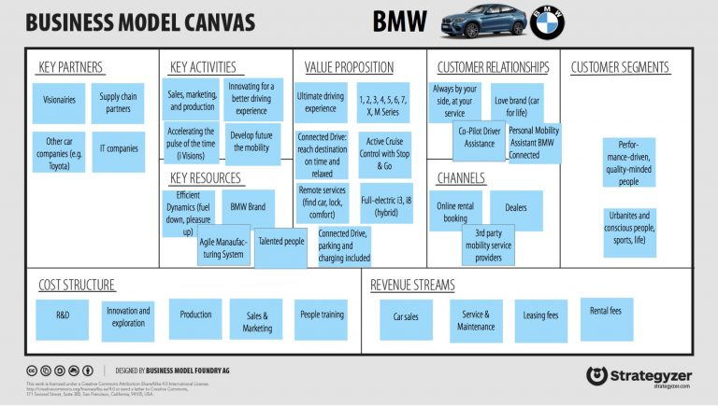
Business model canvas

Slide 7
Business model canvas Analysis : Customer Segments: - performance-driven and quality-minded people. - started targeting urbanites Customer Relationships: - BMW provides Co-Pilot Driver Assistance Revenue Streams: - BMW earns money with car sales. - earn money with service & maintenance, - leasing fees, and rental fees.

Slide 8
Conclusion
BMW is considered as one of the leading producers of luxury & state of the art vehicles.it also holds a strong image in the automobile industry all across the world.
The corporate image of the BMW as one of the highest sought after organizations offering an excellent working environment is highly regarded all across the world.
as they to focus on reducing CO₂ emissions, increasing resource efficiency and substantially improving social and environmental standards.

Slide 9

References
Jurevicius, O. (2021, October 22). BMW SWOT analysis - SM insight. Strategic Management Insight. Retrieved June 12, 2022, from https://strategicmanagementinsight.com/swot-analyses/bmw-swot-analysis/
BMW Group - Sustainability - Our Goals. (nod). Retrieved June 6, 2022, from https://www.bmwgroup.com/en/sustainability/our-goals.html .

Slide 10

THANKS
Do you have any questions?
Please keep this slide for attribution

