Slide 1


The Situation and Events that Shifted the Managing Process From Government to Governance
Libyan Medical International University
Faculty of Business Administration
Name: Hamza Mohamed Ali
ID:4125

Slide 2

Table of contents
01
02
03
04
Introduction
Situation and Events
Conclusion
Reference
2

Slide 3
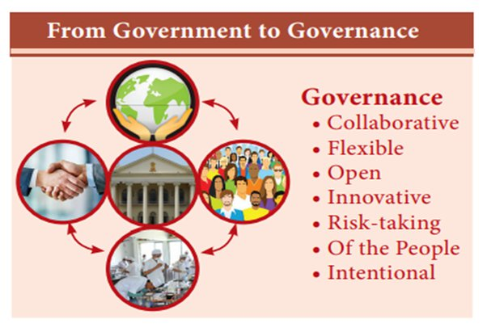
Introduction
To understand this shift of government" and "governance." In the context of management, often associate "government" with a centralized system in which a central authority makes decisions and implements policies. On the other hand, "governance" refers to a broader and more inclusive approach where multiple stakeholders, including government, collaborate in decision-making and policy implementation.
3

Slide 4
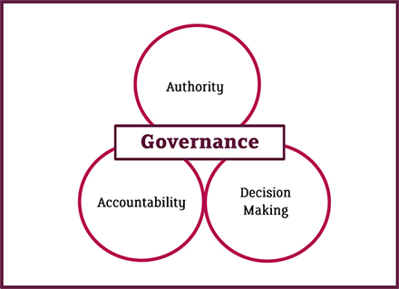
Complexity of Issues
The problems and challenges facing society have become increasingly
complex and interconnected. Traditional government-centric management
often struggles to address these multifaceted issues alone.
4

Slide 5
Rise of Civil Society and NGOs
Civil society organizations and non-governmental organizations
(NGOs) have gained prominence in advocating for various causes
and influencing decision-making. The emergence of these
organizations has pushed for a shift from traditional government
management to governance-based approaches.
5

Slide 6
Digital Transformation and Technology
The rapid advancements in technology and the digitization of
various sectors have influenced the shift towards governance-based
management.
6

Slide 7
Conclusion
few key factors that have contributed to the shift from government to governance in the managing process. It's important to note that the transition is not always linear or uniform across different countries and contexts.
7

Slide 8
Reference
Kim, S., Chen, J., Cheng, T., Gindulyte, A., He, J., He, S., Li, Q., Shoemaker, B. A., Thiessen, P. A., Yu, B., Zaslavsky, L., Zhang, J., & Bolton, E. E. (2018). PubChem 2019 update: improved access to chemical data. Nucleic Acids Research, 47(D1), D1102–D1109.
8

Slide 9


