Slide 1


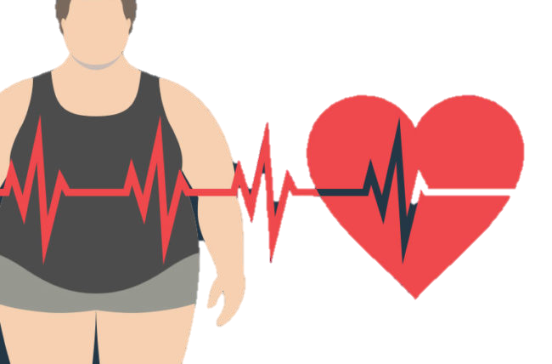
LIBYAN INTERNATIONAL MEDICAL UNIVERSITY
^{1nd} YEAR
obesity
Presented by: Khaled Nouh 3229
2022\6\1

Slide 2

Objectives:
Define of obesity
1
2
Epidemiology of obesity
3
Etiology of obesity
Role of diet and physical activity
4

Slide 3
DEFINE OF OBESITY
Overweight and obesity occur when there is excess fat accumulation which increases risk of human disease.

Slide 4
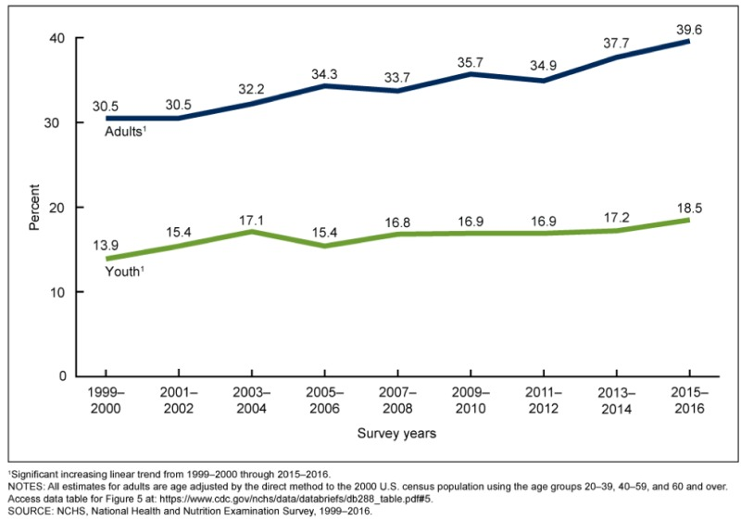
EPIDEMOLOGY OF THE OBESITY
In the United States (US), data from the National Health and Nutrition Examination
the Survey using measured heights and weights shows that the study increase in the prevalence of obesity in both children and adults over the past several decades.

Slide 5
ROLE OF PHYSICAL ACTIVITY
There’s an inverse relationship between physical activity and adiposity. In a large population of adult Finns, the prevalence of overweight was found to be higher in sedentary women (21%) and men (14%) more than in physically active women (8%) and men (7%). Exercise training also generally results at least a decrease in body fat (approximately 0.1 kg/week).

Slide 6
Role of Diet
In 1994 the leptin gene was described. Its product, leptin, acts via the leptin receptor to suppress food intake and to increase energy expenditure in animals (27). Evidence for genetic linkage of the leptin locus with human obesity has been reported, but only in extremely obese persons. Only two cases of leptin deficiency in humans have been reported, due in both cases to a mutation in the leptin gene.

Slide 7
CAUSES OF OBESITY
There’s four factors can play important role in gaining of excessive weight these include :
Food and lack of exercise
Environment
Genetics
Health Conditions and Medications

Slide 8
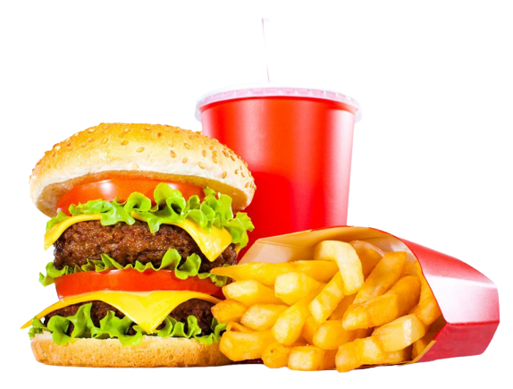
FOOD AND lack of exercise

Slide 9
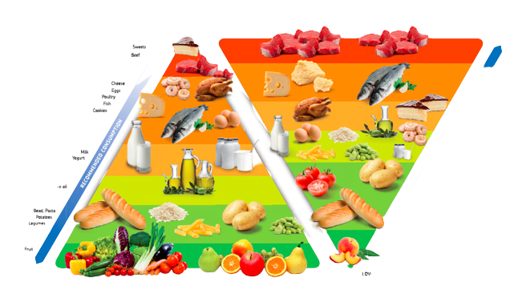
ENVIRONMENT

Slide 10

GENETICS

Slide 11

HEALTH CONDITIONS AND MEDICATIONS

Slide 12
Summary
Overweight and obesity occur when there is excess fat accumulation
There’s an inverse relationship between physical activity and adiposity
There is Evidence for genetic linkage of the leptin locus with human obesity has been reported
There’s four factors can play important role in gaining of excessive weight these include : food, lack of exercise, environment, and genetic factor

Slide 13
References
Weinsier RL, Hunter GR, Heini AF, Goran MI, Sell SM. The etiology of obesity: relative contribution of metabolic factors, diet, and physical activity. The American journal of medicine. 1998 Aug 1;105(2):145-50.
Purnell JQ. Definitions, classification, and epidemiology of obesity. Endotext [Internet]. 2018 Apr 12.
What causes obesity & overweight? [Internet]. Eunice Kennedy Shriver National Institute of Child Health and Human Development. U.S. Department of Health and Human Services; [cited 2022May12]. Available from:https://www.nichd.nih.gov/health/topics/obesity/conditioninfo/cause

Slide 14


