Slide 1
Parasitic skin Infections
DR. AMAL ALEREBI

Slide 2
The parasitic skin diseases include:
Scabies
Pediculosis
Leishmaniasis

Slide 3
Scabies
Scabies is a common contagious infestation Caused by a mite Sarcoptes scabiei.
Average 12 mites .
Scabies affect all races , any ages , both sexes

Slide 4
Transmission
Direct skin-to-skin contact
Sexually
Indirect-clothing or bedding

Slide 5
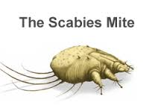
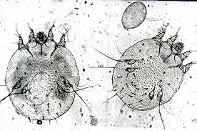
Scabies mite

Slide 6
Clinical features
Characterized by generalized itching (Nocturnal itching )
I.P: 3 - 4 weeks
Sites: fingers webs, anterior axillary fold, periumblical area, buttocks.
In adult male……penis and scrotum
In women……. Aerolae
In infants….. face, palms and soles
Lesions: papules, vesicles, pustules, scratch marks, eczematous lesions and burrows ( pathgnomonic lesion).

Slide 7
Clinical variants of scabies
Crusted (norwegain)scabies:
Nodular scabies
Scabies in clean

Slide 8
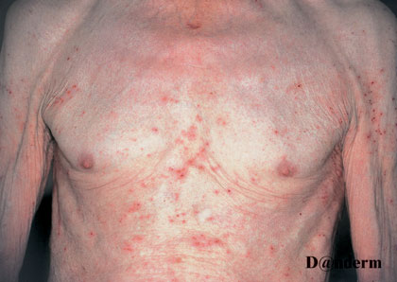
scabies

Slide 9
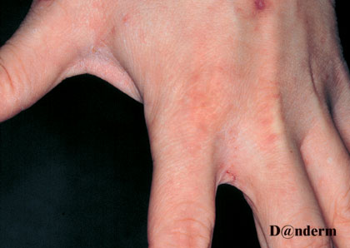
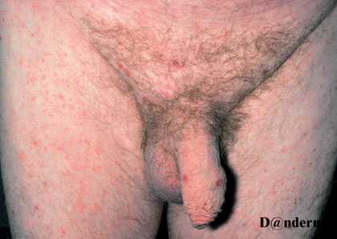
scabies

Slide 10
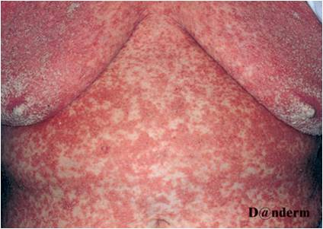
Crusted scabies

Slide 11
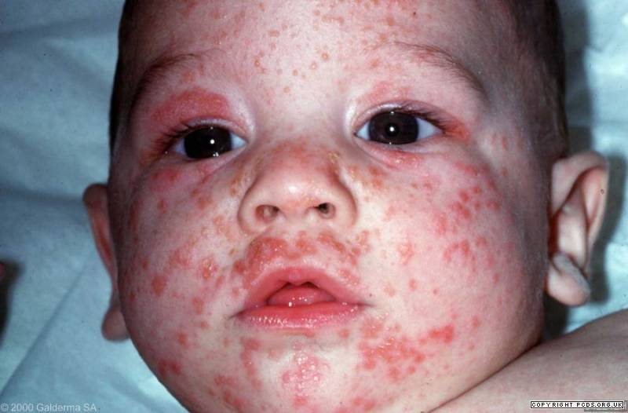
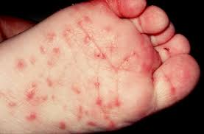
Scabies in Infants

Slide 12
Treatment
All close contacts should be treated at the same time
Application of treatment should cover all skin sites
Bedding ,clothing and towles should be decontaminted by machine washing at 60c
The scabicidal preparation should be applied after bathing(Except lindane)

Slide 13
Scabicidal preparation
1. Precipitated sulfur ( 5% - 10%). Topically overnight treatment, for 3 days.
2. Benzyle Benzoate (10% - 25%). Topically overnight treatment, for 3 days
3. Gamma Benzene Hexachloride 1%. Overnight treatment; on days 1 and day 8
4. Permethrin 5% . Topically overnight treatment; on days 1 and on day 8
5. Malathion 0.5% Topically overnight treatment; on days 1 and on day 8.
6. Crotamiton 10% ( Weak scabicidal ). Overnight, on days 1, 2, 3 and on day 8
7. Systemic ivermectin 200microg/kg single dose. Orally on day 1 and on day 14.

Slide 14
Pediculosis infestation with lice
Pediculosis capitis ……. P. Humanus capitis
Pediculosis corporis …… p.humanus corporis
Pediculosis Pubis…….phthirus pubis

Slide 15
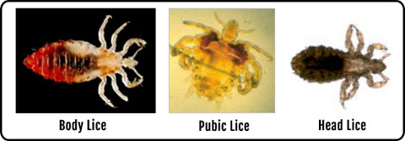

Slide 16
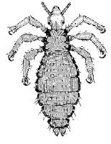
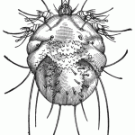
Head louse
Body louse

Slide 17
Pediculosis capitis
Infestation of the scalp by the head louse
Affects all ages sex races
Common in children 3-11y ( girls longer hair )
Transmission: direct head to head contact
Indirect :combs bedding …..etc

Slide 18
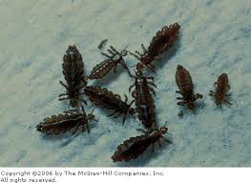
Head lice

Slide 19
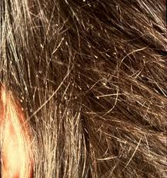

Slide 20



Life Cycle
Eggs(nits)
5 – 10 eggs/day
1 – 2 days
About 10 days
Nymph
About 10 days
Adult Louse
Life span 1 month

Slide 21
Clinical features
Any where on the scalp , occipital & post auricular region .
Scalp itching is characteristic
Identification of nits and lice on the scalp hair
Secondary bacterial infection pustules, crusting, cervical LAP

Slide 22
Treatment
All close contacts should be treated at the
same time
All pediculicides are effective against lice but not against nits except malathion
Gamma Benzene Hexachloride 1% (Lindane)
Permethrin 1%
Melathion 0.5%
Pyrethrins
Ivermectin tab

Slide 23
Pediculosis Pubis
Pediculosis pubis is caused by Phthirus pubis ( Crab louse).
Often considered a STD.
Other MOT includes contaminated clothing, towels or bedding.
Pubic hair is the most common site of infestation.
May involve other hair-bearing sites e.g upper thighs, axillae, chest, or beard.
Majority of pt. complain of pruritus & aware that something is crawling on the groin.
Maculae ceruleae: Gray-blue macules varying in size, (0.5cm-1cm) seen in groin, upper thigh, and lower trunk. They are seen in chronic infestations and represent altered blood pigment.
Shaving the pubic hair plus application of one of pediculicidales preparation is curative.

Slide 24
Pediculosis corporis
Caused by Pediculus humanus var. corporis.
• Associated with overcrowding, poor hygiene, wars and natural disasters.
• The lice live and lay their nits in the seams of clothing
• They visit the skin surface only to feed.
• Body lice induce pruritus that leads to scratching and secondary infection.
• The back, neck, shoulders and waist areas are commonly involved sites.
• Diagnosis i by demonstration of nits and/or adult lice in the clothes seams.
• Ironing the clothes will destroy the lice as well as the nits.
• Plus one of pediculicidales preparation applied to the patient is curative.

Slide 25
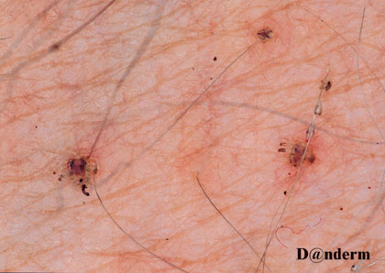
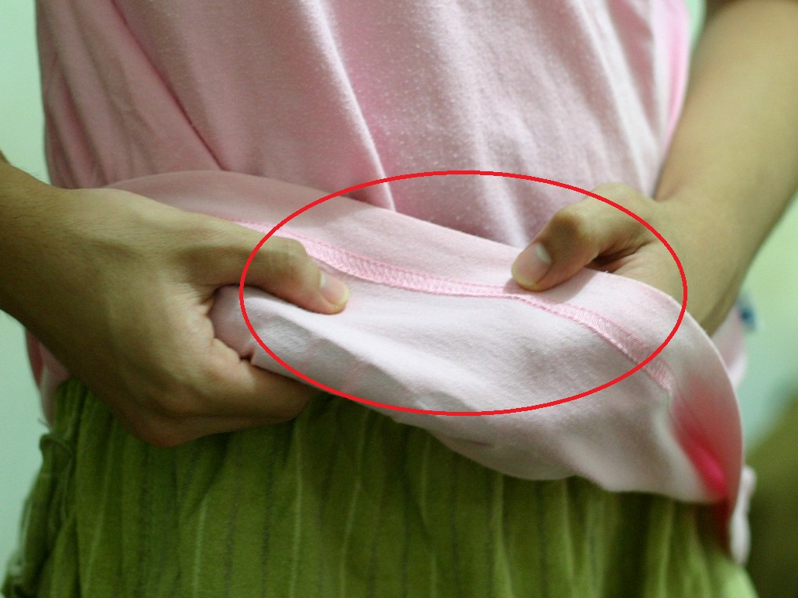
Pediculosis corporis

Slide 26
Leishmaniasis
Parasitc infection caused a protozoa Leishmania charateraizd clinically by single/multiple papules at the site of sandfly bite that evolve into nodule which ulcerate and eventually heals with scarring

Slide 27
Classification of Leishmaniasis
Cutaneous Leishmaniasis
Mucocutaneous Leishmaniasis.
Visral Leishmaniasis

Slide 28
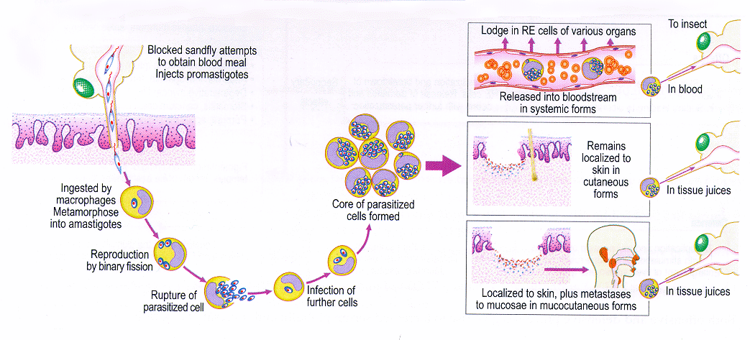
Life cycle:

Slide 29
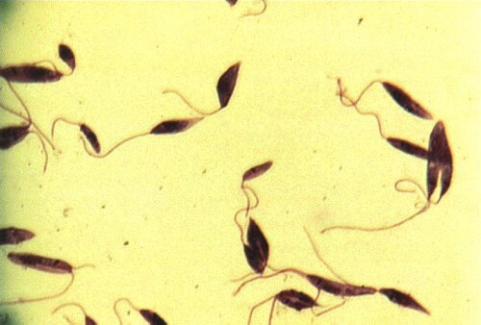
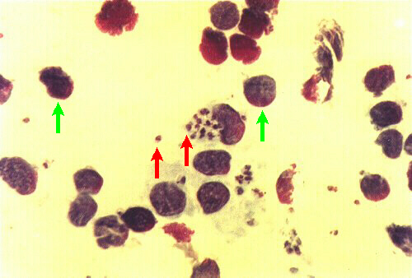
Promastigote
Amastigote
In Sandfly promastigote
Spindle shaped.
Flagellated.
10 -15 microm.
Sandfly GIT.
In Human Amastigote.
Oval / Round.
Aflagellated.
2 – 3 micom.
Cells of RES.

Slide 30
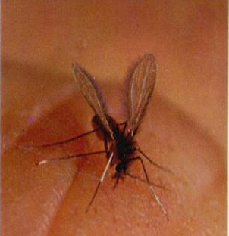

Slide 31
Epidemiology
• Worldwide, 400.000 new cases annually.
• Over 90% of cutaneous leishmaniasis occur in Afghanistan, Iran, Saudi Arabia, Syria,…
•Also seen in the Mediterranean basin.
• The reservoirs are canine and rodent.
• Any age and both sexes are equally affected.

Slide 32
Cutaneous Leishmaniasis
OWCL
NWCL
Rural
L. major.
2 – 4 weeks.
Wet nodule.
Heals > 6 months
Urban
L. tropica.
>2 months.
Dry nodules.
Heal< 6months

Slide 33
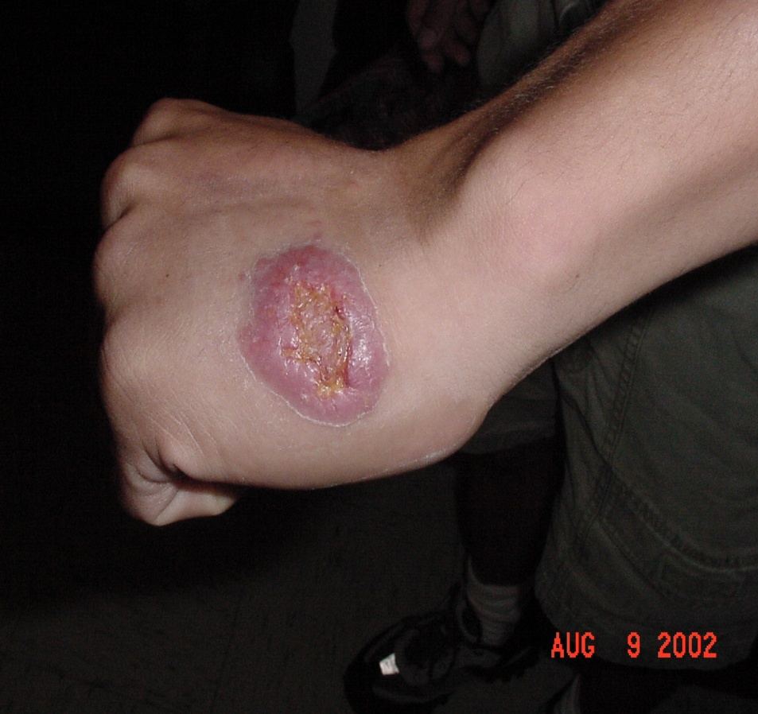
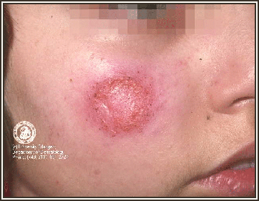
Cutaneous Leishmaniasis

Slide 34
Differential Diagnosis
Impetigo
Furuncle
Carbuncle
Ecthyma
Kerion
keratoacathoma

Slide 35
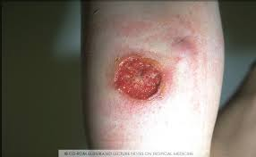
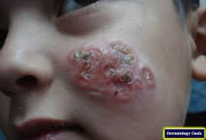
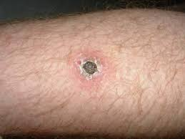

Slide 36
Diagnosis
1) Skin Slit and Smear (SSS).
The cytoplasm appears blue , the nucleus pink and the kinetoplast a deep red.
2) Culture :
On Nicolle–Novy–MacNeal (NNM) media or chick embryo media.
Cultures are positive in approximately 40% of cases.
3) Serologic Testing:
PCR which when available represents the most sensitive diagnostic test.
4) Montenegro Skin Test ( Leishmanin intradermal test) :
An important diagnostic tool in non-endemic area.
The test is positive in up to 90% of patients.
It cannot distinguish between past and present infections

Slide 37
Amastigote
Amastigote.
Oval / Round.
Aflagellated.
2 – 3 micom.
Cells of RES.

Slide 38
Treatment
LOCAL THERAPY
CRYOTHERAPY
ELECTRIC CAUTRY.
PENTOSTAM.
SYSTEMIC THERAPY
Na. STIBOGLUCONATE
AMOPHOTERICIN B
RIFAMPICINE
ITRACONAZOLE

Slide 39
THANKS

