Slide 1


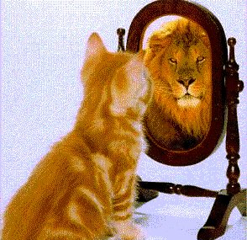
Self-esteem
2022/nov/9
Libyan International Medical University
Faculty of Business Administration
By: Marwan Fouad Abed Eloshipi
ID: 3782
Email: marwan_3782@limu.ed.ly

Slide 2
Table of Contents
01
02
03
04
Self-esteem
Conclusion
Introduction
Definition
Components
2
Reflection
References
2

Slide 3
Learning Objectives
Hopefully at the end of this presentation you will be able to:
Describe Self-esteem.
List the Components of Self-esteem.
3

Slide 4
01
Introduction
4

Slide 5
Introduction
You studied in one of the best universities, got married, had twins, and decided to be a stay-at-home parent. At a college reunion you see that all of your classmates have achieved professional success. How do you speak about yourself?
As a proud parent of beautiful twins.
As the spouse of a successful professional.
As a person who missed the boat to success and is now stuck at home.
You avoid talking about yourself.
5

Slide 6
02
Self-esteem
Definition
Components
6

Slide 7
Self-esteem
Self-esteem Is a measure of your perception of your own worth. If you have high self-esteem, you think highly of yourself; if you have low self-esteem, you tend to view yourself negatively. (Reasoner, 2010).
Self-esteem can also be thought of as Self-confident.
7
Hopefully at the end of this presentation you will be able to:
Describe Self-esteem
List the components of Self-esteem

Slide 8
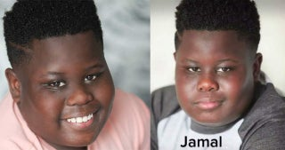
Example
A black, over weighted kid named Jamal was being bullied because of his color and weight (looks) but he…
Agreed to what they said about him and thought less of himself. Low Self-esteem
Disagreed and stood up for himself and spread awareness about racism and fat shaming. High Self-esteem
8

Slide 9
Components of Self-esteem
Cognitive Self-esteem Is how you perceive your abilities and limitations, as well as who you are and who you would like to be. What is the best version of me? How close am I to achieve it?
Affirmative Self-esteem Is your perceptions of yourself after evaluating your strengths and faults. Are you satisfied with your abilities? Does your analysis makes you pleased or depressed?
Behavioral Self-esteem Is the verbal and nonverbal actions like your disclosures, assertiveness, and gestures. Do you allow others to take advantage of you? Are you confident to disclose who you really are?
9

Slide 10
Conclusion
To sum things up, Self-esteem is how we see and value ourselves. Your Self-esteem affects whether you like and value yourself as a person or not.
10

Slide 11
Reflection
In my opinion, Self-esteem plays a big role in many important life outcomes. Therefor, it is crucial for everyone to have a High Self-esteem for better outcomes.
11

Slide 12
References
Library management system | Perpustakaan Universitas bakrie. (n.d.). Retrieved November 8, 2022, from https://slims.bakrie.ac.id/repository/f7d4f28f39e8b9d8cb794f6c4eb9cb0f.pdf.
What is self-esteem? (no date) Mind. Available at: https://www.mind.org.uk/information-support/types-of-mental-health-problems/self-esteem/about-self-esteem/ (Accessed: November 8, 2022).
12
3

Slide 13
THANKS!
DO YOU HAVE ANY QUESTIONS?

