Slide 1


HIV infection
Cognitive Impairment in Patients with
HIV
name :Hajer Al Ariby
Roll num:3097
Block : PTS
Date :2021/2022

Slide 2
Objective
Define cognitive impairment .
Outline the risk factor of cognitive impairment.
List the clinical features of cognitive impairment .
Discuses the Primary psychiatric conditions associated with cognitive impairment
1

Slide 3
Introduction
2

Slide 4
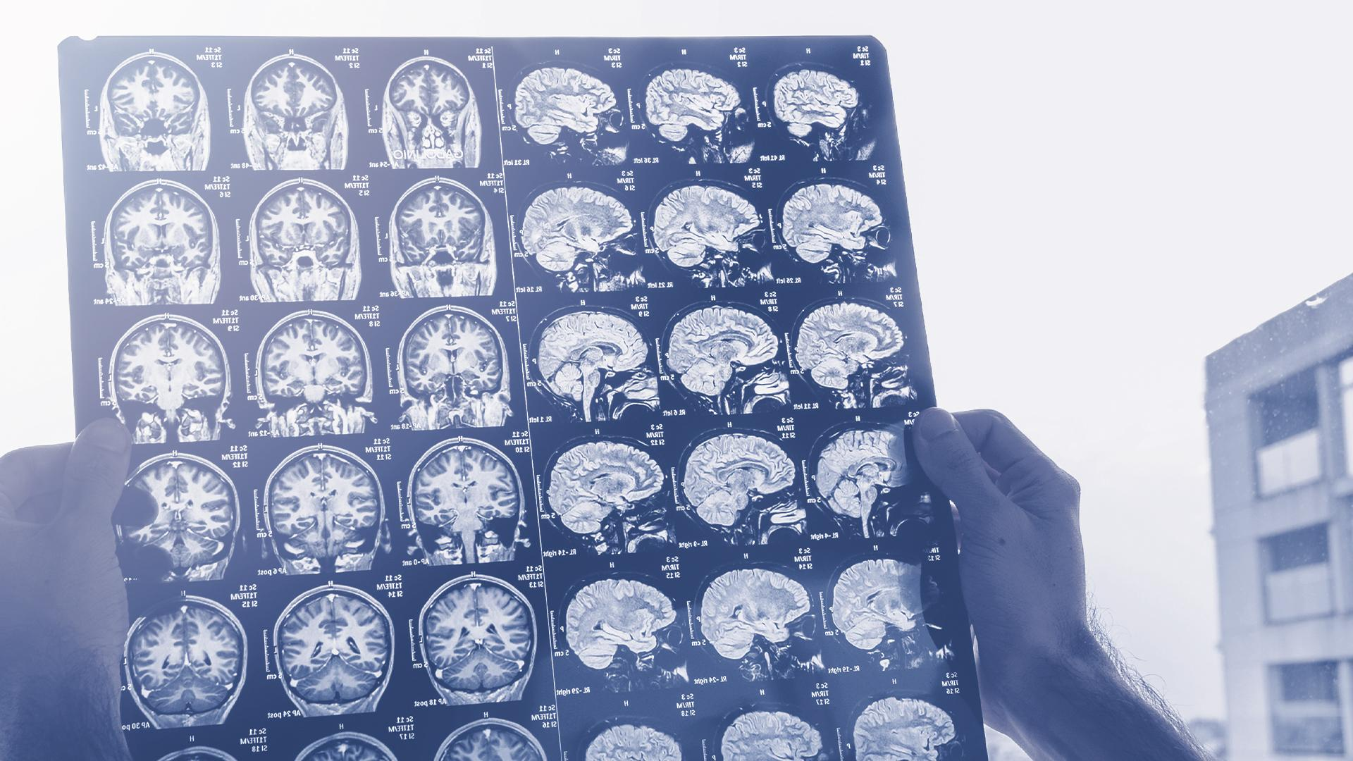
1. Define Cognitive Impairment

Slide 5
Definition
A person has trouble remembering, learning new things, concentrating,
or making decisions that affect their everyday life.
4

Slide 6
2. List the risk factors of Cognitive Impairment

Slide 7
Risk factors
low weight
Anemia
Female gender
Old age (>50)
8

Slide 8
3 -List the clinical features of cognitive impairment

Slide 9
Clinical features
Word-finding difficulties
Difficulty recalling recent information
Disorganization
Missing appointments
10

Slide 10
4.Discuses the Primary psychiatric conditions associated with cognitive impairment

Slide 11


Delirium
Prevalence and severity
Risk factor
Major depression

Slide 12

2%
25%
General community.
In general Hospital.
In hospital patient with HIV.
73%

Slide 13
Management
highly active antiretroviral therapy (HAART)
SAFETY!
Daily cares as needed
Family counselling
Family education
11

Slide 14
Conclusion
- Many mental and physical disorder infect people with HIV include : delirium, depression
- Daily cares ,Family counselling and Family education are very important to treat these conditions
12

Slide 15
Reference
1 –1 Family Caregiver Alliance. Available at www.caregiver.org/caregiver/jsp/content_node.jsp?nodeid=438.
2- Herbert LE, Scherr PA, Bienias JL, Bennett DA, Evans DA population: Prevalence estimates using the 2000 census. Archives of Neurology 2003;60:1119–1122
3- David,RO. Maggie,CH. Lorenzo,L.Marissa,MA.Lauren,BE.VA gov | Veterans Affairs. HIV, Hepatitis, and Related Conditions Programs. March 2020.
13

Slide 16
Thanks!
Any questions?

