Slide 1




The Differences Between Equity Theory and Social Exchange Theory
Libyan International Medical University Faculty of Business Administration
Name: Hossen Mohammed Aldarrat
ID: 3783
Email: husayn_3783@limu.edu.ly

Slide 2
Table of Contents
01
02
03
04
Objective
Introduction
Equity theory
Social exchange theory
05
06
Differences between Equity & Social exchange theories
Conclusion
02
07
08
Reflection
References

Slide 3

Objective
03
By the end of this presentation, you’ll be able to:
1. Define equity theory
2. Define social exchange theory
3. Know the differences between Equity theory & Social exchange theory

Slide 4

Introduction
04
Most people are unaware of how social exchange and equity theory can relate to their relationships. Both Equity theory and Social exchange theory address the costs and advantages of a relationship. The main distinction is that equity theory asserts that both parties in a relationship should benefit and that benefits and costs should be balanced, as opposed to social exchange theory, which seeks to maintain a relationship as long as benefits outweigh costs.

Slide 5

Equity theory
01
05

Slide 6

Equity theory
06
According to equity theory, successful relationships are equitable when partners perceive an equal distribution of costs and benefits.

Slide 7

07
Components of Equity Theory
Based on equity theory, how relationships form and develop depends on the distribution of costs and benefits.
Equity theory suggests relationships are maintained depending on the realignment of any new or continuing costs and benefits.
Dissatisfaction in a relationship can lead to a breakdown of the relationship due to inequity.

Slide 8

Social exchange theory
02
08

Slide 9

Social exchange theory
09
Social exchange theory proposes that social behavior is the result of an exchange process. The purpose of this exchange is to maximize benefits and minimize costs.

Slide 10
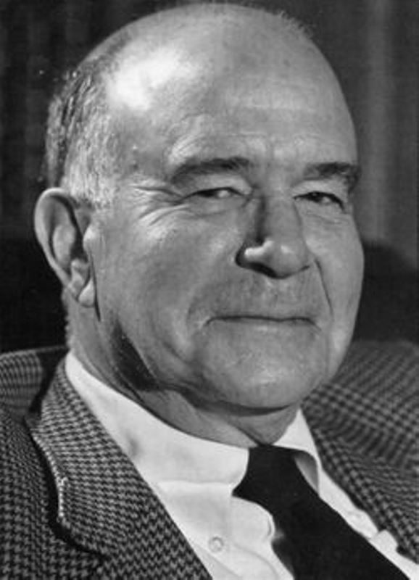
George C. Homans
10
The social exchange theory was initially developed by an American psychologist, George C. Homans. He mentioned this theory in his article titled “Social Behavior as Exchange.”

Slide 11

Basic concepts of Social Exchange theory
Costs:
Rewards:
Resources:
11
Costs can be anything whether time, effort or money.
It can be anything whether the sense of acceptance, support, and companionship.
Resources are any commodities, material or symbolic, that can be transmitted through interpersonal behavior and give one person the capacity to reward another.

Slide 12

Differences between Equity & Social exchange theories
03
13

Slide 13
14
Differences Between Equity & Social Exchange Theories
The social exchange theory advocates taking advantage of all the benefits of a relationship without giving anything in return, whereas the equity theory essentially holds that you get out of a relationship what you put into it.

Slide 14
Examples of Social exchange theories
15
Workplace:
The employees in the company, who give their hundred per cent in every assigned project may lose their motivation to work hard and eventually lose productivity if they will see that they are not receiving any extra benefits than the employees who perform average. Organizations or companies use the concept of social exchange theory in boosting the productivity of the employees.

Slide 15
Example of Equity theory
16
1. Business
The capitalist economy, wherein the producers and the consumer both receive mutual benefits through the exchange of goods and services is also a prominent example of social exchange theory. The producer receives the monetary expenses (benefit) and the customers receive the quality product (benefit). The consumer can analyze the benefits or costs involved in this exchange by evaluating the quality of the product or the service received.
2. Shareholders’ Equity:
For businesses the amount of money (capital) invested by the owners of the business in order to buy various assets. It is also referred to as owners’ equity.

Slide 16

Conclusion
04
17

Slide 17

Conclusion
18
The main difference is while the social exchange theory seeks to maintain a relationship as long as the benefits outweigh the costs, equity theory states that both people in the relationship should benefit, both benefits and costs should be balanced.

Slide 18

Reflection
05
19

Slide 19

Reflection
20
While the equity theory focuses on a fair profit for both partners, the social exchange theory focuses on what you get out of the partnership. So the equity theory are more better than social exchange theory .

Slide 20

References
06
21

Slide 21
References
22
DEVITO, J.O.S.E.P.H.A. (2022) Interpersonal Communication Book, Global edition. S.l.: PEARSON EDUCATION LIMITED.
Kaur, G. (2022) 6 social exchange theory examples, StudiousGuy. StudiousGuy. Available at: https://studiousguy.com/social-exchange-theory-examples/ (Accessed: December 21, 2022).
What is the difference between equity theory and Social Exchange theory? - answers (no date) QaAnswers. Answers Corporation. Available at: https://qa.answers.com/other-qa/What_is_the_difference_between_equity_theory_and_social_exchange_theory (Accessed: December 21, 2022).

Slide 22
23
123helpme.com (2021) Social Exchange and equity theory, 1978 Words | 123 Help Me. Available at: https://www.123helpme.com/essay/Social-Exchange-And-Equity-Theory-488421#:~:text=The%20main%20difference%20is%20while%20the%20social%20exchange,benefit%2C%20both%20benefits%20and%20costs%20should%20be%20balanced. (Accessed: December 21, 2022).
Equity theory (no date) StudySmarter US. Available at:
https://www.studysmarter.us/explanations/psychology/relationships/equity-theory/ (Accessed: December 21, 2022).
Tiwari, G. (2020) What is social exchange theory and explanation, Sociology Group: Sociology and Other Social Sciences Blog. Available at: https://www.sociologygroup.com/social-exchange-theory/#:~:text=GEORGE%20HOMANS%20George%20Homans%20in%201958%2C%20created%20the,their%20own%20economic%20and%20psychological%20needs%20or%20benefits. (Accessed: December 21, 2022).

Slide 23

Thanks

